Slide 1
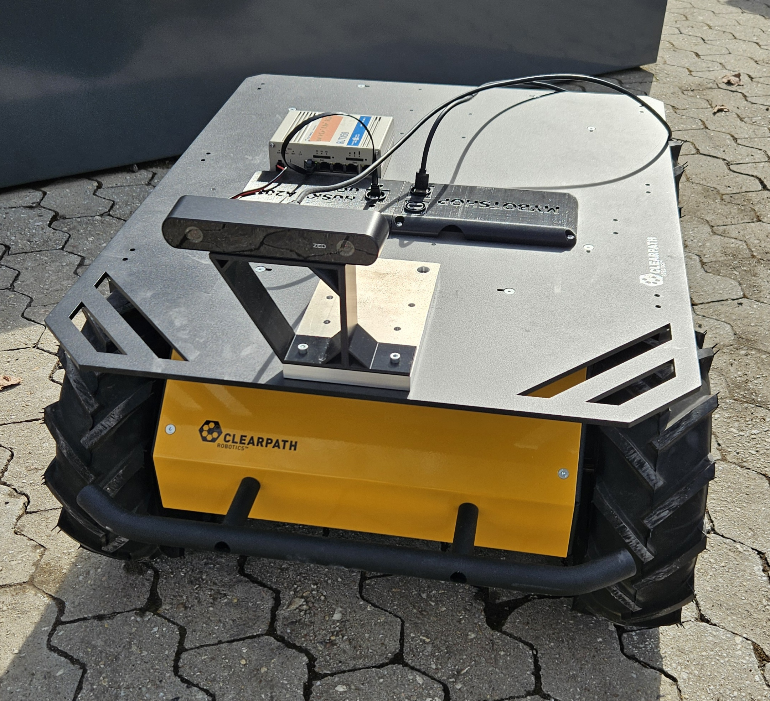
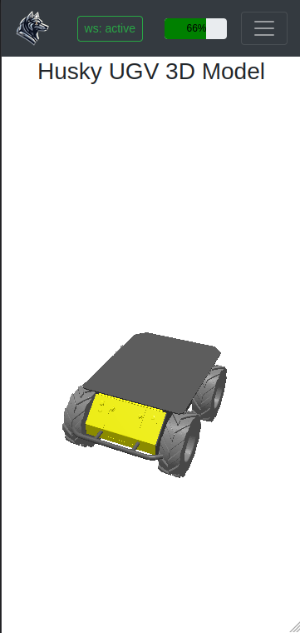
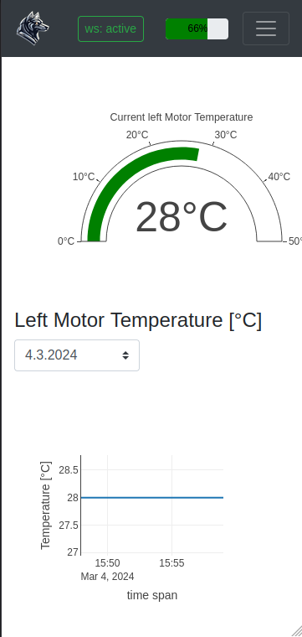
Husky Onboard PC
Web Video Server
RGB-D images
localhost:8080
Twist msg
Twist msg
embedded
Twist msg
Human
Any device with browser
Rosbridge WebSocket Server
localhost:9090
Webpages
localhost:8000
ROS2 topics:
/cmd_vel
/battery_percentage
/driver/temperature
SQLite3 Database User: id, name, password
Battery: id, state of charge, timestamp
Motors left & right: id, temperatures, timestamp
Flask Web App

Slide 2
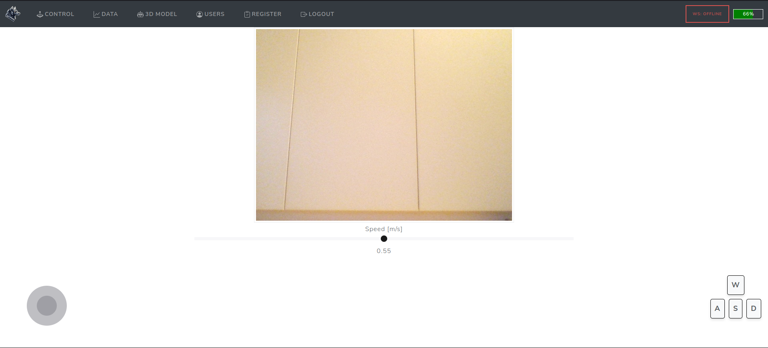

Slide 3
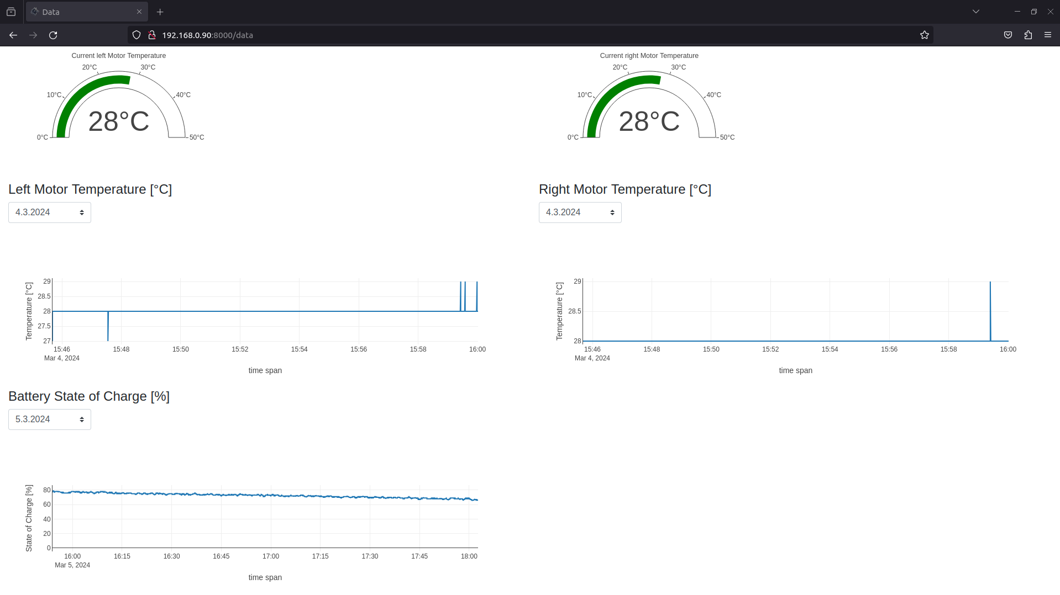

Slide 4
