Slide 1
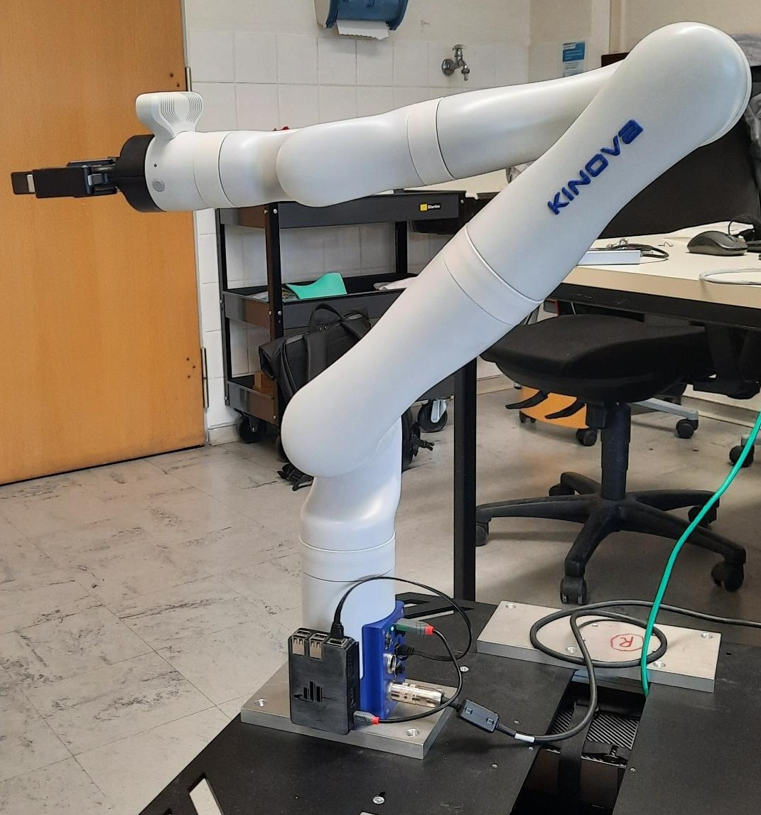
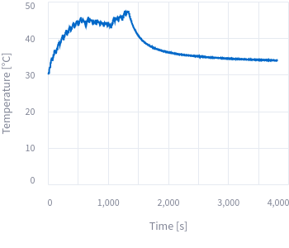
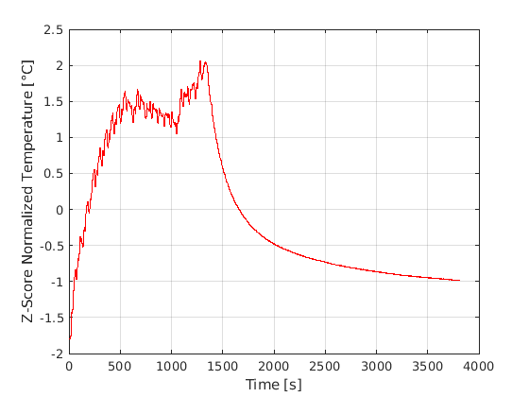
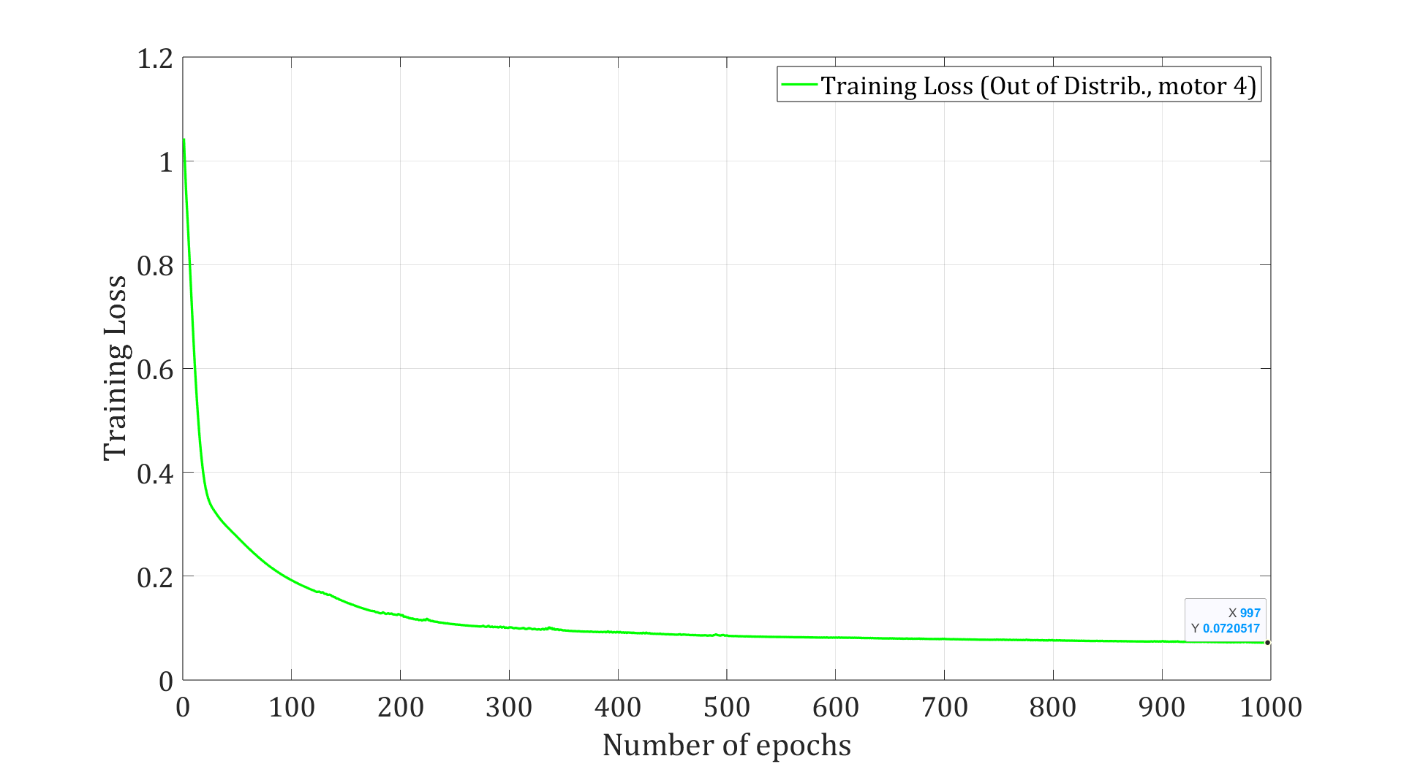
streamlit app
Normalization
LSTM/FNN
visualize
CSV
Position 1 ... 7
Temperature 1 … 7
Torques 1 … 7
Current 1... 7
Velocity 1 … 7
e.g. zscore
OPC UA Server
Client app
Preprocessing
Training

