Slide 1
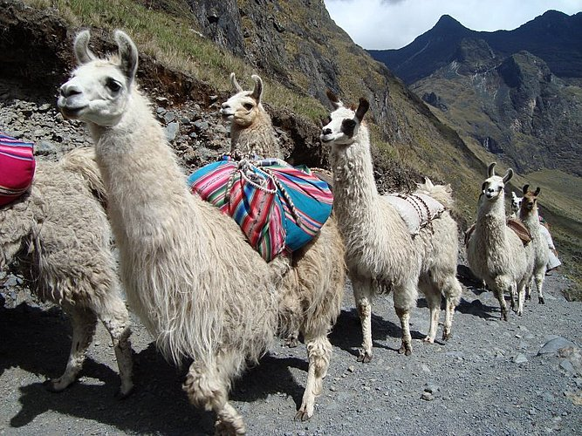
Latin America
Physical Geography

Slide 2
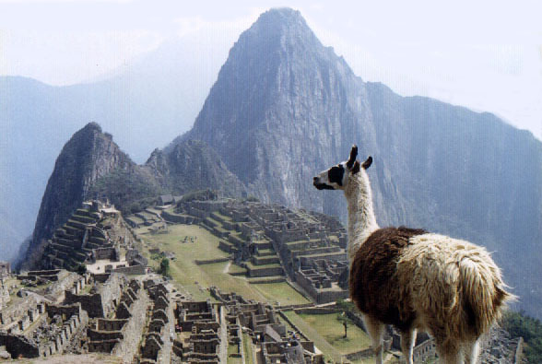
Mountains
Andes (located in western South America
Sierra Madre Occidental and Oriental (located in Mexico

Slide 3
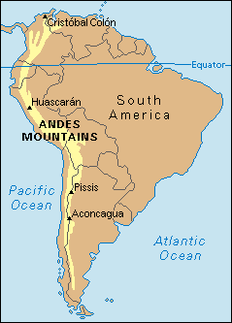
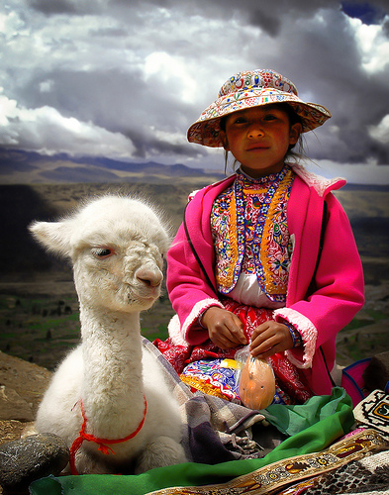
Andes

Slide 4
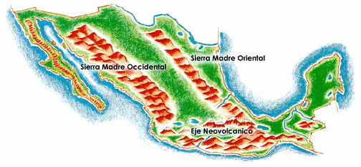
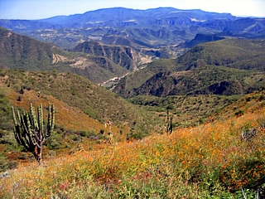
Sierra Madres

Slide 5
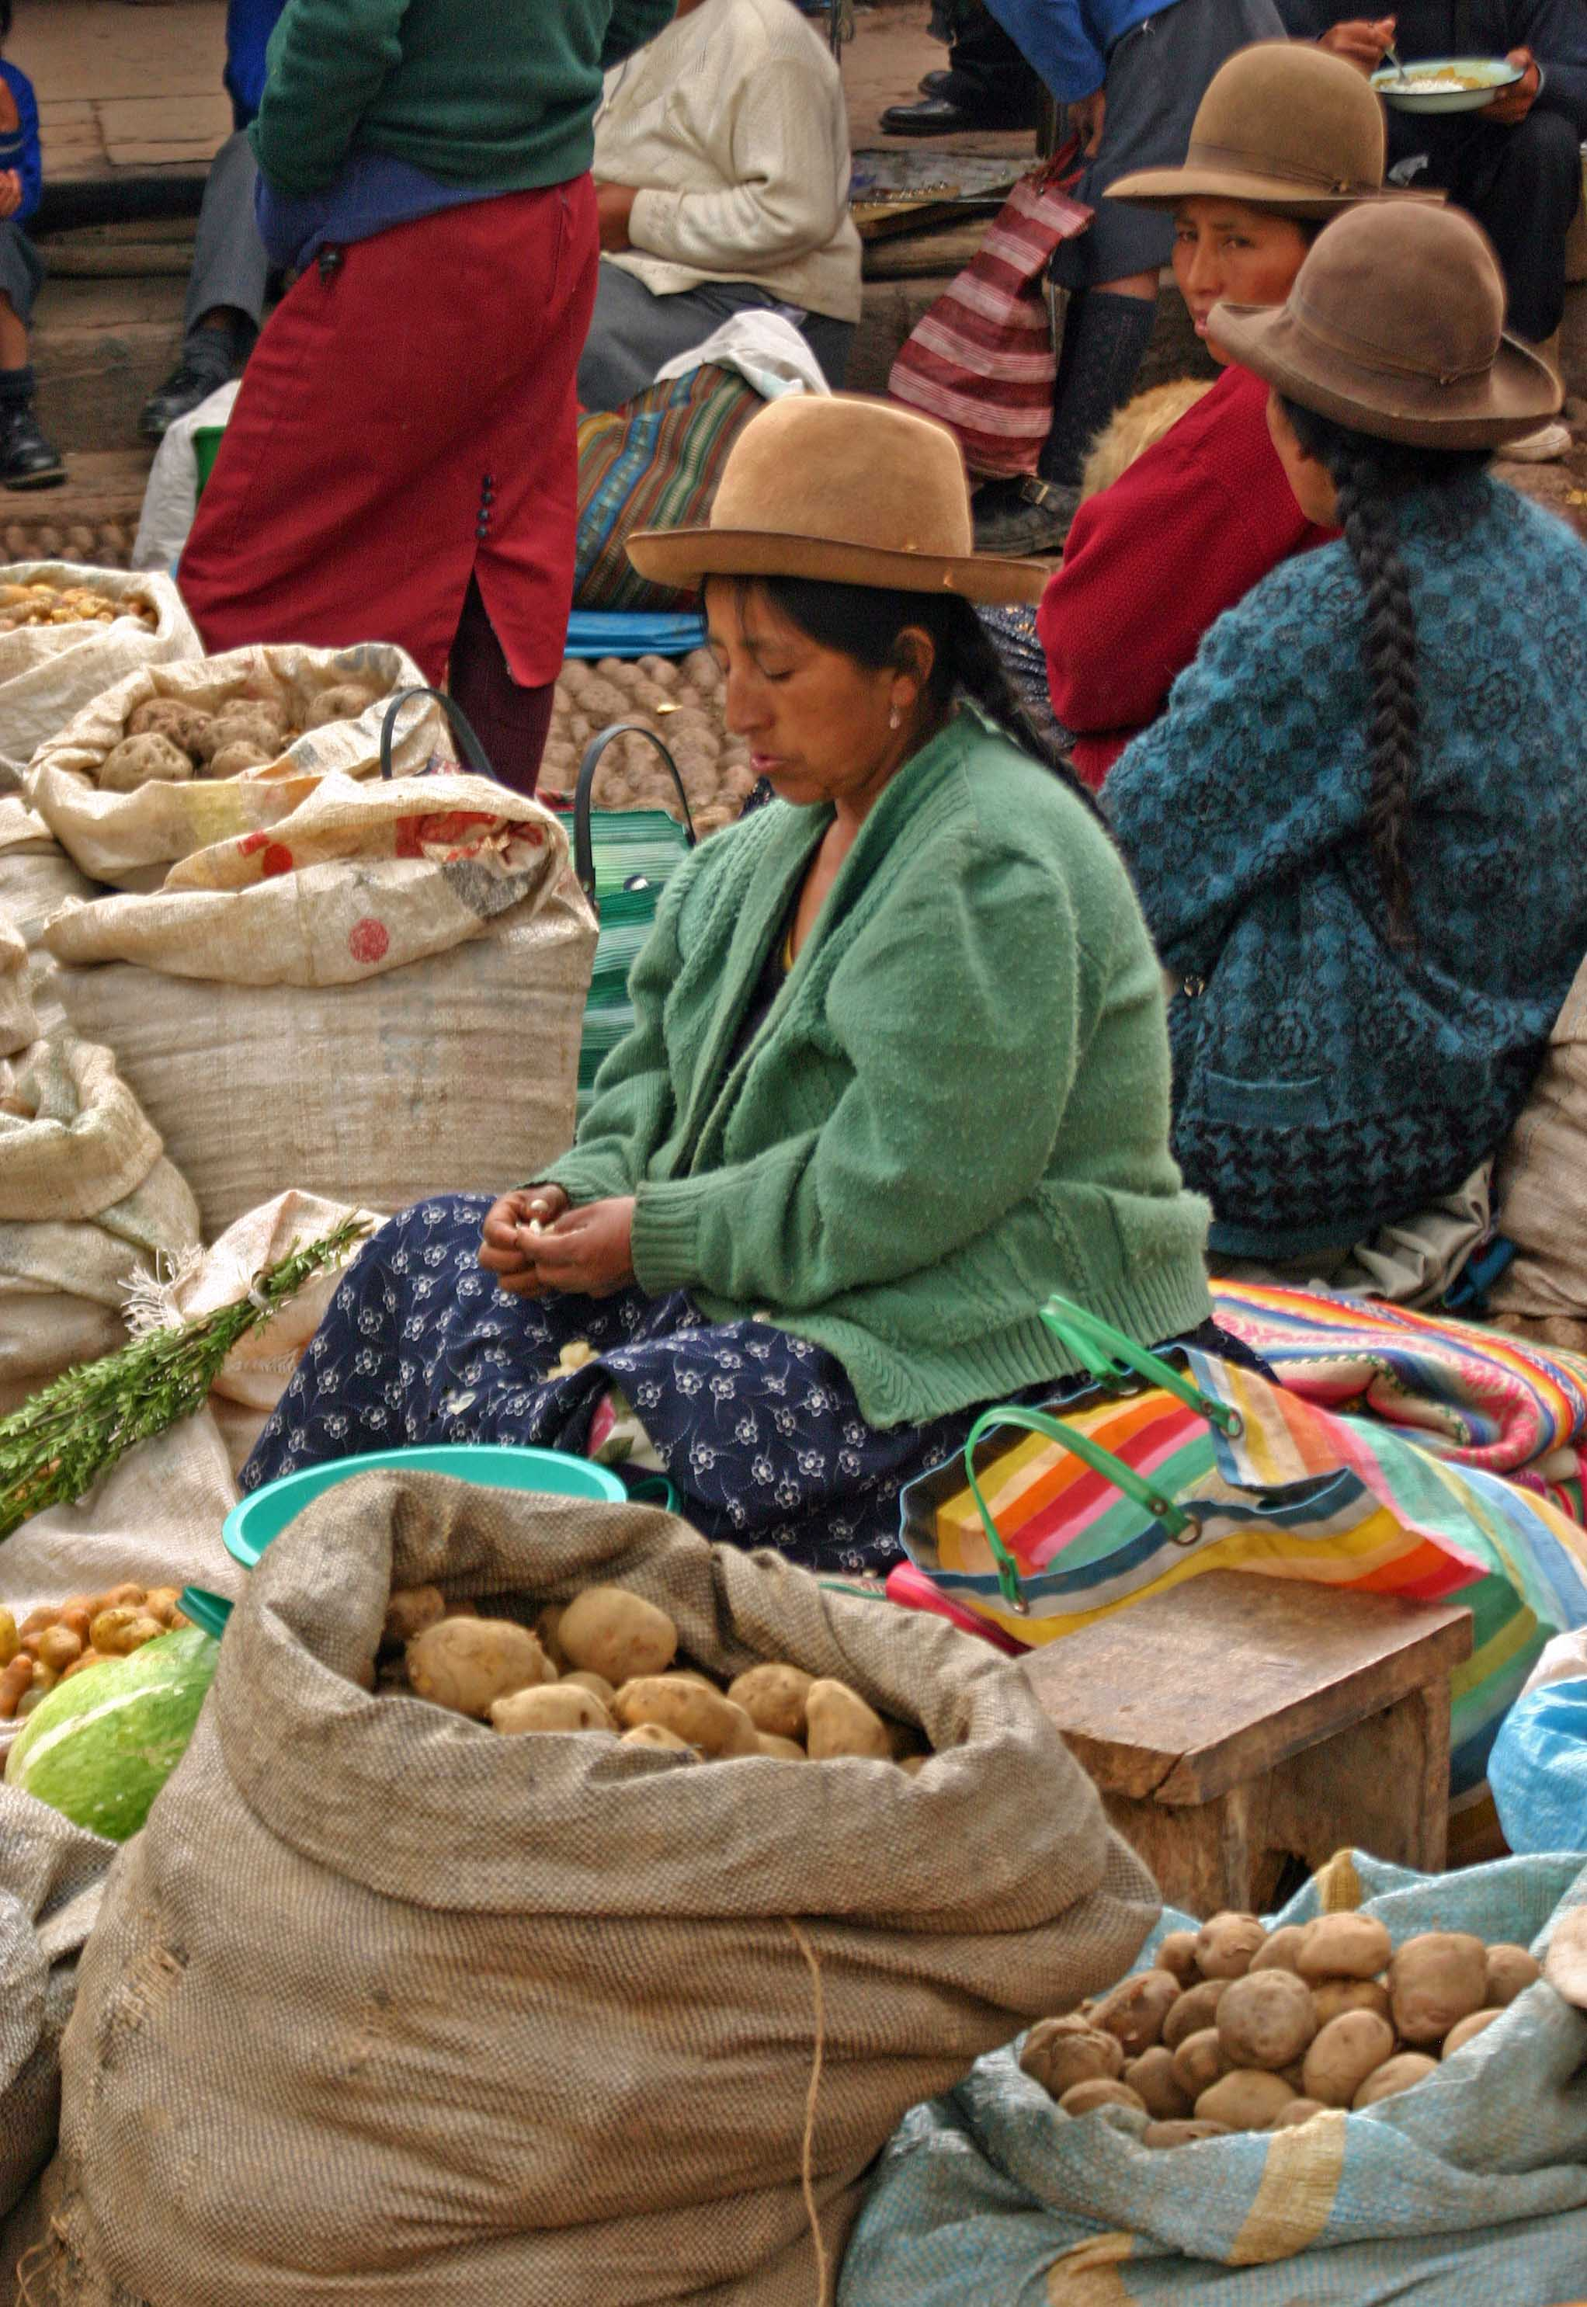
Vertical Zonation
Different elevations in the mountains have different temperatures
Different types of food can be grown at different elevations

Slide 6
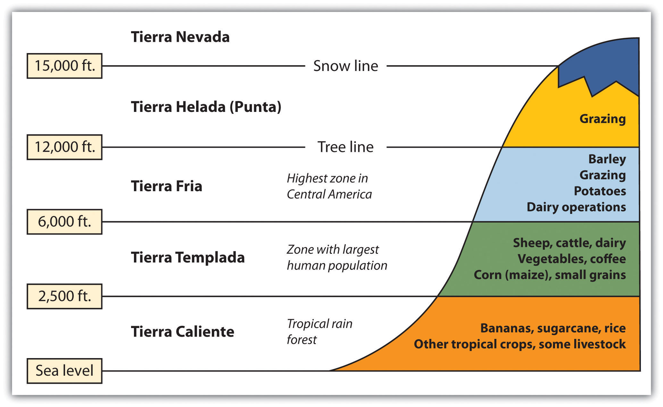
Vertical Zonation

Slide 7
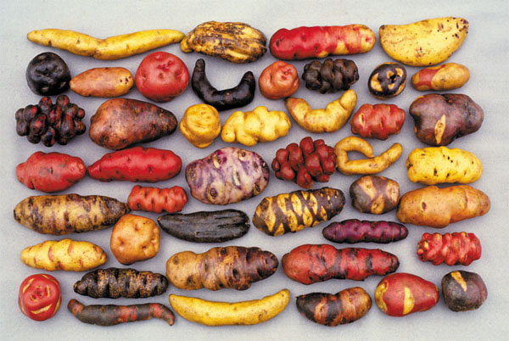
Vertical Zonation

Slide 8
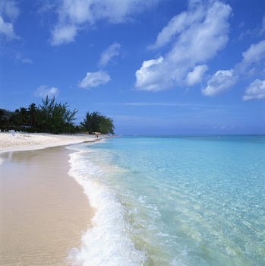
Bodies of Water
Atlantic Ocean
Pacific Ocean
Caribbean Sea
Amazon River (located in South America)
Orinoco River (tributary of the Amazon)
Panama Canal

Slide 9
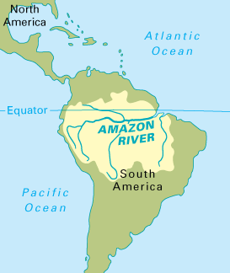
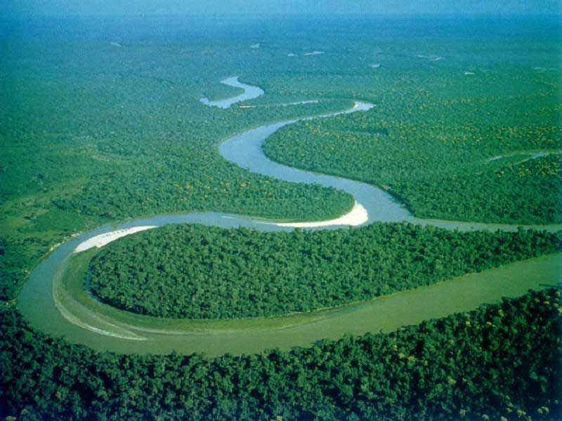
Amazon River
The world’s longest river in the
middle of the largest rainforest.

Slide 10
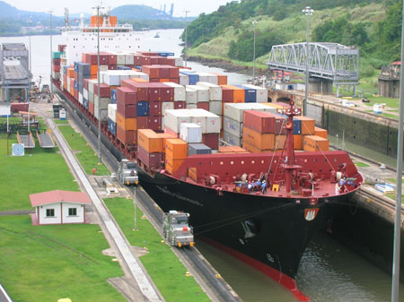
Panama Canal
Human made canal that connects the Atlantic Ocean with the Pacific Ocean

Slide 11
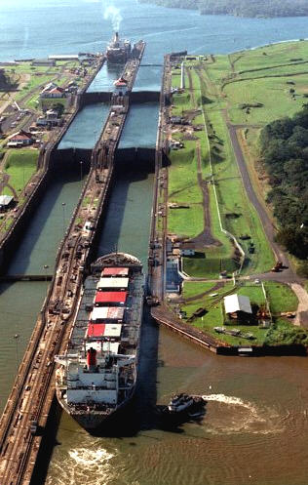
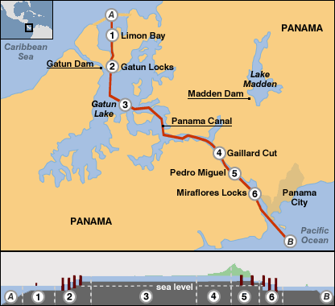
Panama Canal

Slide 12
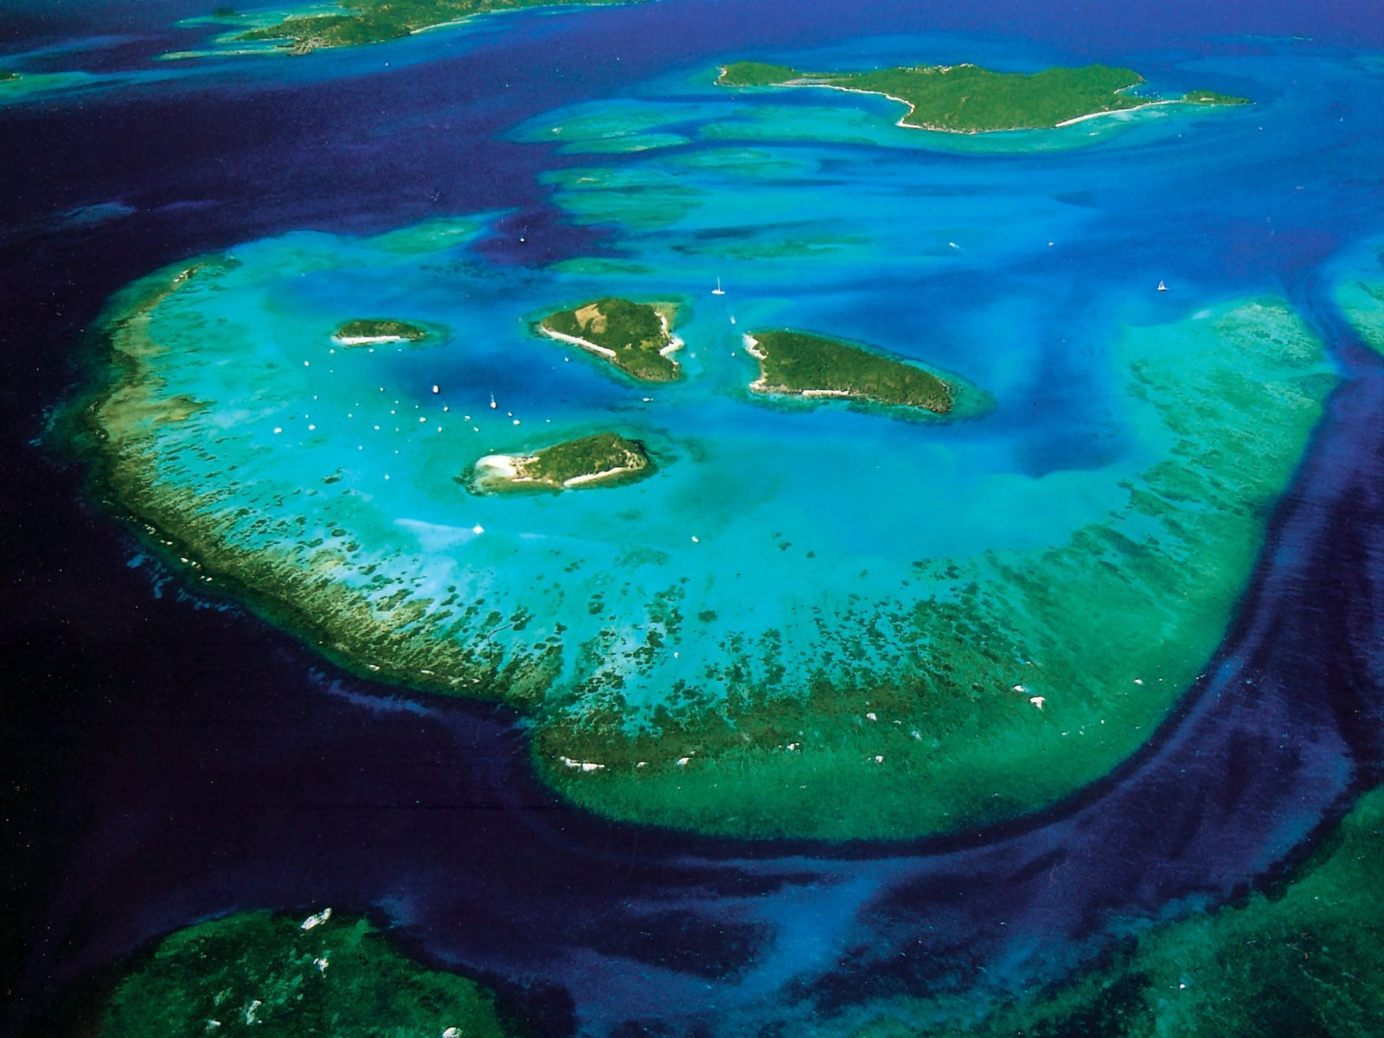
Archipelagoes
Groups of islands
The Greater Antilles – Jamaica, Hispaniola, Cuba, Puerto Rico
The Lesser Antilles – many small islands

Slide 13
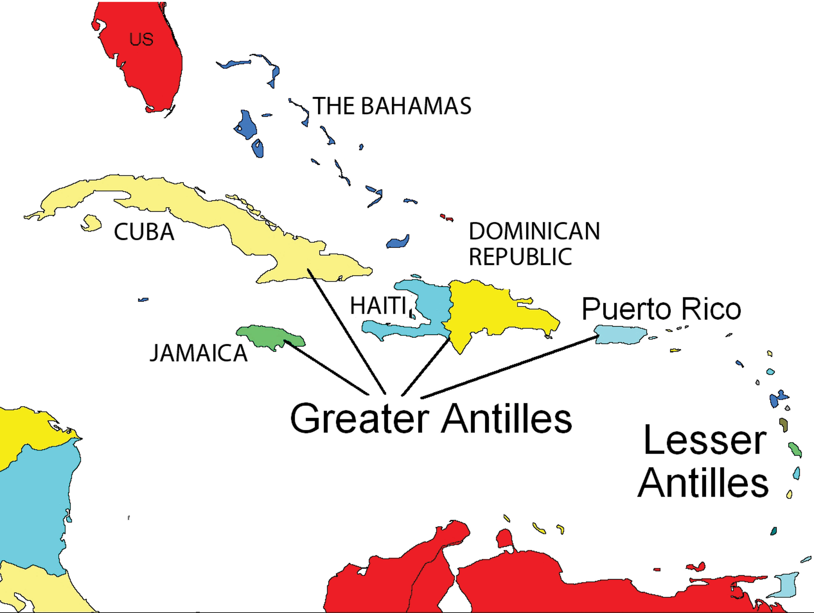
Antilles

Slide 14
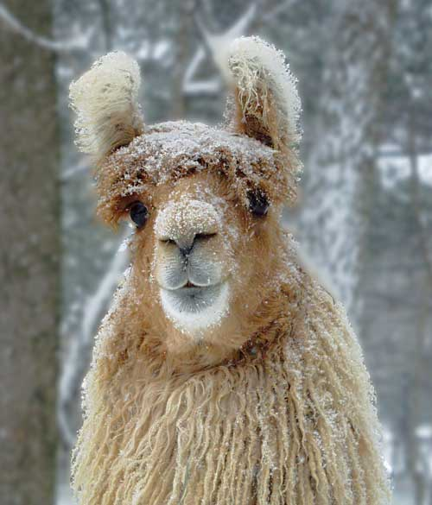
Climate
Tropical climates cover most of the area
Tropical Wet – tropical rainforest in Amazon and Central America
Tropical Wet and Dry – tropical grasslands in Brazil

Slide 15
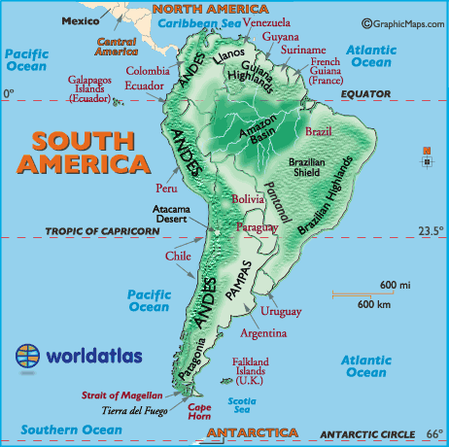
Grasslands
Pampas is a grassland in Argentina (good place to raise cattle)
Gauchos are cowboys in Argentina
Llanos are grasslands in Columbia (they get more rain than the pampas)

Slide 16
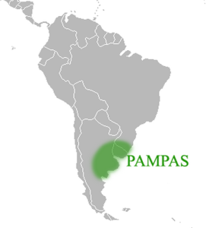
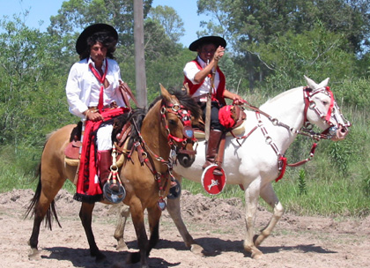
Pampas
Gauchos in the pampas in Argentina

Slide 17
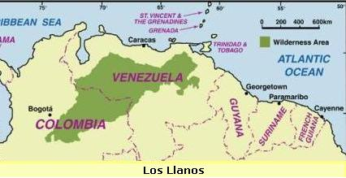
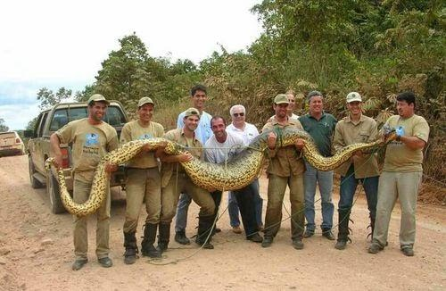
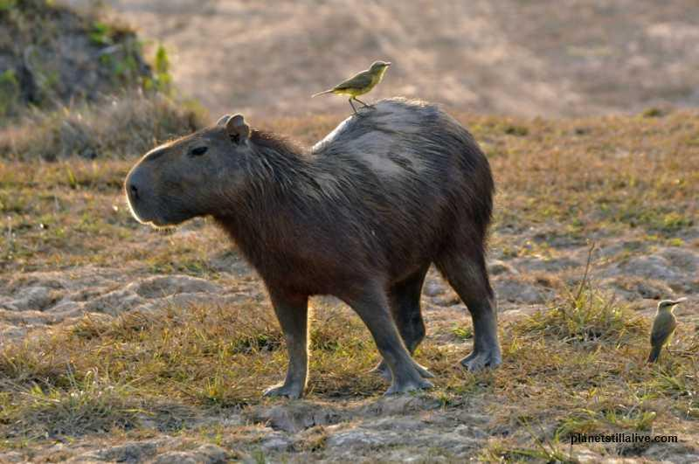
Llanos
Men hold an Anaconda above. To the left is a capybara, the world’s largest rodent.

Slide 18
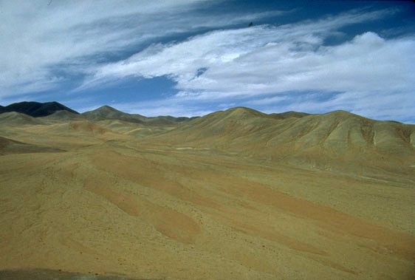
Deserts
Most of Mexico is arid or semiarid
Atacama Desert – located on the western coast of South America in Peru and Chile

Slide 19
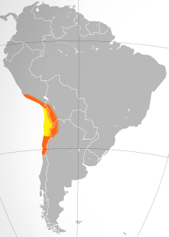
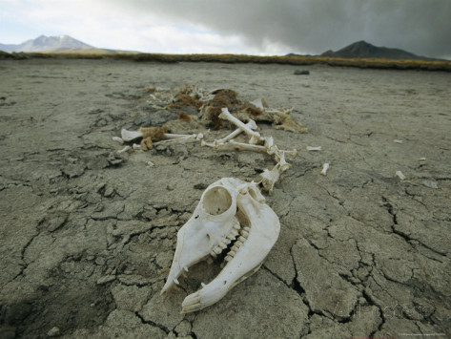
Atacama Desert
Hey, do you have a glass of water?

Slide 20
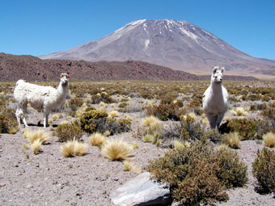
Natural Hazards
Don’t look at me. Look at the volcano behind me!
Part of this area is on the Ring of Fire
There are many active and dormant volcanoes and earthquakes

Slide 21
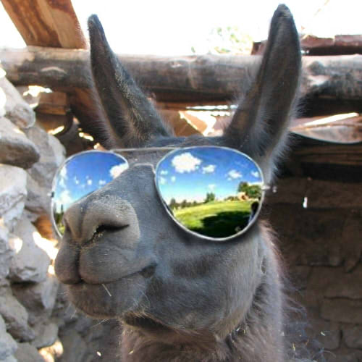
Seasons
The seasons are reversed South of the Equator
When it is summer in Newport, VA it is winter in Argentina!
Near the equator there are only wet and dry seasons

Slide 22
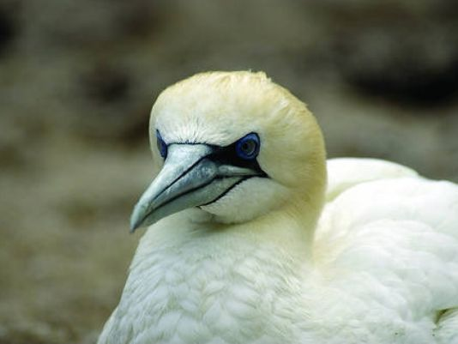
Wildlife Migrations
I’m going to Mexico! Voy a Mexico.
Many animals migrate to Mexico when it turns to winter in the U.S.
Monarch butterflies migrate to Mexico
Many birds migrate to Mexico and Central America

Slide 23
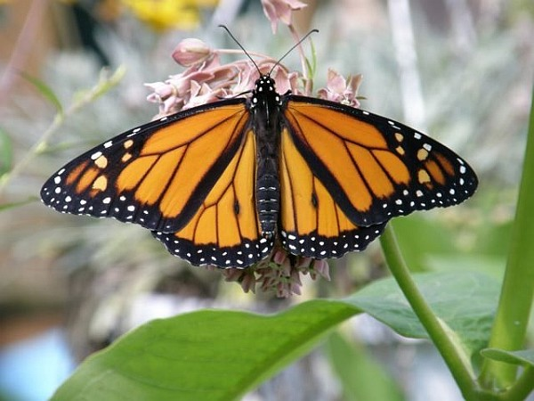
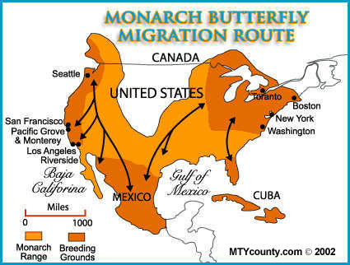
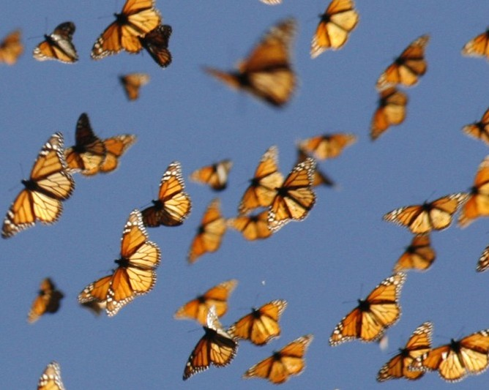
Migration

