Slide 1


The Physical World
Seen through
Latin America

Slide 2
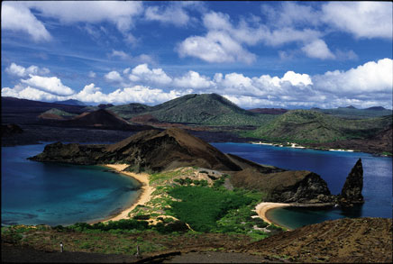
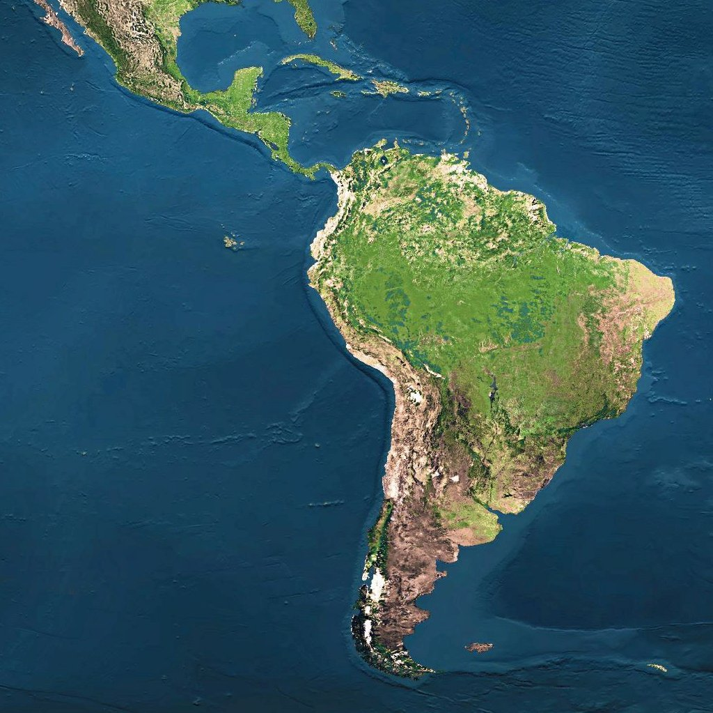
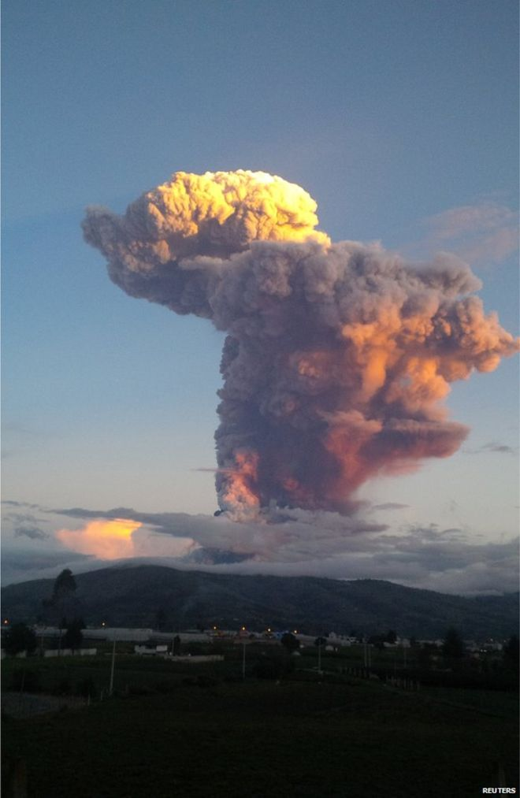
How was this created?

Slide 3
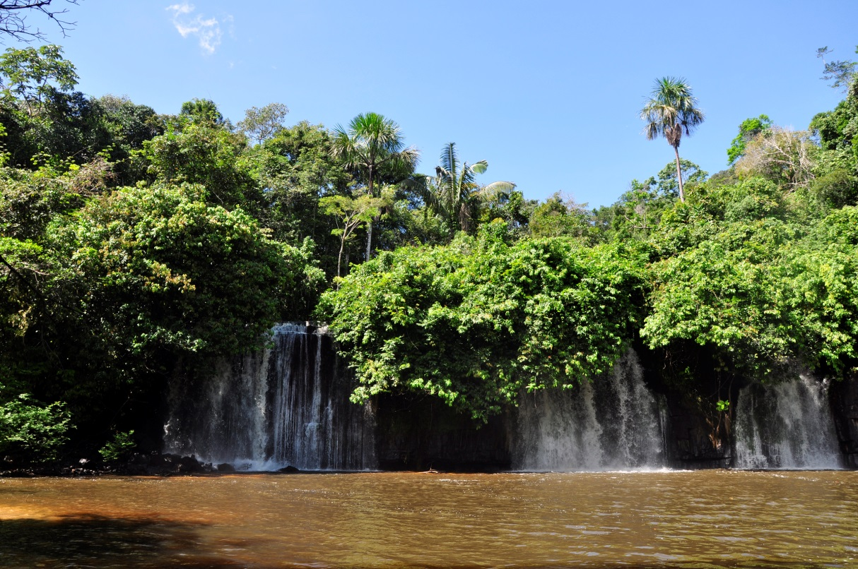
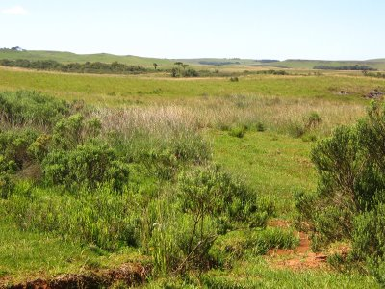
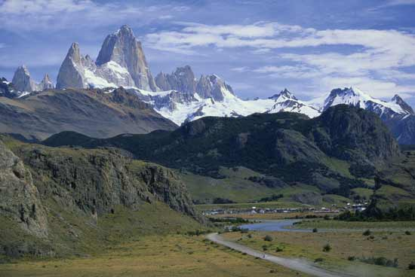
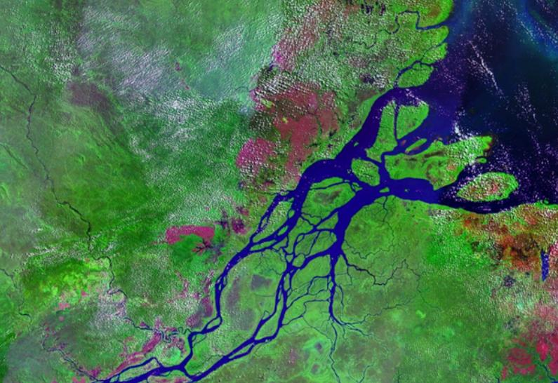
…and these?

Slide 4
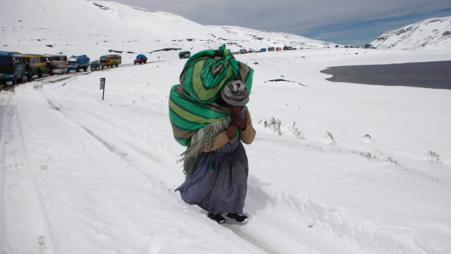
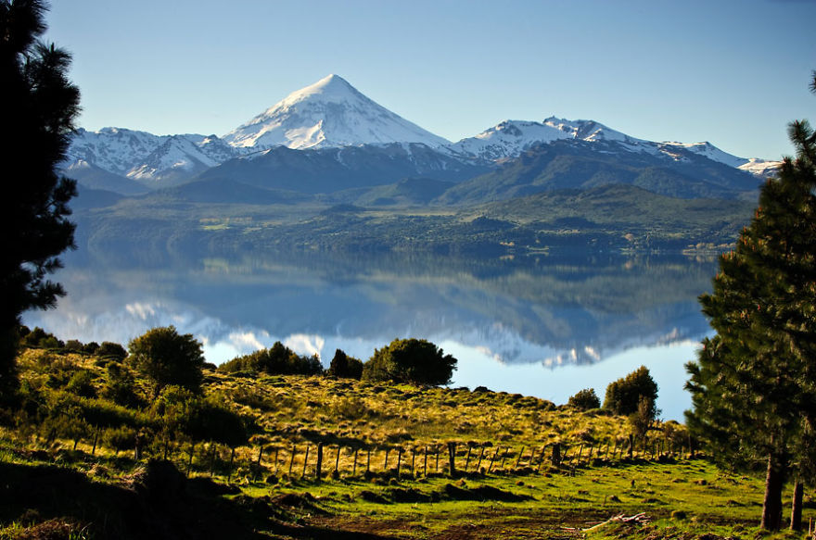
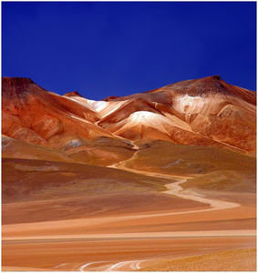
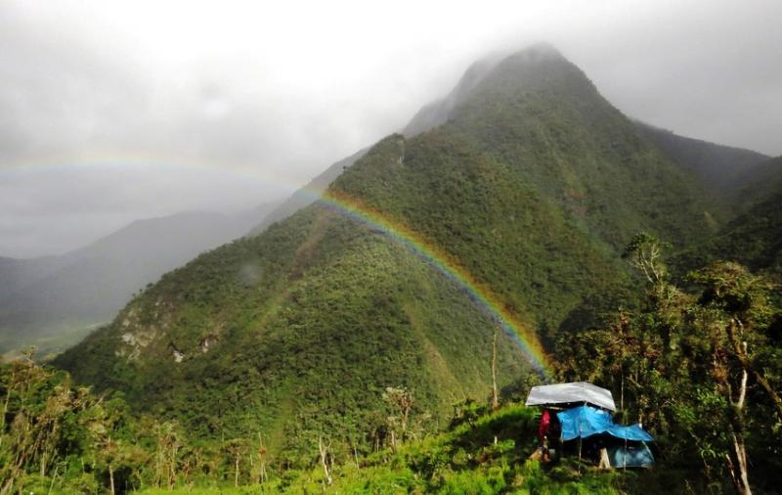
What causes such a change?

Slide 5
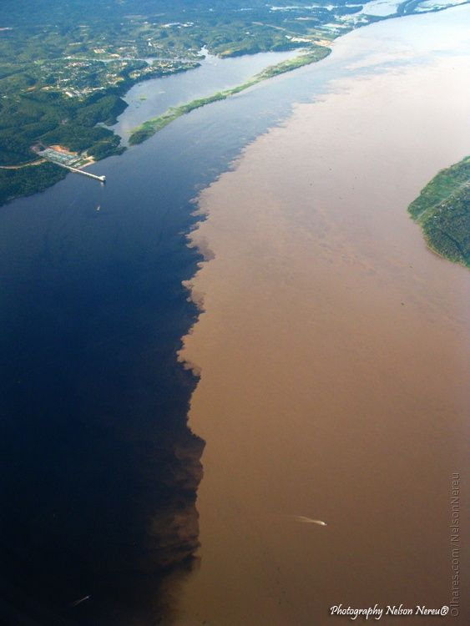
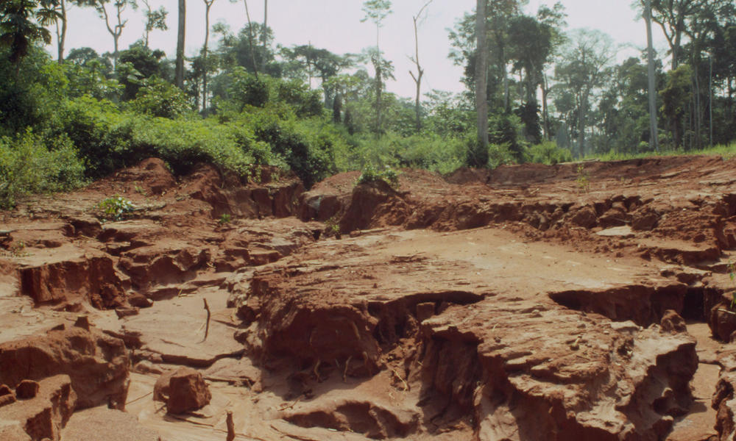
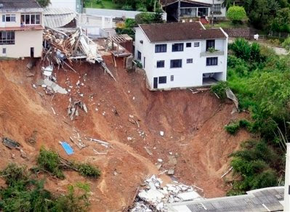
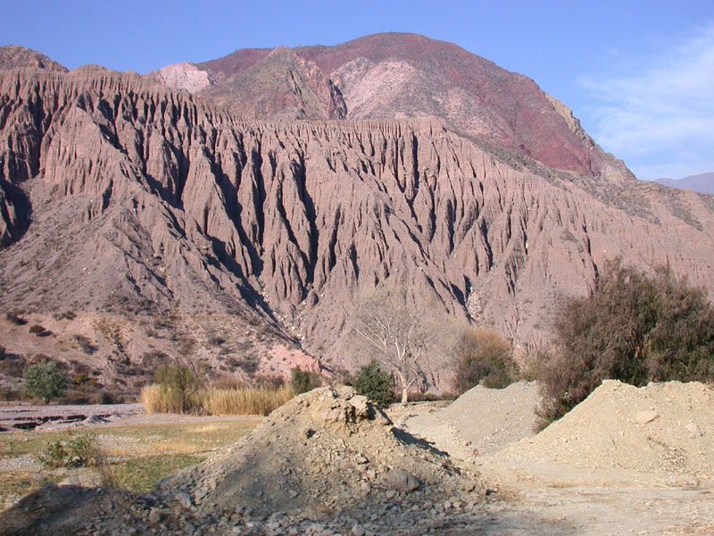
What forces cause these conditions?

Slide 6
The World is a Wonderful & Mysterious Place
Stunning Landmarks of Latin America

Slide 7
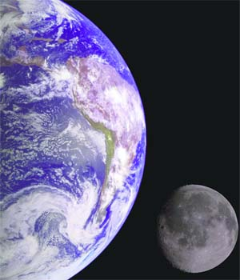
What are the physical forces that shape our planet?

Slide 8
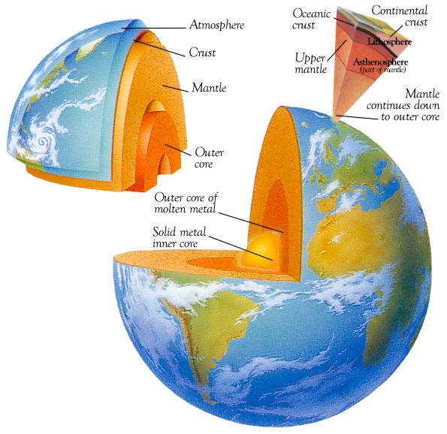
It all starts inside our planet…
What is Earth made of?
What is the center of the planet? (2 parts)
core
What is the middle layer of the planet? (thickest)
mantle
What is the outer layer of the planet? (thinnest)
crust

Slide 9
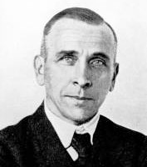
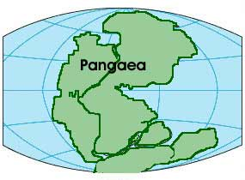
A Little Historical Background
Alfred Wegener (late 1800s)
continents look like a puzzle
Finds evidence of the same animal fossils in Africa & South America
Finds an ancient tropical plant fossil in Iceland
Creates theory continents are moving
Continental Drift Theory
No one believes his theory
Continental Drift Theory
A theory the continents are not anchored and float about over the surface of the planet
Wegener names his super continent Pangaea

Slide 10
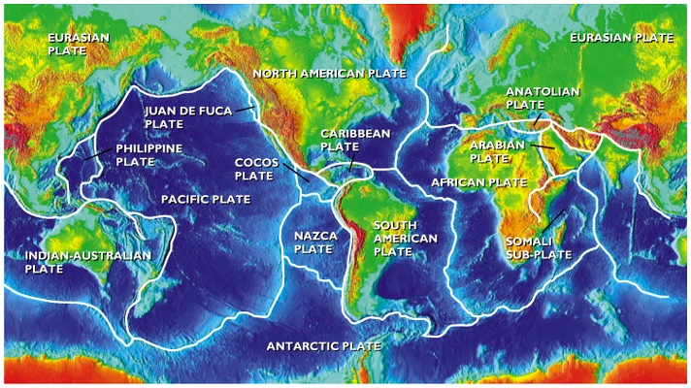
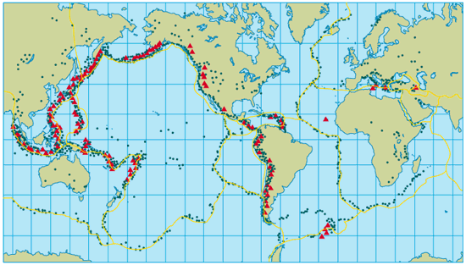
Tectonic Plate Theory
the Earth’s outer shell is made up of a number of individual moving plates (Forces of the Tectonic Plates) that are in constant motion
Tectonic plates – layers of rock that makeup the parts of the planet’s shell
2 types = continental plates & oceanic plates
volcanoes & earthquakes were used to identify and learn about plate movement
the Ring of Fires is an area around the Pacific Ocean with the most active volcanic and earthquake activity

Slide 11
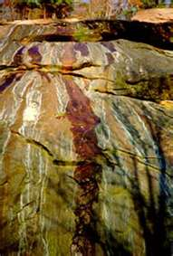
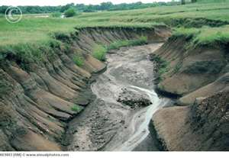
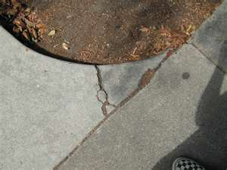
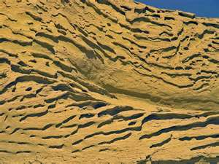
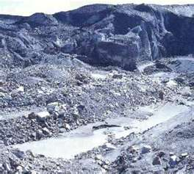
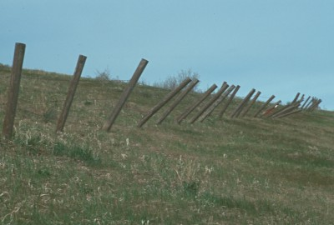
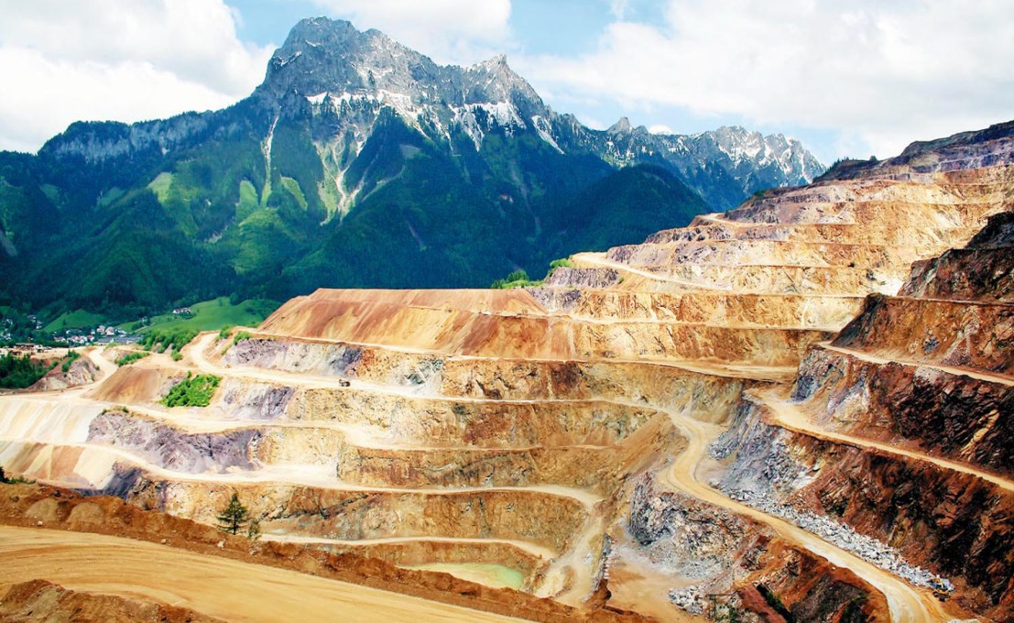
How is the surface changed?
weathering
erosion
The breakdown of earth materials such as: landforms, rock, plants, etc.
mechanical weathering: physical breakdown of earth materials → just making stuff smaller
chemical weathering: a chemical breakdown that changes the make up of earth material
The movement of weathered materials
water: especially running water
wind
glaciers
gravity
people

Slide 12
How does this impact Latin America?

Slide 13
How does this impact Latin America?
faulting
When one plate slides past another plate
San Andres Fault in California
subduction
When one plate slides beneath or is forced beneath another plate
The Andes Mountains on the west coast of South America
spreading
when 2 plates move away from each other
along the Mid Atlantic Ridge on the bottom of the Atlantic Ocean

