Slide 1
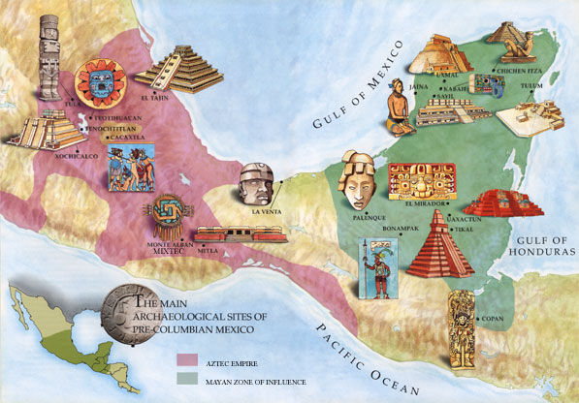
Ancient Mesoamerican Civilizations
The Olmec, Maya, Aztec, and Inca

Slide 2
At the Height of Power Timeline
Olmec
1200 B.C. – 600 B.C.
First known civilization to form in Latin America.
Maya
250 A.D. – 900 A.D.
Developed in what is now called the Yucatan Peninsula.
Aztec
1200 A.D. – 1521 A.D.
Built their capital on what is now Mexico City.
Inca
1438 A.D. – 1533 A.D.
Developed in the Andes Mountains in what is now Peru.

Slide 3
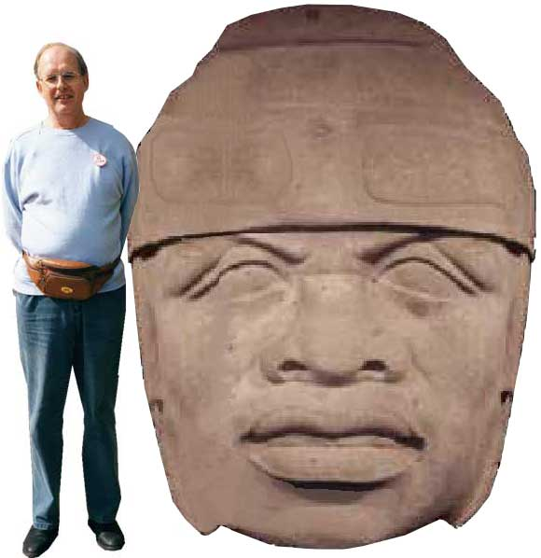
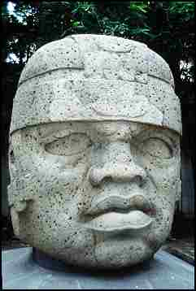
The Olmec
The Olmec developed advanced cities that included plazas, housing areas, and ceremonial centers.
The Olmec are known for HUGE stone sculptures of heads.

Slide 4
The Olmec
Around 600 B.C. the Olmec began to abandon their cities for unknown reasons.
The Olmec are considered a cultural hearth by historians.
The Olmec culture helped shape other cultures in the region, particularly the Maya.
Strongly devoted to religion, priests were highly respected.
Olmec Contributions:
1. Invented a calendar.
2. Developed a system of writing made up of carved inscriptions.

Slide 5
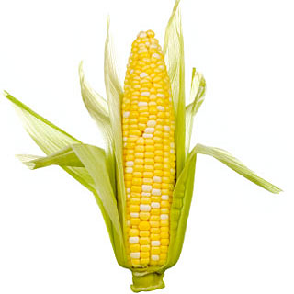
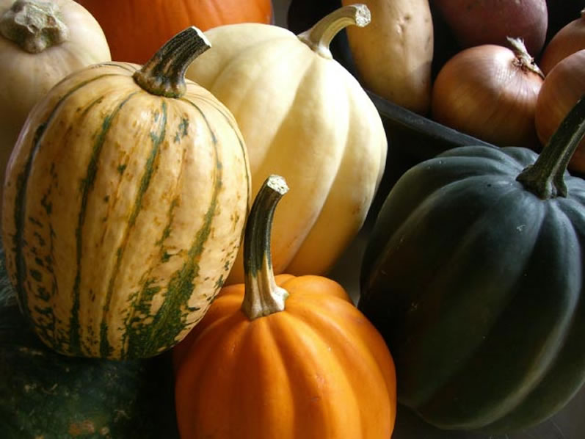

The Maya
The Maya built impressive cities with stone temples, pyramids, plazas, palaces, and ball courts.
Farming and trading was the focus of the Mayan civilization. Corn, beans, and squash were important crops. The Maya also traded salt, chocolate, and cotton with other cultures.

Slide 6
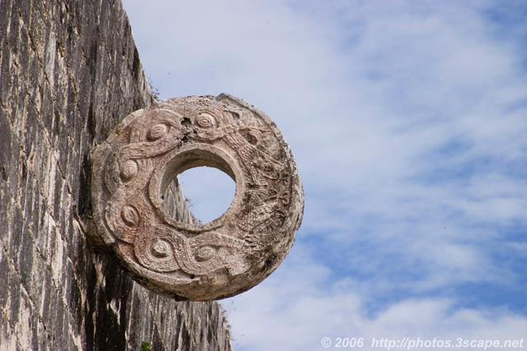
Mayan Ball Game
The court was approximately 25 feet wide, by 75 feet long. The ball was six inches in diameter and made out of rubber and weighed about eight pounds! This made the game very difficult to play and could cause severe injury. In contrast, a modern football is filled with air and weighs less than one pound.
The game was a combination of basketball, volley ball, and soccer. Two teams of two to eleven players would play the game. They would try and get a rubber ball through a small hoop that was about twenty-seven feet off of the ground. The players would have to keep the ball in motion using parts of their bodies like hips, thighs and forearms, but the use of hands and feet was not allowed.
The ball was very hard to get through the hoop. Because of this, when a player successfully got the ball through a hoop, the spectators would have to give him their jewelry.

Slide 7
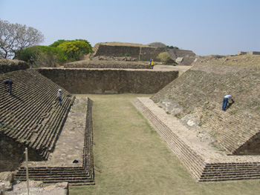
The court was shaped like an upper case I and many believe it to be the first team sport.
Explore the Mayan Ball Game

Slide 8
The Maya
Around 900 A.D. the Maya began abandoning their cities just like the Olmec. Historians do not know why.
Mayan Contributions:
Created a 365 day calendar by watching the stars.
The Maya used math and were the first people to use the zero.
Developed glyph writing using symbols that stood for words.

Slide 9
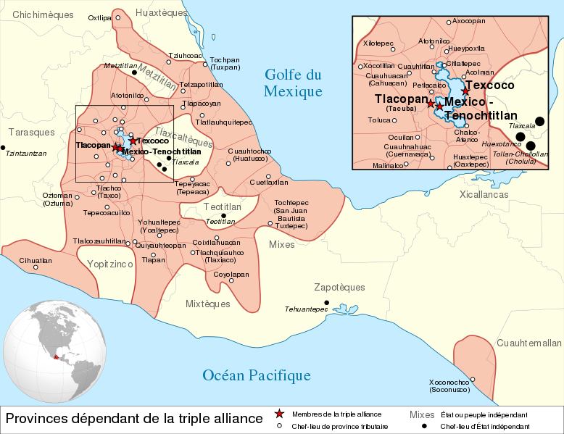
The Aztecs
Aztec people settled in the Valley of Mexico and what is now Mexico City.
The Aztecs were fierce warriors who used military power to build a huge empire.
Collecting taxes from the people they conquered was how the Aztec became so wealthy.

Slide 10
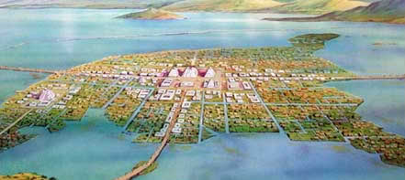
Aztec Capital
At the height of Aztec civilization there were over 300,000 people living in the capital city of Tenochtitlan and approximately 30 million living in the entire empire.

Slide 11
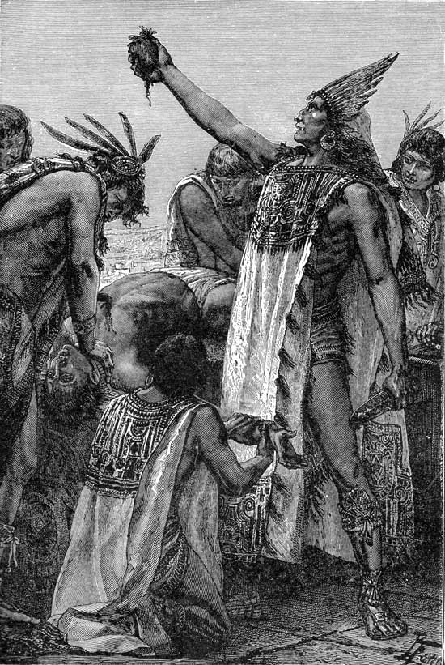
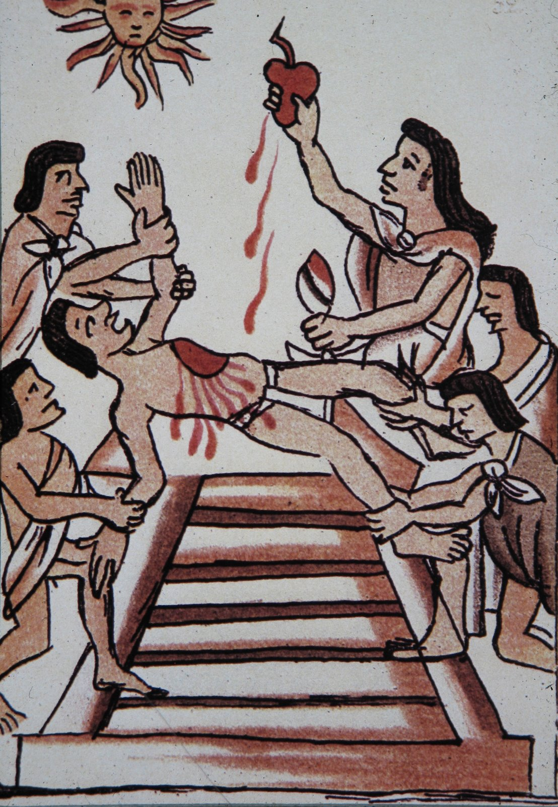
Aztec Religion
Priests were highly respected.
Most important God to the Aztecs was the Sun God.
To please their gods, Aztecs offered human sacrifices their Gods

Slide 12
Contributions of the Aztec
Doctors learned to set bones and dentists learned to treat cavities.
Engineers created bridges to connect the island capital together.
Developed an accurate calendar
Established schools

Slide 13
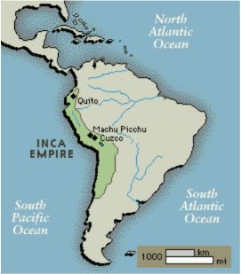
The Inca
The Incas developed in the Andes Mountains in what is now Peru.
The Incas were ruled
by an emperor who had
absolute power.
The people had to speak
the Incan language and
worship the Incan gods.

Slide 14
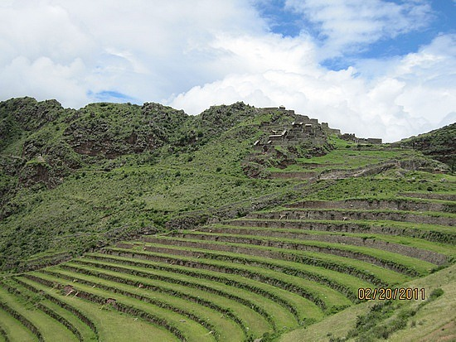
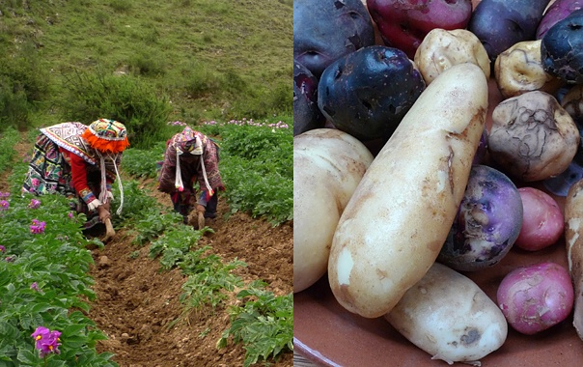
Farming in the Andes
To farm the steep land they cut terraces into the mountainside and built aqueducts, or canals, to irrigate crops.
The Inca grew mostly corn and potatoes.

Slide 15
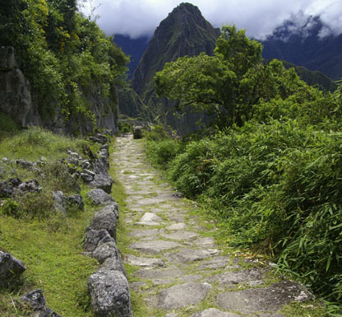
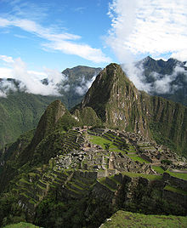
Incan Roads
The Inca built 14,000 miles of roads on which runners carried messages to far cities and the capital of Cuzco. Many of theses roads are still used today.

Slide 16
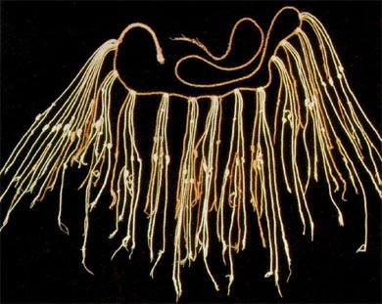
Contributions of the Inca
To keep records the Inca used quipus which are knotted cords used as counting tools.

