Slide 1
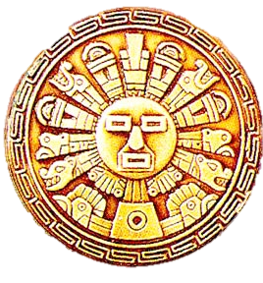
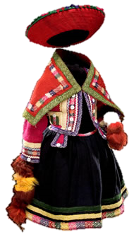
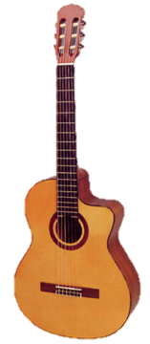
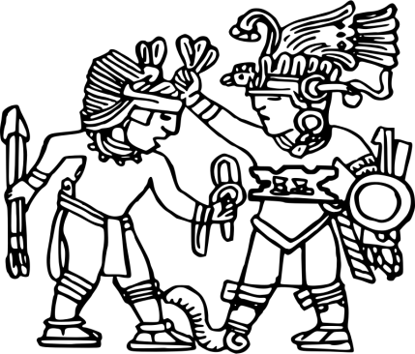
Latin America- Introduction
Where is Latin America?
What is Latin America?
Where is Latin America in relationship to the world?

Slide 2
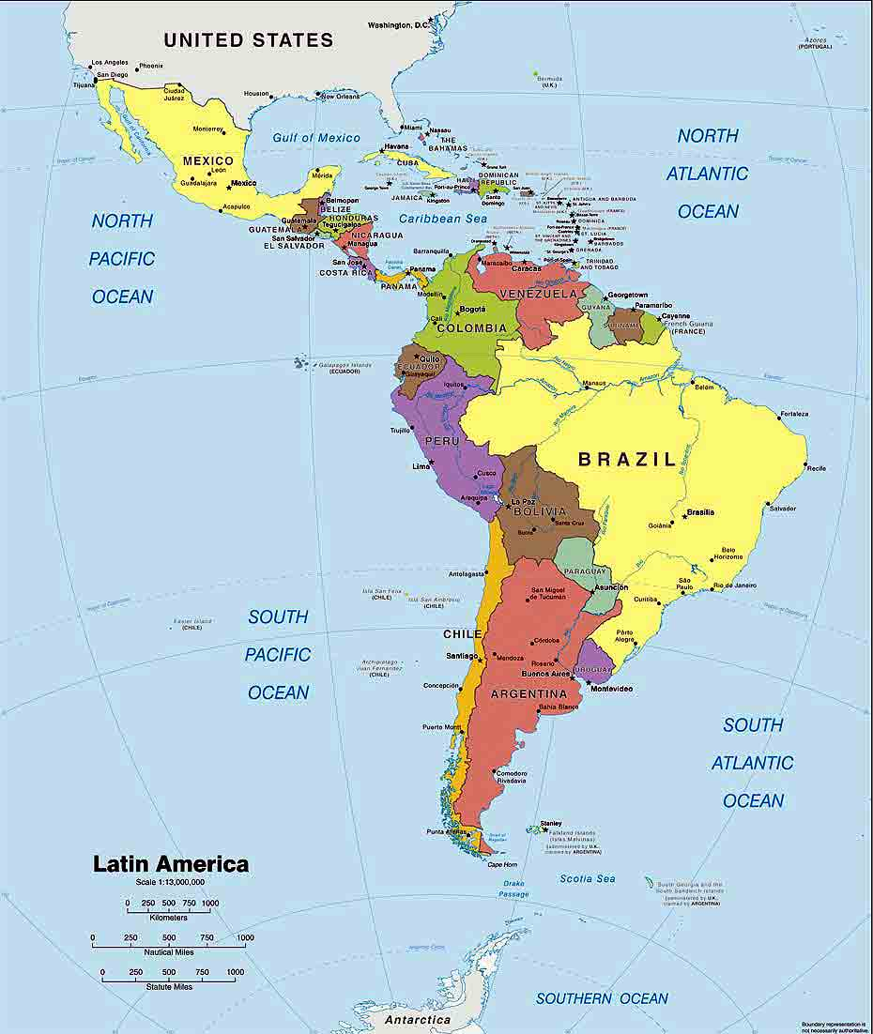
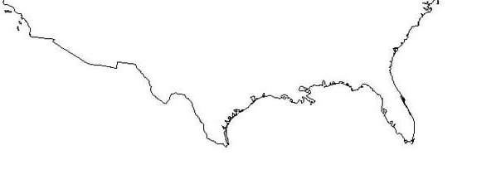
How well do you know Latin America? Using only your memory (no books, maps, images, etc.) draw a map of Latin America. (HINT- don’t forget the North American part)

Slide 3
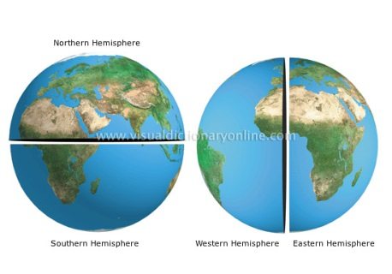
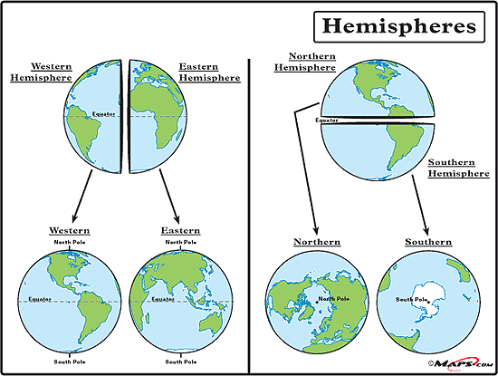
A Quick Refresher…
What is a hemisphere?
half of a sphere… in our case the globe
The equator divides the Earth into…
north & south
The prime meridian divides the Earth into…
east & west

Slide 4
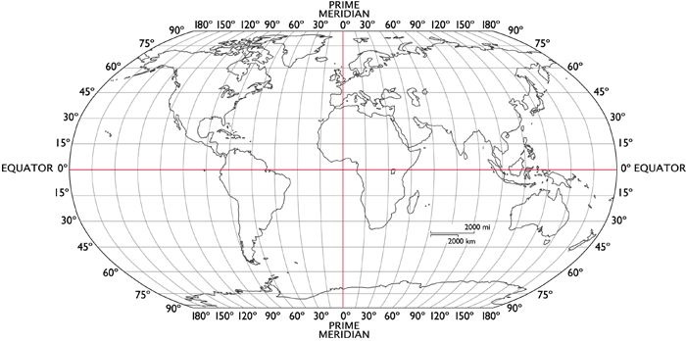
Latin America is found in which hemisphere?
Based upon the equator, Latin America is found in the __________ & __________ hemispheres.
Based upon the prime meridian, Latin America is found in the __________ hemisphere.
northern
southern
western

Slide 5
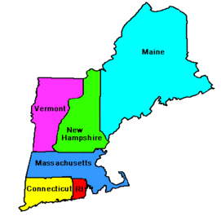
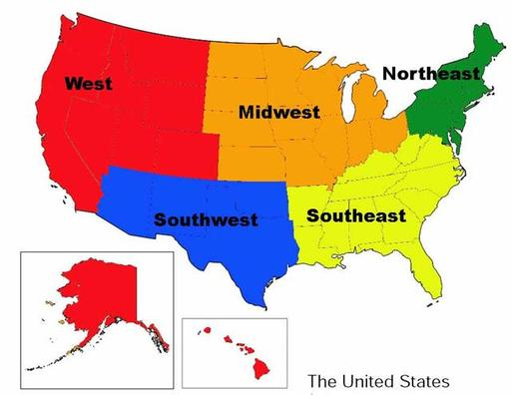
Another Quick Refresher…
What is a region?
a group of locations that have shared characteristics
How do we observe regions & they’re shared features?
we look at the human characteristics
we look at the physical characteristics

Slide 6
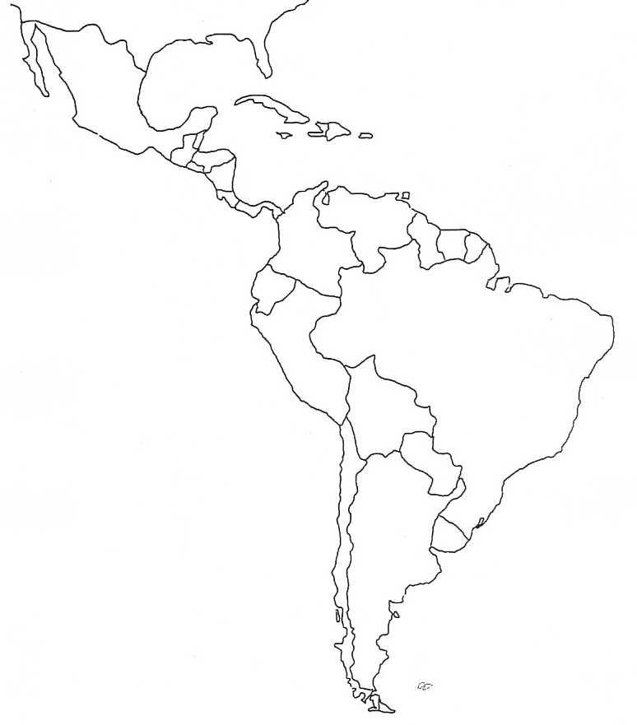
What 3 regions make up the larger region of Latin America?
The regions of Latin America are…
Middle America (Mexico & Central America)
the Caribbean
South America (the entire continent)
Latin America is on 2 continents
North America (Middle America & the Caribbean)
South America (the entire continent)
the Caribbean
Middle America
South America

Slide 7
Landform & Waterway Terms
continent – one of the 7 largest landmasses on the planet
oceans – the largest bodies of salt water that cover 70-75% of the planet’s surface
coast – where the ocean or sea meets land

Slide 8
What continents & oceans are found near Latin America?
North America
Atlantic Ocean
_______________ is part of & lies to the north
_______________ is across the Atlantic to the northeast
_______________ is across the Atlantic to the east
the _______________ lies along the east coast
the _______________ lies along the west coast
the _______________ lies off the southern tip
Europe
Pacific Ocean
Africa
Southern Ocean
North America
Europe
Atlantic Ocean
Latin
America
Africa
Pacific Ocean
Southern Ocean

Slide 9
Let’s Recap…
Where is Latin America?
What is Latin America?
Where is Latin America in relationship to the world?

