Slide 1
Using Hadoop to Cluster Twitter Data
Yuval Dekel, Jarvis Johnson, Daniel Kester,
Nick Olive

Slide 2
Motivation
Finding communities in social networks is difficult and valuable
If you can identify communities based on interest, you can make recommendations
Useful for content providers and advertisers
Analysts can use known communities to predict information propagation
Useful for news sites and social promoters
Users can be classified based on their communities, thus eliminate guessing/estimating

Slide 3
Design
Gather a large set of Twitter data
Preparse the set, looking for links between users
lower filesize, reorganize data, gather data about scaling
Run the algorithm in parallel using MapReduce
Uses k-means clustering

Slide 4
Twitter Preprocessing
Started with a freely available list of users and users that follow them
One link per line
26 Gb of data
too large to use without a large cluster of computers
First we reduced the size by removing redundancy (26 Gb -> 13 Gb)
e.g. if line 1 and 2 are "user1 user2" and "user1 user3", we combine them into "user1 user2 user3"
Then we filtered out users with very few and very many links

Slide 5
preprocessed versions
Several different versions were used to test scaling and collect metrics about the data
Each version contains only users that have more than 15 followers and up to X followers
X = 150: filesize is 2.29 Gb, 6,264,575 entries
X = 100: filesize is 1.89 Gb, 5,889,020 entries
X = 80: filesize is 1.67 Gb, 5,617,855 entries
X = 60: filesize is 1.38 Gb, 5,164,969 entries
X = 40: filesize is 977 Mb, 4,265,168 entries
X = 30: filesize is 695 Mb, 3,390638 entries
X = 20: filesize is 265 Mb, 1,527,196 entries
X = 18: filesize is 141 Mb, 850,586 entries
X = 17: filesize is 72 Mb, 448,782 entries

Slide 6
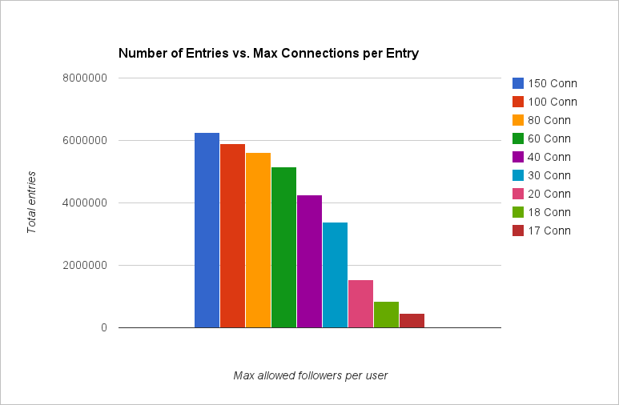
Charts

Slide 7
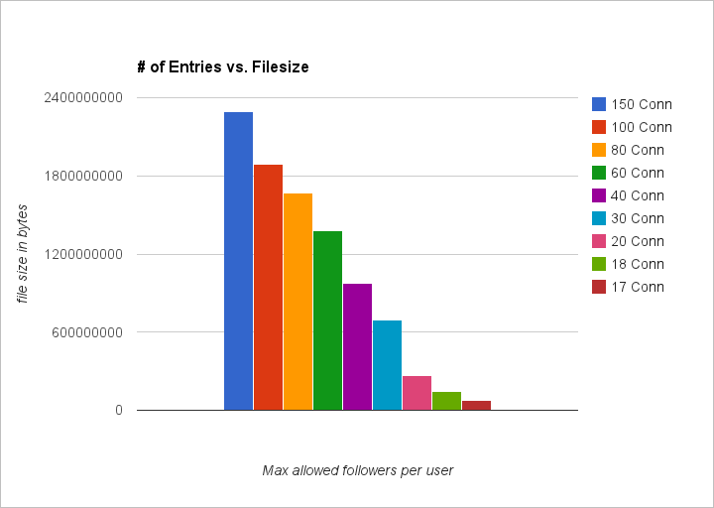
Charts part 2

Slide 8
k-Means Clustering
Partitions n observations into k clusters
Each observation will belong to the cluster with the nearest mean
Assumes clusters of relatively similar size (messes up the mean)
Very parallelizable (just need datapoint and centroid)

Slide 9
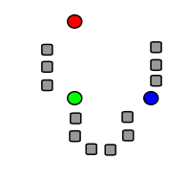
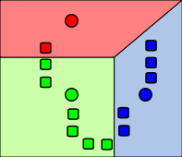
k-Means Clustering

Slide 10
MapReduce k-Means
Not converged yet
MapReduce Start
MapReduce 1
MapReduce 2
Initialization Map picks starting centroids randomly
Initialization Reduce sets each node to its nearest starting centroid
Map each node to its nearest centroid
Reduce to find the new centroid of each cluster
Map is skipped
Reduce swaps key value pairs

Slide 11
Evaluation Function
Returns the number of connections to a specific node
Nodes are considered in the cluster of the centroid closest to the same number of nodes.

Slide 12
Hadoop Specifics
Loop multiple times rather than until convergence instead of calculating convergence.
Too hard to compare large outputs
Save intermediate files between each Map and Reduce
Using hdfs

Slide 13
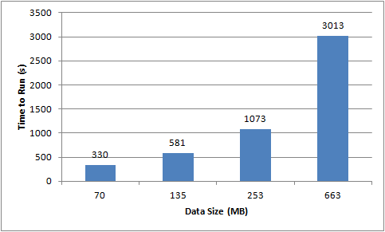
Performance
Tests involved a loop of 6 MapReduces on one node
For comparison, downloading the Twitter data took 3 hours to being with

Slide 14
Problems
Twitter data shutdown
Lack of time after finally getting data
Weird mix of Java and Hadoop versions
Limited choices for evaluation function

Slide 15
Potential Improvements
Save Twitter indegree in addition to outdegree
Add additional evaluation functions
Make number of clusters, specific evaluation function and number of loops parameters instead of hardcoded
Finding correct number of clusters

Slide 16
Best Features
Preprocess to reduce size of input
Loop a specified number of times instead of until convergence

Slide 17
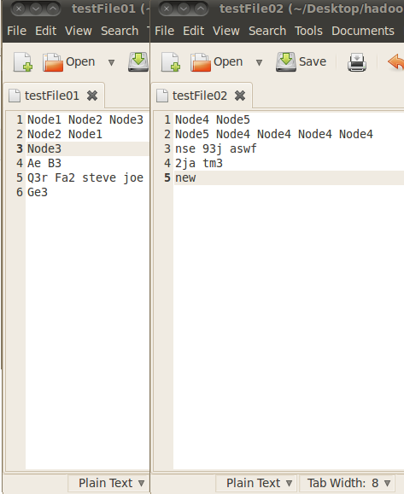
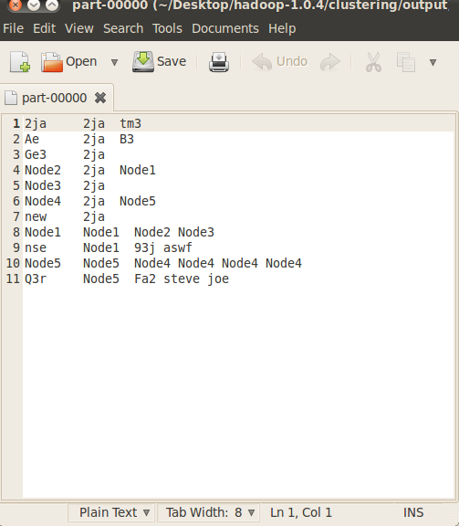
Screenshots
Input Format:
node spacedListOfOutEdges
Output Format:
node clusterCentroid spacedListOfOutEdges

Slide 18
References
Hadoop. (2012). Retrieved from http://hadoop.apache.org/
Haeberien, A. (2012, October 18). Scalable and cloud computing. Retrieved from http://www.google.com/url?sa=t&rct=j&q&esrc=s&source=web&
Rytsareva, I., & Kalyanaraman, A. (2012). An efficient MapReduce algorighm for parallelizing large-scale graph clustering.

