Slide 1
RoBERTa: A Robustly Optimized BERT Pretraining Approach
FINAL PROJECT
Instructor: Lê Anh Cường
StudentID: 520K0323 – Trần Vũ Kỳ Anh

Slide 2
Outline
Transformer Innovations
What is BERT?
RoBERTA

Slide 3
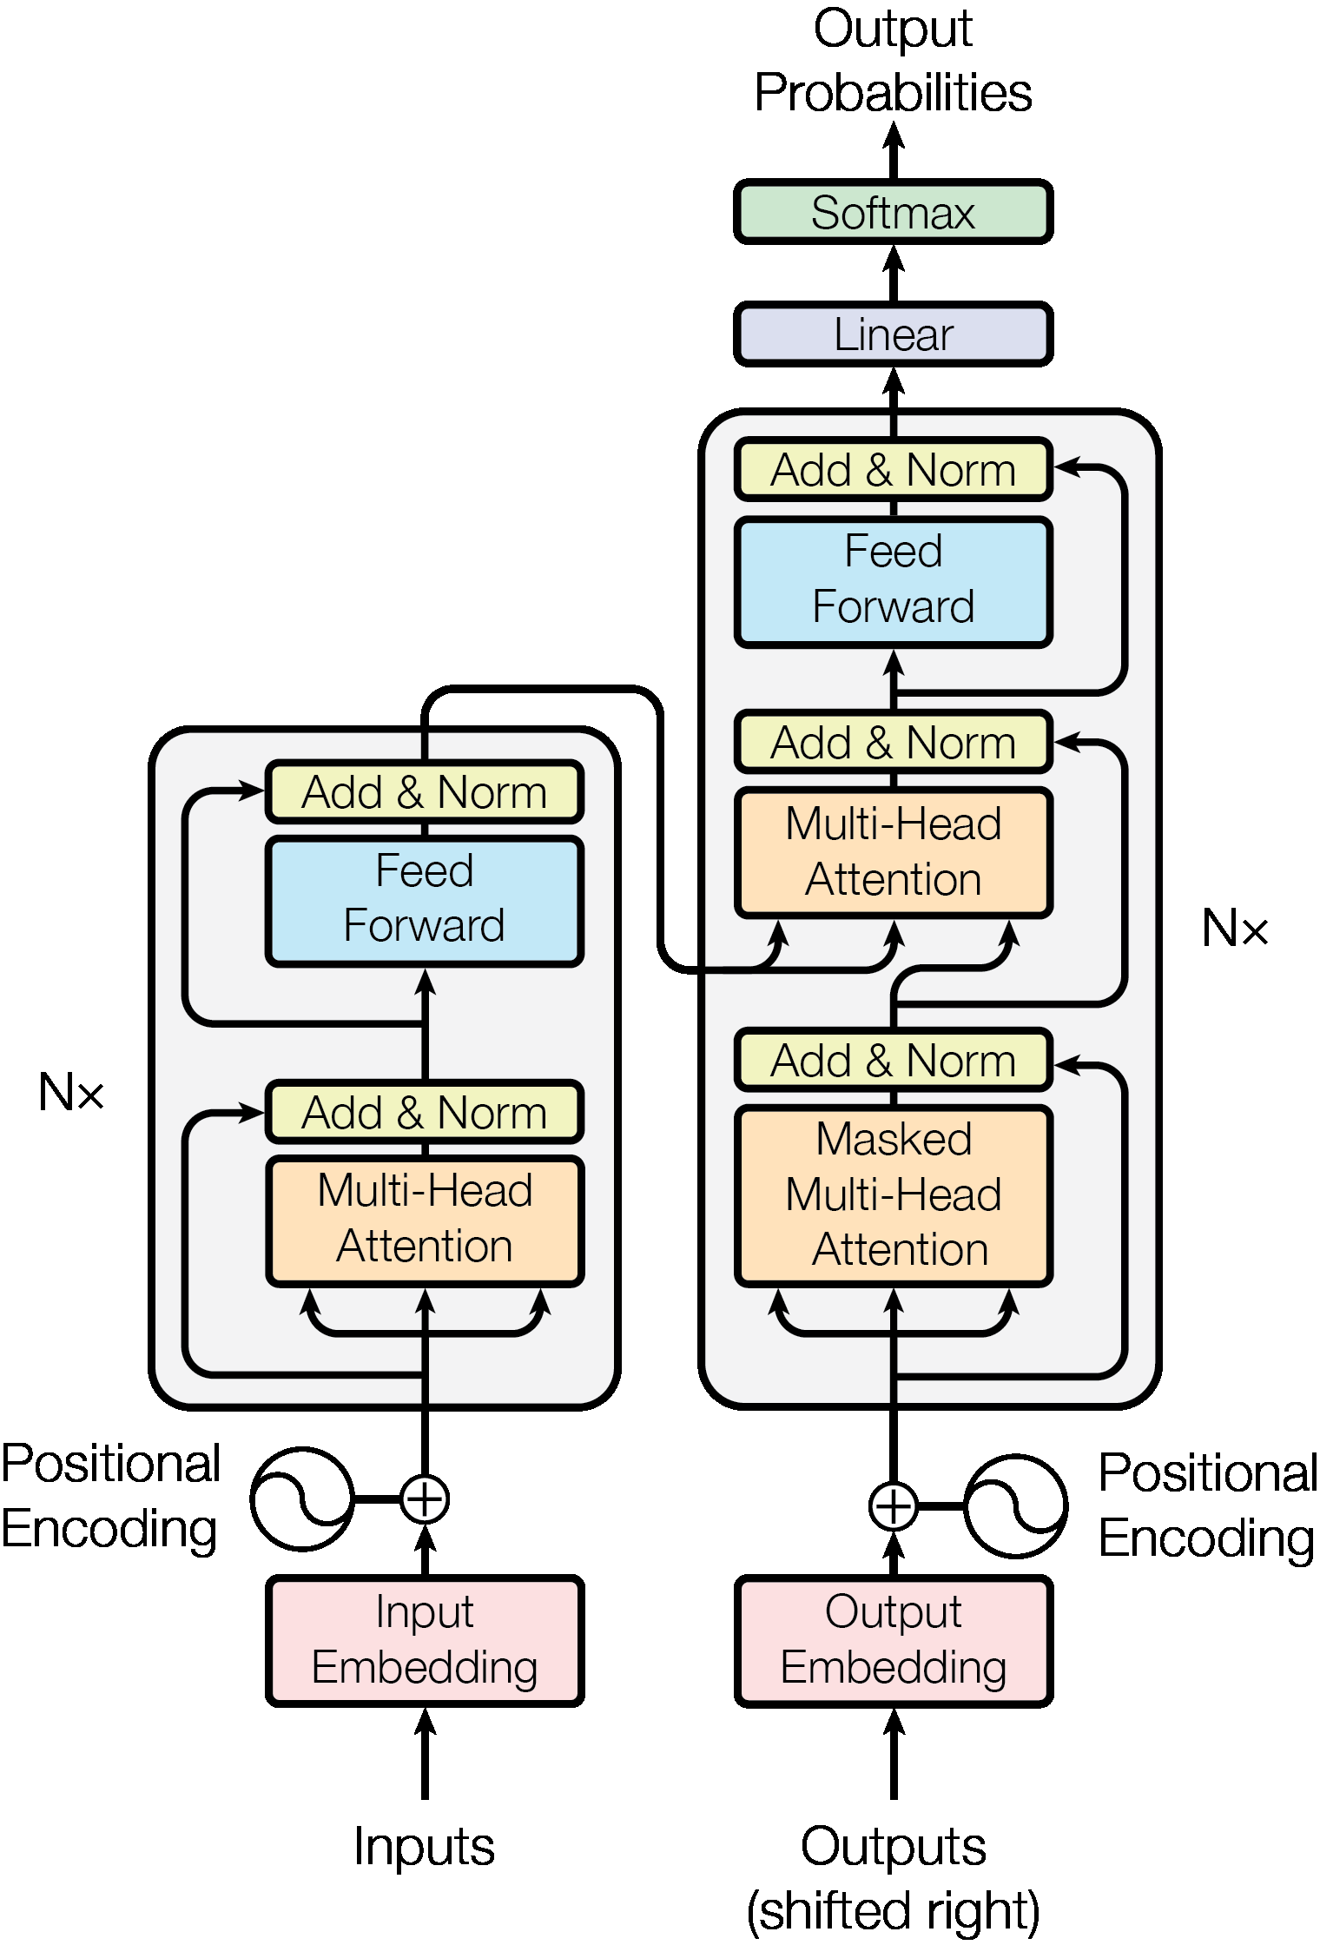
1. Transformer
Transformer was announced by Google in 2017
Before that, most natural language processing tasks, especially Machine Translation used architecture Recurrent Neural Networks (RNNs)
The weakness of this method is that it is difficult to catch the long dependence between words in the sentence and the training speed is slow due to sequential input processing.
Transformers were born to solve these two problems; and its variants like BERT, GPT-2 generate new state-of-the-art for NLP related tasks.
Transformer - model architecture

Slide 4
1. Transformer
Encoder block
Encoder blocks in Transformer
Encoder consists of 6 main structures:
Input Embedding
Positional Encoding
Multi-Head Attention
Feed-forward Network (fully-connected layer)
Layer Normalization
Residual connection
as shown in the encoder branch on the left side of the figure. At the end of the encoder process, we get a vector embedding output for each word.

Slide 5
1. Transformer
Residual connections mainly help mitigate the vanishing gradient problem. During the back-propagation, the signal gets multiplied by the derivative of the activation function.
Residual connection
Encoder blocks in Transformer
layer normalization plays a crucial role in controlling the gradient scales.
tokens are converted into embedding vectors by using a fixed representation like word2vec or any other
Layer Normalization
Input Embedding
Feed-forward Network
Helps the model learn word order, context, structure, and sentence information
Multi-Head Attention
The birthplace of the transformer's quintessential data element:self-attention
Positional Encoding

Slide 6
Outline
Transformer Innovations
What is BERT?
RoBERTA

Slide 7
BERT - Bidirectional Encoder Representations from Transformers
N stacks of encoder (6, 12, 24,…) based on which BERT architecture
Classifier
BERT
….
BERT is designed to pre-train word embedding. A special feature of BERT is that it can balance the context in both left and right directions.(for short BERT uses a bidirectional Transformer)
Notes:
Do đó Transformer được xem như là huấn luyện hai chiều (bidirectional) mặc dù trên thực tế chính xác hơn chúng ta có thể nói rằng đó là huấn luyện không chiều (non-directional).

Slide 8
BERT
How do we understand languages?
NLP Task
Neural Machine Translation
Question Answering
Sentiment Analysis
Text Summarization
Require a model understand language in a more advanced way than with traditional methods

Slide 9
BERT
While BERT uses a new method
Pretrain BERT to understand language
Fine-tuning BERT to learn specific task
BERT Training

Slide 10
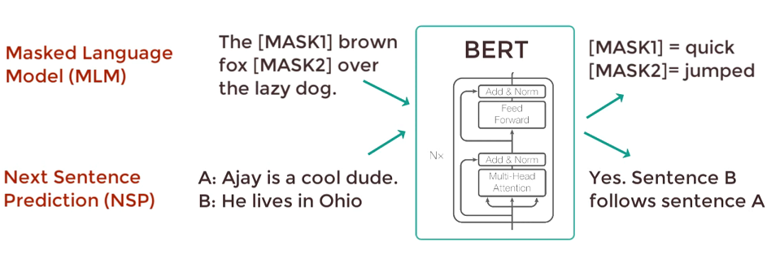
BERT
2.1. Pretraining BERT

Slide 11
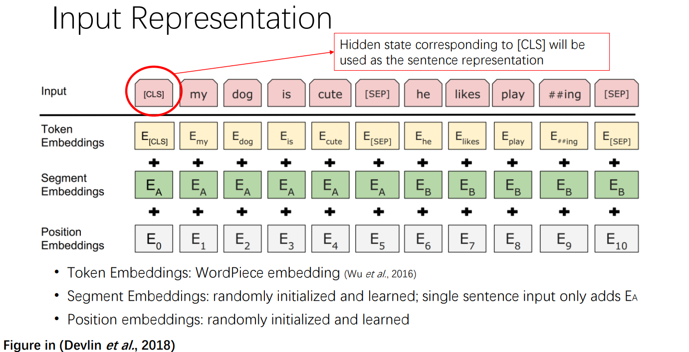
Initialization token is [CLS] at the beginning of the sentence, token [SEP] in the middle to separate the 2 sentences.

Slide 12
BERT
2.1. Pretraining BERT
Masked Language Modeling (MLM)
Next Sentence Prediction (NSP)
MLM is a task that allows us to fine-tuning word representations on any unsupervised-text tuples. We can apply MLM to different languages to create embedding representations for them
This is a supervised classification problem with 2 labels (also known as binary classification). The input of the model is a pair of sentences (pair-sequence) such that 50% of the second sentence selected is the next sentence of the first sentence and 50% is randomly selected from the set of documents without any input. What is the relationship with the first sentence?
The model's label will correspond to IsNext when the sentence pair is consecutive or NotNext if the sentence pair is not consecutive.
Notes:
To prevent the model from focusing too much on a particular position or tokens that are masked, the researchers randomly masked 15% of the words
The masked words were not always replaced by the masked tokens [MASK] because the [MASK] token would never appear during fine-tuning
So, the researchers used the below technique:80% of the time the words were replaced with the masked token [MASK]
10% of the time the words were replaced with random words
10% of the time the words were left unchanged

Slide 13
Outline
Transformer Innovations
What is BERT?
RoBERTA

Slide 14
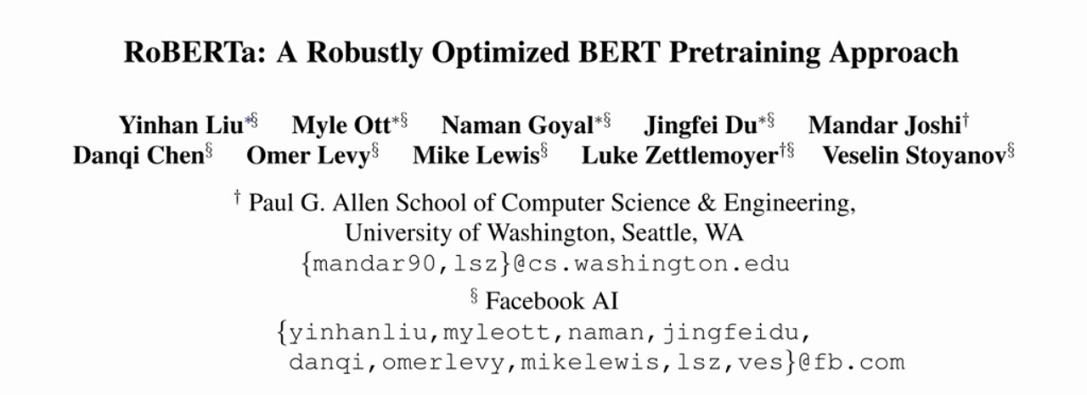
RoBERTa: A Robustly Optimized BERT Pretraining Approach
RoBERTa is a variant of the BERT model, which was developed by researchers at Facebook AI. Like BERT, RoBERTa is a transformer-based language model that uses self-attention to process input sequences and generate contextualized representations of words in a sentence.

Slide 15
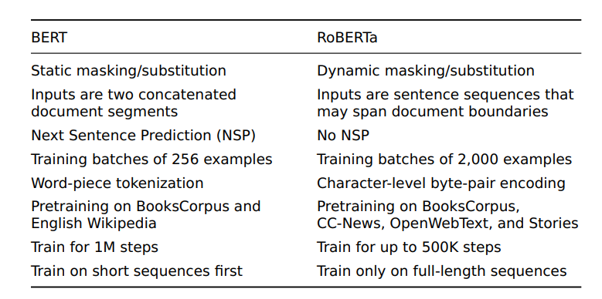
RoBERTa vs BERT

Slide 16
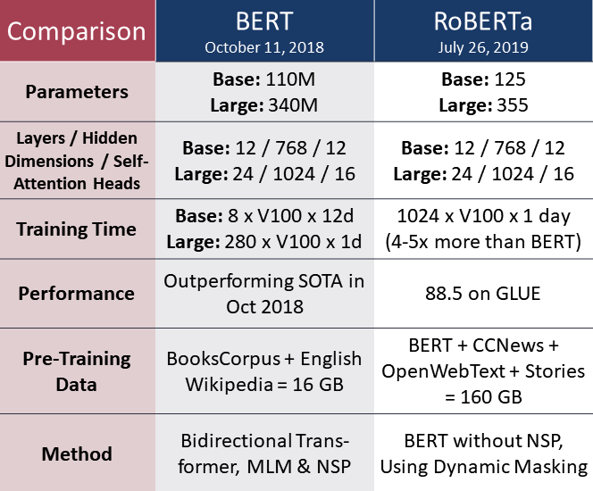
RoBERTa vs BERT
RoBERTa has a model slightly larger size than BERT (5M params) in both base and large versions
The number of layer, hidden dimension, multi-head attention is the same
Training time take longer(5x)
RoBERTa trains on corpus 10 times larger and costs 5 times more resources
BERT variant remove NSP, use Dynamic Masking, and BPE

Slide 17
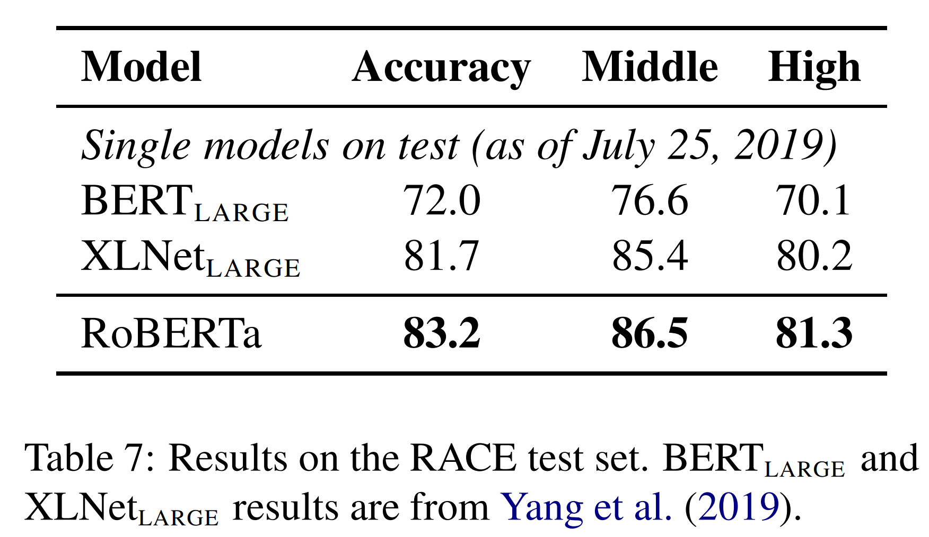
RoBERTa vs BERT

Slide 18
References
Phạm Đình Khánh Blog | Bài 4 - Attention is all you need
Phạm Đình Khánh Blog | Bài 36 - BERT model
geeksforgeeks | Overview of ROBERTa model
https://viblo.asia/p/tan-man-ve-self-attention-07LKXoq85V4
https://machinelearningmastery.com/the-transformer-attention-mechanism/
https://www.youtube.com/watch?v=xI0HHN5XKDo&t=615s
https://viblo.asia/p/transformers-nguoi-may-bien-hinh-bien-doi-the-gioi-nlp-924lJPOXKPM
https://towardsdatascience.com/robustly-optimized-bert-pretraining-approaches-537dc66522dd

