Slide 1
ACRSENT
Kevin Fitzpatrick, Tessa Karlovitz, Dustin Luchmee

Slide 2
SDA UPDATES AND WEEK 7 PROGRESS
Book Review Updates
Electronics Review Updates
Mobile-Electronic Review Updates

Slide 3
BOOK DATA UPDATES
Wrote three Python files to clean the Amazon book review data
Original file from Amazon contained 10,319,090 reviews. It was 6.7GB.
After first pass: 7,450,412 reviews, 2.66GB.
Most common issue was not verified purchases.
Performed second pass to count number of reviews per book
Once with every book: 1.65 million books
Once with only books that contain 30 reviews or more: 34,194 books
Third pass created file of cleaned reviews containing book titles with at least 30 reviews: 2,668,988 reviews, 893 MB

Slide 4
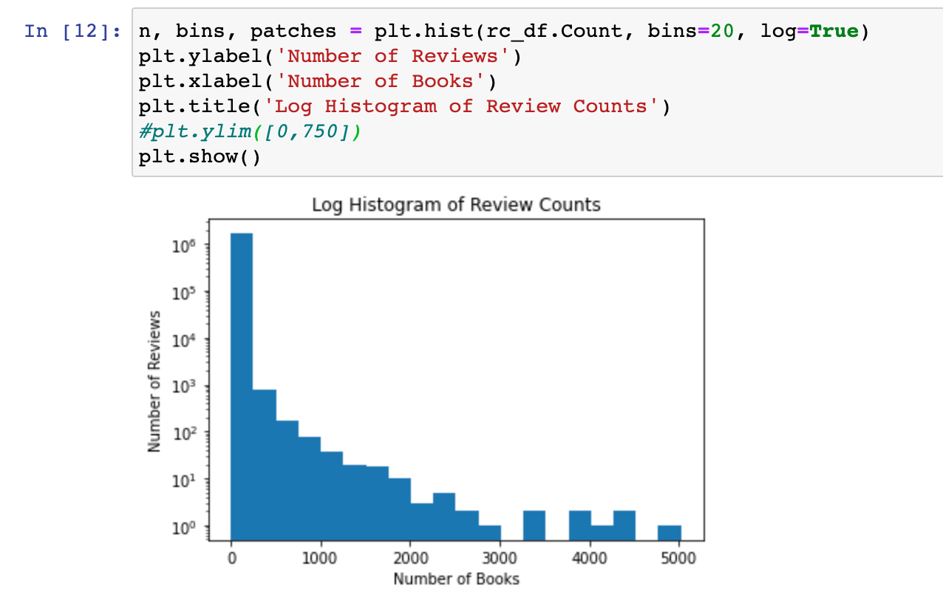
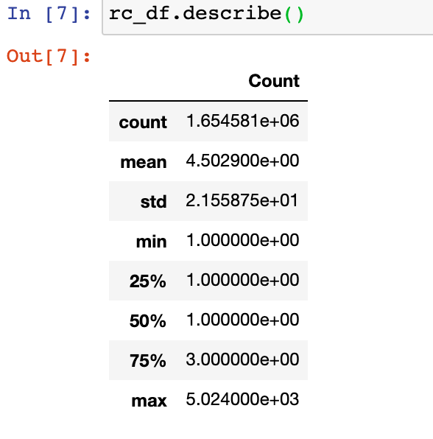
SOME SDA ON AMAZON BOOK REVIEW DATA
All Data from 2nd Pass

Slide 5
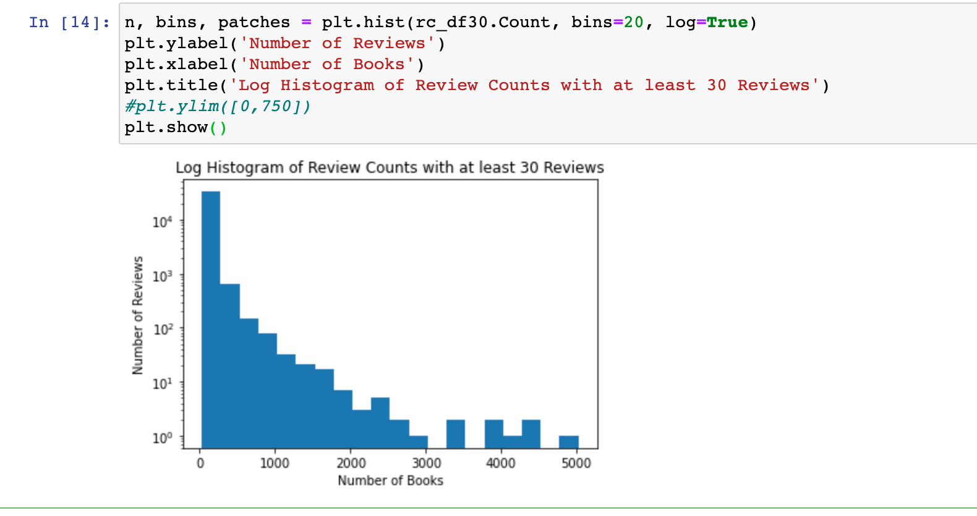
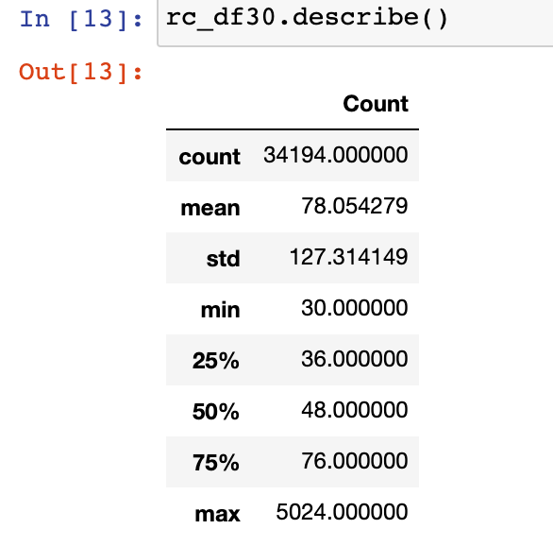
SOME SDA ON AMAZON BOOK REVIEW DATA
At least 30 Reviews Data from 2nd Pass

Slide 6
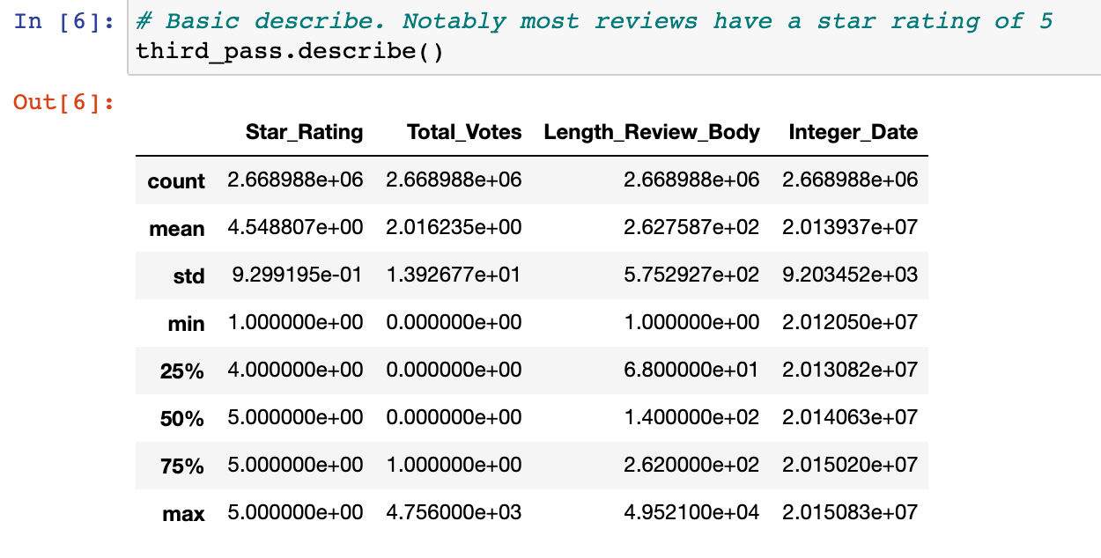
SOME SDA ON AMAZON BOOK REVIEW DATA

Slide 7
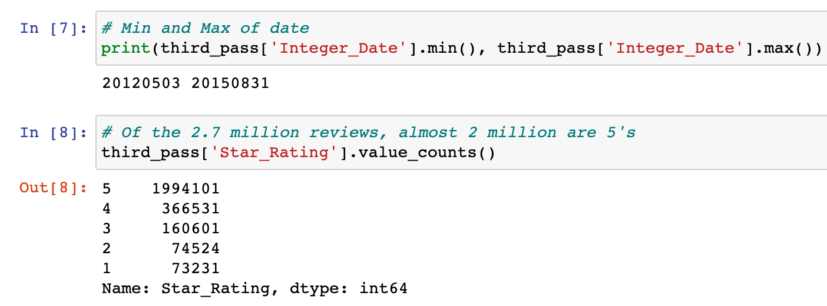
SOME SDA ON AMAZON BOOK REVIEW DATA

Slide 8
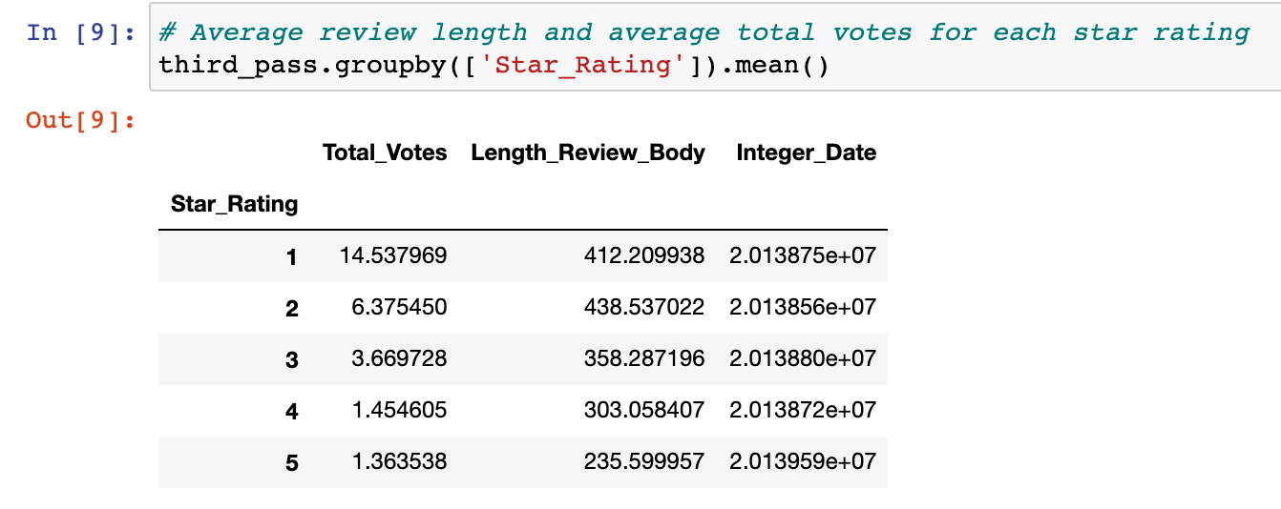
SOME SDA ON AMAZON BOOK REVIEW DATA

Slide 9
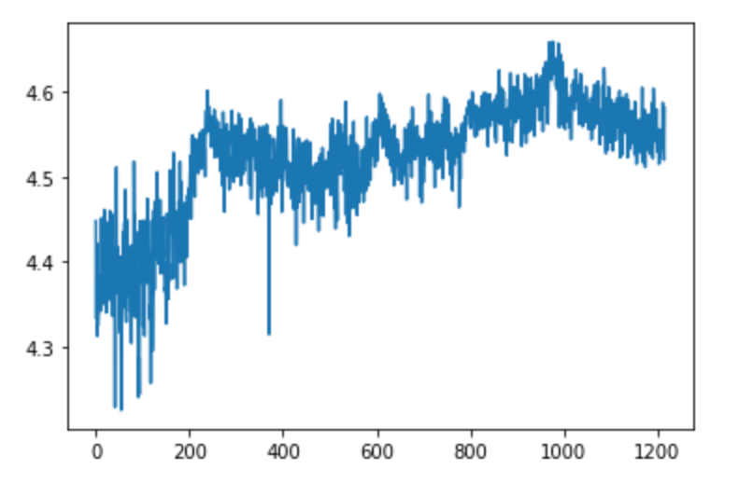
SOME SDA ON AMAZON BOOK REVIEW DATA
Plot of the average star rating by date over time

Slide 10
KAGGLE BOOK DATA UPDATES
Successfully pulled it into pandas
We can match on book title but currently need to do a better merge than just left join since we care about the year
Have not fully implemented this yet
Make a second version of the book review data where we keep just the first 30 reviews of each book since we want to know long term if we can predict if a book will make the top 100 by its initial reviews
Title, first review date, 30th review date, all 30 reviews, top 100 yes or no (one line of new dataset)
If we do this then might not need to merge, simply check each title if it is in corresponding top 100 list or not

Slide 11
Electronic Data
Attempted to remove rows containing words such as case, sleeve, male, female, etc. Resulted in purging a lot of the data.
Removed null values, but found that some product titles have: (Create a generic Title per Amazons guidelines)
Cleaned and lemmatized review body data, created a document term matrix
used wordcloud to look for frequently occurring words for each product to review to inform analysis

Slide 12

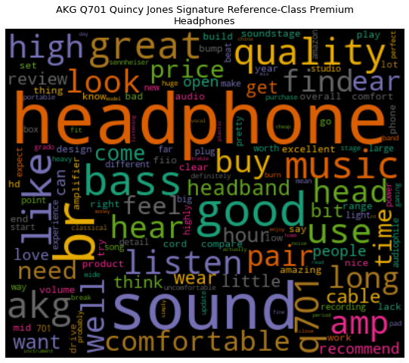
Findings with WordCloud

Slide 13
Polarity
What makes a really positive review from a negative one?
3 Random Reviews with Highest Polarity:
Review 1: Works perfectly
Review 2: Perfect for the price
Review 3: Perfect picture quality. No need to spend hundreds of dollars on one.
3 Random Reviews with Lowest Polarity:
Review 1: HORRIBLE.
Review 2: Piece of cr*p. they broke within 2 days. The seattle seahawks pieces fell off of both ears. This is a terrible product!
Review 3: HDMI metal tip bent and separated from the casing after first insertion. Terrible build quality. Would almost spend the time and pay for the shipping just to send it back to them. Almost...

Slide 14
Polarity and Star Ratings of Products
Currently trying to optimize graphs. It appears that there is a lot of data, so it may be useful to focus on specific devices, rather than the full range of electronic devices.
Also pulling readability indices of positive and negative reviews: Flesch-Kinkaid, Dale Chall, Gunning Fog. Do reviews become more complex or less depending on the sentiment?
And examining reading time: do positive or negative reviews tend to take longer to read? If so, which one?

Slide 15
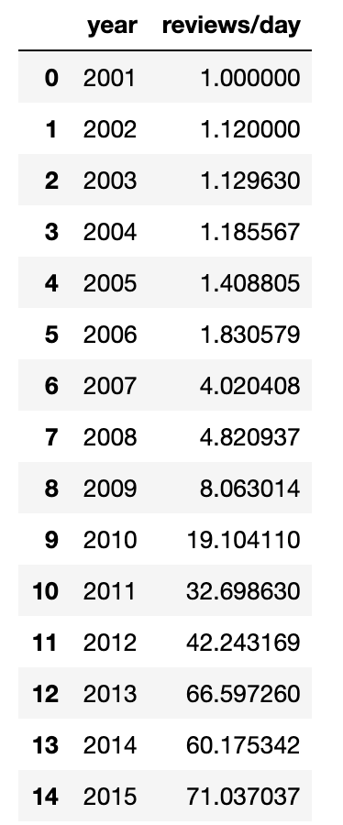
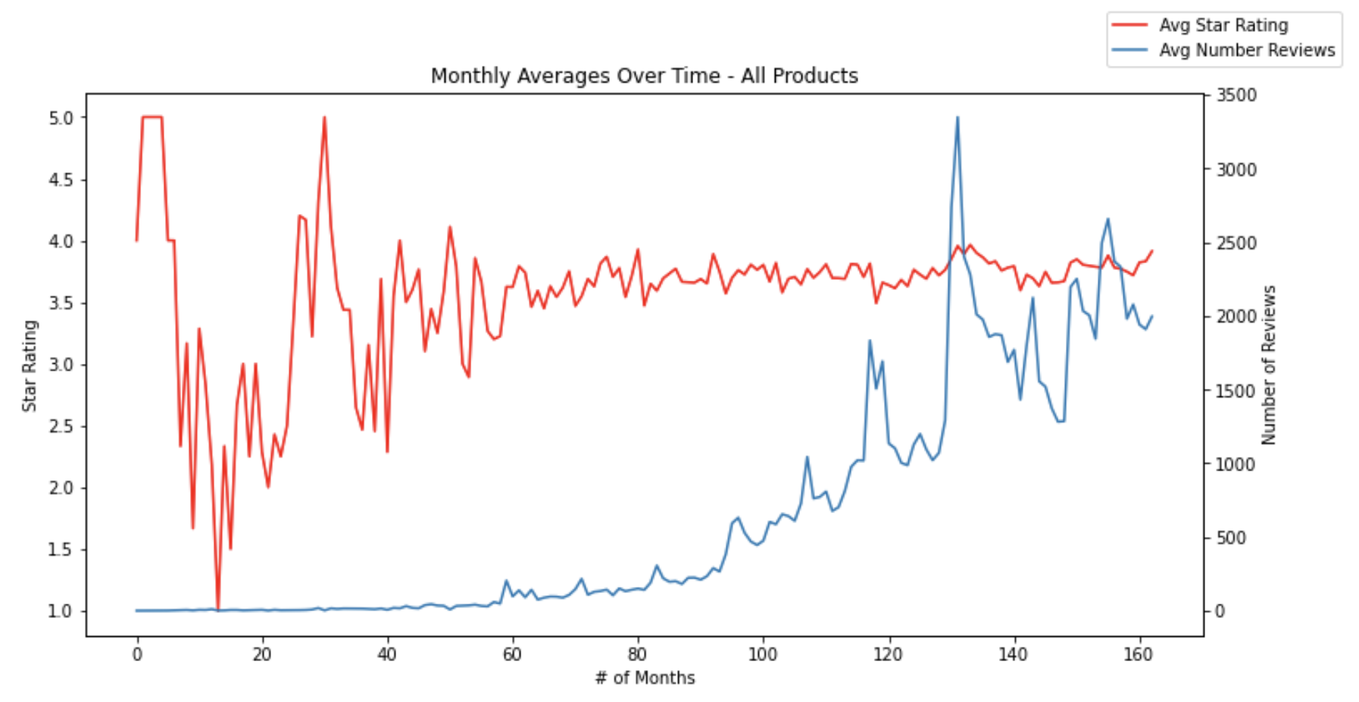
Some SDA on Amazon Mobile Electronics Review Data

Slide 16
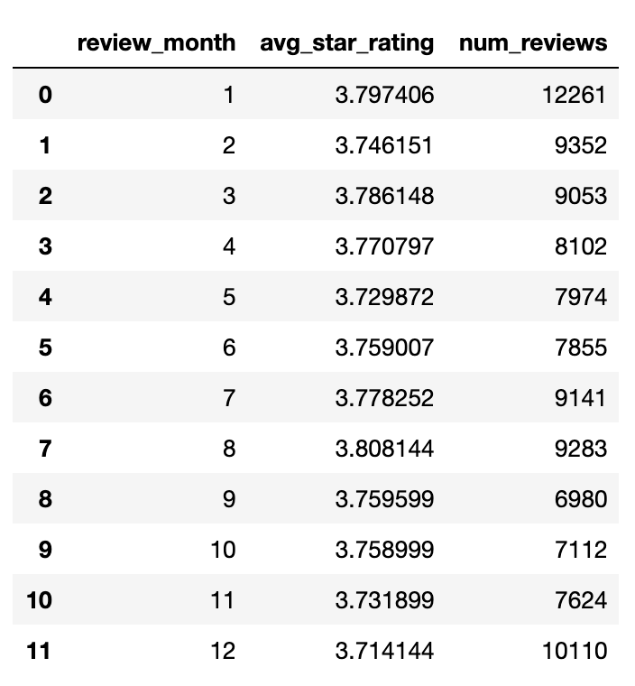
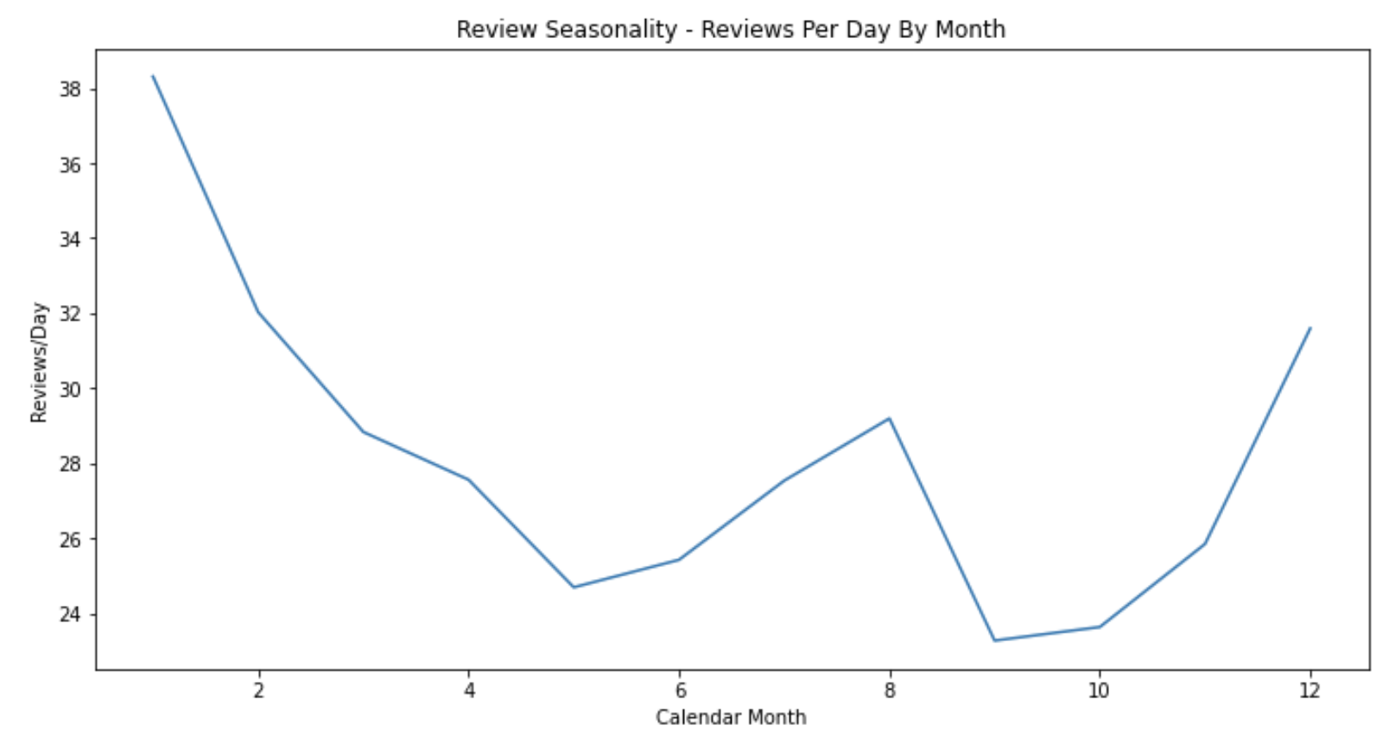
Some SDA on Amazon Mobile Electronics Review Data

Slide 17
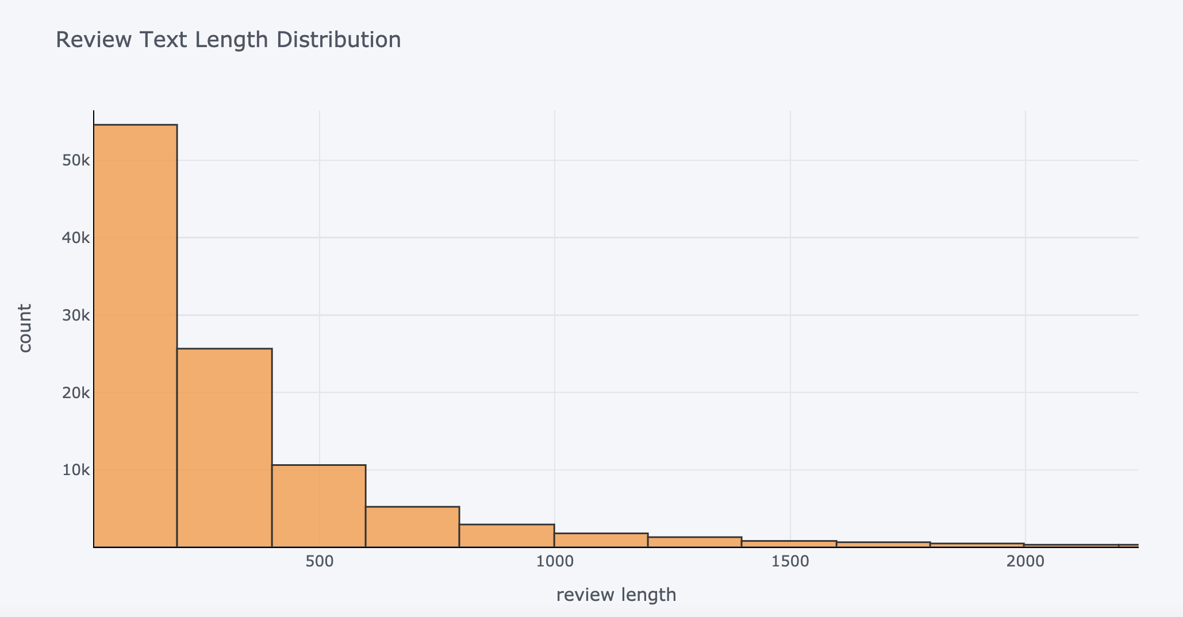
Some SDA on Amazon Mobile Electronics Review Data

Slide 18
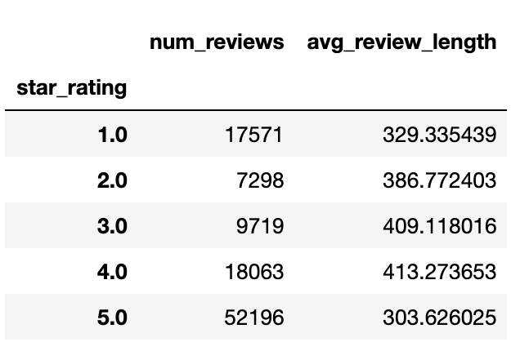
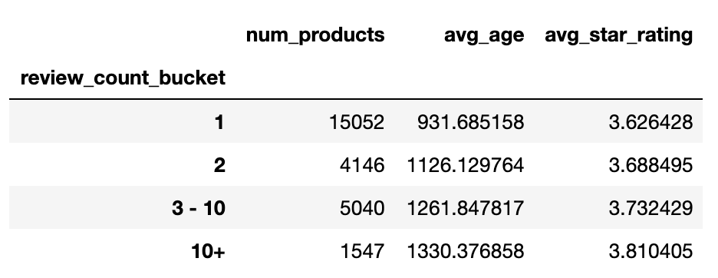
Some SDA on Amazon Mobile Electronics Review Data

Slide 19
Mobile Electronics Next Steps
Word clouds
By star rating
“Positive” vs. “negative” words: give a sentiment score to each word by looking at it’s usage statistics in each star rating
Keyword extraction
By star rating

