Slide 1
Cricket Match Score Prediction
Department of Computer Science and Engineering
Project Title :
Submitted By :
Tushar Kaushik
Roll no. :
1810991421
Submitted To :
Mr. Vivek Bhardwaj

Slide 2

Abstract
Department of Computer Science and Engineering
(Problem statement)
CRICKET SCORE PREDICTION is online platform where prediction system that takes in data of matches played in past and makes a prediction of future match events such as final score and results in a victory or loss. Our system will predict match outcome by analysing pre-stored match data using various machine learning algorithms.
It is easy to use application in which user could add the teams playing, number of overs bowled, runs, wickets, wickets lost in last 5 overs, runs scored in last 5 overs,

Slide 3
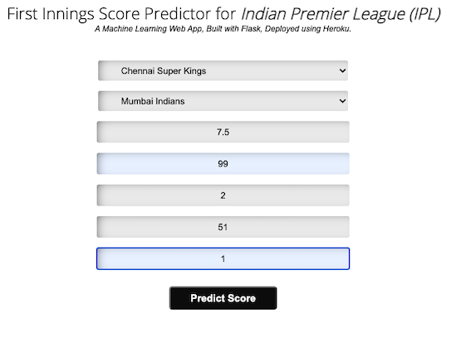
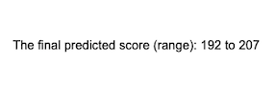
Introduction
Department of Computer Science and Engineering
Testcase 1
Testcase 2
User

Slide 4
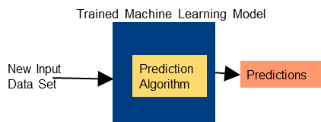
Technology Used
Department of Computer Science and Engineering
Frontend :
HTML, CSS
Backend :
Linear Regression, Lasso
And ridge regression

Slide 5
Steps for building model
Department of Computer Science and Engineering
Data Collection
Data Pre-processing
Model Building
Model Evaluation
Model Deployment to Production

Slide 6

Data Collection
Department of Computer Science and Engineering
Dataset is in the form of rows
and columns and is available on Kaggle. It contains data of all the IPL matches from 2008 2017. It contains columns like venue, date, batsman, bowler, runs, wickets, overs, wickets in last 5 overs, runs in last 5 overs, striker, non striker, and total

Slide 7
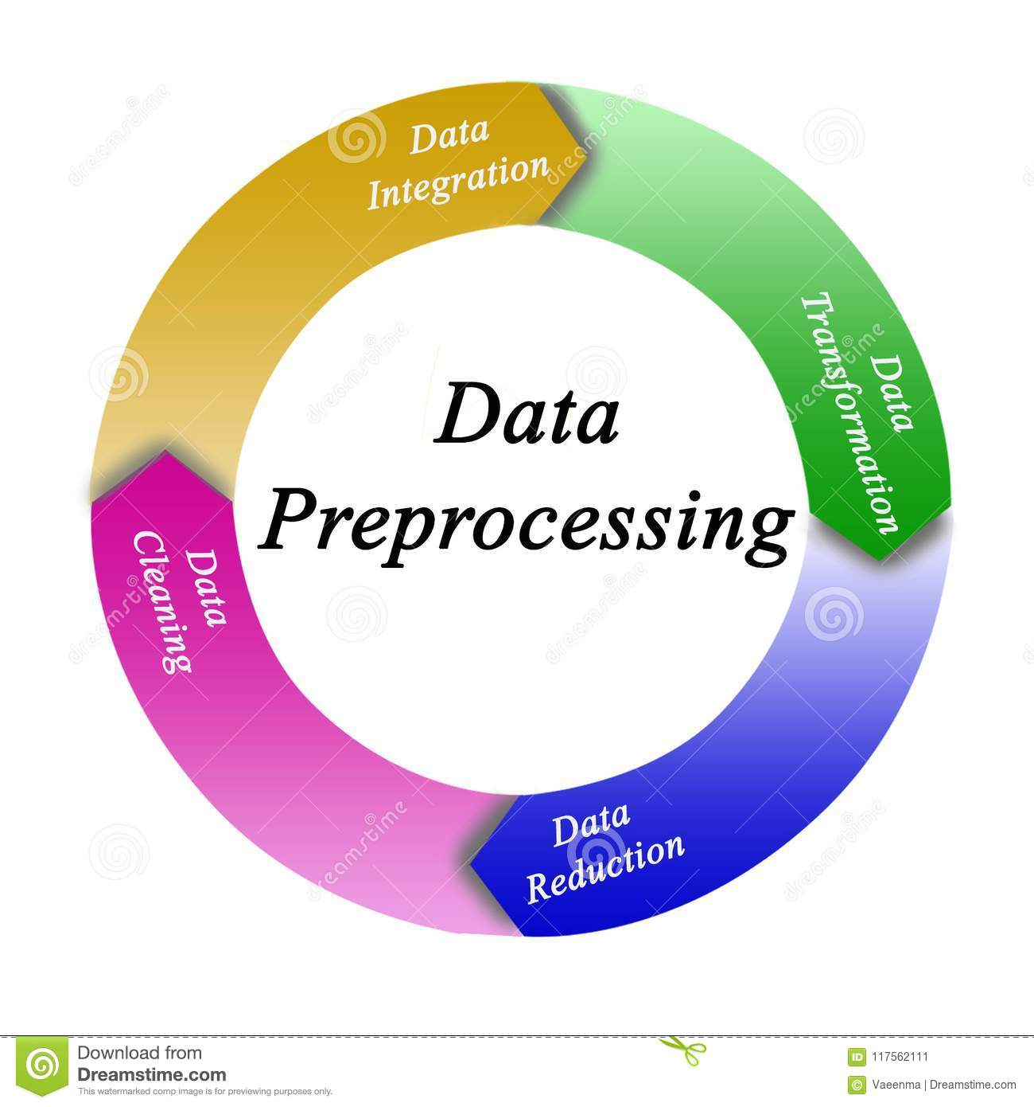
Data Pre-processing
Department of Computer Science and Engineering
Data is loaded using pandas and features like batsman, bowler, runs, wickets, overs, wickets in last 5 overs, runs in last 5 overs, striker, non striker, and total are loaded into a data frame other columns which are not important are deleted

Slide 8
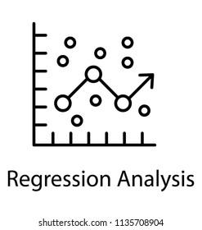
Model Building
Department of Computer Science and Engineering
We want to predict a continuous dependent variable from a number of independent variables. Since the dependent variable is dichotomous, then logistic regression should be used.
We predicted the output using simple Linear Regression, Lasso Regression, and Ridge Regression

Slide 9
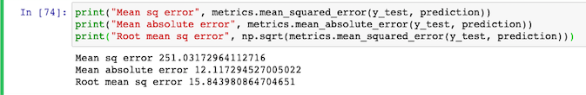
Model Evaluation
Department of Computer Science and Engineering
Accuracy of the model is evaluated using Mean square error,
Mean absolute error, Root mean square error

Slide 10


Model Deployment and Production
Department of Computer Science and Engineering
Made a flask app using the saved model h5 file and then using the ngrok - flask deployed it to production.It uses a generated public address generated by ngrok.

Slide 11
Links
Department of Computer Science and Engineering
https://github.com/TKaushik15/ipl_score_prediction

Slide 12
THANK YOU
Department of Computer Science and Engineering

