Slide 1

GridSense AI
See your power. Spend less.
An energy-intelligence platform for Rwanda — homes · landlords · enterprises
https://gridsense-ai-zeta.vercel.app
Tesi Songa Kelia · BSc Software Engineering · African Leadership University, Kigali
Capstone Defense · June 2026
Notes:
Open with confidence. 'Rwandans just got a more expensive, tiered electricity bill — and almost no way to see it coming. GridSense AI fixes that.' The tagline is the whole thesis.

Slide 2
The problem
You can't manage what you can't see
● Oct 2025: residential power became steeply tiered — 89 → 310 → 369 RWF/kWh. Average tariff up ~15%.
● Households pay via prepaid "cash power" — they see a falling balance, not which appliance drains it.
● No warning when a home crosses from a cheap tier into an expensive one.
89 RWF
310 RWF
369 RWF
0–20 kWh 20–50 kWh above 50 kWh
Creep from 20 → 21 kWh and the marginal unit costs 3.5× more — with zero visibility into why.
Source: 01-research §1 — REG tariffs, RURA press release
gridsense-ai-zeta.vercel.app
Notes:
Make them feel it. The tiered cliff is the pain. A home creeping one kWh over a threshold pays 3.5x more on the marginal unit and has no idea. This invisibility is what we sell against.

Slide 3
The insight that reshaped our strategy
We confront the brutal truth instead of hiding it
● ~50% of connected homes use ≤ 20 kWh/month (the 89 RWF lifeline). A 20% saving there ≈ 356 RWF (~$0.25)/mo. No one buys a device for that.
● The money — and willingness to pay — is with homes, landlords & SMEs that cross into the 310 & 369 RWF tiers.
● So we don't target "every household." We target the tier-crossers.
Source: 01-research §3; 02-strategy §A, §D1
gridsense-ai-zeta.vercel.app
Notes:
This is the rigor slide that wins points. We confronted the weakness (half of homes can't save meaningfully) and it reshaped targeting. Pre-empts the panel's #1 question: who actually pays, and does the math work?

Slide 4
The solution
● A low-cost kit: whole-home CT clamp + ESP32 (Wi-Fi) for real-time total use & live RWF cost, plus energy-metering smart plugs for the biggest appliances.
● A simple web app + tariff-aware AI: live cost, bill forecast, tier-cliff alerts, and specific savings advice.
● Localized: RWF, Rwanda's real tiers, Kinyarwanda-ready.
Source: DIRECTION.md; 02-strategy §D2
gridsense-ai-zeta.vercel.app
Notes:
Cheap, safe, self-installable. CT = whole-home picture; plugs = 'which appliance?'. The intelligence is the localization and the tariff-aware AI, not exotic hardware.

Slide 5
One platform — three customers
Same verified tariff engine powers all three
● Home (free): a household sees its own live cost, tier-cliff alerts & personalized savings.
● Landlord / Property: manage many units & tenants — exact per-tenant bills, invoices, reminders, get paid on time.
● Enterprise: hotels & large compounds — many properties, teams, exports, connected devices.
Live: choose a workspace after sign-in · 05-build (workspace.tsx)
gridsense-ai-zeta.vercel.app
Notes:
GridSense isn't just a home gadget — it's a platform. After sign-in you pick a workspace. The same exact tariff engine serves a single home, a landlord with many tenants, and an enterprise. Landlords are the clearest paying wedge.

Slide 6
Landlords: bill fairly, get paid on time
The feature that ends "I don't know how I'm charged"
● Add properties → units → tenants (name, phone, email) + meter readings.
● Exact amount due per tenant from the real tariff — with billing period and due date.
● One tap: Invoice / Receipt / Consumption Report (printable) → send via WhatsApp / SMS / email.
● Payment reminders as a calendar (.ics): 5 / 3 / 2 / 1 days before, the morning of, and 12:00 on the due day.
● Transparent, itemized charges that respect tenant privacy (Law 058/2021).
Live: Properties workspace · 05-build (landlord.tsx, Documents.tsx, billing.ts)
gridsense-ai-zeta.vercel.app
Notes:
This is the monetizable headline. Tenants constantly dispute power charges; GridSense shows the exact math, generates the invoice, sends it, and schedules the reminders. One buyer (the landlord), many meters, recurring value.

Slide 7
Plans & pricing
Individuals free for adoption; landlords & enterprise pay
Plan | Price (indicative) | For
Home | Free | A single household
Landlord — Starter | ~RWF 9,900/mo (≤5 units) | Small landlords
Landlord — Growth | ~RWF 29,000/mo (≤20 units) | Growing portfolios
Enterprise | from ~RWF 150,000/mo | Hotels, estates, teams
Device add-on | kit 40,100–69,100 + ~2,500/device/mo | Automatic live data
Premium checkout + cart are live; demo mode charges no card and is payment-provider-ready (MTN MoMo / Flutterwave / Stripe).
Indicative pricing — 02-strategy/platform-expansion.md §E
gridsense-ai-zeta.vercel.app
Notes:
Pricing is indicative and labelled as such. Home is free to drive adoption and data; revenue comes from landlords and enterprise plus the device add-on. Checkout is a real premium flow but charges nothing in demo — integration-ready, never faked.

Slide 8
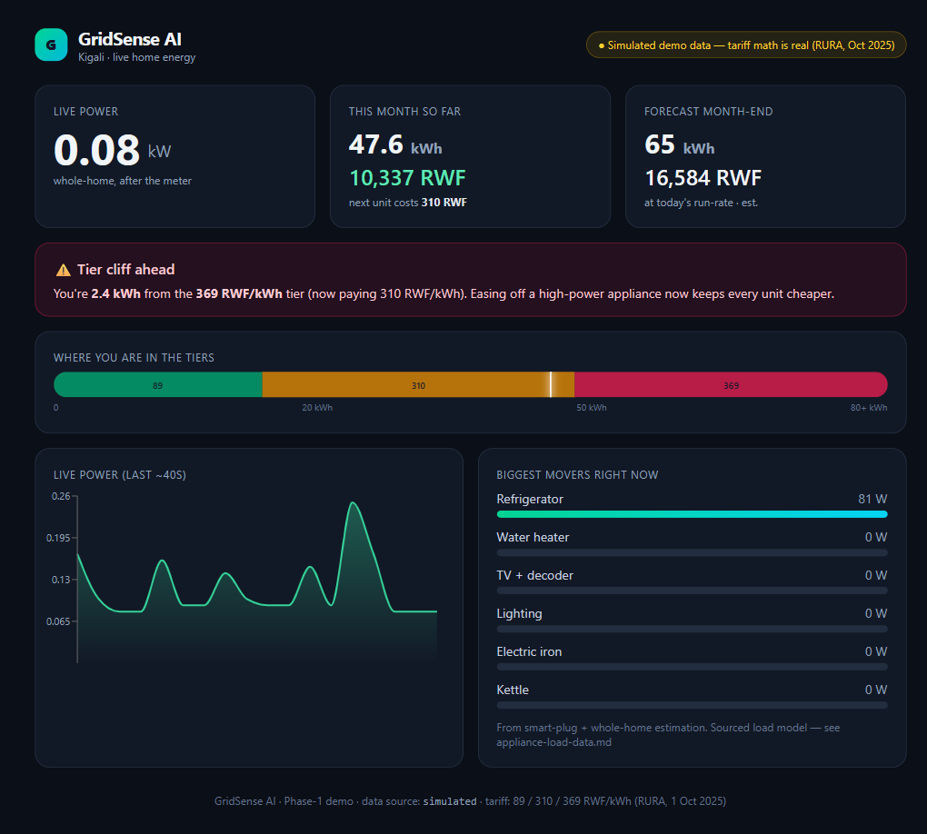
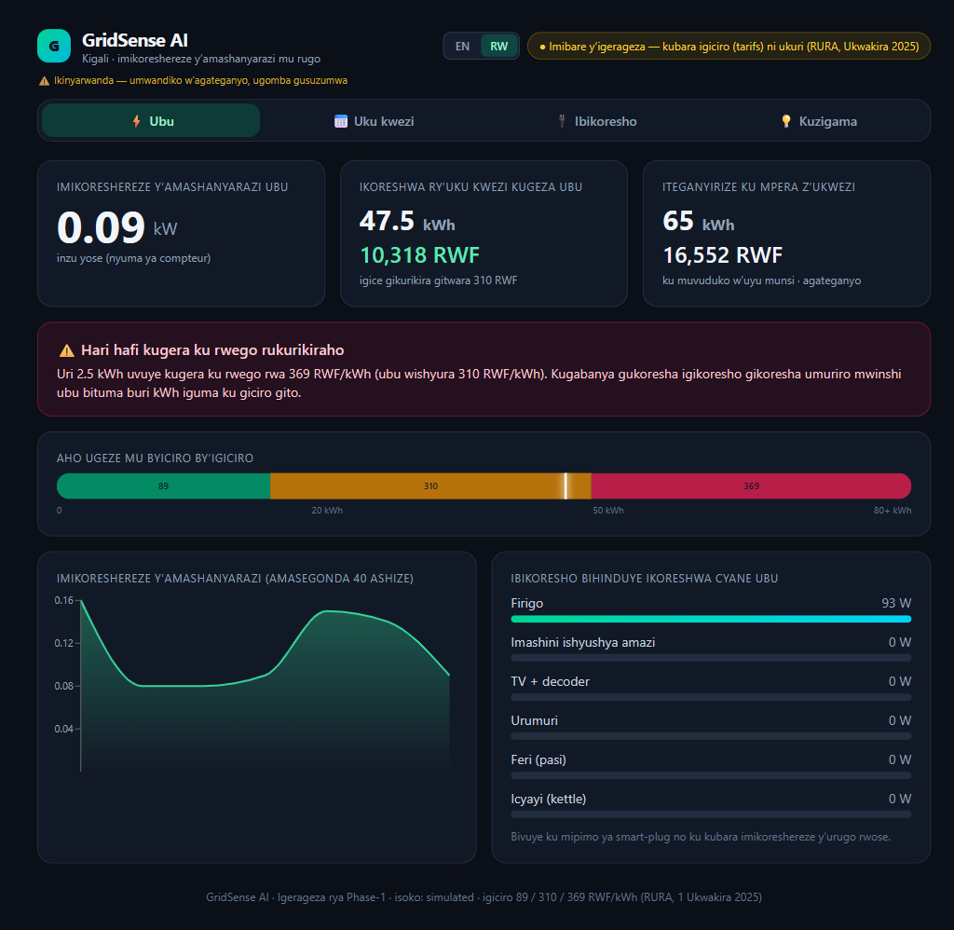
Live demo
English & Kinyarwanda — same app, one toggle
4 screens — Live Now · This Month · Appliances · Save. Sensor data is simulated & labelled; the tariff math is real.
Built & tested: 9 unit + 5 e2e tests · Lighthouse 100/100/100/100 · 05-build/
gridsense-ai-zeta.vercel.app
Notes:
DO THE LIVE DEMO HERE — open the Vercel URL. Walk Live Now, trigger the tier-cliff alert, show This Month forecast, Appliances, Save. SWITCH TO KINYARWANDA LIVE — it lands. Say out loud: 'sensor data is simulated and labelled; the tariff math and appliance model are real and sourced.' Honesty is a strength.

Slide 9
Is the "AI" real? — told honestly
● Now: tariff-aware analytics (kWh → live RWF across real tiers) + rule-based recommendations + run-rate forecasting.
● Next: ML bill forecasting + anomaly detection ("your fridge is drawing 30% more than usual").
● Later: appliance disaggregation (NILM) as data grows.
● We never claim NILM we haven't built.
Source: 02-strategy §D3 — visible in the Save screen + roadmap
gridsense-ai-zeta.vercel.app
Notes:
Pre-empts 'is the AI real?'. Honest scoping is a defense, not a weakness. A panel respects a clear roadmap over an over-claim it can puncture.

Slide 10
How it works — and why it's buildable
● Non-invasive CT clamp on the main feed; ESP32 reads current and uploads over Wi-Fi.
● Built on proven open-source designs (ESP32 + SCT-013 + EmonLib; CircuitSetup).
Sensors
CT clamp + smart plugs
ESP32
reads current · Wi-Fi
Cloud
/api/ingest (JSON)
Dashboard
+ tariff-aware AI
The simulated demo emits the same JSON contract — real hardware swaps in with a one-line change.
Source: 01-research §5; 05-build/dashboard-build-plan.md, src/lib/types.ts
gridsense-ai-zeta.vercel.app
Notes:
Pre-empts 'did you really build hardware?'. Hardware is off-the-shelf and proven; our innovation is localization + tariff-aware AI + GTM. The real ingestion contract makes the demo a genuine product slice, not a mockup.

Slide 11
Feasibility & cost — sourced, in RWF
Component | Local price (RWF) | Source
ESP32 dev board | 15,500 | SoftTech Supply (Kigali)
SCT-013-100 CT clamp | 12,000 | SoftTech Supply
Metering smart plug | 14,500 | SoftTech Supply
PSU + wiring | 7,600 | SoftTech Supply
Whole-home monitor (entry SKU) | ~40,100 (~$27) | core unit
Full kit (+2 plugs) | ~69,100 (~$47) | 1 USD ≈ 1,464 RWF
Source: 04-business/capex-opex.md §1 — priced from live Kigali retailers (taxes embedded)
gridsense-ai-zeta.vercel.app
Notes:
We priced locally in RWF, not off a foreign catalogue — the most defensible, conservative basis (bulk import would be cheaper). 93% of the kit is live-sourced; the small remainder is flagged.

Slide 12
Unit economics & payback — the math is real
Verified tiers → a 100 kWh home pays 29,530 RWF/month. Payback = kit cost ÷ monthly RWF saved.
● Core monitor: ~9 months @ 15% savings.
● Heavy users (200 kWh): ~6 months @ 10%.
● < 12 months for tier-crossers ✓
● Shown as a range — we don't fake one number.
Source: 04-business/capex-opex.md §4 — tariff engine unit-tested in 05-build
gridsense-ai-zeta.vercel.app
Notes:
Bills computed straight from the verified RURA tiers (tested in code: 100→29,530, 150→47,980, 200→66,430). Payback under 12 months for tier-crossers proves the beachhead economically. The savings % is a labelled assumption — see Risks.

Slide 13
Market & beachhead
● 1.946M households on the grid; 84.6% national electricity access.
● Beachhead = tier-crossing urban homes + landlords/compounds + SMEs — they cross 310/369, own appliances, have Wi-Fi + smartphones, and feel the hike.
● Mass-market & lifeline homes = a later social-impact tier (grant-funded), not the paying entry.
Source: 01-research §2–3; 02-strategy §D1
gridsense-ai-zeta.vercel.app
Notes:
Landlords are arguably the best wedge — one buyer, many meters, a billing-dispute pain point. SMEs have a clear ROI line. Mass-market is impact, not the paying entry.

Slide 14
Competition & our moat
● Sense (~$300, US, ML) · Emporia Vue · IoTaWatt (DIY) · Bidgely (utility B2B).
● None is localized: no RWF-tier logic, no Kinyarwanda, not Rwanda-priced or -serviced.
● Moat = localization + tariff-aware AI + go-to-market, at a Rwandan price.
Source: 01-research §4
gridsense-ai-zeta.vercel.app
Notes:
Strong tech exists — we don't pretend to out-engineer Sense. We win on the wedge they ignore: a tariff-aware, Kinyarwanda, affordably-serviced product for Rwanda.

Slide 15
Regulation & compliance — a credibility asset
● Behind-the-meter, non-invasive — no utility permit to clip a CT on your own wiring; we never touch the REG/EUCL meter.
● Board-side install by a licensed electrician (REG/RURA requirement); smart plugs are plug-and-play.
● Data: compliant with Law 058/2021; register with NCSA; consent + encryption + data minimization.
Source: 01-research §6 — RURA, REG, RwandaLII (verified, not assumed)
gridsense-ai-zeta.vercel.app
Notes:
Pre-empts 'will it mess with the meter?' and 'what about privacy?'. We verified the rule rather than assuming, and built compliance in from day one.

Slide 16
Go-to-market & funding — the lean ladder
● $0 to win the capstone (free cloud, open-source, ALU resources). Funding is for scaling.
● Ladder: demo → Hanga PitchFest (50M RWF; RDB+MINICT+UNDP) → 3–5 kits + 1 pilot → larger grants (FEC 2026, Youth4Climate $30k, ClimaFii $70k, EEP Africa €200–500k) → production.
● Channel: direct + landlord/SME partnerships + possible REG partnership.
Source: 04-business/fundraising-plan.md
gridsense-ai-zeta.vercel.app
Notes:
Each rung needs only the proof from the one below — never a big upfront ask. Hanga is the #1 target (2026 call not yet published — we're prototype-ready and watching).

Slide 17
Roadmap
● Phase 1 (now): whole-home CT + ESP32 (Wi-Fi) + plugs; tariff-aware analytics, alerts, rules; web app. (demoed today)
● Phase 2: multi-circuit "by-area" CT in the board (partner electrician); GSM option; landlord sub-metering.
● Phase 3: ML forecasting → anomaly detection → NILM disaggregation.
Source: DIRECTION.md; 02-strategy §D2
gridsense-ai-zeta.vercel.app
Notes:
Clear, staged, honest. Each phase unlocks the next as data and funding grow.

Slide 18
Risks & honest mitigations
Risk | Mitigation
Savings % is an assumption (we show a 5–20% range) | Pilot will measure it; cite behavioral-feedback literature
Hardware funding (~$27–47 / kit) | $0 capstone path; bench PoC if free parts; Hanga/grants to scale
Wi-Fi penetration in target homes | Beachhead chosen for Wi-Fi/smartphone ownership; GSM in Phase 2
Hanga 2026 dates unconfirmed | Monitoring official channels; prototype-ready now
Source: open questions in PROJECT-REPORT.md, 01-research, 04-business
gridsense-ai-zeta.vercel.app
Notes:
Showing the gaps WITH mitigations beats pretending there are none. This is the slide that earns trust. Be calm and direct here.

Slide 19
Impact & the ask
● Impact: energy literacy, lower bills, less waste, reduced peak demand, climate — real and fundable.
● The ask: capstone validation · a first pilot home/landlord · a path into Hanga PitchFest.
GridSense AI — see your power, spend less.
Thank you — questions welcome (Q&A defense rehearsed)
gridsense-ai-zeta.vercel.app
Notes:
Close on the mission and a concrete ask — Tesi's strength. Land it with conviction. Thank the panel; invite questions. You're ready (appendix).

Slide 20
Appendix — Q&A defense
Rehearse these cold
If they ask… | Answer
Who actually pays? | Tier-crossers: urban homes, landlords, SMEs. Economics on slides 3, 9, 10.
Sense/Emporia exist. | None localized / RWF-tier-aware / Kinyarwanda / Rwanda-priced (11).
Is the AI real? | Tariff-aware + rules now; ML next; NILM later — no over-claim (6).
Did you build hardware? | Proven off-the-shelf; real ingestion contract; live demo (5, 7).
Will it touch the meter? | No — behind-the-meter, non-invasive; licensed electrician for board (12).
Privacy? | Law 058/2021; NCSA registration; consent + encryption (12).
How do you make money? | Device sale + optional subscription; landlord/SME tiers (13).
Where did the numbers come from? | Live Kigali retailers (RWF) + verified RURA tiers; savings as a range (8, 9).
Full attack list: 02-strategy §E · sources in 01-research, 04-business
gridsense-ai-zeta.vercel.app
Notes:
Don't show this unless asked — it's your cheat sheet. Each answer maps to a slide you can jump to.

