Slide 1

SA Reverse Engineering
Advisor Meeting
Meeting 17.11.2022

Slide 2
Deliverables
Advisor
Migrate Lab 1-3 to demo tenant
Pwntools lab docker
Students
Fix pwntools lab -> Problem with running it
Introductions for IDA Freeware, GDB and x64dbg
Test the new labs

Slide 3
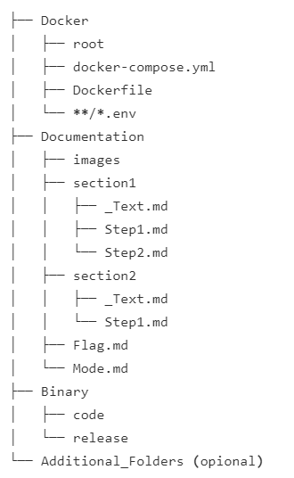
Decisions from Sprint Meeting
Create a naming convention for the Labs

Slide 4
Tool Introductions
IDA Freeware
GDB
Question: Example needed?
x64dbg

Slide 5
Documentation
Claudia Furrer Mail → Structure for SA / BA

Slide 6
Topic | Description
Intro: IDA Freeware | Introduction to IDA Freeware, its GUI and tools
Intro: GDB | Introduction to GDB and its commands
Intro: x64dbg | Introduction to x64dbg, its GUI and tools
(Refresher) | Refreshing Knowledge of previous modules and lectures
Introduction into RE #1 | Introducing the different tools to the student
Introduction into RE #2 | Static analysis of a given Program
Introduction into RE #3 | Dynamic analysis of a given Program
First RE attempts | Given simple files compiled in several languages (py, c#, c++…) get flag
Client Server Application | Using Docker to give students a downloadable file with changing flag
Pwntools | Find Vulnerability and exploit with pwntools
First keygen | Not only finding out the password but writing a keygen for the program
Harder CrackMes | Introduce new native API funcs / techniques like stack strings
Injection techniques | Explain some injection techniques
Dump memory | Explain how to dump memory off a given executable which uses a previously explained injection technique
“Anti”- Techniques | Introduce “Anti”- Techniques and provide program for students to bypass

