Slide 1

SA Reverse Engineering
Lab concepts etc.
Meeting 20.10.2022

Slide 2
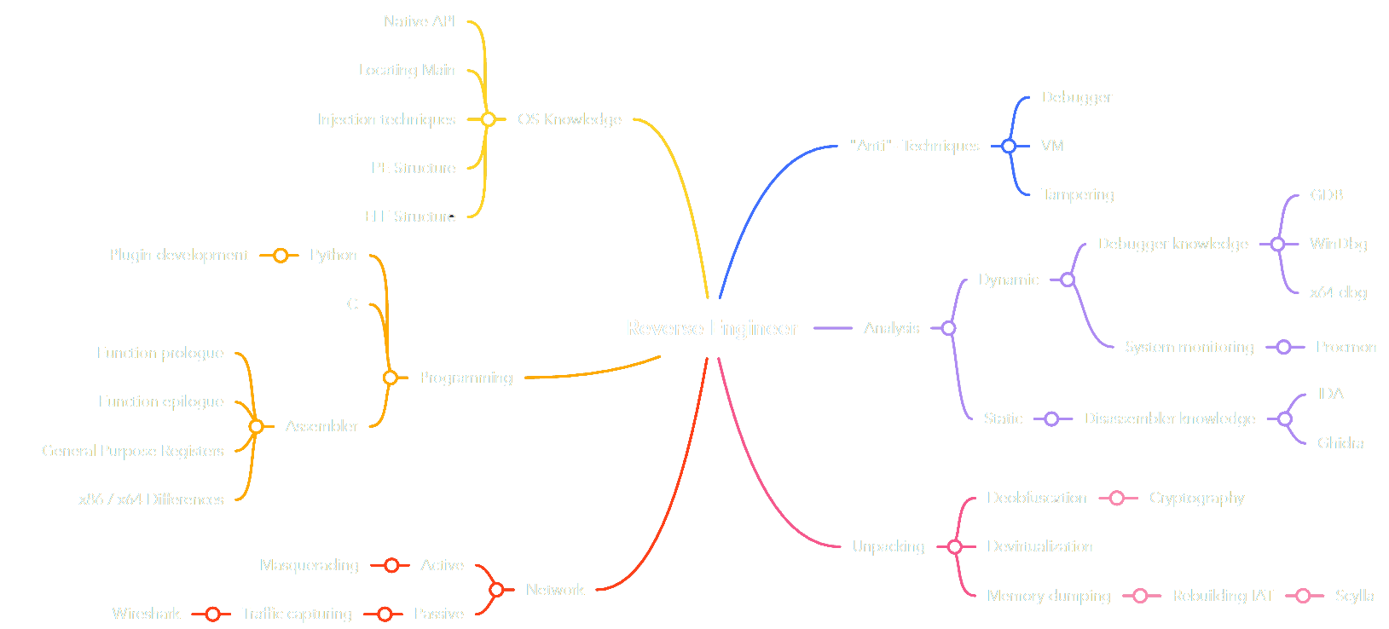
Problem Domain

Slide 3
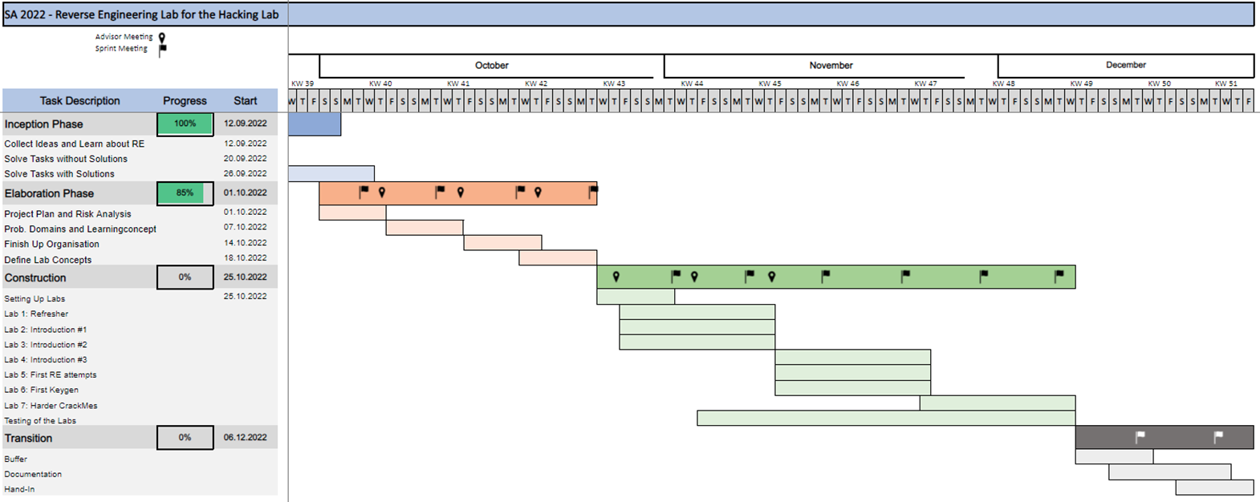
GANTT Diagram #1

Slide 4
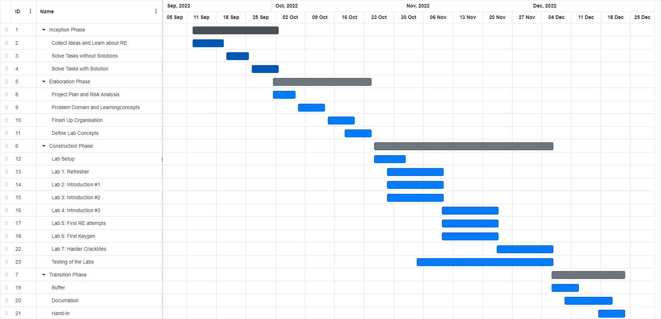
GANTT Diagram #2

Slide 5
Lab concept: Refresher
Students get:
Information about different subjects regarding ASM
Exercises for the different subjects
Students hand in:
Multiple Choice Answer Sheet or Write Up

Slide 6
Lab concept: Intro #1
Students get:
Description of Static / Dynamic Analysis
List with Programs used and what their Usage is
Download Links to the programs
Students hand in:
Multiple Choice Questions
Hints:
External Resources

Slide 7
Lab concept: Intro #2
Students get:
2 Programs with same Code but one with Symbols one without
Simple: if(input == “SecretKey”)
Students hand in:
Combined Flag from both Programs
Hints:
Finding Main Guide
Explanation Symbols

Slide 8
Lab concept: Intro #3
Students get:
A file like the one before but the key gets encrypted with simple XOR.
Basic writeup on GDB and x64dbg (showcase on how to solve the prev. exercise without entering the right key.)
Students hand in:
Key of newly given file
Hints:
Recap on what XOR does
Recap on how to find Main function
Show which function the decryption happens in

Slide 9
Further concepts
Topic | Description
(Refresher) | Prev slides.
Introduction into RE #1 | Prev slides.
Introduction into RE #2 | Prev slides.
Introduction into RE #3 | Prev slides.
First RE attempts | Given simple files compiled in several languages (py, c#, c++…) get flag
First keygen | Not only finding out the password but writing a keygen for the program
Harder CrackMes | Introduce new native API funcs / techniques like stack strings
Injection techniques | Explain some injection techniques
Dump memory | Explain how to dump memory off a given executable which uses a previously explained injection technique
“Anti”- Techniques | Introduce “Anti”- Techniques and provide program for students to bypass

