Slide 1

SA-Reverse Engineering
Advisor Meeting 25.11.2022
Construction Phase

Slide 2
Agenda
Deliverables
GANTT
Challenges:
Pwntools Challenge
Cryptographic Challenge
Assembly Refresher Challenge
Concepts:
Patching
Pwntools Iter
Testing

Slide 3
Deliverables
Students
Testing Labs / Feedback implementing
GANTT-Diagram Update
Assembly Refresher Challenge
Concept of last Challenge
Advisor
-

Slide 4
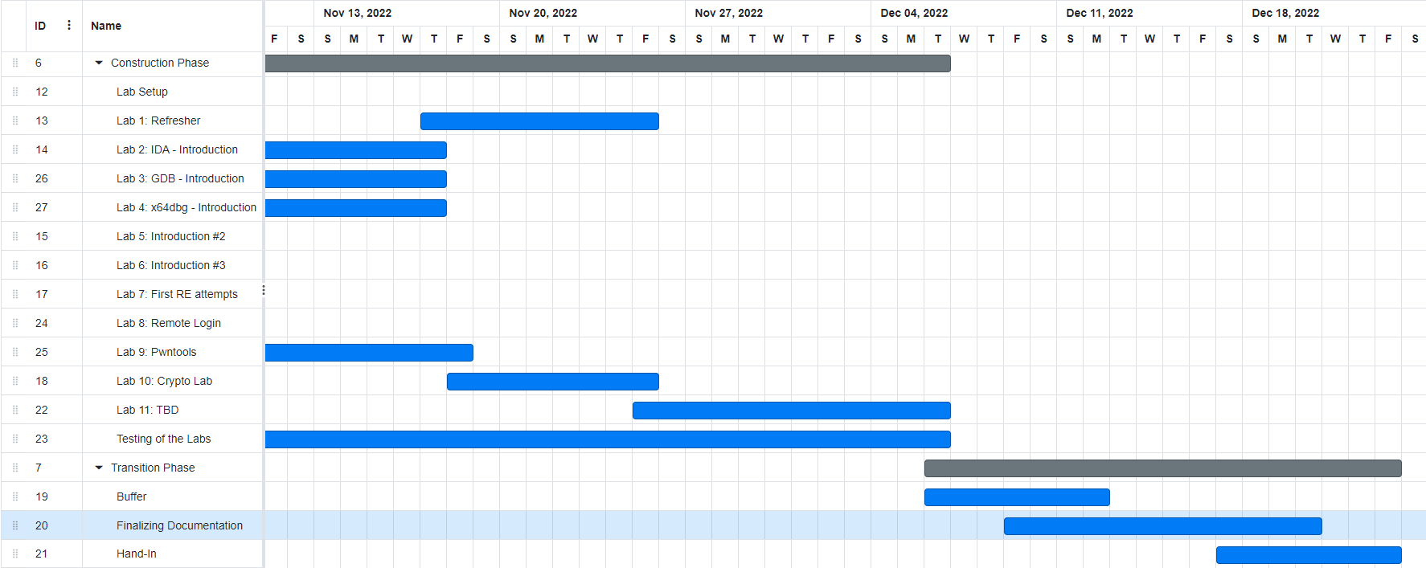
GANTT

Slide 5
Pwntools Challenge
Walkthrough
Find Vulnerability → Exploit it with pwntools
Local or Remote

Slide 6
Cryptographic Challenge
Walkthrough
AES-ECB Mode
Remote
Idea: Learn about unsecure Cryptography

Slide 7
Assembly Refresher Challenge
Create „Hello World“
Help with Step By Step Instructions
Find and Use Exit function
Idea: Repeat assembly basics

Slide 8
Patching Challenge Concepts
In Function a
if(false) printFlag();
Patch it and Upload it and then access with socat to read Flag.
Idea: Simple Introduction to patching and that it changes the programs behavior.

Slide 9
Pwntools Iter Concepts
Insecure Private Key Cryptography

Slide 10
Testing
Multiple participants
Internal Testing of each Lab

Slide 11
Further Plan

