Slide 1


SA Reverse Engineering
Lab 3 and 4 POC
Meeting 27.10.2022

Slide 2



Deliverables for this meeting
Students: - Add Exploitation to Mind-Map - Update GANTT-Chart - POC for Lab 2 and 3
Advisor: - Sample Courses for RE - Upload and Unlock ECSC Hacking-Lab Examples

Slide 3
Decisions from Sprint Meeting
- Show students multiple tools in the starting labs
Decide on the solution tools to have uniformity
VM or local? → We hand out the programs, but the OS and way is for students to decide

Slide 4
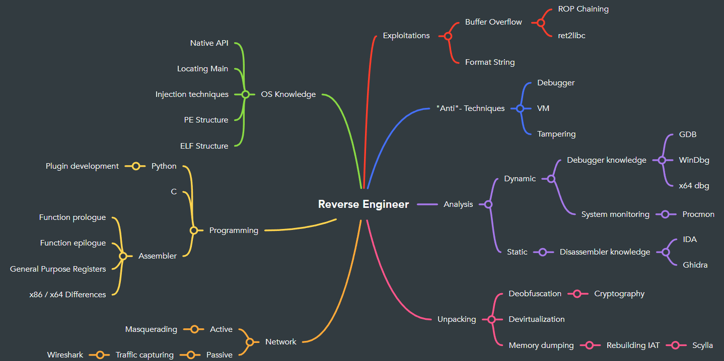
Updated Mind-Map

Slide 5
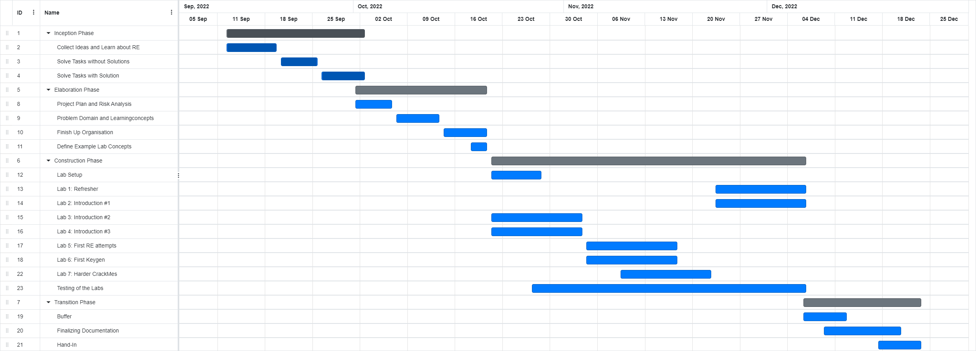
Updated GANTT-Chart

Slide 6
POC Lab 3: Introduction #2
Students get:
2 Programs with same Code but one with Symbols one without
Simple: if(input == “SecretKey”)
Students hand in:
Combined Flag from both Programs
Hints:
Finding Main Guide
Explanation Symbols

Slide 7
POC Lab 4: Introduction #3
Students get:
A file like the one before but the key gets encrypted with simple XOR.
Basic writeup on GDB and x64dbg (showcase on how to solve the prev. exercise without entering the right key.)
Students hand in:
Key of newly given file
Hints:
Recap on what XOR does
Recap on how to find Main function
Show which function the decryption happens in

Slide 8
Topic | Description
(Refresher) | Refreshing Knowledge of previous modules and lectures
Introduction into RE #1 | Introducing the different tools to the student
Introduction into RE #2 | Static analysis of a given Program
Introduction into RE #3 | Dynamic analysis of a given Program
First RE attempts | Given simple files compiled in several languages (py, c#, c++…) get flag
First keygen | Not only finding out the password but writing a keygen for the program
Harder CrackMes | Introduce new native API funcs / techniques like stack strings
Injection techniques | Explain some injection techniques
Dump memory | Explain how to dump memory off a given executable which uses a previously explained injection technique
“Anti”- Techniques | Introduce “Anti”- Techniques and provide program for students to bypass

