Slide 1

SA-Reverse Engineering
Advisor Meeting 25.11.2022
Construction Phase

Slide 2
Agenda
Deliverables
GANTT
Challenges:
Pwntools Challenge
Cryptographic Challenge
Assembly Refresher Challenge
Testing
Concepts:
Patching
Pwntools Iter

Slide 3
Deliverables
Students
Testing Labs / Feedback implementing
GANTT-Diagram Update
Assembly Refresher Challenge
Concept of last Challenge
Advisor
Change Challenge Modes

Slide 4
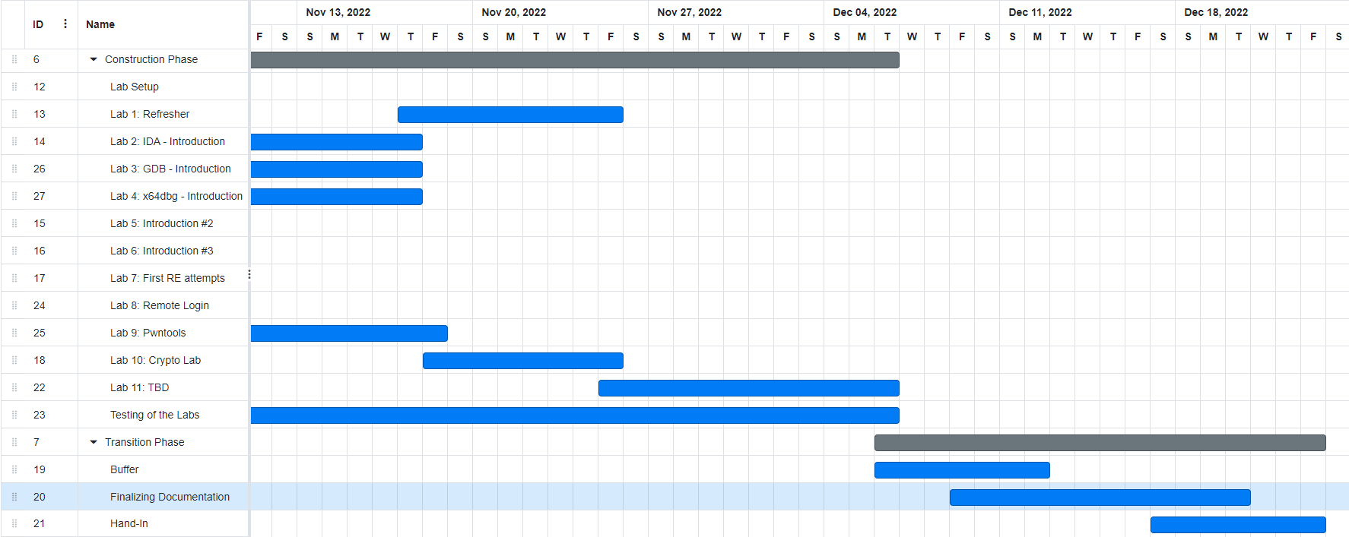
GANTT

Slide 5
Pwntools Challenge
Walkthrough
Find Vulnerability → Exploit it with pwntools
Local or Remote

Slide 6
Cryptographic Challenge
Walkthrough
AES-ECB Mode
Remote
Idea: Learn about unsecure Cryptography

Slide 7
Assembly Refresher Challenge
Create „Hello World“ with the Help of John Hammond
Write Follow-Up Program
Count from 1 to 9

Slide 8
Testing
Multiple participants
Internal Testing of each Lab

Slide 9
Patching Challenge Concepts
In Print Flag Function a
if(false) printFlag();
Patch it and Upload it and then access with socat to read Flag.
Idea: Simple Introduction to patching and that it changes the programs behavior.

Slide 10
Pwntools Iter Concepts

Slide 11
Further Plan

