Slide 1

Reverse Engineering
Problem domain, Learning Concepts

Slide 2
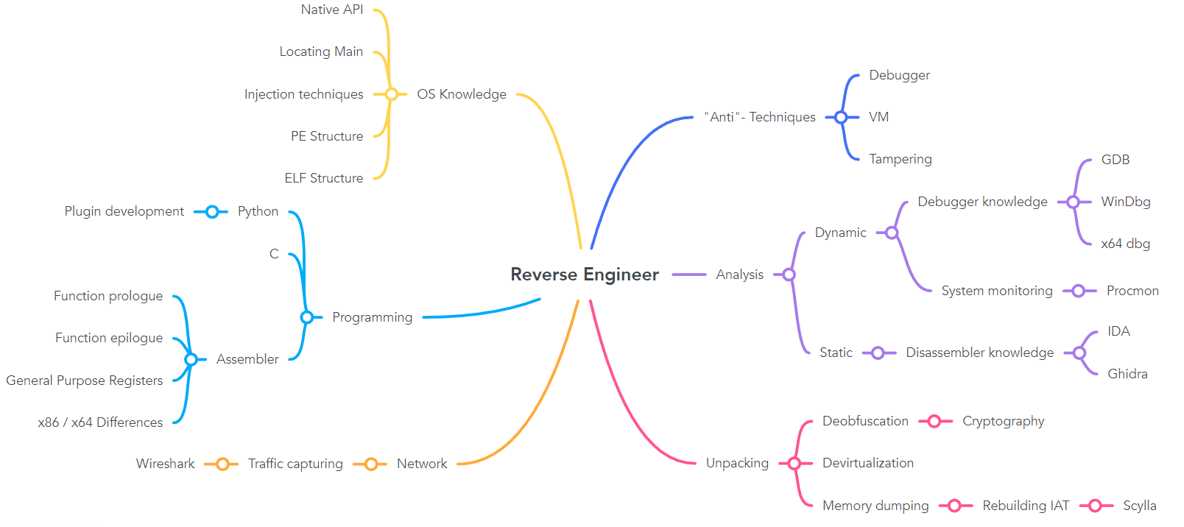
Problem Domain

Slide 3
Learning concepts
Precondition
Assembler (Bsys)
C (Bsys)
Python (OOP)
Fundamental knowledge
Analysis
Programming
OS Knowledge
Nice to have
«Anti»-Techniques
Unpacking
Network

Slide 4
Learning concepts
Topic | Description
(Refresher) | Give the students some little refreshing on the key topics (Assembly)
Introduction into RE #1 | Explain analysis approaches (Dynamic / Static) and install tools
Introduction into RE #2 | Given a simple C file, students compile it and try to find a key (Static) (Find Main function)
Introduction into RE #3 | Given a simple C file, students compile it and try to find a key (Dynamic) (learn GDB / x64)
First RE attempts | Given simple files compiled in several languages (py, c#, c++…) get flag
First keygen | Not only finding out the password but writing a keygen for the program
Harder CrackMes | Introduce new native API funcs / techniques like stack strings
Injection techniques | Explain some injection techniques
Dump memory | Explain how to dump memory off a given executable which uses a previously explained injection technique
“Anti”- Techniques | Introduce “Anti”- Techniques and provide program for students to bypass
… | …

