Slide 1
Bachelor thesis presentation
Model-based investigation and experimental validation of evaporator interconnections for thermal performance enhancement for use in refrigerated display cabinets

Slide 2
Bachelor thesis presentation
Model-based investigation and experimental validation of evaporator interconnections for thermal performance enhancement for use in refrigerated display cabinets

Slide 3
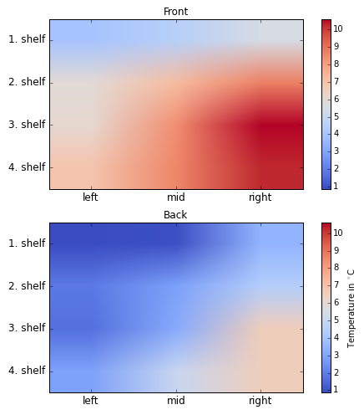
Integrated display cabinet
Problems:
Product temperature between -1°C and 5°C can not be achieved
Refrigerant capacity of 150g propane per circuit is too low
Bad air distribution
Necessary Enhancements:
Increase cooling capacity
Reduce refrigerant capacity
Improve air distribution
Problems:
Necessary Enhancements:

Slide 4
Integrated display cabinet
Problems:
Product temperature between -1°C and 5°C can not be achieved
Refrigerant capacity of 150g propane per circuit is too low
Bad air distribution
Necessary Enhancements:
Increase cooling capacity
Reduce refrigerant capacity
Improve air distribution
Problems:
Necessary Enhancements:

Slide 5
Investigations on the IDC150
Oil filling: 3MAF vs HATCOL 4467
Refrigerant solved in oil?
Bad oil return?
Defrost intervals: 4h vs demand defrost
When is the best time to defrost?
Compressors: ZB09KAU-TFD – Hybrid (aluminium) vs Standard (copper)
Which compressor provides better cooling capacity?
Evaporator: AHT vs LIDL V1 vs LIDL V2
2 rowed AHT-evap → 4 rowed LIDL-evap
Modification of the coil arrangement
Building and validation of a simulation model to evaluate the new coil arrangement

Slide 6

Cooling circuits

Slide 7
Oil filling: 3MAF vs HATCOL 4467
Problems:
Refrigerant solved in oil?
Calculation of the solubility of both oils
Loss of cooling capacity?
Oil trapped in condenser and evaporator?
Using a flushing device to check for remaining oil
Problems:

Slide 8
Oil filling: 3MAF vs HATCOL 4467
Properties | 10% Oil in Evaporator | 80% Oil in Compressor | 10% Oil in Condenser
Viscosity (cSt) | 3.72 | 38.66 | 0.89
Density (g/cm³) | 0.79 | 0.94 | 0.73
Solubility (%) | 35.4 % | 5.0 % | 37.1 %
Refrigerant in oil (g) | 13.09 | 17.55 | 12.79
Refrigerant in oil (%) | 8.7 % | 11.7 % | 8.5 %
Viscosity (cSt) | 1.95 | 17.73 | 0.87
Density (g/cm³) | 0.75 | 0.93 | 0.70
Solubility (%) | 41.0 % | 5.2 % | 41.6 %
Refrigerant in oil (g) | 14.53 | 18.07 | 13.80
Refrigerant in oil (%) | 9.7 % | 12.0 % | 9.2 %
DF Qty of refrigerant 3MAF VS HATCOL 4467 (g) | 1.45 | 0.52 | 1.01
HATCOL 4467
3MAF

Slide 9
Oil filling: 3MAF vs HATCOL 4467
 | 3MAF | HATCOL 4467
el. Leistung Verdichter [W] | 2436 | 2542
Leistung Verdampfer [W] | 5383 | 5442
Leistung Kondensator [W] | 7589 | 7882
EER | 2.21 | 2.14

Slide 10
Oil filling: 3MAF vs HATCOL 4467
Problems:
Problems:
Refrigerant solved in oil?
Calculation of the solubility of both oils
Loss of cooling capacity
Oil trapped in condenser and evaporator?
Using a flushing device to check for remaining oil
Results:
The solubility of refrigerant in 3MAF is higher than in HATCOL 4467
More refrigerant is solved in 3MAF
No remaining oil in heat exchangers!
HATCOL 4467 provides better cooling capacity for the cost of a worse
efficiency
Results:

