Slide 1
EE 445L – Embedded System Design Lab
Sound Generation
Music
For more information read sections 8.4, 9.2.2

Slide 2
Audio
Frequency defines pitch
Humans hearing ~ 25 - 20,000 Hz
most sensitive to sounds in the 1 – 5 kHz range
Sound intensity level
L_{I} = 10log₁₀|I|/I₀; I₀ = 10⁻¹² Watt/m²
A whisper = 15 dB
Normal conversation = 60 dB
A lawnmower = 90 dB
A car horn = 110 dB
A rock concert or a jet engine = 120 dB
A gunshot or firecracker = 140 dB

Slide 3
Music
a Note has five parameters
Amplitude (loudness)
Frequency (pitch)
Voice (shape)
Envelope (time varying shape)
Duration
middle A is 440 Hz
relation of frequency of other notes:
Note frequency = 440 *2^{N/12}Hz
where "N" is number of notes up or down from middle A
middle C is 261.6 Hz
music contains multiple harmonics

Slide 4
Music
music contains multiple harmonics

Slide 5
Sine wave generation
Timer ISR
Output one value to DAC
Tone generated from 256 discrete 12-bit outputs
SNR = 20log₁₀(signal/noise)
Signal and noise measured in volts, SNR in dB
5 bits is 20log₁₀(32) = 30 dB
8 bits is 20log₁₀(256) = 48 dB
10 bits is 20log₁₀(1024) = 60 dB
12 bits is 20log₁₀(4096) = 72 dB
Number of bits
DAC precision
Buffer size

Slide 6
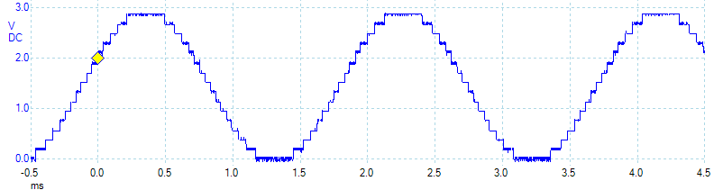
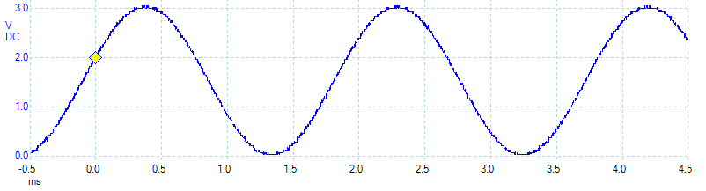
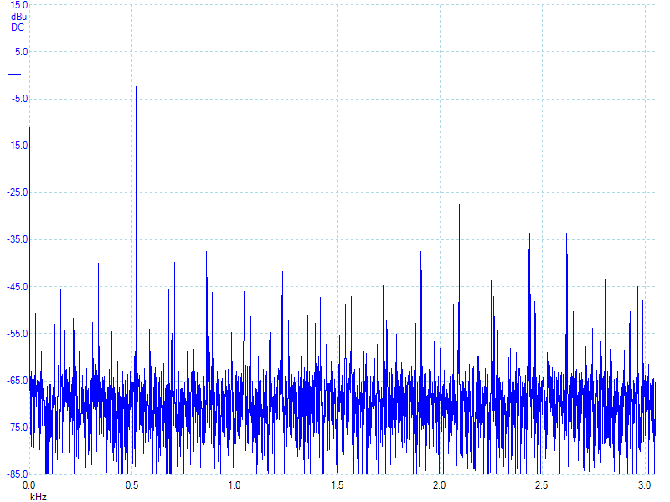
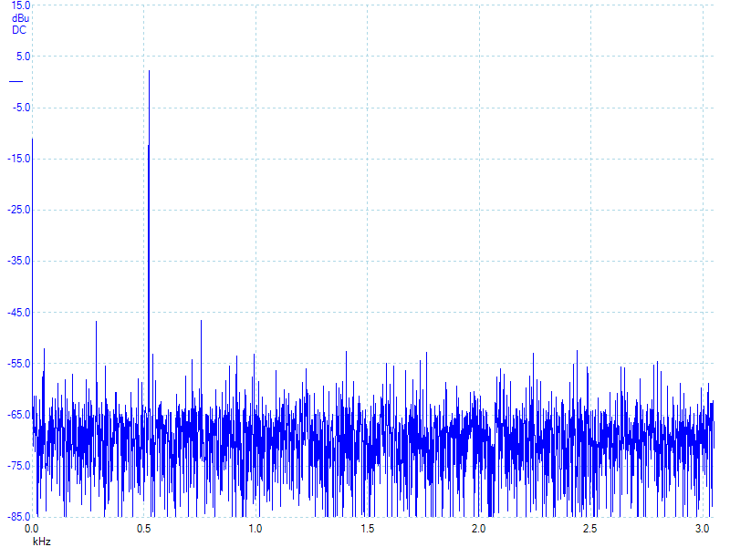
523 Hz sine wave output 12-bit DAC
32 outputs 256 outputs
SNR = 31 dB (3dB – -28dB)
SNR = 49 dB (3dB – -46dB)
31 dB ≈ 35 to 1 ratio 49 dB ≈ 281 to 1 ratio
6

Slide 7
Musical Notes

Slide 8
Tone Generation
Sample rate
440 Hz tone
80 MHz clock (12.5 ns interval)
64 points/sinusoid period
(80Mcounts/s/440Hz)/64 points = 2841 counts = 35.5 us/point
if 256 points/period ➔ 8.9 us/point

Slide 9
Tone Generation
Why 11 bits?
uint32_t I;
// 11-bit 64-element sine wave
const uint16_t Wave[64] = {
1024,1122,1219,1314,1407,1495,1580,1658,1731,1797,1855,
1906,1948,1981,2005,2019,2024,2019,2005,1981,1948,1906,
1855,1797,1731,1658,1580,1495,1407,1314,1219,1122,1024,
926,829,734,641,553,468,390,317,251,193,142,
100,67,43,29,24,29,43,67,100,142,193,
251,317,390,468,553,641,734,829,926
};
TIMER0_TAILR_R = 2841; // 35.5125us, 439.9859Hz
void Timer0A_Handler(void){
TIMER0_ICR_R = TIMER_ICR_TATOCINT;// acknowledge
I = (I+1)&0x3F; // 0 to 63
DAC_Out(Wave[I]);
}
Timer ISR
Output one value to DAC

Slide 10
Tone Generation
Combining two tones:
1) Reduce range of each to 11 bits, 0 to 2047
2) Use two timer interrupts, one for each wave
3) Maintain two indices I0 and I1
4) Add the waveforms together in both ISRs
EE 445L – Bard, Valvano

Slide 11
Tone Generation
Design data structures for musical information
voltage versus time (the sin wave)
timer delays for each note in a scale (pitch)
song table (voice, pitch, duration)
songs divided into measures
pauses between notes
constant DAC input

Slide 12
Song Generation
a Note is defined by five parameters
Amplitude (loudness)
Frequency (pitch)
Voice (shape)
Envelope (time varying shape)
Duration

Slide 13
Envelope
Each different type instrument has unique tone qualities
a Note is defined by five parameters
Amplitude (loudness)
Frequency (pitch)
Voice (shape)
Envelope (time varying shape)
Duration

Slide 14
Summary
SNR = 20log₁₀(signal/noise)
DAC resolution
Frequency resolution
Sound
Amplitude (loudness)
Frequency (pitch)
Voice (shape)
Envelope (time varying shape)
Duration
For more information read sections 8.4, 9.2.2

