Slide 1
EE 445L – Embedded System Design Lab
Data flow graphs
Processor
Architecture
Interfaces
Reading assignment: Chapters 1, 2 & 3

Slide 2
Data Flow Graph
Lab 3 Alarm clock
Circles
Software components
Rectangles
Hardware components
Systems
Components
Interfaces
Arrows
Data format
Data bandwidth
Data direction
For more information read Section 1.3.3 in the book

Slide 3
Motor Controller Data Flow Graph
Lab 10 Integral Controller
Arrows
Data format
Data bandwidth
Data direction
Circles
Software components
Rectangles
Hardware components

Slide 4
Memory Mapped Processor Architecture
 | TM4C123
0x0000.0000 | 256 KiB
∙∙∙ | Flash
0x0003.FFFF | ROM
0x2000.0000 | 32 KiB
∙∙∙ | Static
0x2000.7FFF | RAM
Harvard Architecture
RISC

Slide 5
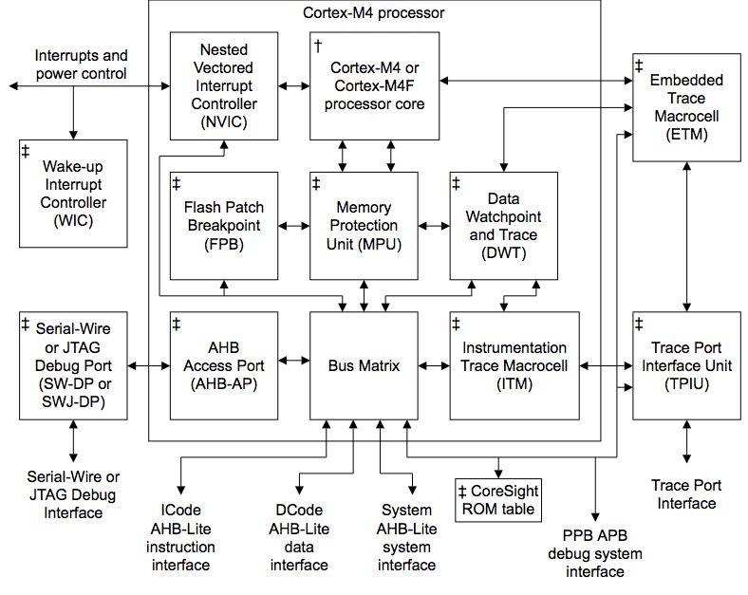
Cortex M4 Block Diagram

Slide 6
Cortex M RISC Architecture
Few instructions
Fixed lengths
Execute in 1 or 2 cycles,
Only load and store can access memory,
No one instruction can both read and write memory
Many GP registers
Few addressing modes
For more information read Sections 2.1 and 2.3 in the book

Slide 7
Cortex M Architecture
APSR contains the current state of the condition
flags from previous instruction executions
IPSR contains the exception type number of the
current Interrupt Service Routine (ISR)
EPSR contains the Thumb state bit and the execution
state bits for the If-Then (IT) instruction

Slide 8
TI Microcontrollers
Launch Pad
 | TM4C123
0x0000.0000 | 256 KiB
∙∙∙ | Flash
0x0003.FFFF | ROM
0x2000.0000 | 32 KiB
∙∙∙ | Static
0x2000.7FFF | RAM
Connected LaunchPad
For more information read Sections 2.1-2.4 in the book

Slide 9
TM4C123 Memory Map

Slide 10
Bit Banding Example
RAM Value: 0x0000_0010
RAM Address [0x2000_0000]
0000_0000_0000_0000_0000_0000_0001_0000
BB DATA:
0x00000000
0x00000000
0x00000000
0x00000001
0x00000000
0x00000000
0x00000000
0x00000000
[0x2200001C]
[0x22000018]
[0x22000014]
[0x22000010]
[0x220000C]
[0x22000008]
[0x22000004]
[0x22000000]
Bit Banded RAM Addresses
bit_word_offset = (byte_offset x 32) + (bit_number × 4) bit_word_offset = 0 x 32 + 4 x 4 = 0x10
bit_word_addr = bit_band_base + bit_word_offset bit_word_addr = 0x2200_0000 + 0x10 = 0x2200_0010

Slide 11
I/O Port Bit Specific Addressing
I/O Port bit banding used to access port data register
Define address offset as 4*2^{b}, where b is the selected bit position
256 possible bit combinations (0-8)
Add offsets for each bit selected to base address for the port
Example: Port A, bits 1,2,3
Port A = 0x4000.4000
PA321 =
0x4000.4000+0x0008+0x0010+0x0020
= 0x4000.4038
Provides friendly and atomic access to port pins
These base addresses are different on the TM4C1294

Slide 12

Little endian memory access

Slide 13
Embedded System Architecture
For more information read Section 1.1 in the book

Slide 14
Introduction to Interfacing
An interface:
is the hardware and software that combine to allow the computer to communicate with external hardware
it must be able to adapt to a wide range of inputs and outputs that can exist in either digital analog or time form
For more information read Sections 2.2 and 2.4 in the book

Slide 15
TM4C123 Architecture
For more information read Section 2.2.1 in the book

Slide 16
Interfaces
Universal Asynchronous Receiver Transmitter
UART
Serial means one bit at a time
Interaction between PC running PuTTy
Microcontroller network, Lab 4 CC3100
ADC
12-bit precision
0 to 3.3V range

Slide 17
Interfaces
The Synchronous Serial Interface (SSI)
Shift registers
Organic Light Emitting Diode (OLED)
ST7735R Liquid Crystal Display (LCD)
Analog to Digital Converters (ADC)
Digital to Analog Converters (DAC)
Other microprocessors

Slide 18
Interfaces
The timer features on the TM4C:
Fixed periodic rate interrupts
Pulse Width Modulated outputs (PWM)
Event counter system for advanced timing operations
Input capture used for period and pulse width measurement
Output compare used for generating signals and frequency measurement

Slide 19
Summary
Data Flow Graph
Microcontroller
RISC processor
Little endian memory
Introduction to interfacing
Digital
Serial
Analog
Time

