Slide 1
EE 445L – Embedded System Design Lab
I/O synchronization
Blind
Busy-wait
Interrupts
DMA

Slide 2
Input/Output Synchronization
Timing Mismatch
Processor ~ MHz
Peripheral ~ KHz or Hz
Respond to events
Periodic tasks: ADC, DAC, control systems
Aperiodic tasks: input, output, alarms

Slide 3
I/O SYNCHRONIZATION

Slide 4
INPUT SYNCHRONIZATION

Slide 5
OUTPUT SYNCHRONIZATION

Slide 6
Busy-Wait Conditions
Predicable
Simple I/O
Fixed load
Dedicated, single thread
Single process
Nothing else to do

Slide 7
Interrupt Conditions
Variable arrival times
Complex I/O, different speeds
Variable load
Other functions to do
Multithread or multiprocess
Infrequent but important alarms
Program errors
Overflow, invalid op code
Illegal stack or memory access
Machine errors
Power failure, memory fault
Breakpoints for debugging
Real time clocks
Data acquisition and control

Slide 8
Direct Memory Access (DMA)
Low latency
High Bandwidth
DMA Examples on web site
DMASoftware_xxx.zip – memory to memory transfer
DMASPI_xxx.zip – memory to DAC continuous output
DMATimerPortRead_xxx.zip – timer-triggered GPIO to memory
DMATimerPortWrite_xxx.zip – timer-triggered memory to GPIO

Slide 9
Interrupts
An interrupt is the automatic transfer of software execution in response to hardware that is asynchronous with current software execution.
external I/O device (like a keyboard or printer) or
an internal event (like an op code fault, or a periodic timer.)
occurs the hardware needs service (busy to done state transition)

Slide 10
Interrupt Processing
All interrupting systems must have the
ability for the hardware to request action from computer
ability for the computer to determine the source of the request
ability for the computer to acknowledge the interrupt

Slide 11
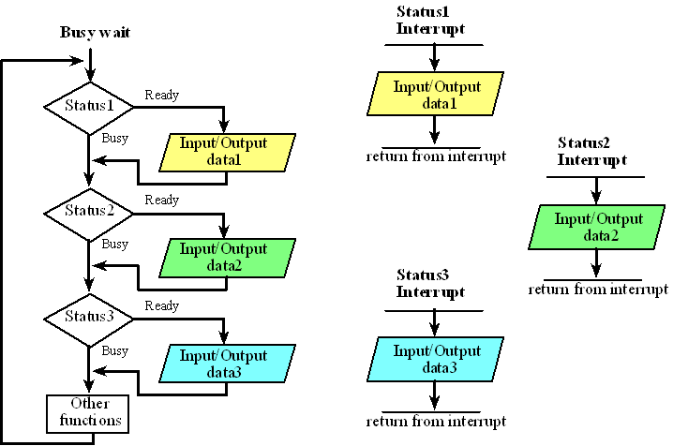
Multiple Devices busy-wait synchronization
Bandwidth can be improved by establishing concurrent I/O operations

Slide 12
Summary
Synchronization
Blind
Busy-wait
Interrupts
DMA
EE 445L – Bard, McDermott, Valvano

