Slide 1
EE 445L – Embedded System Design Lab
Interrupts
Lab 2

Slide 2
Thread
A thread is defined as the path of action of software as it executes.
a background thread interrupt service routine is called.
a new background thread is created for each interrupt request.
local variables and registers used in the interrupt service routine are unique
threads share globals

Slide 3
Processor Modes
ARM has seven basic operating modes
Each mode has access to its own stack space and a different subset of registers
Some operations can only be carried out in a privileged mode
Mode | Description
Supervisor (SVC) | Entered on reset and when a Supervisor call instruction (SVC) is executed | Privileged modes
FIQ | Entered when a high priority (fast) interrupt is raised
IRQ | Entered when a normal priority interrupt is raised
Abort | Used to handle memory access violations
Undef | Used to handle undefined instructions
System | Privileged mode using the same registers as User mode
User | Mode under which most Applications / OS tasks run | Unprivileged mode
Exception modes

Slide 4
The ARM Register Set
User mode
IRQ
FIQ
Undef
Abort
SVC
r0
r1
ARM has 37 registers, all 32-bits long A subset of these registers is accessible in each mode
Note: System mode uses the User mode register set.
r2
r3
r4
r5
r6
r7
r8
r8
r9
r9
r10
r10
r11
r11
r12
r12
r13 (sp)
r13 (sp)
r13 (sp)
r13 (sp)
r13 (sp)
r13 (sp)
r14 (lr)
r14 (lr)
r14 (lr)
r14 (lr)
r14 (lr)
r14 (lr)
r15 (pc)
cpsr
spsr
spsr
spsr
spsr
spsr
Current mode
Banked out registers
EE 445L – Bard, McDermott, Valvano

Slide 5
Program Status Registers
31
28
27
24
23
19
16
15
10
9
8
7
6
5
4
0
N Z C V
Q
[de]
J
GE[3:0]
IT[abc]
E A
I F
T
mode
f
s
x
c
Condition code flags
N = Negative result from ALU
Z = Zero result from ALU
C = ALU operation Carried out
V = ALU operation oVerflowed
Sticky Overflow flag - Q flag
Indicates if saturation has occurred
SIMD Condition code bits – GE[3:0]
Used by some SIMD instructions
IF THEN status bits – IT[abcde]
Controls conditional execution of Thumb instructions
T bit
T = 0: Processor in ARM state
T = 1: Processor in Thumb state
J bit
J = 1: Processor in Jazelle state
Mode bits
Specify the processor mode
Interrupt Disable bits
I = 1: Disables IRQ
F = 1: Disables FIQ
E bit
E = 0: Data load/store is little endian
E = 1: Data load/store is bigendian
A bit
A = 1: Disable imprecise data aborts

Slide 6
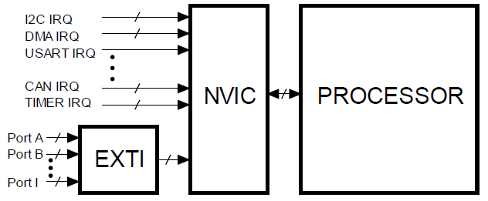
Interrupts
Cortex-M Nested Vector Interrupt Controller.
Interrupt Priorities
Active Status
Enable and Clear Enable registers
Set-Pending and Clear-Pending registers
For more information read Sections 4.7-4.9 in the book

Slide 7
Device Enable
Nested Vectored Interrupt Controller (NVIC)
Device must be enabled in the NVIC and its priority set
BASEPRI register sets priority of interrupts that are permitted to occur
if BASEPRI = 3, interrupts with priority
0 – 2 can occur, suspending this interrupt
3-7 will be postponed until this interrupt is finished

Slide 8
Arming Device Interrupts
Each potential interrupt source has a separate arm bit.
Set arm bits for those devices from which it wishes to accept interrupts,
Deactivate arm bits in those devices from which interrupts are not allowed

Slide 9
Flag
Each potential interrupt source has a separate flag bit.
hardware sets the flag when it wishes to request an interrupt
software clears the flag in ISR to signify it is processing the request

Slide 10
Enable
Interrupt enable bit, I, (bit 0 of PRIMASK) which is in the condition code register.
enable all armed interrupts by setting I=0
disable all interrupts by setting I=1
I=1 does not dismiss the interrupt requests, rather it postpones them

Slide 11
Interrupt Enable/Disable
;*********** DisableInterrupts
; disable interrupts
; inputs: none
; outputs: none
DisableInterrupts
CPSID I
BX LR
;*********** EnableInterrupts ***************
; disable interrupts
; inputs: none
; outputs: none
EnableInterrupts
CPSIE I
BX LR
In startup.s

Slide 12
Interrupt Requirements
1) Enable device in the NVIC
2) Initialization software will set the arm bit
individual control bit for each possible flag that can interrupt
3) When it is convenient, the software will enable, I=0
allow all interrupts now
4) Hardware action (busy to done) sets a flag
e.g., new input data ready, output device idle, periodic, alarm

Slide 13
Latency
Input device
latency is the time between new input data ready and the software reading the data
Output device
latency is the time between output device idle and the software giving the device new data to output.
Periodic events (ADC, DAC, control system).
latency is the time between when it is supposed to be run and when it is actually run.
Time jitter

Slide 14
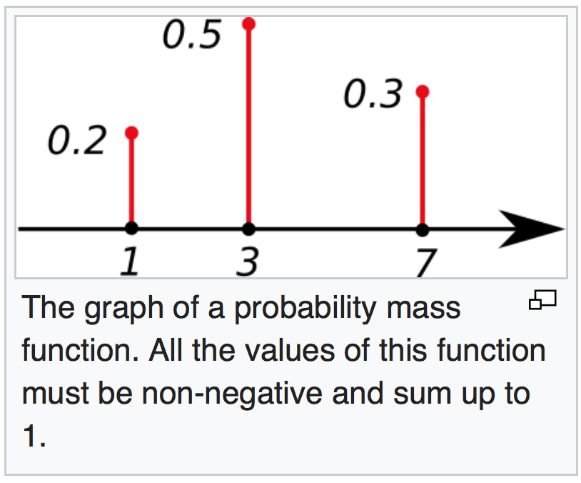
Periodic Events
Real-time system
Sampling jitter
In probability and statistics, a probability mass function (pmf) is a function that gives the probability that a discrete random variable is exactly equal to some value.
https://en.wikipedia.org/wiki/Probability_mass_function

Slide 15
Performance measures
Hardware or device latency is the time between when an I/O device is given a command, and the time when command is completed
Bandwidth is maximum data flow
bandwidth can limited by the I/O device or software
can be reported as an overall average or a short-term max
Priority determines the order of service when two or more requests are made simultaneously.
a "soft-real-time" system supports priority
Turnaround time : Set priority according to shortest remaining time first.
Response time: Set priority to be equal (round robin)
Rate Monotonic Scheduler: more frequent tasks have a higher priority

Slide 16
Bandwidth Limits
I/O bound is defined as
Bandwidth is limited by speed of I/O device
Making the I/O device faster will increase bandwidth
Making the software run faster will not increase bandwidth
Software often waits for the I/O device

Slide 17
Bandwidth Limits
CPU bound is defined as
Bandwidth is limited by speed of executing software
Making the I/O device faster will not increase bandwidth
Making the software run faster will increase bandwidth
Software does not have to wait for the I/O device
For more information read Sections 5.1, 5.2 in the book

Slide 18
Real-time DAS
ADCSWTrigger_4C123
Sample ADC 100 Hz
Timer0 interrupts
Show project in Keil

Slide 19
Real-time DAS
ADCSWTrigger_4C123
Sample ADC 100 Hz
Timer0 interrupts
Lab 2 starter projects
Your Lab 1
ADCSWTrigger_4C123
PeriodicTimer1AInts_4C123

Slide 20
Timer0A or Timer1A interrupts
Timer0 clock (Timer1 clock)
32-bit mode
Periodic mode
TAILR sets rate
Arm TATO
Enable Timer0 (Timer1)
Priority
Enable interrupt 19 (20)
Enable processor (I=0)
Acknowledge
ADC conversion
Show project in Keil

Slide 21
Summary
Synchronization
Latency
Bandwidth
Arm enable priority
Trigger flag
Acknowledge
Real-time, sampling jitter
Timer periodic interrupts

