Slide 1
EE 445L – Embedded System Design Lab
Digital logic
Bipolar Junction Transistor (BJT)
MOS Field Effect Transistor (MOSFET)
Effect of capacitance
Buzzer

Slide 2
Digital Logic (MOS-MOS) Output High State
The device providing (driving) the output is capable of sourcing a maximum current to that output
I_{OH}
Each input device receiving (sinking) the output as an input requires a maximum current:
I_{IH}
For more information read Section 1.4 in the book

Slide 3
Digital Logic (MOS-MOS) Output Low State
The device providing (driving) the output is capable of receiving (sinking) a maximum current through the output
I_{OL}
Each input device sources a maximum current:
I_{IL}

Slide 4
Digital Logic (MOS-TTL(BJT)) Output High State
The device providing (driving) the output is capable of sourcing a maximum current to that output
I_{OH}
Each input device receiving (sinking) the output as an input requires a maximum current:
I_{IH}
For more information read Section 1.4 in the book

Slide 5
Digital Logic (MOS-TTL(BJT)) Output Low State
The device providing (driving) the output is capable of receiving (sinking) a maximum current through the output
I_{OL}
Each input device sources a maximum current:
I_{IL}

Slide 6
Digital Logic Families
The following five parameters most affect our choice of logic families:
power supply voltage
power supply current
speed
output drive, I_{OL}, I_{OH}
noise immunity

Slide 7
Digital Logic Families
Logic voltage levels
V_{IL} – voltage below which an input is considered logic low
V_{IH} - voltage above which an input is considered logic high
V_{OH} – output voltage for a logic high (current less than I_{OH})
V_{OL} - output voltage for a logic low (current less than I_{OL})
V_{OL} ≤ V_{IL}
V_{OH} ≥ V_{IH}

Slide 8
Logic Families
Family | Example | I_{OH} | I_{OL} | I_{IH} | I_{IL}
Standard TTL | 7404 | 0.4 mA | 16 mA | 40 µA | 1.6 mA
Schottky TTL | 74S04 | 1 mA | 20 mA | 50 µA | 2 mA
Low Power Schottky | 74LS04 | 0.4 mA | 4 mA | 20 µA | 0.4 mA
High Speed CMOS | 74HC04 | 4 mA | 4 mA | 1 µA | 1 µA
Adv High Speed CMOS | 74AHC04 | 4 mA | 4 mA | 1 µA | 1 µA
TM4C 2mA-drive | TM4C123 | 2 mA | 2 mA | 2 µA | 2 µA
TM4C 4mA-drive | TM4C123 | 4 mA | 4 mA | 2 µA | 2 µA
TM4C 8mA-drive | TM4C123 | 8 mA | 8 mA | 2 µA | 2 µA
TM4C 12mA-drive | TM4C1294 | 12 mA | 12 mA | 2 µA | 2 µA
For more information read Section 1.4 in the book

Slide 9
Digital Logic Families
V_{OH} ≥ V_{IH}
I_{OH} ≥ I_{IH}

Slide 10
Digital Logic Families
V_{OL} ≤ V_{IL}
I_{OL} ≥ I_{IL}

Slide 11
Digital Logic Families
V_{OH} ≥ V_{IH}
I_{OH} ≥ I_{IH}
V_{OL} ≤ V_{IL}
I_{OL} ≥ I_{IL}

Slide 12
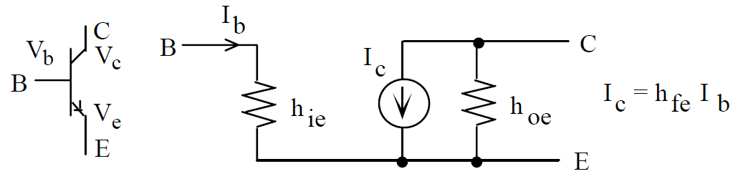
NPN Transistor Model
PN2222 Lab 3
TIP120 Lab 10
1) Normally V_{c} > V_{e}
2) Current can only flow in the following directions
from base to emitter (input current)
from collector to emitter (output current)
from base to collector
(doesn’t usually happen, but could if V_{b} > V_{c})
3) Each transistor has maximum values that should not be exceeded
Ib Ic Vce and Ic•Vce
4) The transistor acts like a current amplifier
I_{c} = h_{fe}•I_{b}
5) The transistor will saturate if V_{b} > V_{e} + V_{be}(SAT)
where V_{be}(SAT) is typically above 0.6V
V_{BC}
E > B > C
E < B > C
Reverse active
Saturation
V_{BE}
Forward active
Cutoff
E > B < C
E < B < C
For more information read Section 1.4 in the book

Slide 13
Transistors
PN2222 Lab 3
TIP120 Lab 10
Type | NPN | PNP | package | V_{be(SAT)} | V_{ce(SAT)} | h_{fe} min/max | I_{c}
general purpose | 2N3904 | 2N3906 | TO-92 | 0.85 V | 0.2 V | 100 | 10mA
general purpose | PN2222 | PN2907 | TO-92 | 1.2 V | 0.3 V | 100 | 150mA
general purpose | 2N2222 | 2N2907 | TO-18 | 1.2 V | 0.3 V | 100/300 | 500mA
power | TIP29A | TIP30A | TO-220 | 1.3 V | 0.7 V | 15/75 | 1A
power | TIP31A | TIP32A | TO-220 | 1.8 V | 1.2 V | 25/50 | 3A
power | TIP41A | TIP42A | TO-220 | 2.0 V | 1.5 V | 15/75 | 3A
Darlington | TIP120 | TIP125 | TO-220 | 2.5 V | 2.0 V | 1000 min | 3A

Slide 14
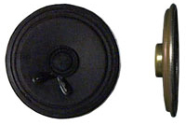
Lab 3 Speaker Interface
Resistor, R, controls loudness
Power = V*I
2.25" 32 OHM SPEAKER - 0.38" thick

Slide 15
Lab 3 Speaker Interface
Use data sheet to guess
Measure with voltmeter
Assume TM4C output at 3.3V
At saturation (maximum loudness)
V_{BE} = 1.2V and V_{CE} = 0.3V
Ohms Law across speaker
I_{CE} = (3.3-0.3V)/32Ω = 94mA (near maximum!)
P = I_{CE}²*32Ω = 0.28 watts (too loud)
Transistor gain is 100
I_{B} =I_{CE} /100 = 1mA
Ohms Law across input resistor
R = (3.3-1.2V)/0.001A = 2000Ω
What if R = 10kΩ?
I_{B} =(3.3-1.2V)/10000Ω = 0.21mA
h_{ie} = 2kΩ (not a fixed value)
I_{B} =V_{OH}/(R +h_{ie}) =3.3V/(10000Ω +2000Ω)= 0.28mA
Transistor gain is 100
I_{CE} =I_{B} *100 = 21mA
P = I_{CE}²*32W = 0.015 watts
quiet

Slide 16
Capacitance
Make it run faster
Decrease R,C
Increase I, P
Make it less noisy
Decrease slew rate
Capacitance loading is an important factor when interfacing CMOS devices

Slide 17
Take Aways
R - Resistive loads require current amplification
L - Inductive loads produce back EMF
Snubber diode
C - Capacitive loads will slow down dV/dt
Time constant, τ = R*C
Make it go faster by
Decreasing R and C
Increasing I
Speed related to power

Slide 18
Summary
Saturated Mode
Current gain h_{fe}
Activation V_{be}
Output V_{ce} I_{ce}
Capacitance
Slows down
Reduces EM emissions

