Slide 1
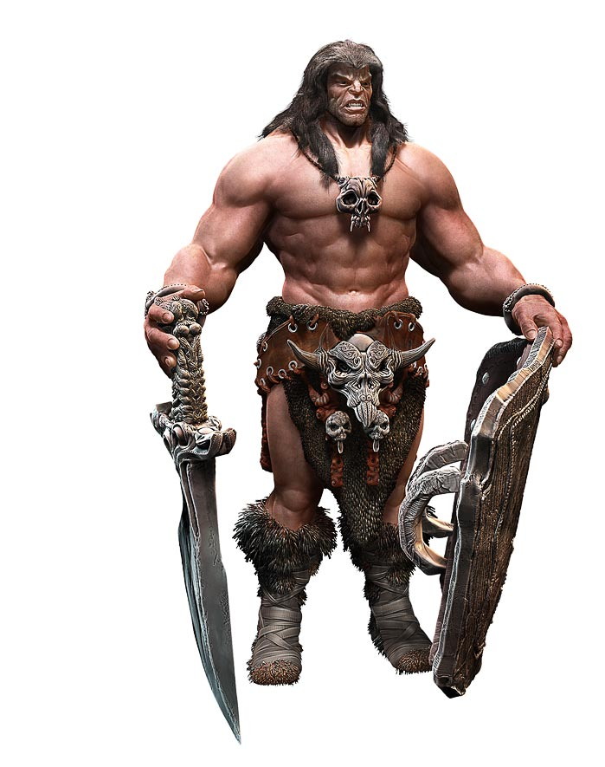

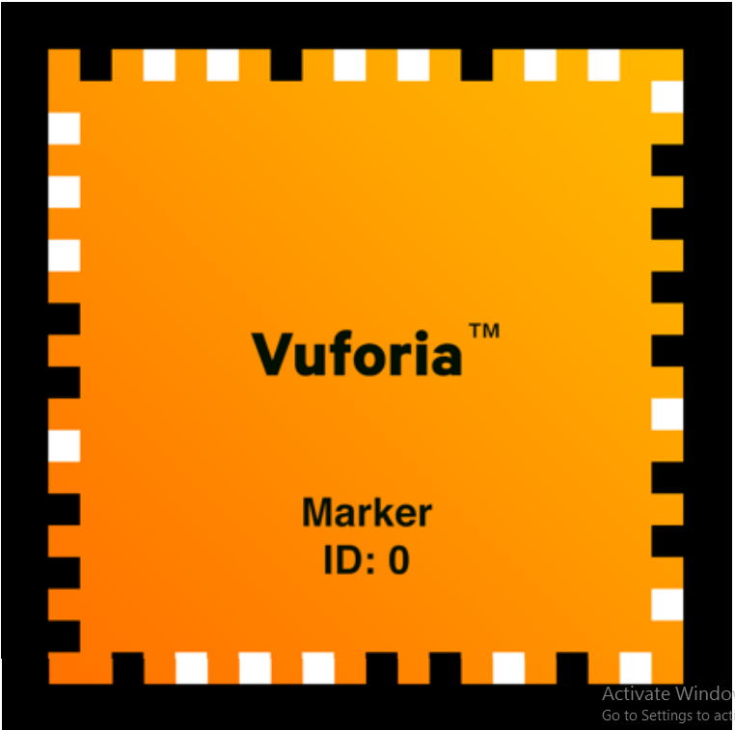
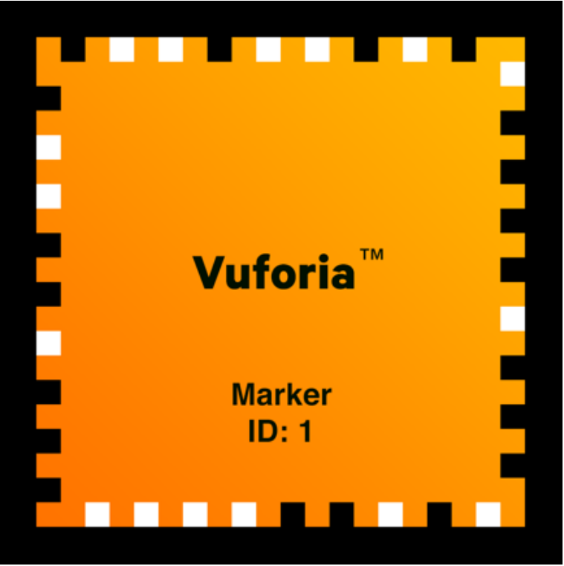

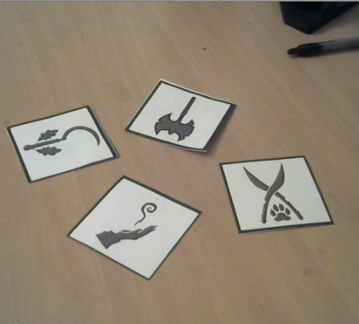
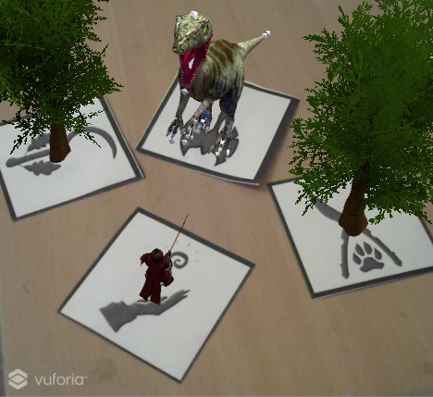
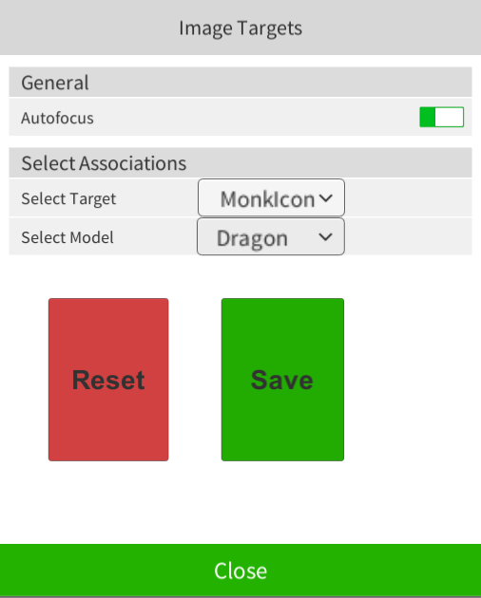



Versatile Augmentati n
Kimberly Zhang
Timothy Kokotajlo
Fall 2016
Introduction
Results
Augmented Reality is the step in-between a camera and complete virtual reality. It relies heavily on computer vision to place objects over a real image in such a way so that they appear part of the original picture/video.
This app is designed to provide an easy to use and flexible tool allowing users to create their own AR scenes without having to learn and design software themselves.
Our application currently supports Android* and allows the user to choose between over a dozen targets and half a dozen models.
There is an ability for the user to select their own images in app for targets, but it severely degrades the quality of the tracking ability.
*AR is resource intensive and we have not optimized any part of the app, so while adding more models is trivial, it significantly slows the app down (or crashes it)
Conclusions
Background
What we have working is a very crude version of the idea. Many of the difficulties came from us learning the software and trying things out, or from issues with the software itself.
AR is relatively new, so as the technology gets better, issues like Unity crashing, the jittering objects, and the atrocious app size will be greatly reduced.
There are almost infinite things we can do to make this better, were we to do this again we would aim for the crude but workable version from the start to give us more time to prioritize features and fixes afterwards.
One of the primary usages that inspired this project was Tabletop games (think Dungeon and Dragons)
As the models and action that happens changes widely per game (even per scene) most of the time players resort to jury-rigged representations or imagination.
Right now almost every Augmented Reality (AR) application is designed exclusively for a specific purpose.
Ex: Pokémon GO , Google Translate, Business cards, Games, etc.
References
Unity 3D Engine:
https://unity3d.com/
Vuforia Augmented Reality
https://www.vuforia.com/
Android SDK
https://developer.android.com/studio/index.html
Methodology
Vuforia is an AR library that can be used in a variety of development settings, from Phone Dev kits, to OS kits, to Unity, which we used
Instead of a traditional player-point of-view camera, the AR camera is fixed and the virtual universe moves around it based on the 2d video input.
Vuforia supports several types of tracking, our app currently uses Image tracking, but can be switched to Framed
The camera recognizes points on the images and uses that to orient the 3d model accordingly

