Slide 1
MDXHelper
xxx

Slide 2
BI Module
ERP System
Data Mart
ETL
SSRS/ PBI/ XLS
OLAP MD

Slide 3
BI Module
ERP System
Staging
Data Mart
ETL
ETL
SSRS/ PBI/ XLS
OLAP MD

Slide 4
ERP System
Data Mart
OLAP MD
Customer A
ETL
ERP System
Data Mart
OLAP MD
Customer B
ETL
ERP System
Data Mart
OLAP MD
Customer C
ETL

Slide 5
Co trzeba porównać
ETL (source => staging)
Staging DB
ETL (staging => DM)
Reports
OLAP (dimensions, measure groups, MDX Calculation Script)

Slide 6
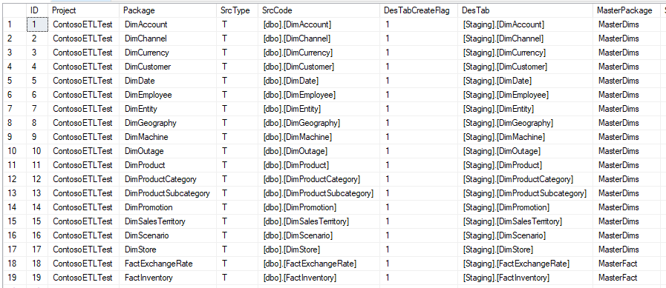
ETL (staging)
Simplified
Standardised
Generated

Slide 7
ETL (DM)
Business Logic
Staging
DataMart
View
Table
ETL
Tables
Simple Logic (select + lookups)

Slide 8
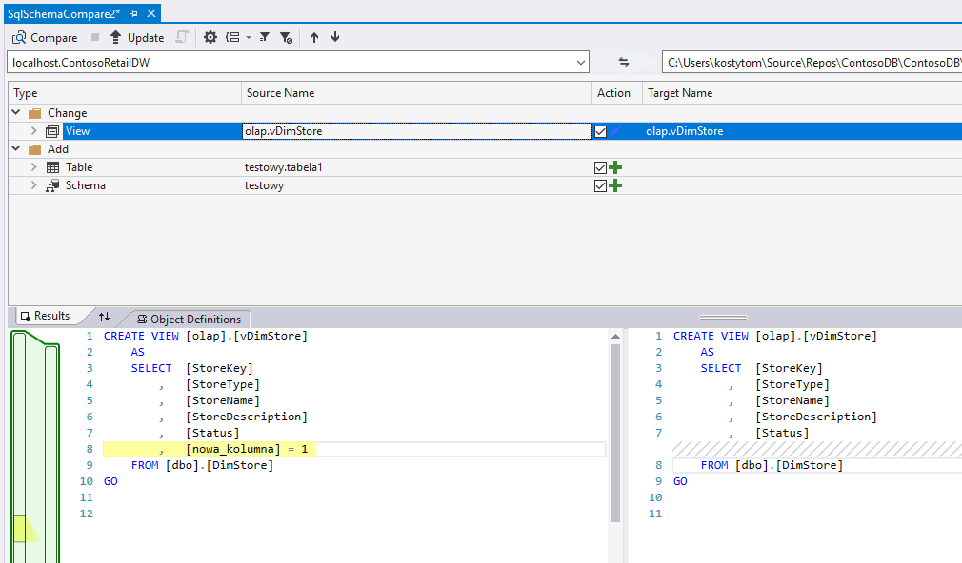
DB Schema - Schema Compare

Slide 9
OLAP
Dimensions
Cubes
Measure Groups / Measures
Calculation Script

Slide 10
Attempt #01: DMVs

Slide 11
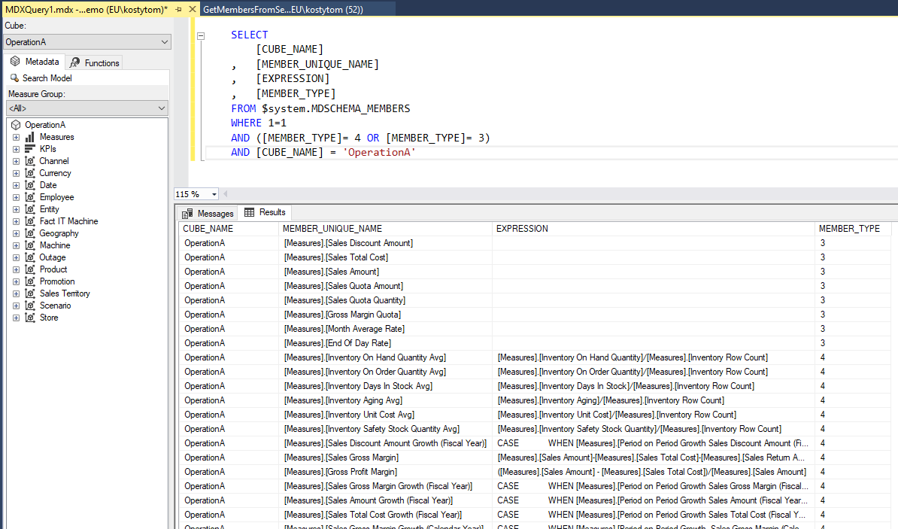

Slide 12
Attempt #02: AMO

Slide 13
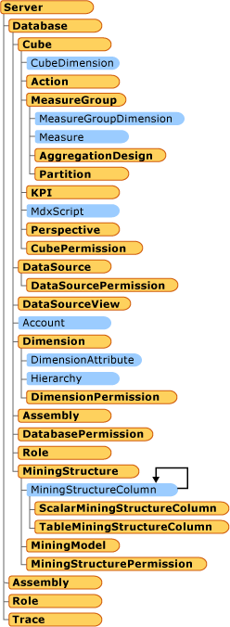
dlls
Analysis Management Objects (AMO)
A library of classes designed to manage an instance of Microsoft SQL Server Analysis Services from a client application. AMO classes are classes that you will use to administer Analysis Services objects such as databases, dimensions, cubes, mining structures and models, roles and permissions, exceptions, and others
https://docs.microsoft.com/en-us/sql/analysis-services/multidimensional-models/analysis-management-objects/amo-classes-introduction?view=sql-server-2017

Slide 14
dlls
The ADOMD.NET server objects are helper objects that can be used to create user defined functions (UDFs) or stored procedures in Microsoft SQL Server Analysis Services.
The ADOMD.NET server components of ADOMD.NET reside within the Microsoft.AnalysisServices.AdomdServer namespace (in msmgdsrv.dll). You use these server components to create custom Multidimensional Expressions (MDX) functions and stored procedures that are run on an instance of Microsoft SQL Server Analysis Services.
https://docs.microsoft.com/en-us/sql/analysis-services/multidimensional-models-adomd-net-server/adomd-net-server-object-architecture?view=sql-server-2017

Slide 15
Attempt #03: Parser

