Slide 1
MDXHelper
xxx

Slide 2
BI Module
ERP System
Data Mart
ETL
SSRS/ PBI/ XLS
OLAP MD

Slide 3
BI Module
ERP System
Staging
Data Mart
ETL
ETL
SSRS/ PBI/ XLS
OLAP MD

Slide 4
ERP System
Data Mart
OLAP MD
Customer A
ETL
ERP System
Data Mart
OLAP MD
Customer B
ETL
ERP System
Data Mart
OLAP MD
Customer C
ETL

Slide 5
Co trzeba porównać
ETL (source => staging)
Staging DB
ETL (staging => DM)
Reports
OLAP (dimensions, measure groups, MDX Calculation Script)

Slide 6
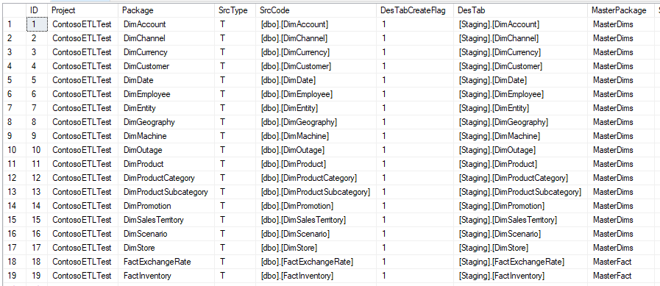
ETL (staging)
Simplified
Standardised
Generated

Slide 7
ETL (DM)
Business Logic
Staging
DataMart
View
Table
ETL
Tables
Simple Logic (select + lookups)

Slide 8
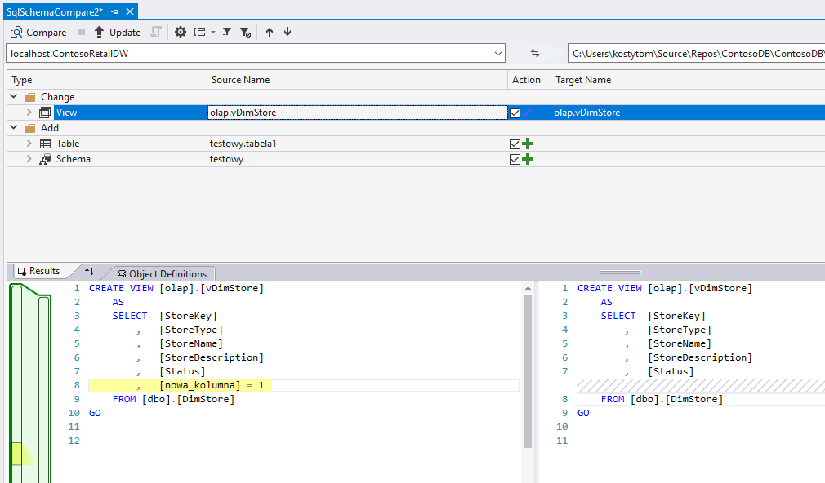
DB Schema - Schema Compare

Slide 9
OLAP
Dimensions
Cubes
Measure Groups / Measures
Calculation Script

Slide 10
Attempt #01: DMVs

Slide 11
SSAS DMV
Analysis Services Dynamic Management Views (DMV) are queries that return information about model objects, server operations, and server health.
The query, based on SQL, is an interface to schema rowsets. Schema rowsets are predescribed tables that contain information about Analysis Services objects and server state, including database schema, active sessions, connections, commands, and jobs that are executing on the server.
DMV queries are an alternative to running XML/A Discover commands. For most administrators, writing a DMV query is simpler because the syntax is based on SQL. In addition, the result is returned in a table format that is easier to read and copy.
https://docs.microsoft.com/en-us/sql/analysis-services/instances/use-dynamic-management-views-dmvs-to-monitor-analysis-services?view=sql-server-2017

Slide 12
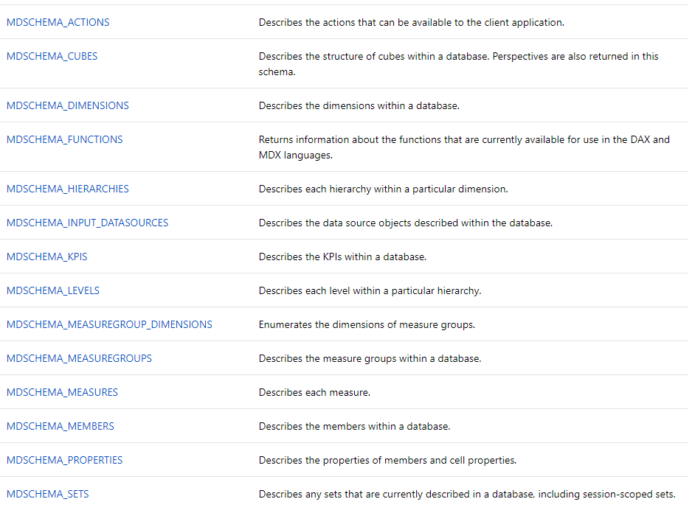

Slide 13
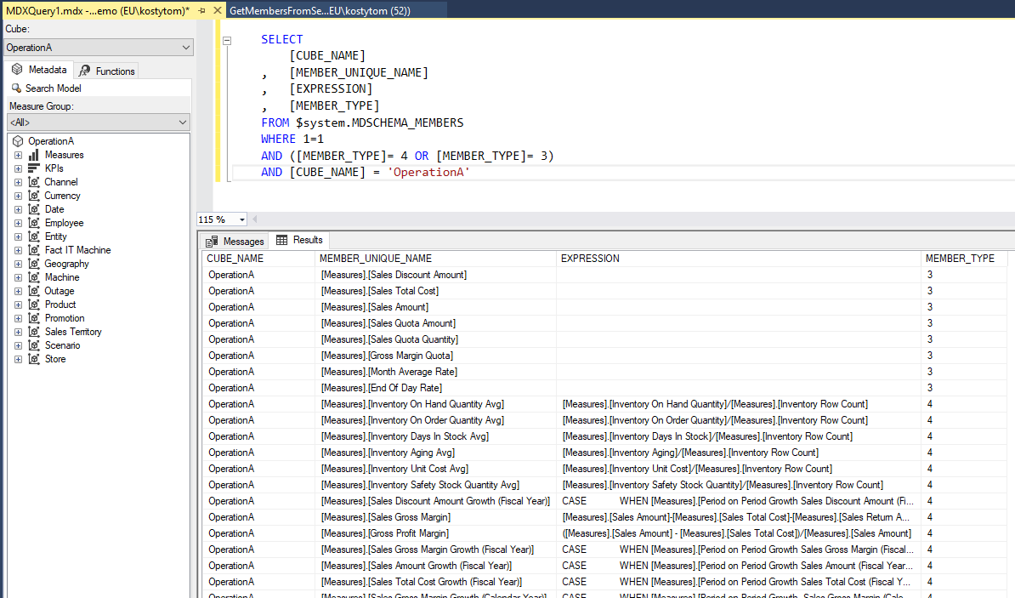

Slide 14
demo #01

Slide 15
Attempt #02: AMO

Slide 16
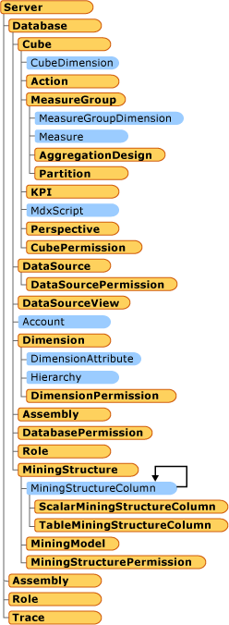
dlls
Analysis Management Objects (AMO)
A library of classes designed to manage an instance of Microsoft SQL Server Analysis Services from a client application. AMO classes are classes that you will use to administer Analysis Services objects such as databases, dimensions, cubes, mining structures and models, roles and permissions, exceptions, and others
https://docs.microsoft.com/en-us/sql/analysis-services/multidimensional-models/analysis-management-objects/amo-classes-introduction?view=sql-server-2017

Slide 17
dlls
The ADOMD.NET server objects are helper objects that can be used to create user defined functions (UDFs) or stored procedures in Microsoft SQL Server Analysis Services.
The ADOMD.NET server components of ADOMD.NET reside within the Microsoft.AnalysisServices.AdomdServer namespace (in msmgdsrv.dll). You use these server components to create custom Multidimensional Expressions (MDX) functions and stored procedures that are run on an instance of Microsoft SQL Server Analysis Services.
https://docs.microsoft.com/en-us/sql/analysis-services/multidimensional-models-adomd-net-server/adomd-net-server-object-architecture?view=sql-server-2017

Slide 18
Attempt #03: Parser

