Slide 1
MDXHelper
Zestawienie skryptów kalkulacyjnych (MDX) dla personalizowanych wdrożeń kostek SSAS

Slide 2

Tomasz Kostyrka
Senior BI Developer @tieto
Assistant @wsei
tomek.kostyrka@gmail.com
https://github.com/TKostyrkaWSEI/SSISPGen

Slide 3
BI Module
ERP System
Data Mart
ETL
SSRS/ PBI/ XLS
OLAP MD

Slide 4
BI Module
ERP System
Staging
Data Mart
ETL
ETL
SSRS/ PBI/ XLS
OLAP MD

Slide 5
ERP System
Data Mart
OLAP MD
Customer A
ETL
ERP System
Data Mart
OLAP MD
Customer B
ETL
ERP System
Data Mart
OLAP MD
Customer C
ETL

Slide 6
OLAP MD
Data Mart
ERP System
Customer A
ETL
ERP System
Data Mart
OLAP MD
Customer B
ETL
Data Mart
OLAP MD
ERP System
ETL
Customer C

Slide 7
Layers
ETL (source => staging)
Staging DB
ETL (staging => DM)
Reports
OLAP (dimensions, measure groups, MDX Calculation Script)

Slide 8
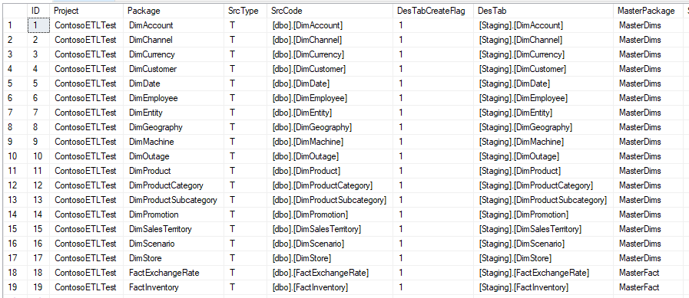
ETL (staging)
Simplified
Standardised
Generated

Slide 9
ETL (DM)
Business Logic
Staging
DataMart
View
Table
ETL
Tables
Simple Logic (select + lookups)

Slide 10
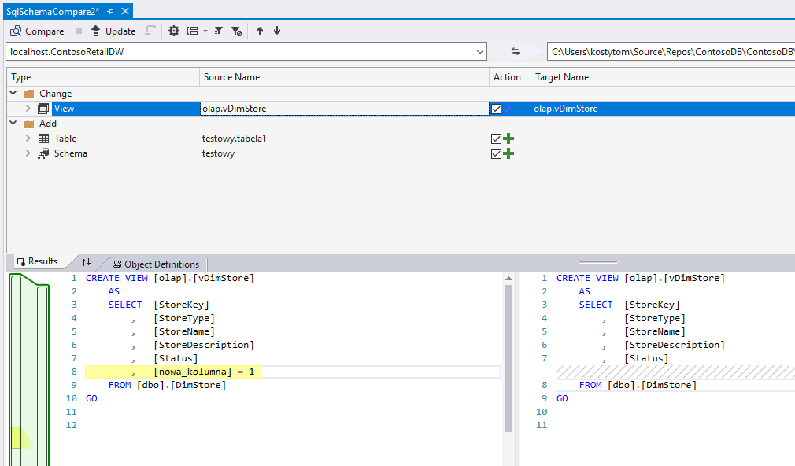
DB Schema - Schema Compare

Slide 11
OLAP
Dimensions
Cubes
Measure Groups / Measures
Actions, KPIs
Calculation Script

Slide 12
Attempt #01: DMVs

Slide 13
SSAS DMV
Analysis Services Dynamic Management Views (DMV) are queries that return information about model objects, server operations, and server health.
The query, based on SQL, is an interface to schema rowsets. Schema rowsets are predescribed tables that contain information about Analysis Services objects and server state, including database schema, active sessions, connections, commands, and jobs that are executing on the server.
DMV queries are an alternative to running XML/A Discover commands. For most administrators, writing a DMV query is simpler because the syntax is based on SQL. In addition, the result is returned in a table format that is easier to read and copy.
https://docs.microsoft.com/en-us/sql/analysis-services/instances/use-dynamic-management-views-dmvs-to-monitor-analysis-services?view=sql-server-2017

Slide 14
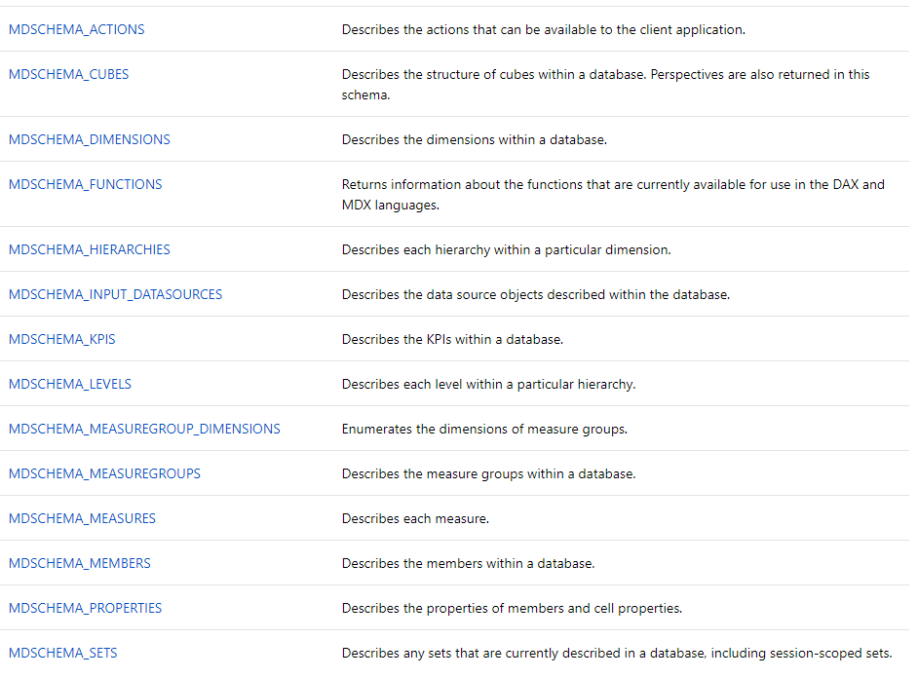

Slide 15
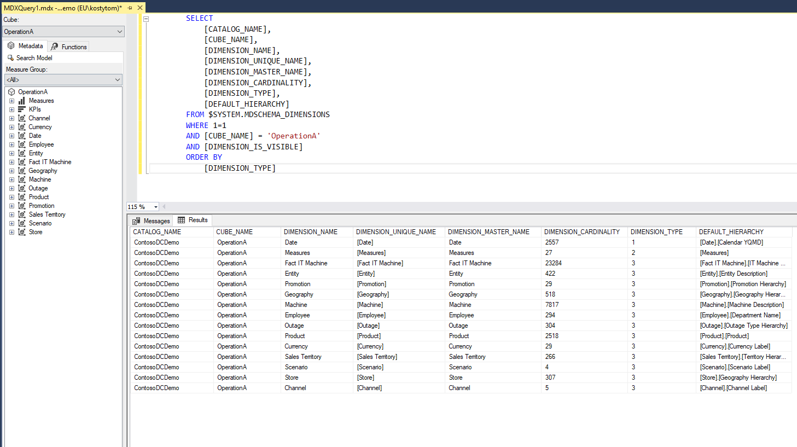

Slide 16
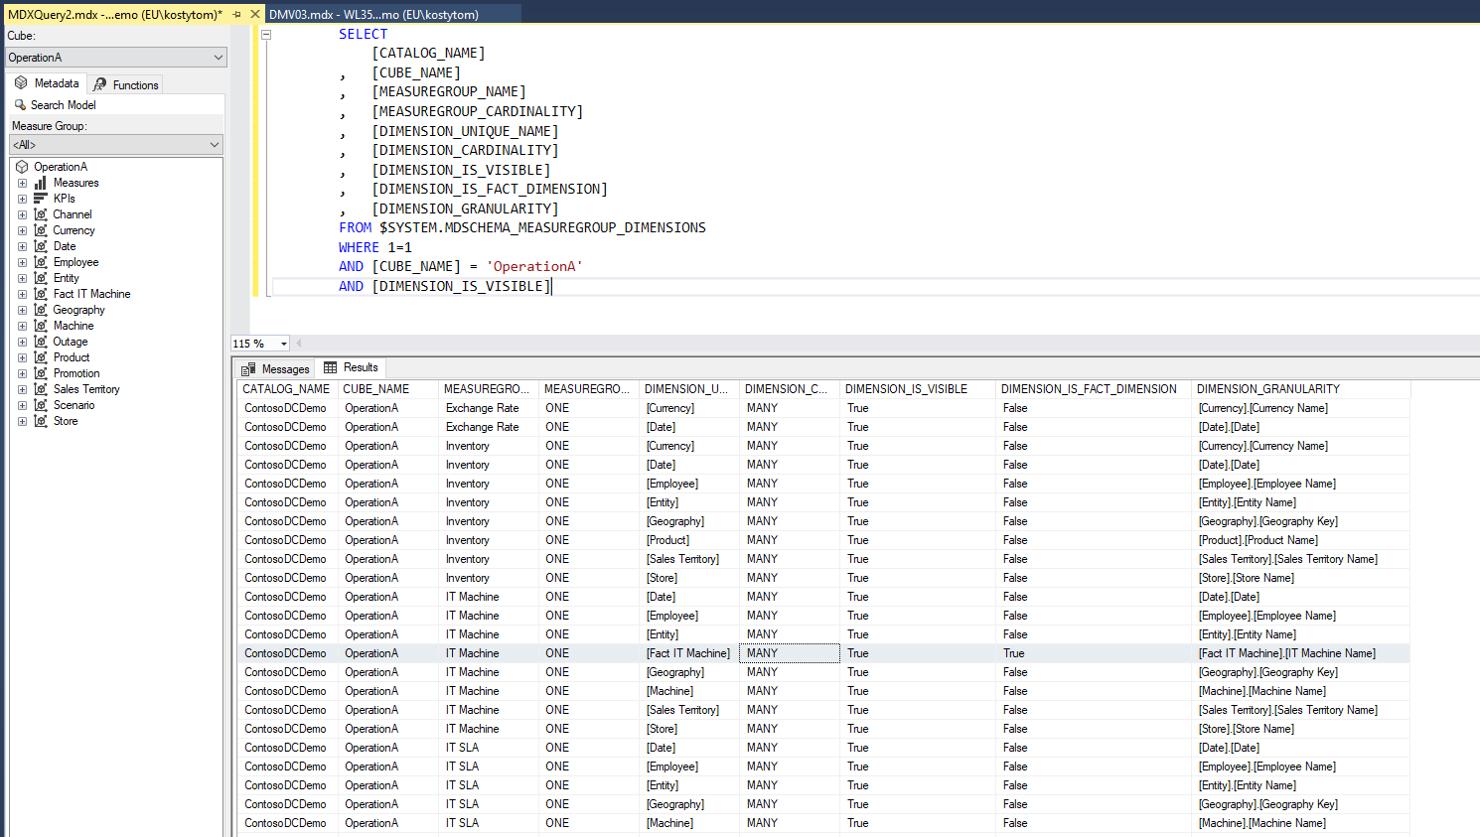

Slide 17
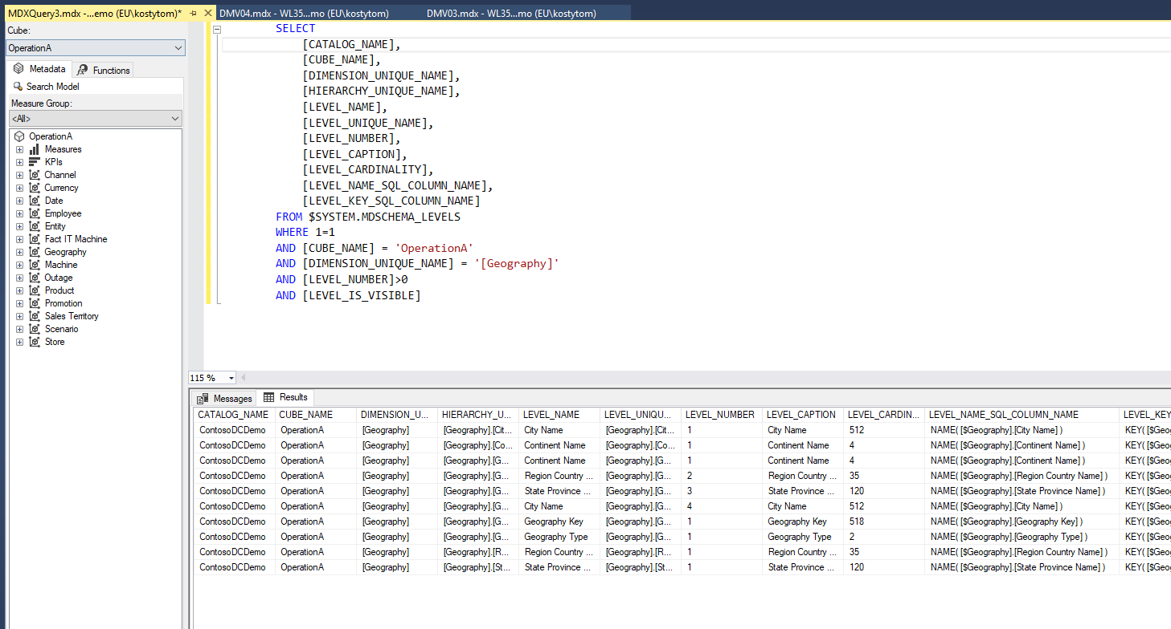

Slide 18
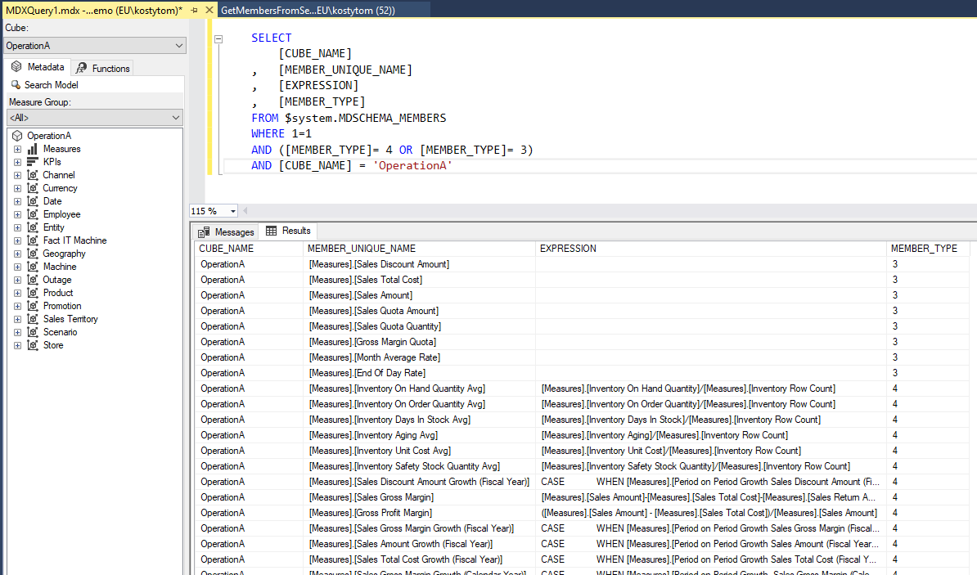

Slide 19
demo #01

Slide 20
Attempt #02: AMO

Slide 21
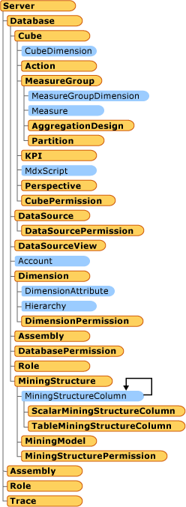
dlls
Analysis Management Objects (AMO)
A library of classes designed to manage an instance of Microsoft SQL Server Analysis Services from a client application. AMO classes are classes that you will use to administer Analysis Services objects such as databases, dimensions, cubes, mining structures and models, roles and permissions, exceptions, and others
https://docs.microsoft.com/en-us/sql/analysis-services/multidimensional-models/analysis-management-objects/amo-classes-introduction?view=sql-server-2017

Slide 22
dlls
The ADOMD.NET server objects are helper objects that can be used to create user defined functions (UDFs) or stored procedures in Microsoft SQL Server Analysis Services.
The ADOMD.NET server components of ADOMD.NET reside within the Microsoft.AnalysisServices.AdomdServer namespace (in msmgdsrv.dll). You use these server components to create custom Multidimensional Expressions (MDX) functions and stored procedures that are run on an instance of Microsoft SQL Server Analysis Services.
https://docs.microsoft.com/en-us/sql/analysis-services/multidimensional-models-adomd-net-server/adomd-net-server-object-architecture?view=sql-server-2017

Slide 23
demo #02

Slide 24
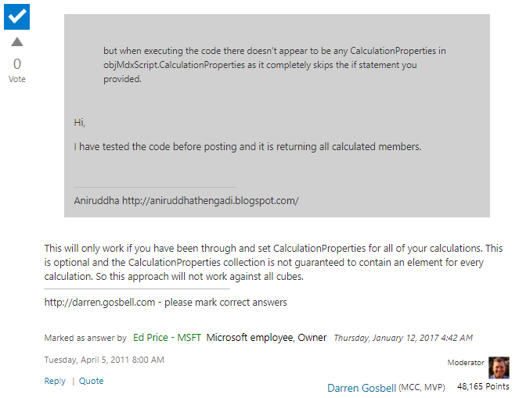
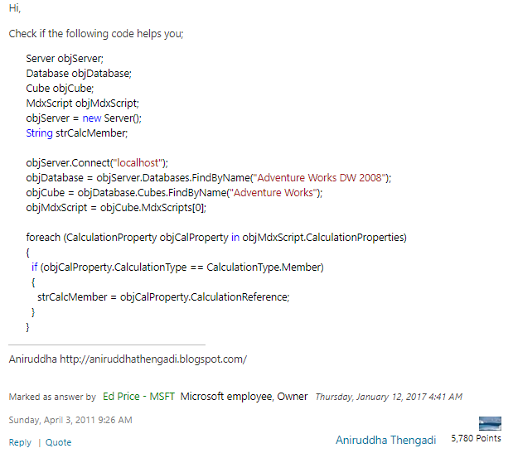
https://social.msdn.microsoft.com/Forums/sqlserver/en-US/f7b161a3-2220-49fe-827e-edb7858c151a/obtaining-calculated-member-names-using-c?forum=sqlanalysisservices

Slide 25


Slide 26
Attempt #03: Parser

Slide 27
Requirements
Extract Measures/KPIs/Actions
Extract all objects and properties from CalculationScript
Connect to *.cube file (XML)
Connect to SSAS server
Keep results in Database (many projects, cubes + full history)
Work in both directions
MDX script generation (formatting, order, comments)
Documentation
dll's

Slide 31
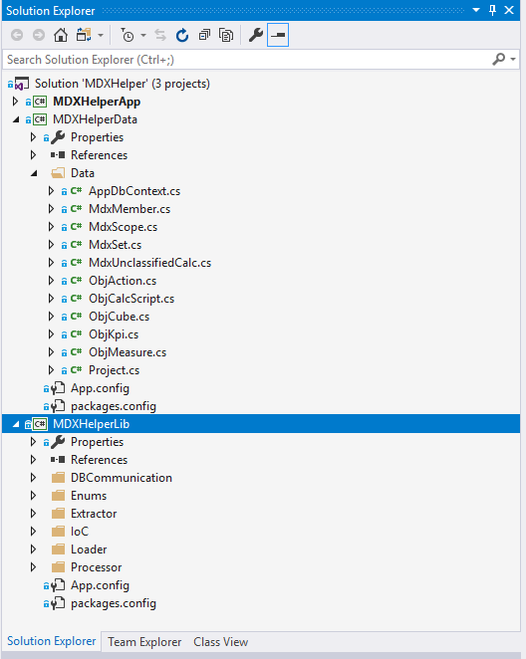
Data Model (EF)
Parser

Slide 32
demo #03

Slide 33
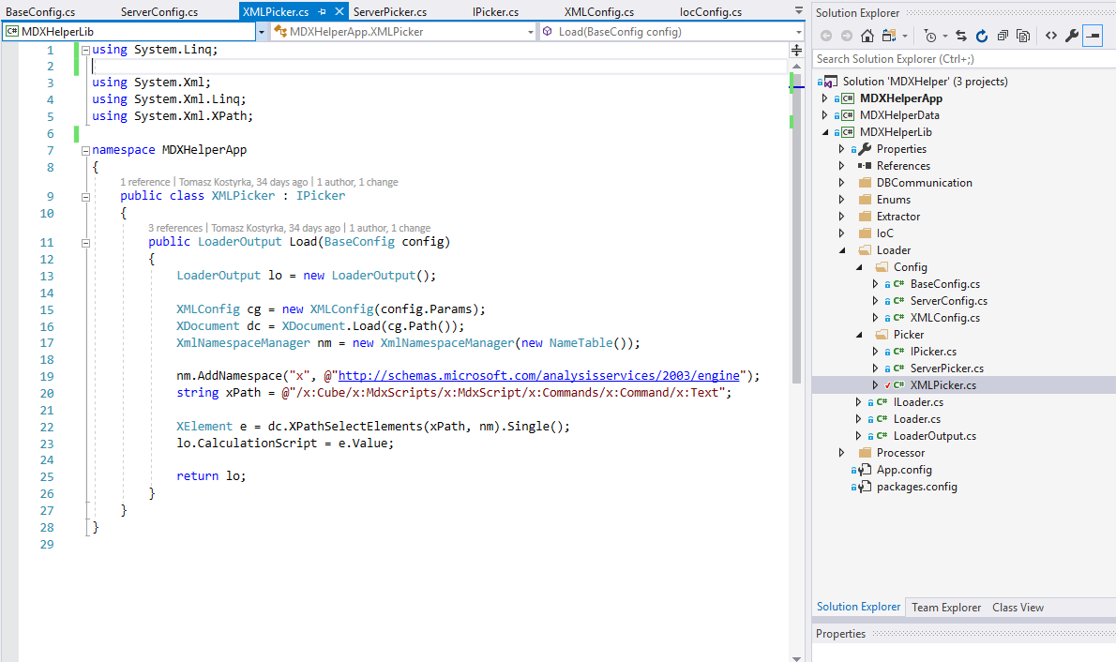
Loader

Slide 34
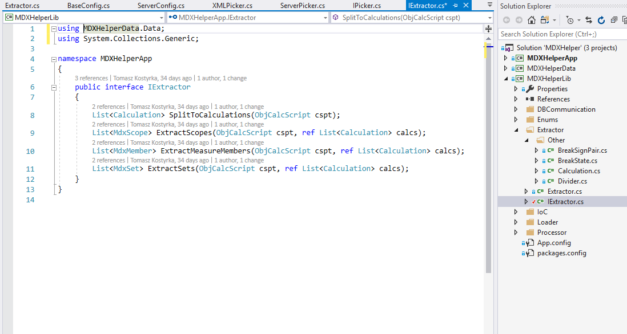
Extractor

Slide 35
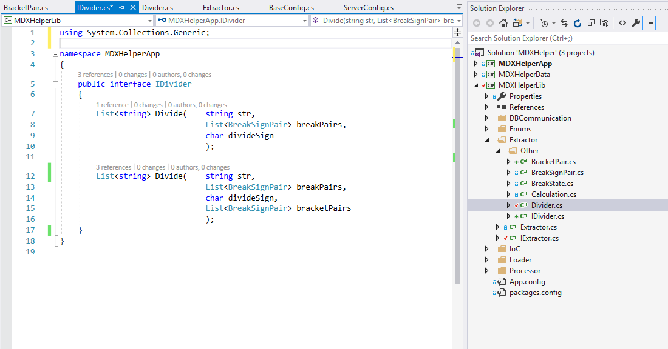
Divider

Slide 36
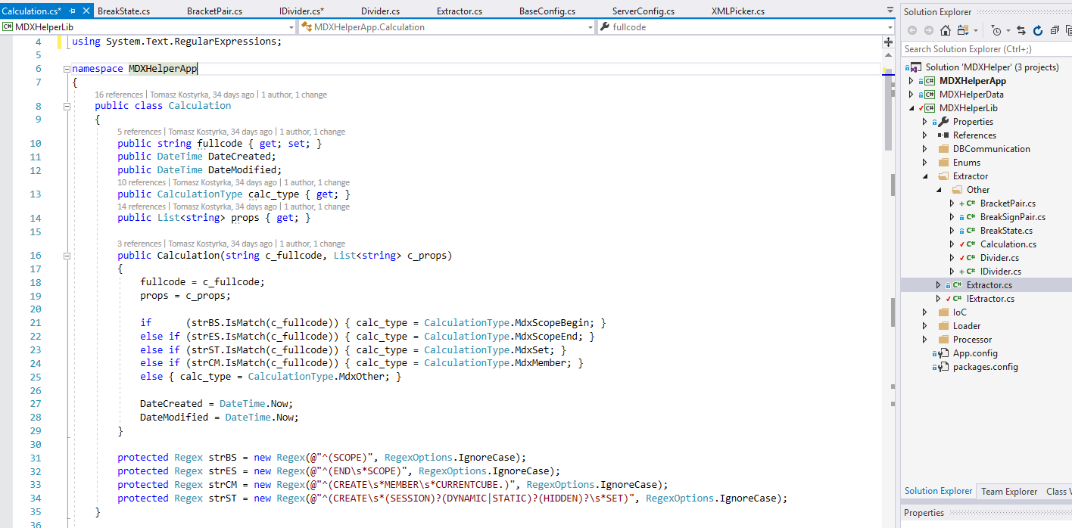
Calculation

Slide 37
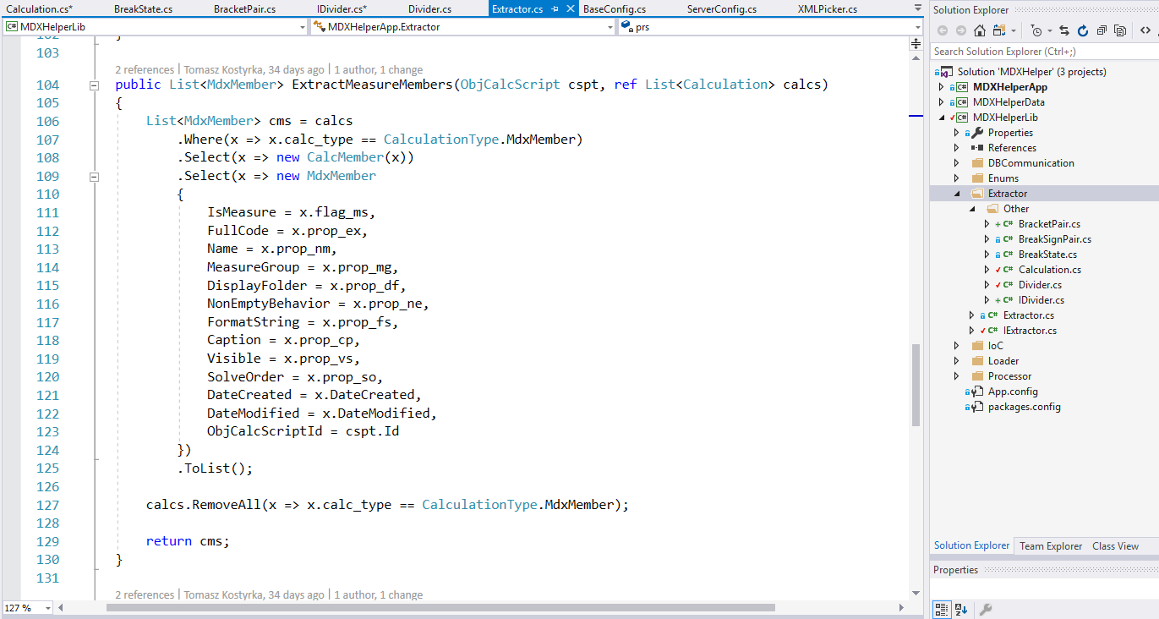
Extractor (Measures)

Slide 38
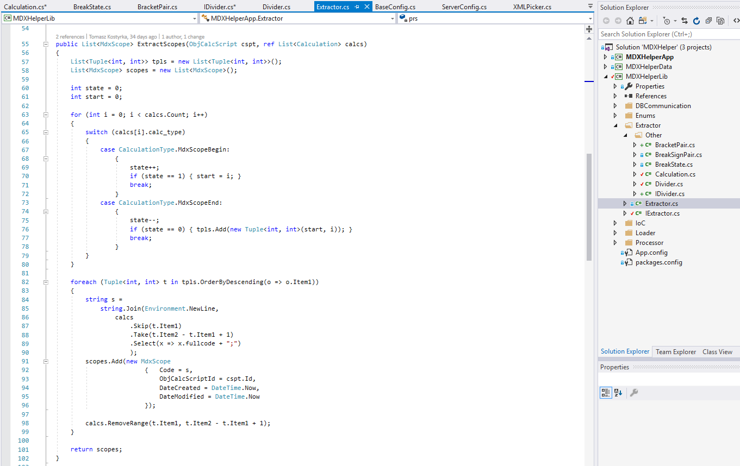
Extractor (Scopes)

Slide 39
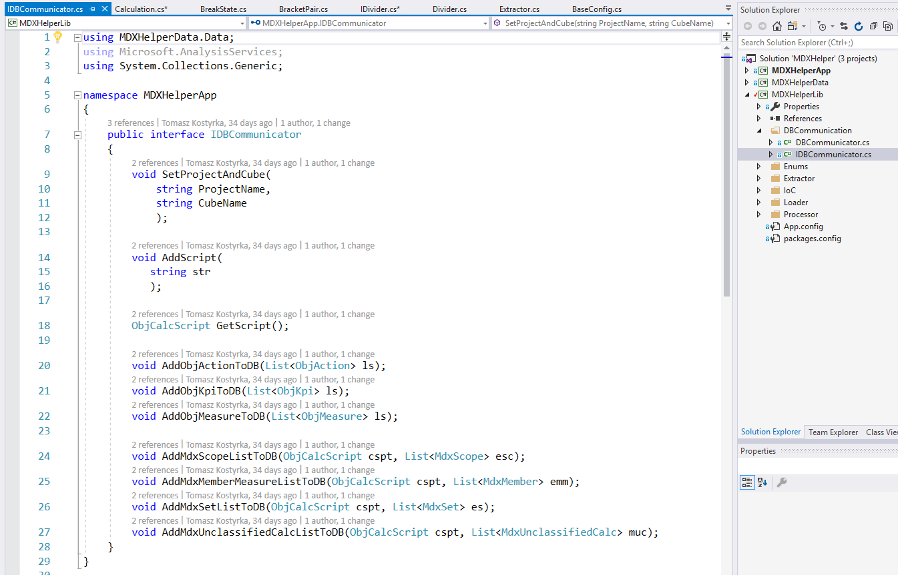
DBCommunication

Slide 40
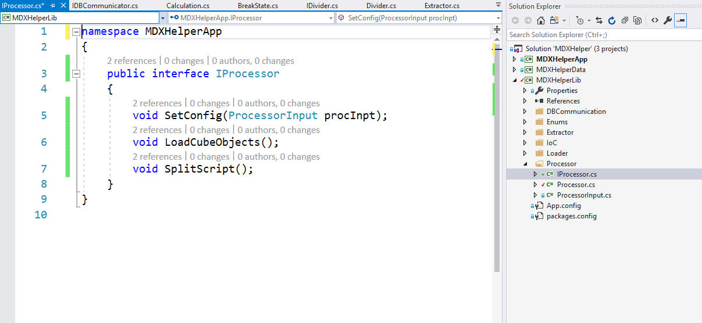
Processor

Slide 41
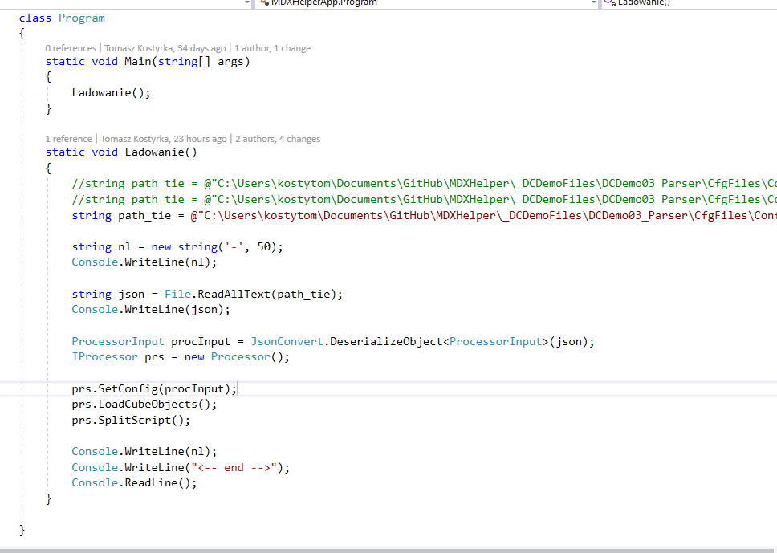
App
config path
deserialize json
processor

Slide 42
Thanks!

