Slide 1


1. Preparing a sky image
Just averaging sky frames
2. Preparing a sky flat
From above sky image…
・Removing Y-line noise by FFT
・Reducing X-line noise by FFT
(only thin components)
・Normalizing

Slide 2
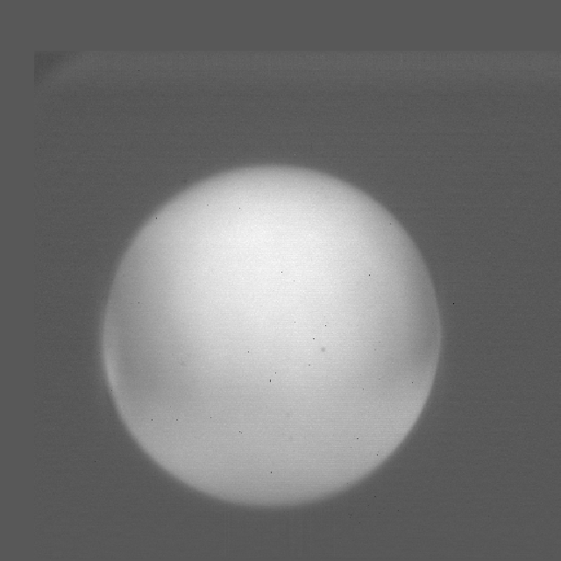
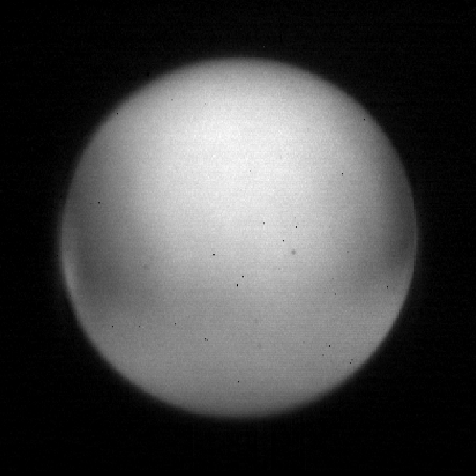
3. Make a reference frame from a good-seeing image for “Shift-and-Add”
Reference frame as a template
412 pix
412 pix
Image reduction:
・Subtracting the prepared sky image, and performing flat correction with the prepared sky flat
・Reducing Y and X-line noises by band-pass filtering with asymmetric (elongated) Gaussian filter

Slide 3
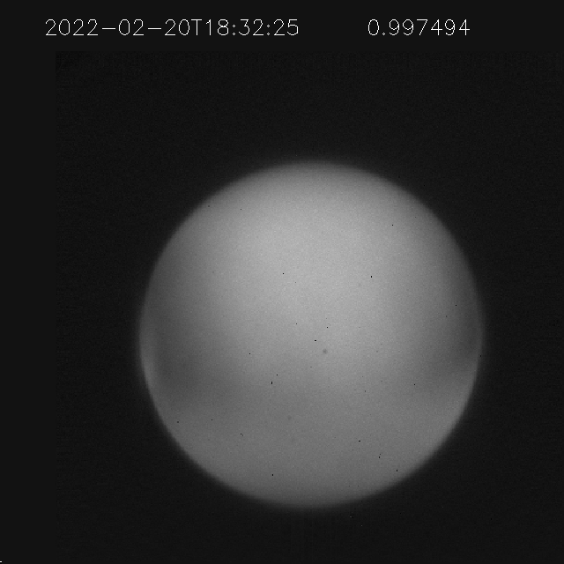
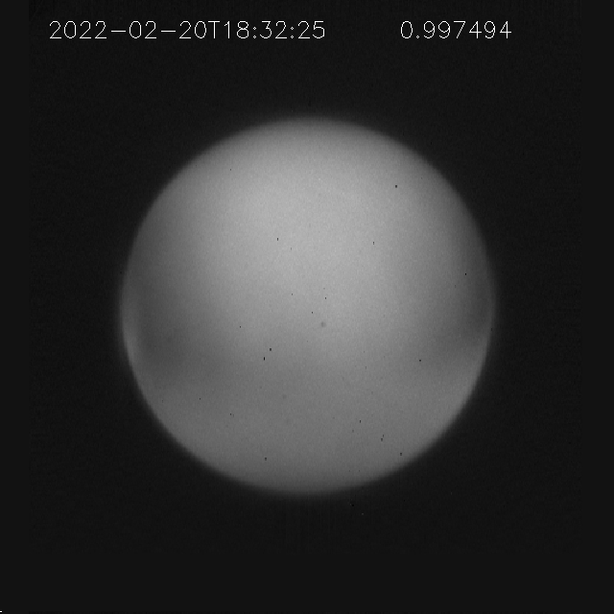
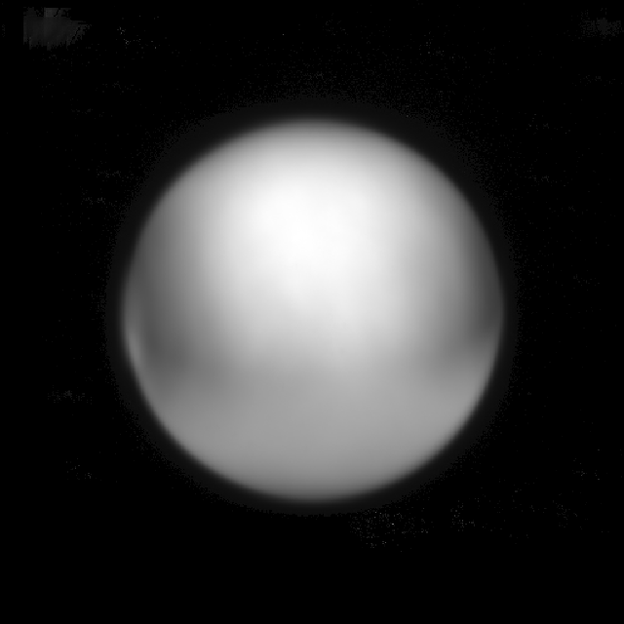
4. Performing “Shift-and-Add” based on template matching
Shifting to match the template position
Target frame
Adding
Template
Template matching to determine the position of Venus in each frame by finding the maximum peak position of correlation surface between observation and template frames
Image reduction:
・Subtracting the prepared sky image, and performing flat correction with the prepared sky flat
・Reducing Y and X-line noises by band-pass filtering with asymmetric (elongated) Gaussian filter

Slide 4
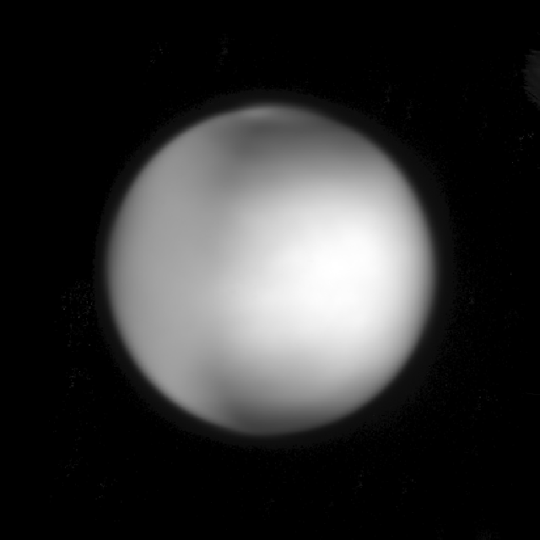
5. Adding geometry information (if necessary), and rotating image
Sub solar Lat: -2.3 [deg]
Sub solar Lon: -66.1 [deg]
Sub earth Lat: -4.9 [deg]
Sub earth Lon: 45.1 [deg]
In fits header: POSANGLE
Observation date
SPICE

Slide 5
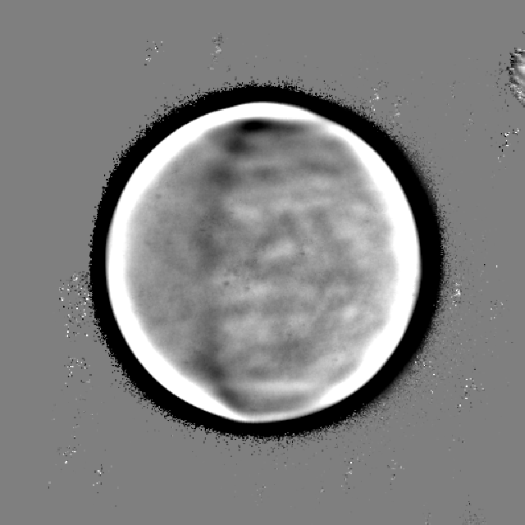
High-passed

