Slide 1
Androitroller
Providing a customizable controller experience to Android owners.
- Final Presentation-
Tyler Kramer & Eric Noble

Slide 2
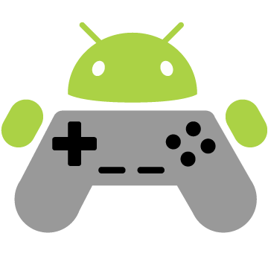
Project Description
Androitroller provides user’s with the ability to configure their ideal controller for PC gaming using their android device.

Slide 3
Components
Androitroller is split into two parts:
A Small-Scale Server – Connects the user’s device to Androitroller.
The Application – Allows for configuration of button set, controller background, and button placement.

Slide 4
Original Intent
The original intent of Androidtroller was to:
Provide a customizable controller
Interface which communicates with PC via server
Multiple button set looks
Customizable background
User-defined placement of buttons
Provide a means to maintain multiple configurations
Ability to save/edit/delete configurations

Slide 5
Realized Implementation
The realized implementation achieved:
Ability to customizable controller
Interface which communicates with PC via server
Multiple button set looks
Customizable background
User-defined placement of buttons
User-defined button sets
Provide a means to maintain multiple configurations
Ability to save/edit/delete configurations

Slide 6
Changes to Implementation
All implementation details in the original intent were successfully implemented and tested.
Changes to implementation:
The ability for users to define the button set i.e., which buttons were present in the controller, was added.

Slide 7
Lessons Learned
From the project, as a team we learned:
With good planning and a well-defined end-goal, project creation can go quite smoothly.
Careful planning in the beginning phases makes the extending of application functionality much easier.
In order to create a successful end-product it is important to capitalize on members’ strengths.

Slide 8
A Look towards the Future
If we had more time to expand upon Androitroller, we would like to implement:
Communication with PC over Bluetooth.
Communication with PC over USB cord.
Additional controller skins and button shapes.

Slide 9
Final Reflection
In the end, Androitroller was a success. This can be attributed to:
A well-defined starting point.
A manageable scope.
Good communication between members and distribution of work tasks.

Slide 10
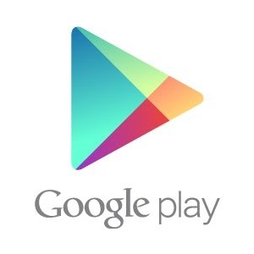

So, Where is our App Now?
Androitroller version 1.0 is available on the Play Store:
[url]
Androitroller is open source and can be downloaded from:
https://github.com/TKramez/Androitroller

