Slide 1
Androitroller
Providing a customizable controller experience to Android owners.
Tyler Kramer & Eric Noble

Slide 2
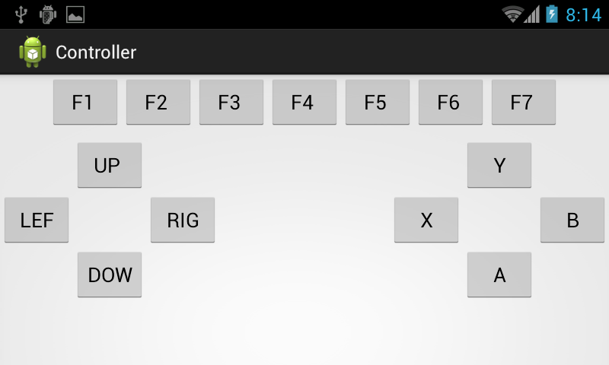
The Main Idea
Androitroller provides user’s with the ability to configure their ideal controller for PC gaming using their android device.

Slide 3
The Components
The Small-Scale Server – Connects the users device to Androitroller.
The Application – Allows for configuration of button locations, controller background, and button placement.

Slide 4
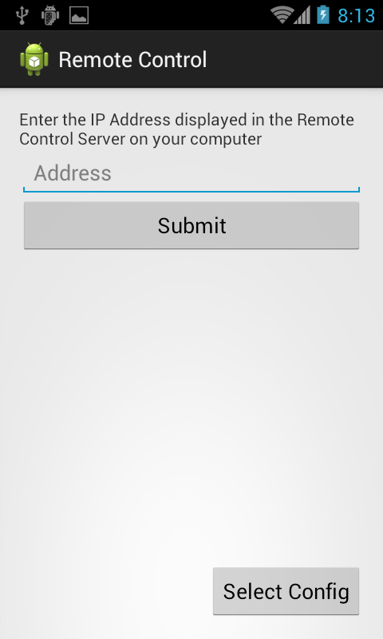
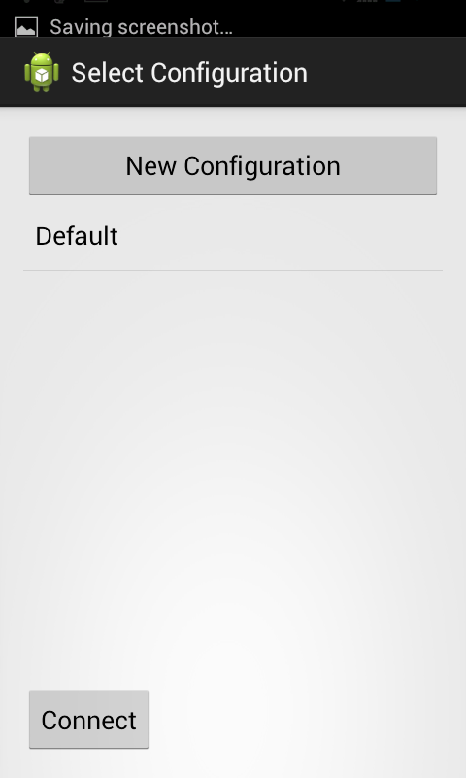
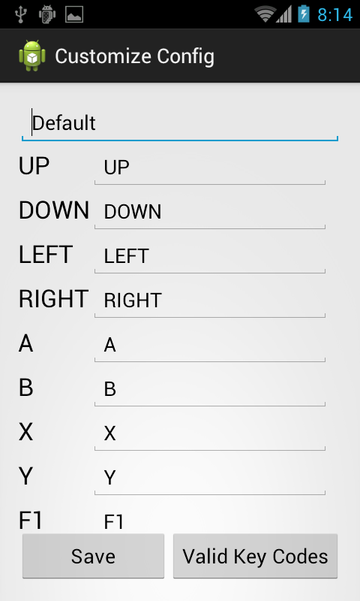
The Current Design

Slide 5
Goals Looking Forward
A Visual Upgrade
Custom graphics, branding, colour scheme.
Enhanced Customization Upgrade
Additional customization options, ability to move buttons.
Streamlining and Improvement of User Interface
Reimagining of user interface to improve useability and appeal.

