Slide 1
MIND - Simulation

Slide 2
Setup Overview

Slide 3
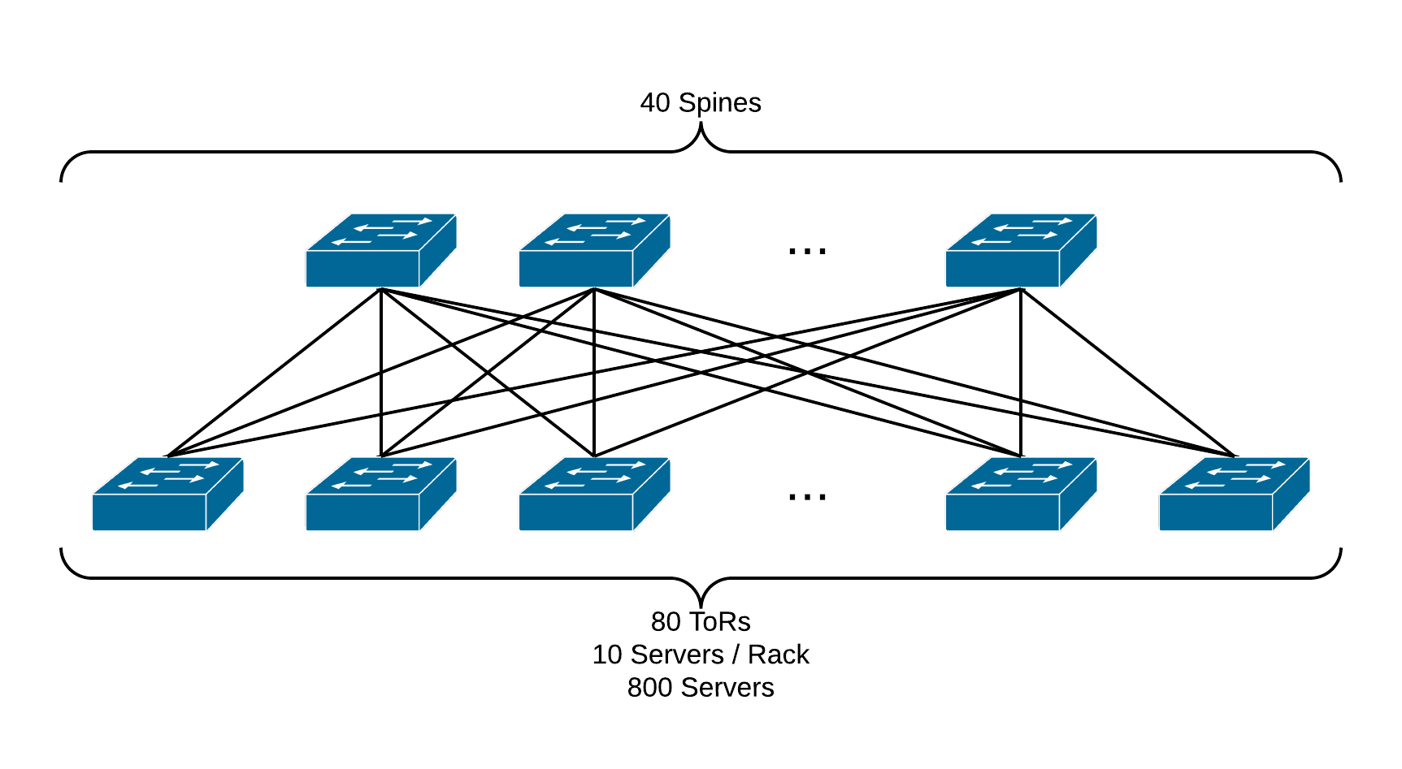
Topology
Spine-Leaf Topology is a popular design choice in recent data centers. [1][2]
Link bandwidth:
Server-to-ToR: 1Gbps
ToR-to-Spine: 10Gbps
[1] Farrington, Nathan, and Alexey Andreyev. "Facebook’s data center network architecture." IEEE Optical Interconnects Conf. 2013.,
[2] Alizadeh, Mohammad, et al. "pfabric: Minimal near-optimal datacenter transport." ACM SIGCOMM Computer Communication Review 43.4 (2013): 435-446.

Slide 4
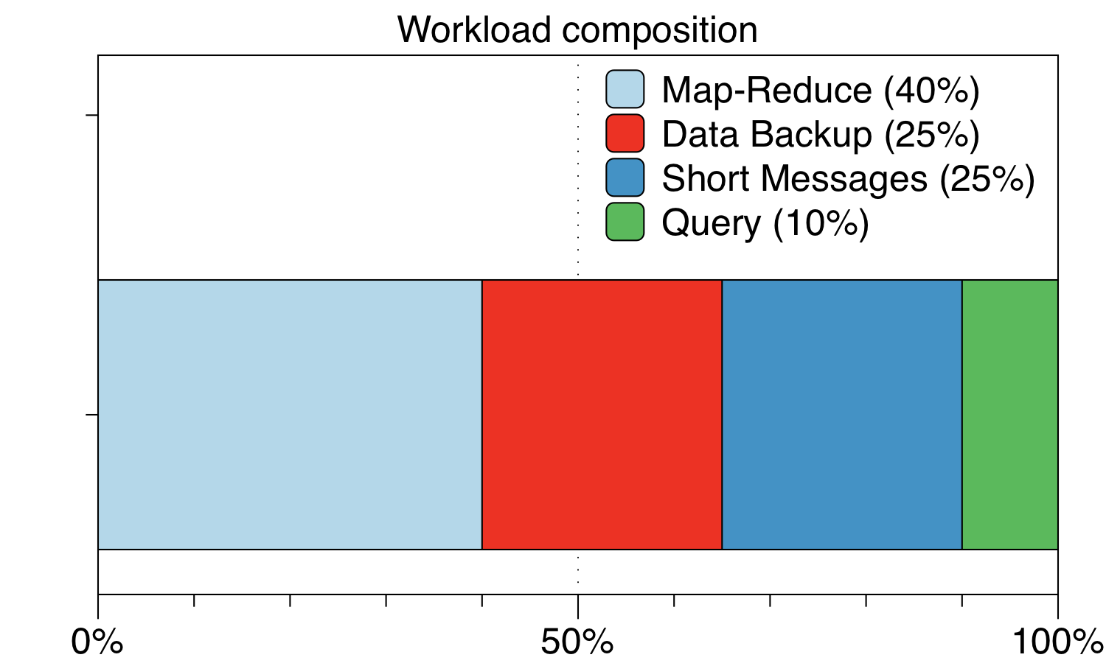
Workload composition
Map-Reduce:
Generated on HKUST testbed running benchmark jobs on Apache Spark framework.
Same as the trace used in coflow simulations
Data Backup:
Long flows larger than 10MB
Short Messages:
Short flows between 1MB to 10MB
Query:
Short flows less than 1MB

Slide 5
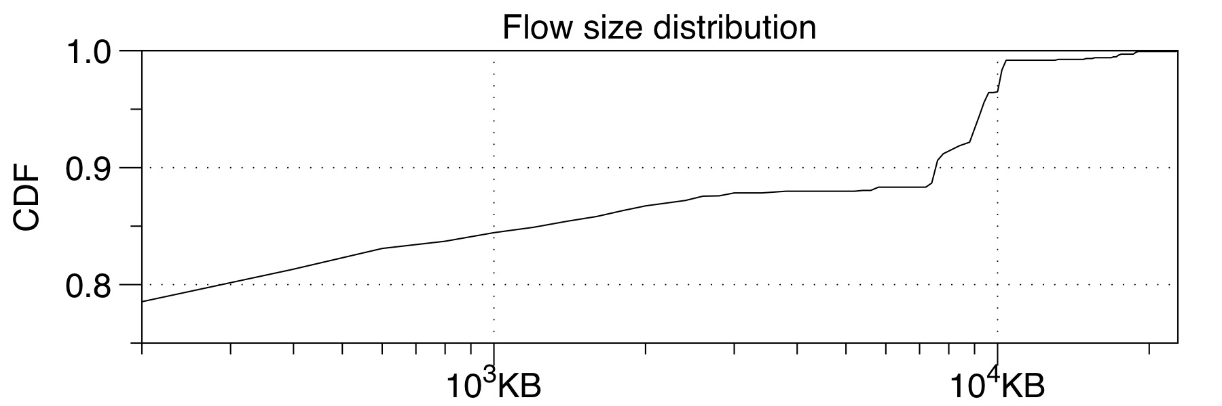
Flow size distribution
The flow size distribution used in the simulations exhibits the same (Heavy-tailed) characteristic s in the literature [1][2][3]:
Most flows (~80%) are short flows within 1MB
Most traffic volume is from long flows larger than 10MB
[1] Kandula, Srikanth, et al. "The nature of data center traffic: measurements & analysis." Proceedings of the 9th ACM SIGCOMM conference on Internet measurement conference. ACM, 2009.
[2] Benson, Theophilus, et al. "Understanding data center traffic characteristics."ACM SIGCOMM Computer Communication Review 40.1 (2010): 92-99.
[3] Greenberg, Albert, et al. "VL2: a scalable and flexible data center network."ACM SIGCOMM computer communication review. Vol. 39. No. 4. ACM, 2009.

Slide 6
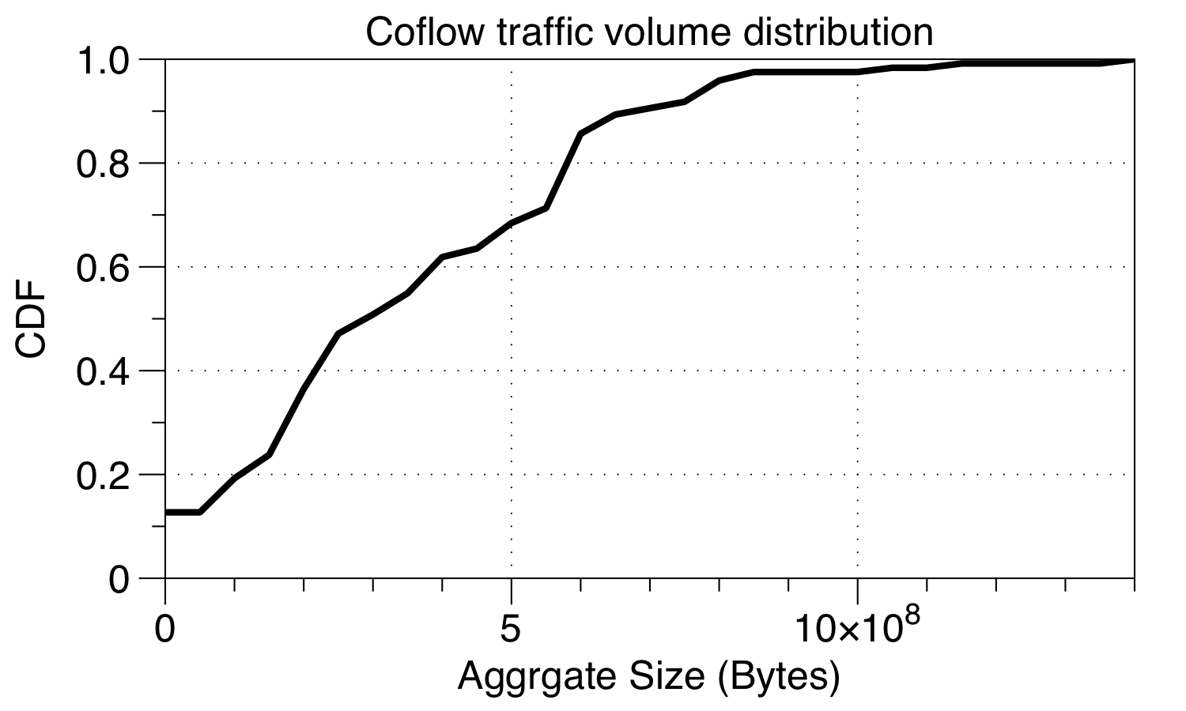
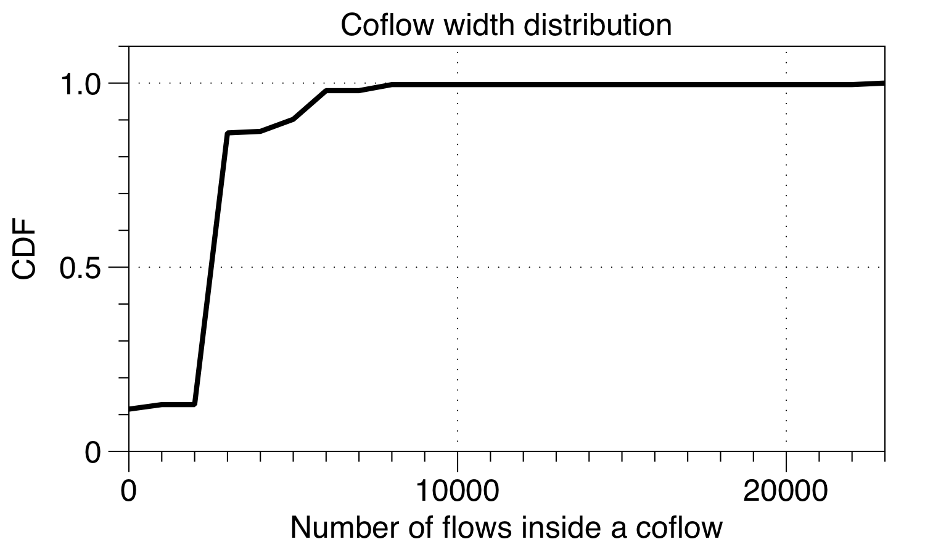
Coflow traffic characteristics
Pattern used in simulation is scaled-up to fill the 800-server topology. The characteristic also agrees with observations in existing literature [1][2], as shown below
[1] Chowdhury, Mosharaf, Yuan Zhong, and Ion Stoica. "Efficient coflow scheduling with Varys." Proceedings of the 2014 ACM conference on SIGCOMM. ACM, 2014.
[2] Zhao, Yangming, et al. "RAPIER: Integrating Routing and Scheduling for Coflow-aware Data Center Networks." Proc. IEEE INFOCOM. 2015.

Slide 7
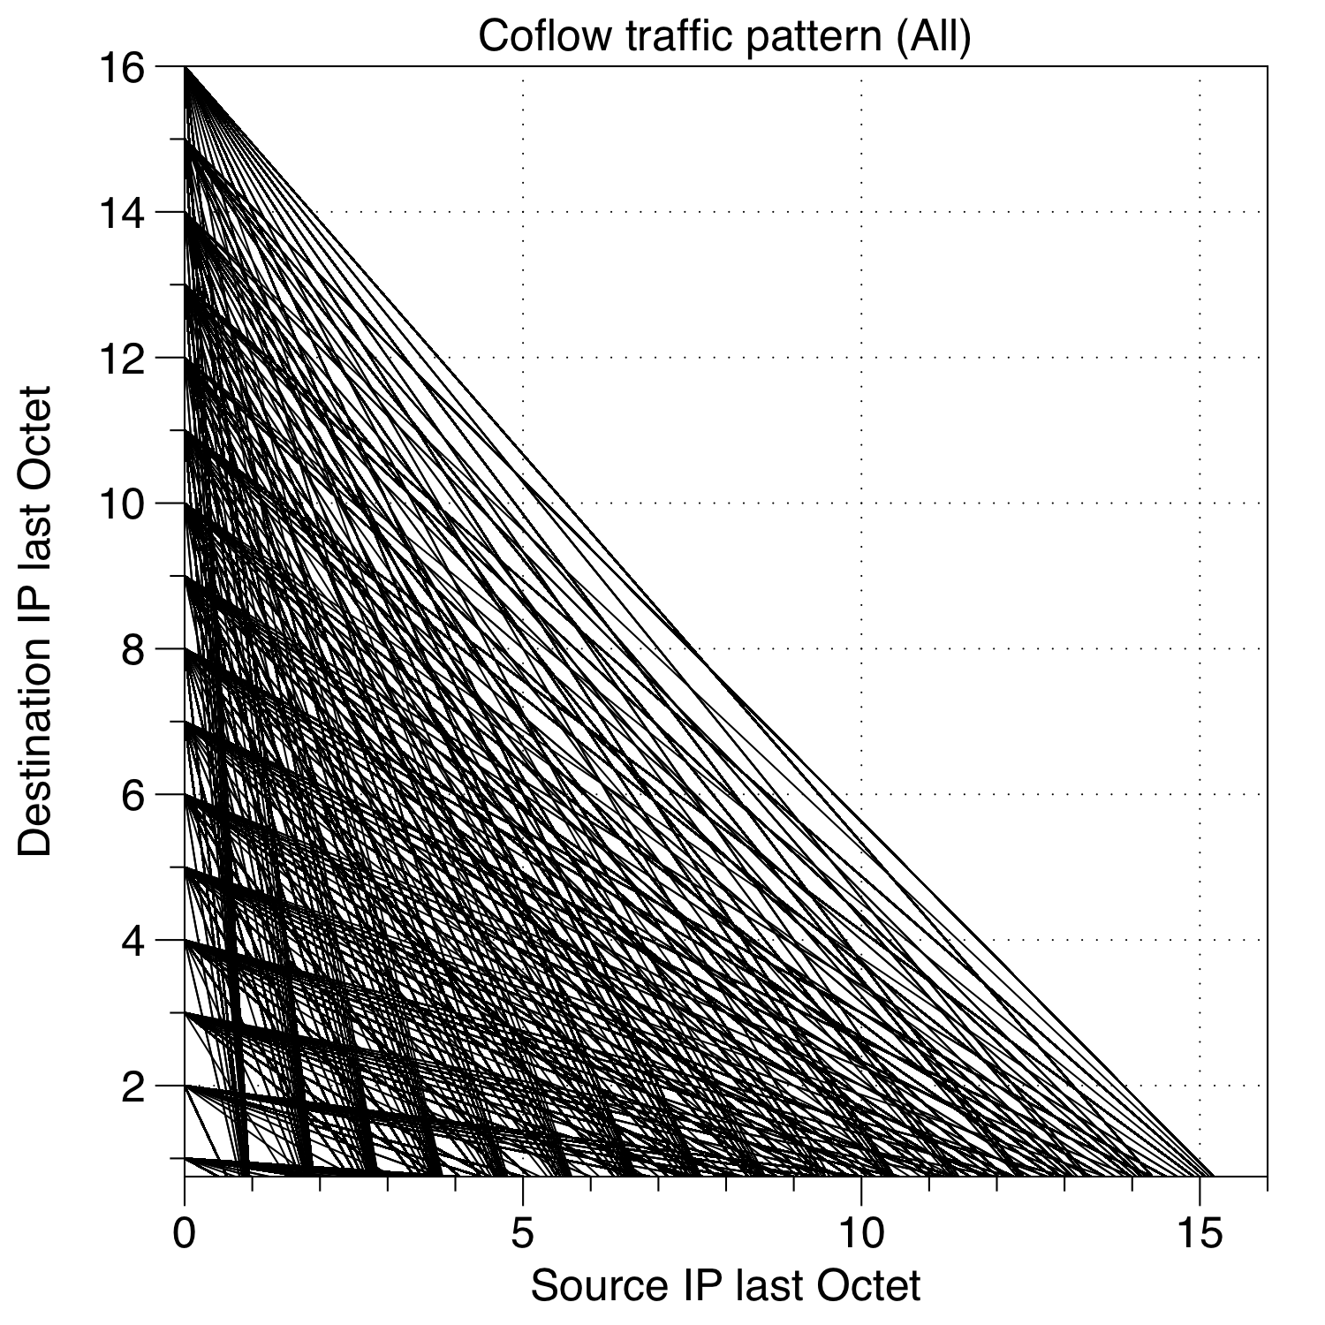
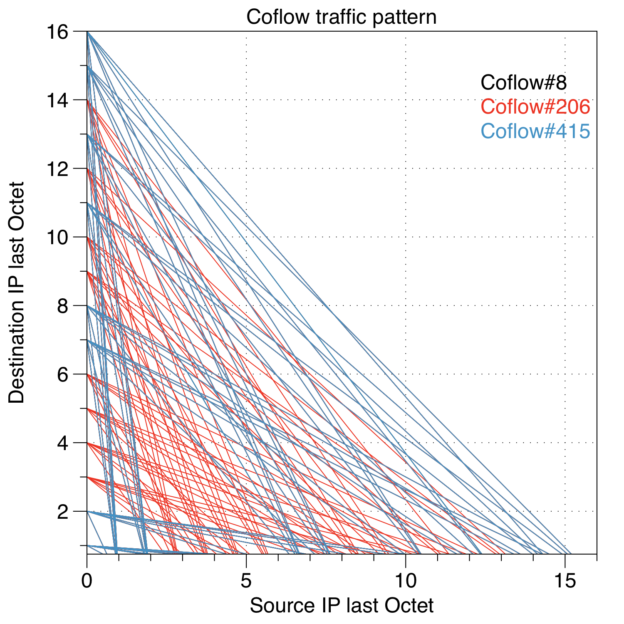
Coflow traffic pattern

Slide 8
Results

Slide 9
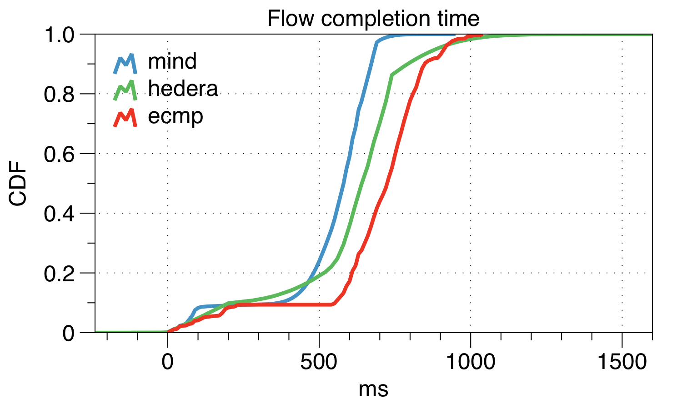
Flow completion time
Flow completion is measured for all flows for MIND, ECMP and Hedera (Global-first-fit). Detailed comparisons are in the next slide.

Slide 10
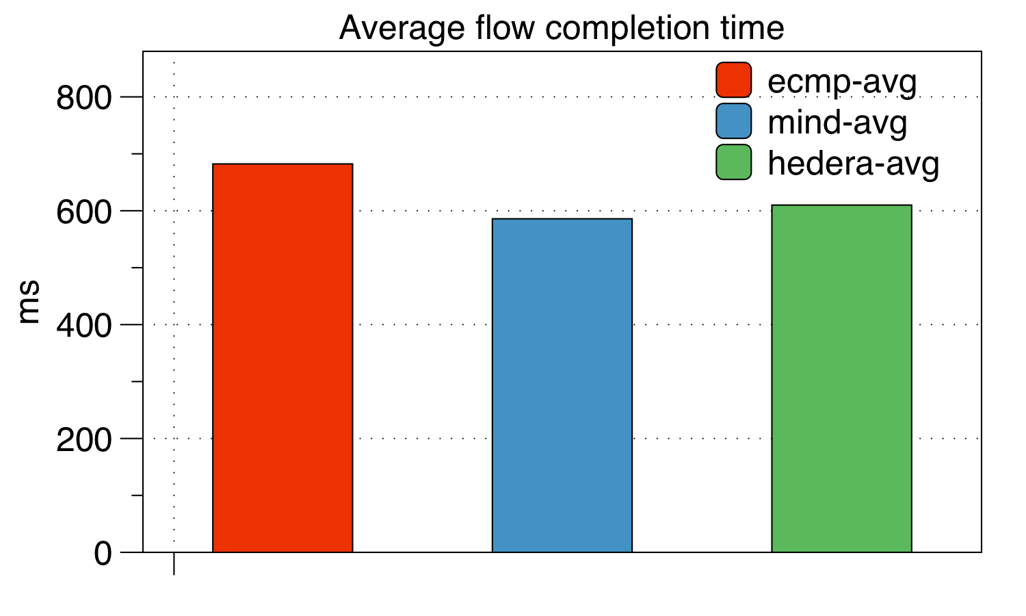
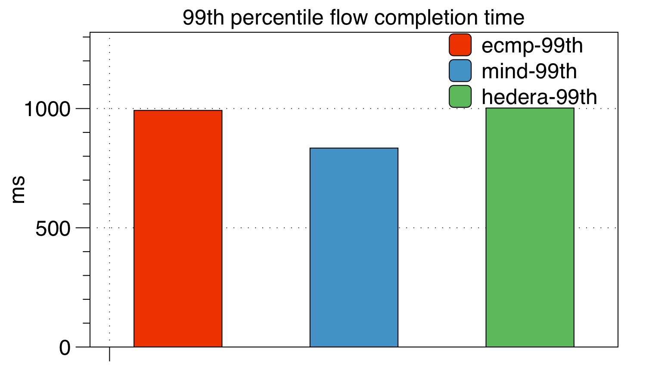
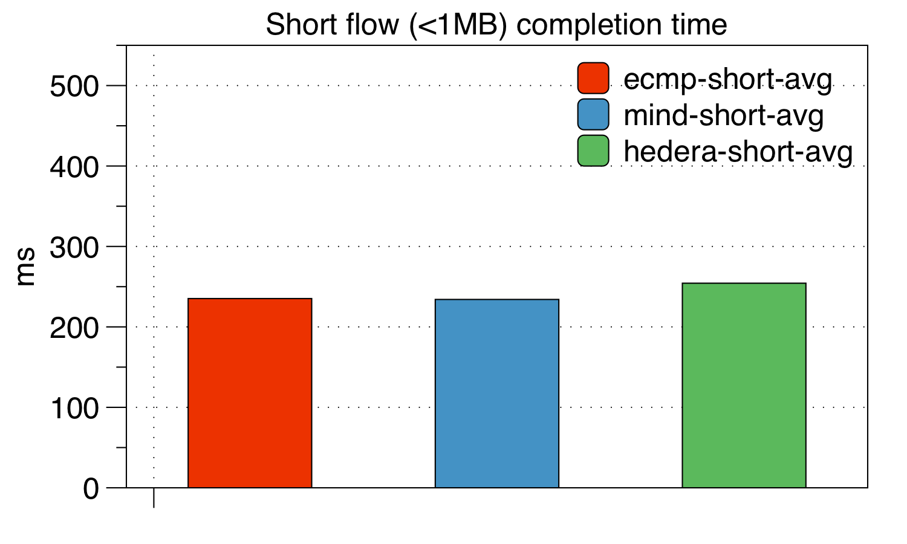

Average & 99th percentile flow completion time

Slide 11
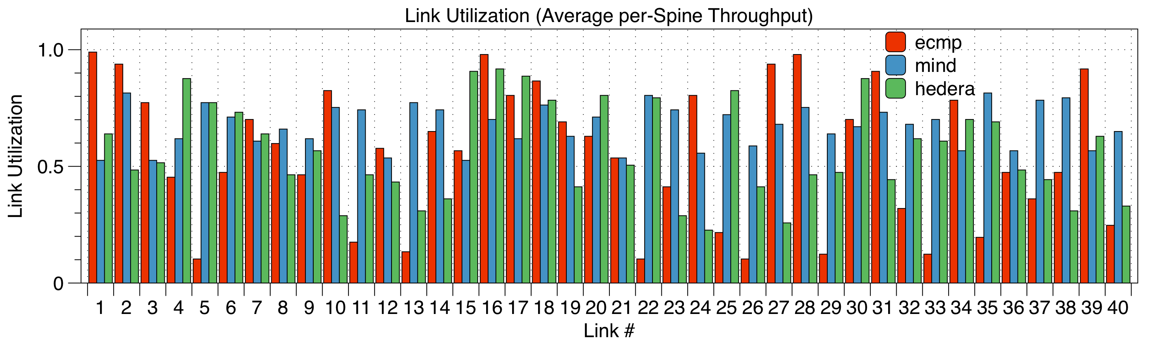
Throughput comparison
Average link utilization of the 40 Spine links are measured. ECMP has some extremely low link utilization, mainly due to its flow-level hashing (marked by circles). MIND and Hedera performs similarly, as they can relocate flows according to traffic distribution.

Slide 12
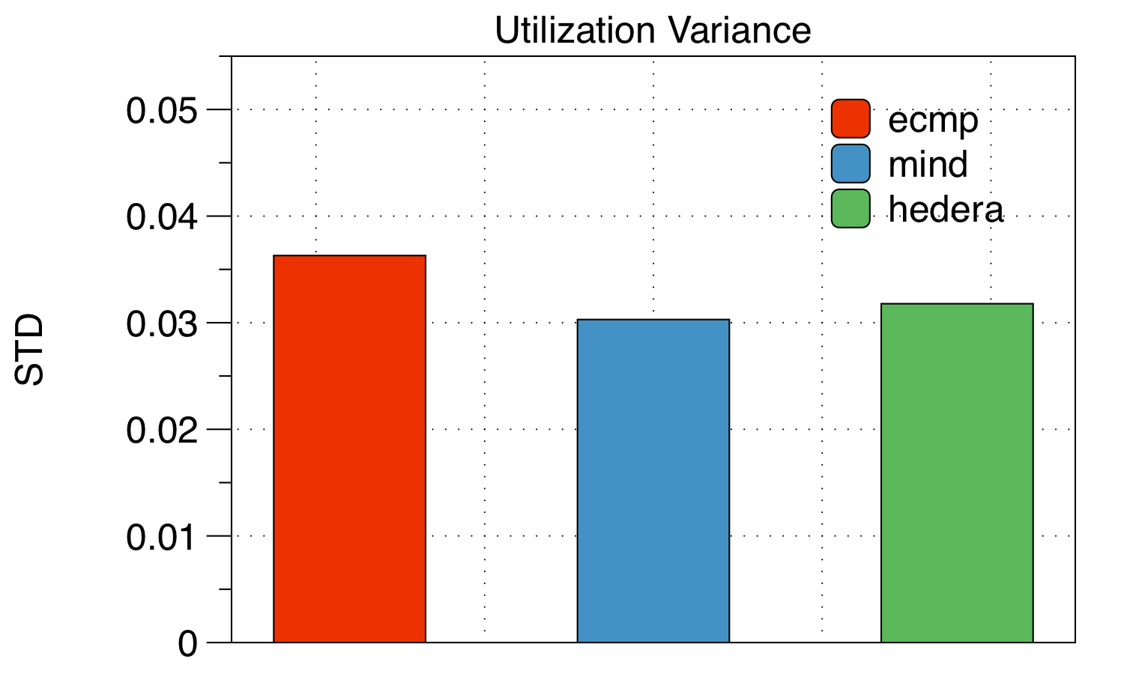
Link Utilization (Lower indicates better load balancing)
The variance of link utilizations are shown. Since ECMP has some extremely low link utilization, its variance is higher than MIND and Hedera. This shows MIND’s reinforcement-learning-based load balancing performs slightly better than Hedera.

Slide 13
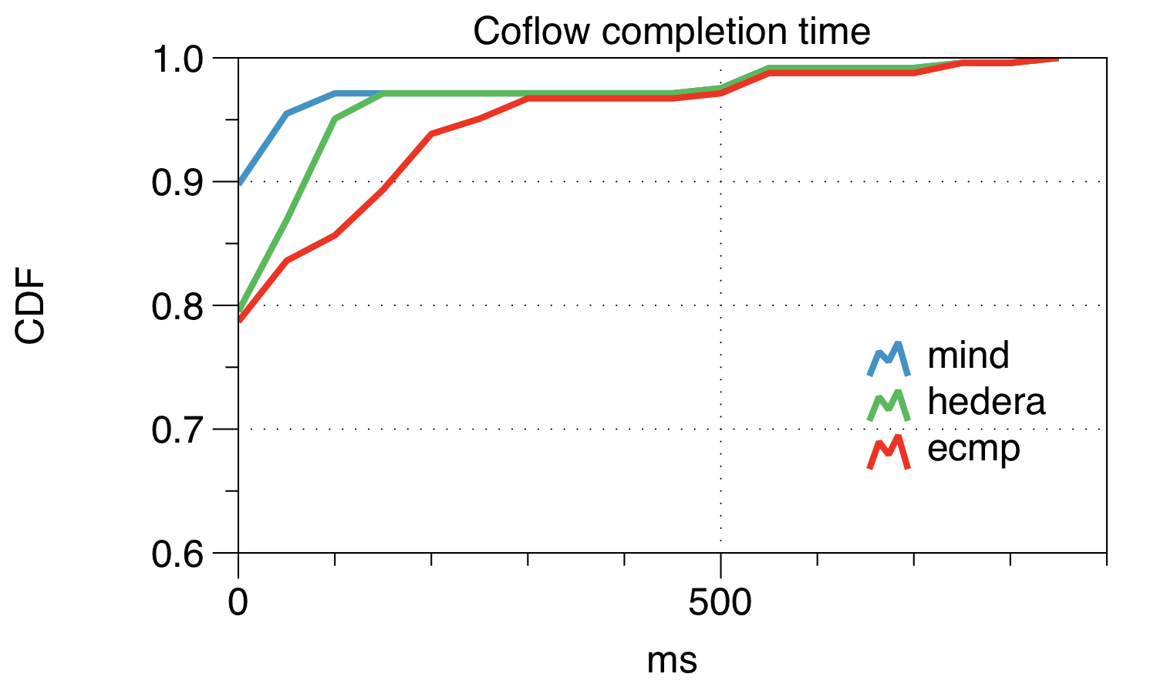
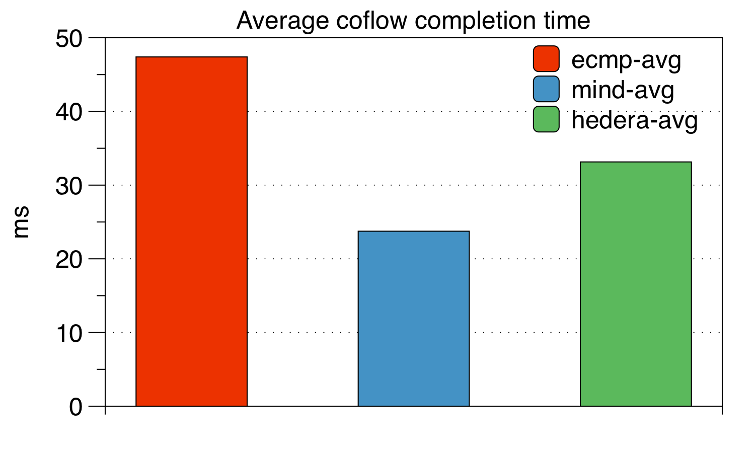
Coflow completion time
Coflow completion time is measured by the the difference between the starting time of the first flow in the coflow and the finishing time of the last. MIND is coflow-aware, which leads to better coflow completion times. Hedera and ECMP suffers from stragglers, i.e. flows lag behind the other flows in the same coflow.

