Slide 1

Note-taking

Slide 2

Did you know…?
99% of college students take notes during lectures
HOWEVER…
The typical student records less than 40% of the lecture’s content in their notes
Only 47% review their notes later
Only 29% edit their notes later by adding, deleting, or reorganizing information

Slide 3

Why is it important to take good notes?
Good notes will…
Keep you actively listening to lectures
Provide a record of the lecture for later use
Allow you to organize and structure information
Help you remember information
If you take notes, you have a 50% chance of recalling the information at test time. If you do not take notes, you have a 15% chance of remembering the information.

Slide 4

Learning to take good notes
Use a note-taking system
Develop note-taking skills
Active listening
Organization
What are good notes?
Good notes occur when you write an accurate, complete, organized account of what you hear in class.

Slide 5
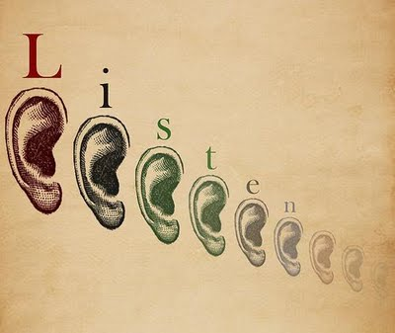
Why is it important to listen actively?
There is a big difference between the speed we speak (125-175 words per minute) and the speed we listen (450 words per minute). This means we only use 25% of our mental capacity to listen.
After listening to a lecture, the average person has heard and understood about 50% of what was said. Within 48 hours, they forget about half of that. This means we only comprehend about 25% of what we hear.

Slide 6

What is Active Listening?
A series of techniques designed to help students avoid distractions and focus fully on a lecture or presentation.

Slide 7
How do I listen actively?
Before a Lecture:
During a Lecture:
Set aside distractions
Read any assigned materials before class
Mentally review what you already know about the subject
Be open-minded
Focus on the person communicating
Determine the speaker’s main point
Actively respond to questions and directions

Slide 8

When actively listening, use the following cues to recognize when the speaker is making an important point:
Pausing
Giving Examples
Repeating him/herself
Repeating the Textbook
Increasing volume/changing pitch
Taking more time in one area
Adding activities or worksheets
Using body language
Writing on the board
Using direct statements (this is important) or signal words (significant, most)

Slide 9

Pre-Reflection: Stop here for a moment and answer a few questions on your handout:
What do you already know about taking notes?
What methods do you usually use?
What challenges do you sometimes face when taking notes?

Slide 10

Note taking Systems
Cornell
Outlining
Mapping
Charting
Parallel Note-Taking

Slide 11
Cornell Notes
Cornell notes are a specific system for organizing notes.
Cornell notes have three parts:
A left column with cues (questions, key words)
A right column with information from the lecture
A summary section at the bottom
 | Note-Taking
What are Cornell notes? | Cornell Notes are a specific method of taking notes
What goes on the left side? | In the left column, write questions or key words that relate to information on the right
Cornell notes provide a specific organizational structure for taking notes.

Slide 12

Getting started with Cornell
To begin, make a line or fold in your paper about 2 or 3 inches from the left margin
Label your notes at the top of the page with the class, date, and topic of the lecture

Slide 13

During class
During class, write down information from the lecture on the right side of the page
When the instructor moves to a new topic, skip a few lines

Slide 14

Cues
As soon after class as possible, write questions and/or key terms in the left column that describe the information in the right column
You may have time to do some of this in class, but be sure to review and expand after class

Slide 15

Summary
After class, draw a line across the bottom of your notes
Reread your notes and write a few sentences that summarize the content of the lecture below the line

Slide 16
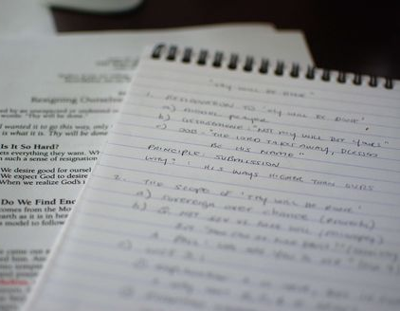
Outlining Notes
An outline is an organized list
Main points to the left margin
Sub-points indented below the main point
For lecture notes, no need to use Roman numerals, letters, or numbers

Slide 17
Outline Example
Title
Extrasensory perception
Definition: means of perceiving without use of sense organs.
Three kinds
Telepathy: sending messages
Clairvoyance: forecasting the future
Psychokinesis: perceiving events external to situation
Current status
No current research to support or refute
Few psychologists say impossible
Door open to future
Main Point
Sub-points

Slide 18
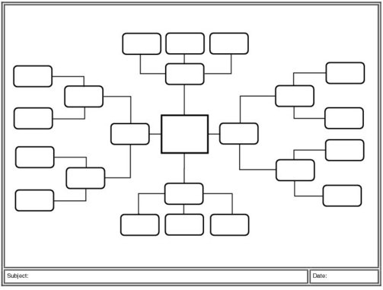
Mapping
Focuses on the relationship between topics
Graphic representation, so it’s good for visual learners
Can incorporate color and images easily
Students can also use their traditional lecture notes to create maps after a lecture

Slide 19
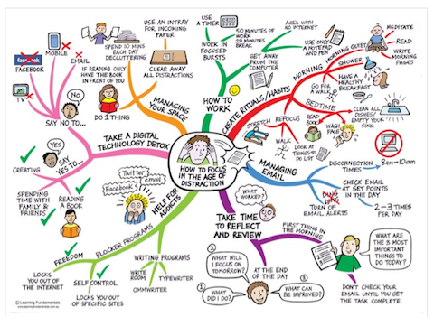
Mapping Example

Slide 20
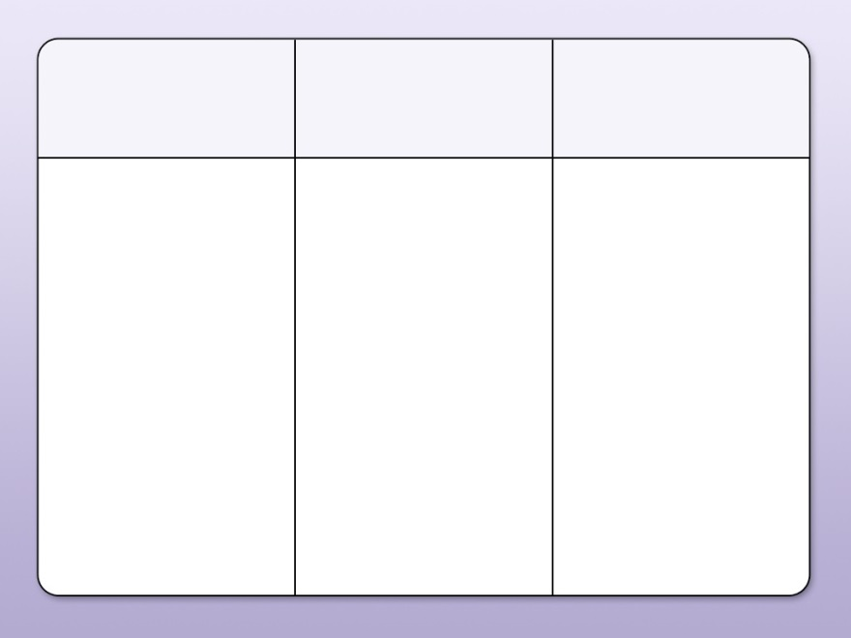
Charting
Create a table with labeled columns
Fill in the table as class progresses
Useful for dates or key terms
Helps to differentiate information by category

Slide 21

Charting Example

Slide 22
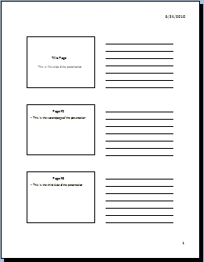
Parallel Note-Taking
Instructors often provide e-support for lectures, such as PowerPoint presentations, lecture notes, or handouts.
If possible, print these support documents before the lecture.
As your instructor lectures, take notes directly on the document.
You can combine this technique with other note-taking techniques like the Cornell system.

Slide 23

Tips for Taking Notes: Before the Lecture
Come to class prepared (paper, pens, assigned reading completed)
Review notes from the previous lecture
Eliminate distractions
Sit where you can see and hear easily

Slide 24

Tips for Taking Notes: During the Lecture
Write down the title of the lecture, the name of the course, and the date
Pay attention to the class agenda/outline
Don’t try to write down every word—use phrases rather than sentences and abbreviate whenever you can
Pay attention to the summary at the end of the lecture
At the end of the lecture, ask questions to clarify any points you don’t understand

Slide 25
Common symbols and abbreviations
And: +
More than: >
Less than: <
With: w/
Because: b/c
For example: e.g.
That is: i.e.
Versus: vs
Circa: c.
Question: ?
Answer: A
Difference: diff
Like: lk
At: @
Approximately: ~
Number: #
Leads to: →
Comes from: ←

Slide 26
Using your notes for review
First, reread your notes
Try to fill in any blanks
Identify key words and main ideas
Make connections between info from the textbook and the lecture notes
Then, use notes to prepare for assignments and exams
Review periodically to avoid cramming for an exam
Quiz yourself
Create flashcards or concept maps
TIP: Compare your notes with a classmate. You can help fill in the blanks in each other’s notes and discuss the lecture to make sure you both understand it.

Slide 27

If you liked this Lesson and would like more information, consider attending:
Outlining Your Essay
Outlining Readings
Reading Textbooks
Test Taking Strategies
Why should you come back?
Students completing Supplemental Learning Activities had a 10% higher success rate across the disciplines, a 21% higher success rate in Math, and a 49% higher success rate in English courses.

Slide 28
Practice: Taking notes from a lecture
When you are ready, click on the button to start the lecture.
Use one of the different note taking systems to take notes during the lecture.
Cornell
Outlining
Mapping
Charting

Slide 29
You have completed the first step of the GLA.
The next step is to apply what you have learned by completing the handout exercises and reviewing your work with a tutor.

