Slide 1
The Misunderstood
Apostrophe
’’’’

Slide 2
Of all the punctuation marks, the apostrophe is probably the most frequently misunderstood.
’

Slide 3

But don’t worry. Understanding the apostrophe isn’t difficult.

Slide 4

In fact, it’s as easy as pie.

Slide 5
The apostrophe has two main uses:
1. To create contractions
2. To show possession
’’’’’’’’’’

Slide 6
Apostrophe Use #1 CONTRACTIONS

Slide 7
A contraction is a word or words with letters omitted.
Some common contractions
do not = don’t
is not = isn’t
it is = it’s

Slide 8
Notice how the apostrophe (’) takes the place of the missing letter.
Some common contractions
do not = donot = don’t
is not = isnot = isn’t
it is =itis = it’s

Slide 9
INSTANT REPLAY
(notice the contractions)
But don’t worry. Understanding the apostrophe isn’t difficult.
In fact, it’s as easy as pie.

Slide 10
More common contractions:
    I am = I’m they are = they’re
    you will = you’ll could have = could’ve
    I have = I’ve cannot = can’t
    you are = you’re have not = haven’t
    she will = she’ll was not = wasn’t
    he had = he’d we have = we’ve

Slide 11

A few unique contractions:
    Time: two of the clock = two o’clock
    Years: 1999 = ’99
    Slang: rock and roll = rock ’n’ roll
    the neighborhood = the ’hood
    Notice that the
    apostrophe
    still takes
    the place of
    omitted letters.

Slide 12

Don’t confuse
it’s with its.
A contraction:
it’s = it is
It’s a great day to build
A snowman!
Showing possession:
its = his, her, its
The snowman lost
its hat.

Slide 13

Don’t confuse
you’re with your.
A contraction:
you are = you’re
Mom said, “You’re not having dessert until you finish those vegetables.”
Showing possession:
your = my, your, his, her Your mother is serious.

Slide 14
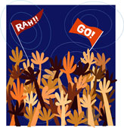
Don’t confuse
they’re with their.
A contraction:
they are = they’re
They’re cheering joyfully.
Showing possession:
their = my, your, his, her Their team just won.

Slide 15
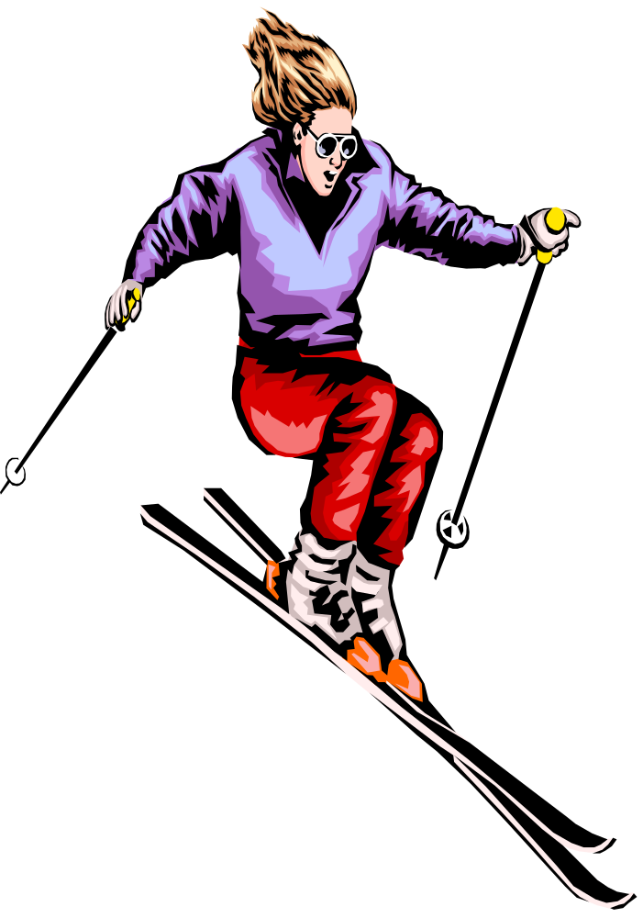
Don’t confuse
who’s with whose.
A contraction:
Who is = who’s
Who’s going on the ski trip with us?
Showing possession:
Whose skis are those?

Slide 16

Check for understanding: Stop here to answer a few questions about what you just learned
Click on the button to go to the interactive exercise.

Slide 17
Apostrophe Use #2
POSSESSION

Slide 18
When you possess something, you own it; it belongs to you.
Apostrophes can be used to show possession or ownership.
Example: John’s dog
(The dog belongs to John.)

Slide 19
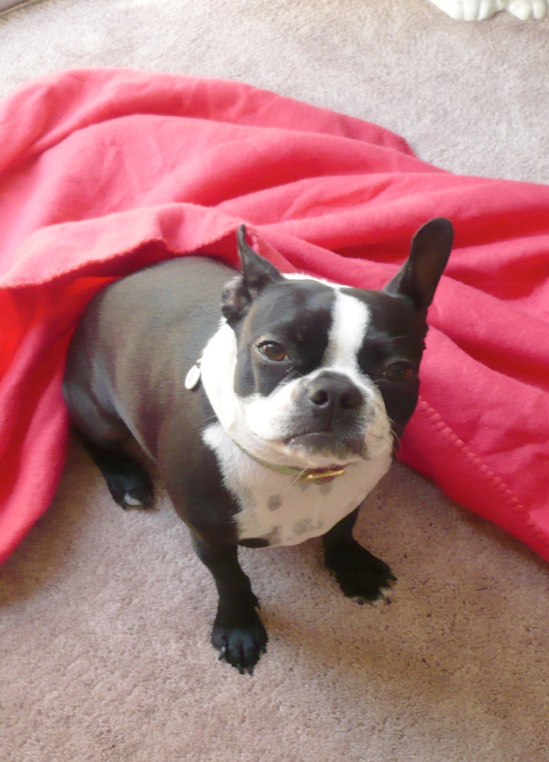
John’s dog
(The dog belongs to John.)
The dog’s blanket
(The blanket belongs to the dog.)
The blanket’s color
(The color belongs to the blanket.)

Slide 20
More possession
Henry’s happiness
(the happiness of Henry)
Mary’s problems
(the problems of Mary)
the paper’s introduction
(the introduction of the paper)
your money’s worth
(the worth of your money)
yesterday’s weather
(the weather of yesterday)

Slide 21
Singular versus Plural Possession
Pluralize nouns first
before adding the apostrophe
Singular: ’s
The doctor’s last patient was late. (one doctor)
Plural: s’
Three doctors’ offices were painted over the weekend. (three doctors)

Slide 22
Singular versus Plural Possession
Irregular nouns
Pluralize nouns first
before adding the apostrophe + s
Singular:
Her child’s toy The man’s clothing
Plural:
Her children’s toys A men’s clothing store

Slide 23
Singular words ending in “s”
Charles, Jesus
If a name has two or more syllables, and would sound funny with an extra syllable, (like Charles’s) just add the apostrophe:
Jesus’ birth Moses’ life
Kansas’ tornadoes Lexus’ features
(Both Charles’ and Charles’s are technically acceptable.)

Slide 24
Don’t let business names confuse you.
McDonald’s ( Restaurant)
Wendy’s ( Hamburgers)
BUT
Popeyes (Fried Chicken and Biscuits)
Starbucks (Coffee Company)
SOMETIMES BUSINESSES DROP THE APOSTROPHE
WHEN PEOPLE GET USED TO THE SHORTER NAME.

Slide 25
Review
The apostrophe has two main uses: 1. To create contractions
2. To show possession
’’’’’’’’’’

Slide 26
SPECIAL USE
The apostrophe also has a special use: to create plurals of a letter or symbol.
I got three A’s on my report card.
Remember to put @’s in the email addresses.
(You will rarely use apostrophes this way, so if this special rule confuses you, forget it.)

Slide 27
When NOT to use the apostrophe
Except for those special cases, DO NOT USE APOSTROPHES TO MAKE SIMPLE PLURALS–EVER!
RIGHT WRONG
She ate three pizzas. She ate three pizza’s.
You make great nachos. You make great nacho’s.
I was born in the 1990s. I was born in the 1990’s
I sold two condos. I sold two condo’s.
She bought two PCs. She bought two PC’s.

Slide 28
ALSO, REMEMBER THIS!
DO NOT ADD APOSTROPHES TO VERBS.
IT MAKES NO SENSE!
RIGHT WRONG
He works at Pizza Hut. He work’s at Pizza Hut.
She makes great nachos. She make’s great nachos.

Slide 29
Check for understanding: Stop here to answer a few questions about what you just learned
Click on the link to go to the interactive exercise.

Slide 30
Congratulations! Now you understand the
Apostrophe.
’’’’

