Slide 1
GUIDED LEARNING ACTIVITY
COLLEGE OF THE CANYONS
Solving Geometry Problems

Slide 2
Solving Geometry Problems
The Goal of this tutorial is to learn how to use algebra to solve geometry problems involving angles, area and perimeter.
Before we can solve though, we need to understand how angles relate to each other in geometry. We also need to review some of the basic formulas of perimeter and area.

Slide 3




Here are some various types of Angles in Geometry
Complementary angles are two angles whose measures have the sum 90⁰.
For example, in the following diagram, angle 1 = 60 degrees and angle 2 = 30
degrees. Notice they add up to 90 degrees.
Supplementary angles are two angles whose measure has the sum 180⁰.
For example, in the following diagram, angle 3 = 130 degrees and angle 4 = 50
degrees. Notice they add up to 180 degrees.

Slide 4
Example 1
Let’s look at a couple geometry problems that involve complementary and supplementary angles.
Ex 1) Find the measure of two complementary angles such that one angle is three times as large as the other angle.

Slide 5
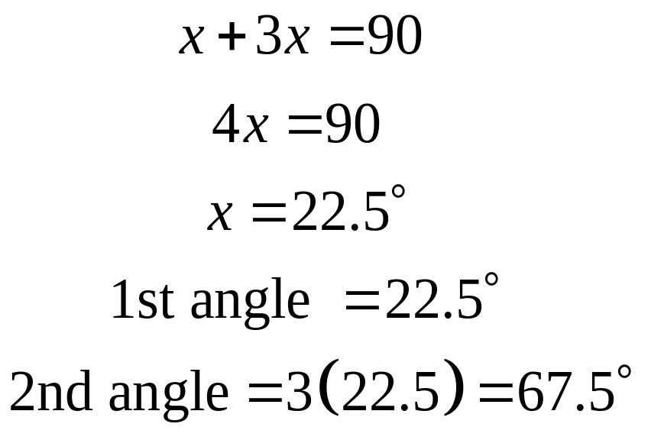
Example 1 Solution
As with any word problem, the key is to find algebraic expressions for your unknowns. Let x = 1st angle and 3x = 2nd angle. Since they are complementary, they add up to 90 degrees. Now solve.

Slide 6
Example 2
Let’s try another problem. This time involving supplementary angles.
Ex 2) One angle is 50 degrees more than four times its supplement. Find both angles.

Slide 7
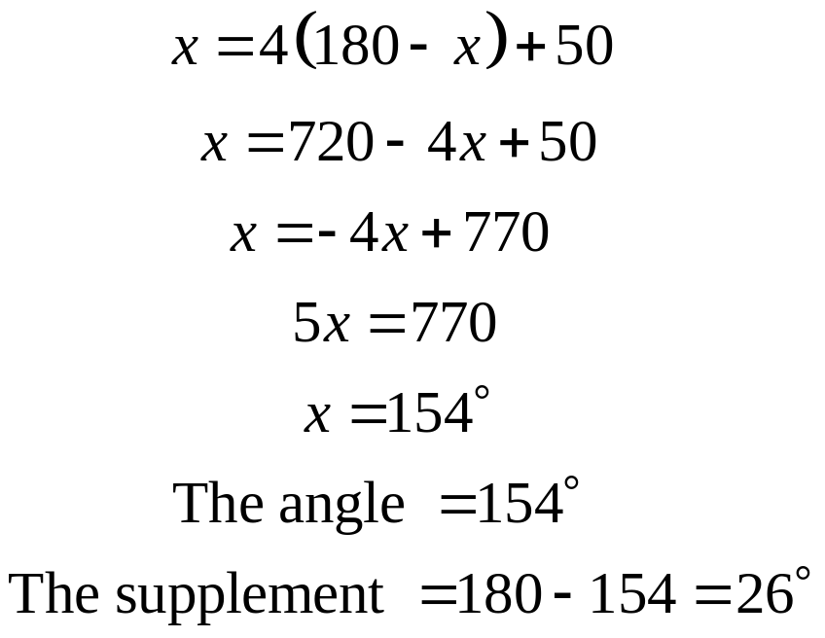
Example 2 Solution
Again, it is important to describe the unknowns with algebraic expressions. Let x = angle. Since the angle x and its supplement must add up to 180, let the supplement = 180 – x. Now we translate the words and solve. “One angle” (x) “is” (=) “50 more than four times the supplement” 4(180-x)+50.

Slide 8
Now its your turn to practice.
On a separate sheet of paper, solve the following two problems. Don’t move on to the next slide till you are done. Ask a tutor for help if you get stuck.
P1) One angle is 30 degrees more than twice its complement. Find the angle and its complement.
P2) Find an angle such that its supplement is equal to 40 degrees less than three times its complement. Find the supplement and complement also.

Slide 9
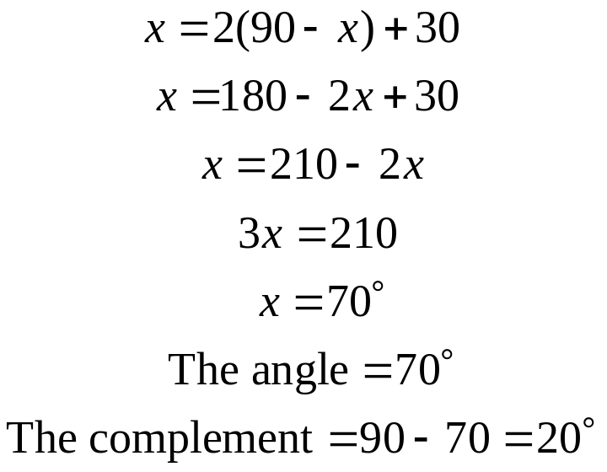
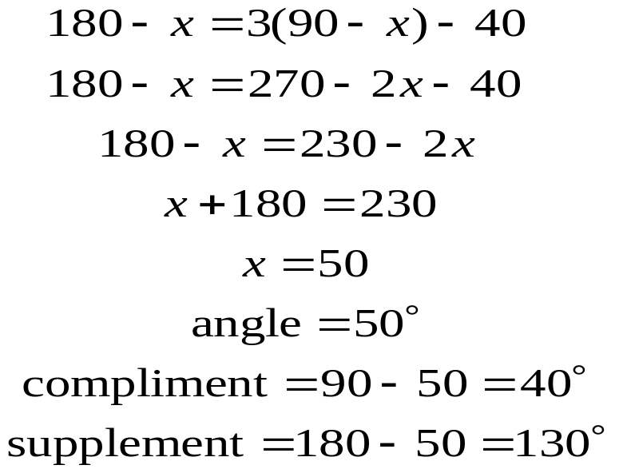
Solutions to practice problems P1 and P2
P1: Let the angle = x and let the compliment = 90 – x Translate and solve.
P2: Let the angle = x , let the complement = 90 – x and let the supplement = 180 – x . Translate and solve.

Slide 10
Here are some other types of angles involving two parallel lines and a transversal.
Alternate interior angles are two angles that are on the opposite sides of the transversal and between lines. Alternate interior angles are equal. For example angles 4 and 5 are alternate interior. Also angles 3 and 6.
Alternate exterior angles are two angles that are on the opposite sides of the transversal and outside of the parallel lines. Alternate exterior angles are also equal. For example angles 1 and 8 are alternate exterior. Also angles 2 and 7.
Corresponding angles are two angles that are on the same side of the transversal and are both acute (less than 90 degrees) or are both obtuse (greater than 90 degrees). For example, angles 1 and 5 are corresponding. Also angles 2 and 6. Corresponding angles are equal.

Slide 11


Lets look at Example #3
Ex 3) In the following diagram, find x. Then find the measure of each angle.

Slide 12
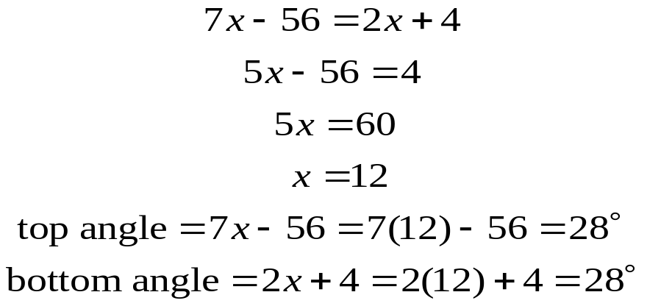
Solving Example #3
Since the angles are alternate interior angles, they must be equal. So let’s set the two expressions equal and solve for x. Then we can find the two angles.

Slide 13
Vertical Angles
When two lines cross, the angles on opposite sides are called vertical angles. Vertical angles are also equal. For example in the following diagram angle
1 = angle 3 and angle 2 = angle 4.

Slide 14


Let’s look at Example 4
Here is an example using vertical angles.
In the following diagram, find x. Then find the measure of both angles.

Slide 15
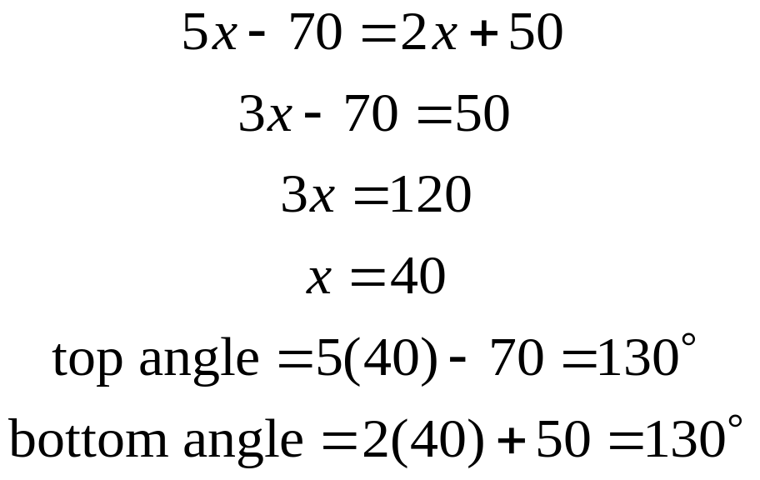
Solving Example 4
Since the two angles in question are vertical angles, they are equal to each other. So we will set the two expressions equal to each other and solve for x. Then we can find the value of each angle.

Slide 16




Now you solve practice problems P3 and P4
Solve the following two problems on a separate sheet of paper before moving on to the next slide. Ask a tutor to help you if you get stuck.
Solve for x in the following two diagrams. Then find the value of each of the angles.
P3) P4)

Slide 17
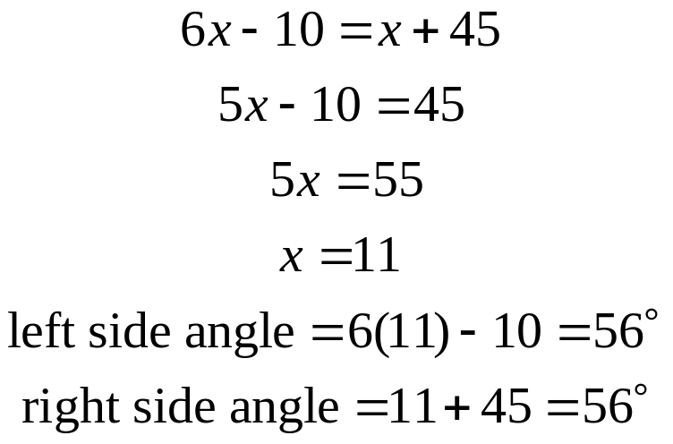
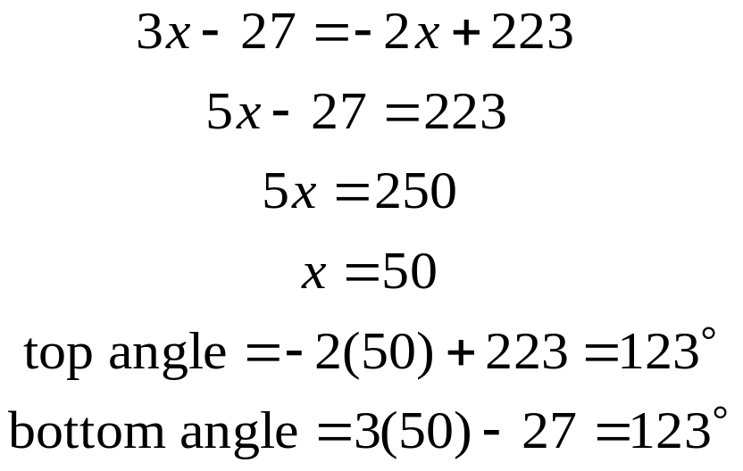
Practice Problem P3 and P4 Solutions
Notice the two angles are corresponding angles and therefore equal. We can set the algebraic expressions equal to each other and solve for x.
Notice the two angles are vertical angles and therefore equal. We can set the algebraic expressions equal to each other and solve for x.

Slide 18



Sum of the angles of a Triangle
A very important theorem in geometry is that the sum of the three angles of any triangle is equal to 180 degrees.
For example look at the following triangle. Notice that the three angles 32 degrees, 59 degrees and 89 degrees add up to 180.

Slide 19
Let’s look at Example 5
The following problem involves the three angles of a triangle.
The largest angle of a triangle is three times as large as the smallest angle. The middle sized angle is 10 degrees more than the smallest angle. Find all three angles.

Slide 20
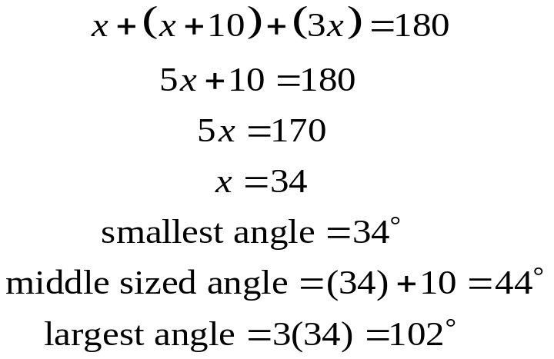
Solving Example 5
As with any word problem, it is vital to find algebraic expressions for the three unknown angles. Always let your variable be the unknown that you have the least amount of information about (smallest angle.) Let smallest angle = x, the middle sized angle = x+10 and the largest angle = 3x. Since the sum of any three angles of a triangle is 180 degrees, we add the three expression and set it equal to 180. Now solve and find all three angles.

Slide 21
Now you try practice problem P5
Solve the following problem on a separate sheet of paper before moving on to the next slide. If you get stuck, ask a tutor to help you.
The largest angle of a triangle is 80 degrees more than the middle sized angle. The smallest angle is 20 degrees less than the middle angle. Find all three angles.

Slide 22
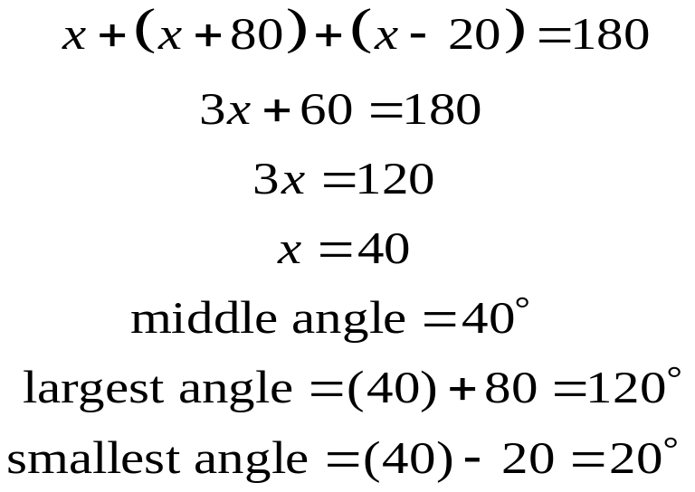
Practice Problem P5 Solution
Since we don’t know anything about the middle angle, let the middle angle = x. Then the largest angle = x+80 and the smallest angle = x-20. Since these are the angles of a triangle, add them and set the sum equal to 180. Now solve and find all three angles.

Slide 23
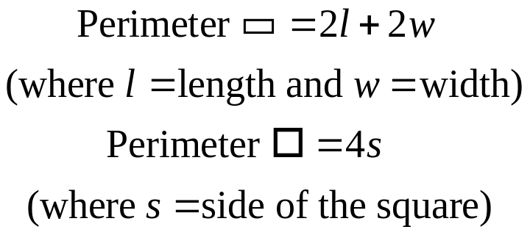
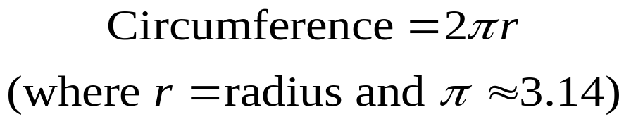
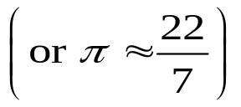
Perimeter
In geometry, the Perimeter is the distance around the outside of a figure. For example, the perimeter of a square or a rectangle, is found by simply adding up the four sides. The perimeter of a triangle is the sum of the three sides. Here are the formulas for perimeter of a rectangle and square.
The Perimeter of a circle has a special name (Circumference). The Circumference of a circle is found using the following formula.

Slide 24
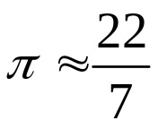
Let’s look at Example 6 and 7
Example 6
The length of a rectangle is 13 feet longer than three times the width. If the perimeter is 58 feet, find the dimensions of the rectangle.
Example 7
Find the radius of circle if the circumference is approximately 88 cm. Use the approximation

Slide 25
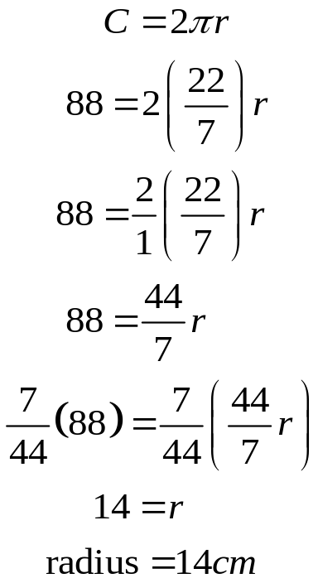
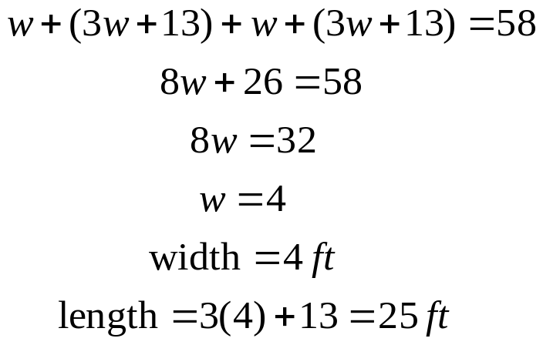
Solutions to Examples 6 and 7
Ex 6) Since we have information about the length let the variable w represent the width. Therefore length = 3w+13. Now add up all four sides and set it equal to the perimeter. Now solve and find the dimensions (length and width.) (You could of also used the formula 2w+2l=P to solve.)
Ex 7) Using the circumference formula we enter the values for C and pi. Now solve for the radius r.

Slide 26
Practice Problem P6
Now it is your turn to try one. On a separate sheet of paper, solve the following problem. Don’t move on to the next slide till you have solved it. Ask a tutor for help if you get stuck.
P6) The longest side of a triangle is twice as long as the shortest side. The middle side is 1 meter less than twice the shortest side. Find all three sides of the triangle if the perimeter is 64 meters.

Slide 27
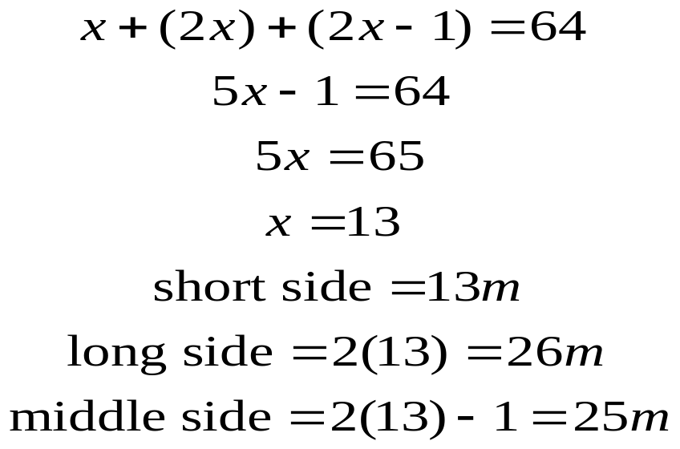
Solution to practice problem P6
P6) Since we have no information about the shortest side, let the shortest side = x. Then the longest side = 2x and the middle side = 2x-1. Now add the three sides and set it equal to the perimeter (64). Now solve and find all three sides.

Slide 28
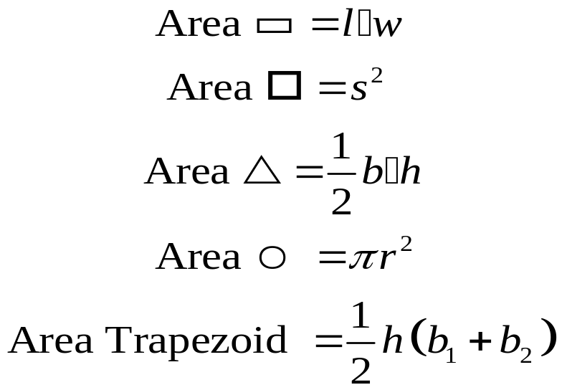
Area
The Area of a two dimensional figure is the amount of space inside the figure. Here are some formulas that are good to know. Remember, Area is always given in square units. (For example: square feet, square inches, ect.)

Slide 29
Let’s look at Example #8 and 9
Example 8
Find the width of a rectangle if the length is 14.5 cm and the area is 87 square cm.
Example 9
Find the area of a trapezoid if the height is 4 feet and the two parallel bases are 13 ft and 9 feet.

Slide 30
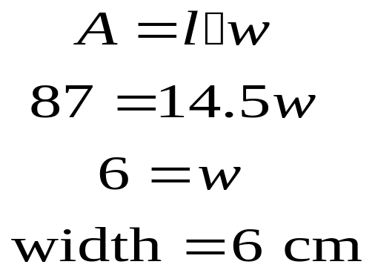
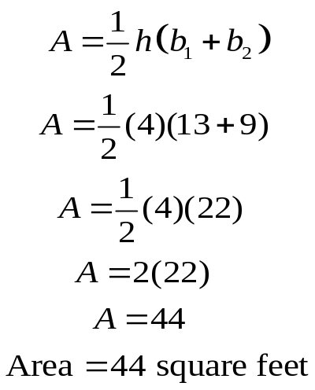
Solutions to Example 8 and 9
Example 8
The area of a rectangle is length times width. By plugging the area and length into the formula, we can then solve for the width.
Example 9
Using the formula for the area of a trapezoid, we plug in the height and the two bases. Now simplify and we get our area. Don’t forget to use square units for area.

Slide 31
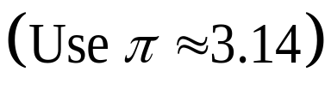
Try Practice Problem P7
On a separate sheet of paper, solve the following area problem. Ask a tutor to help you if you get stuck. Don’t move on to the next slide until you are completely finished.
P7) A circular field has a radius of 80 feet. What is the area of the field.

Slide 32
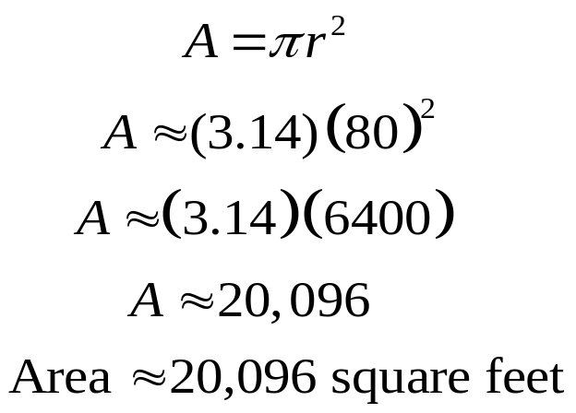
Solution to practice problem P7
Using the area formula for a circle, we can plug in 3.14 for pi and 80 for r. Now use the order of operations to simplify and find the Area. Don’t forget to use square units.

