Slide 1
Stress Management
COLLEGE OF THE CANYONS
SUPPLEMENTAL INSTRUCTION

Slide 2
What is Stress?
Stress is a physical and psychological response to outside stimuli
Stress can be good or bad. A small amount of stress can energize you to deal with a problem. In contrast, a large amount of stress can overwhelm you.

Slide 3
Constant Stress
When the stress lasts for a short time, the body has a chance to recuperate after the stressful situation is over, but when the stress is ongoing, the body does not get a chance to recover. This constant stress is particularly harmful.
An exam, for example, is a short-term stress, while having to worry about money problems produces long-term stress.
Stress can have physical and psychological effects.

Slide 4

Physical Effects of Stress
Heart rate increases
Headaches and migraines
Constant feeling of tiredness
Allergy or asthma attack
Frequent colds, sinus infections, flu symptoms
Upset stomach, indigestion, heartburn, ulcers

Slide 5
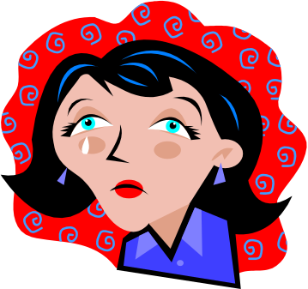
Psychological Effects of Stress
May experience difficulty in your ability to think clearly (confusion, trouble concentrating, inability to remember things, poor problem solving)
May experience emotions such as fear, anxiety, depression, irritability, anger or frustration
May experience insomnia or difficulty with sleeping

Slide 6
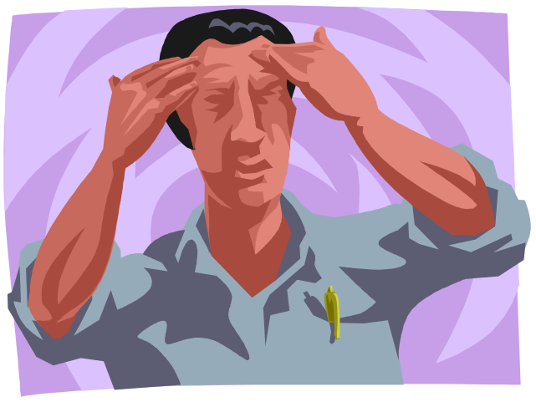
Emotional Reactions to Stress
Stress can affect your emotions.
It can lead to:
Depression
Anxiety
Taking your stress out on others
(lashing out, angry outbursts)

Slide 7
Behavioral Reactions to Stress
Stress can also change how you behave. These are some common copying behaviors associated with stress:
Eating, drinking or sleeping too much
Zoning out in front of the TV or computer
Allowing negative thinking to take over
Starting bad habits such as smoking/drinking
Spending too much money
Procrastinating

Slide 8

Physical Responses to Stress
Your body also reacts to the stress:
Blood pressure goes up
Skin problems
Back pain
Muscles tighten up and joint pain
Lowered immune system
Worsening of existing health conditions

Slide 9
Learning How to Reduce Stress
Learning to deal with stress can help you to cope with whatever life brings you. You may be doing okay now, but you never know when something unexpected will happen. A car accident, a sick family member, or losing a job may test your ability to cope with stress.

Slide 10
Tips on Reducing Stress
Tip One: Identify the cause
This may seem obvious, but sometimes we are stressed without knowing why. Talking to a counselor may help you with this.

Slide 11
Tips on Reducing Stress
Tip Two: Monitor Your Moods
Keep track of how you feel during the day. It may help you find out what’s triggering your stress. Pay attention to your self-talk. Are your thoughts helping you cope or making things worse?

Slide 12
Tips on Reducing Stress
Tip Three: Make Time for Yourself
Find time to get away from it all and recover both physically and mentally. Turn off your phone, find a place where you can be alone, meditate, exercise, or treat yourself to something healthy, like watching a movie, or going for a walk.

Slide 13
Tips on Reducing Stress
Tip Four: Analyze Your Schedule
Days only have so many hours. Weeks only have so many days. Packing days and weeks with things to do builds up your stress and does not necessarily help you get things done. Things will keep falling through the cracks while you get more and more frustrated. Find a way to prioritize or delegate to make your schedule more bearable.

Slide 14

What do College Students Stress Over?
Taking too many units
Papers and exams
Studying and homework
Work responsibilities
Finances
Personal relationships
Parental conflicts
Too many demands
Career and future success

Slide 15
Tips for Students: Time Management
Determine your peak energy levels of the day - schedule classes when you’re most alert
Balance time and energy on things that matter
Follow a regular schedule - include study time, work, sleep and relaxation
Minimize stress by planning in advance
Avoid sleep deprivation - can lead to accidents, increased mistakes, anxiety, depression
Use a notebook or planner to keep track of due dates, work, etc.

Slide 16
Tips for Students: Goal Setting
Setting goals helps you avoid procrastination and feeling overwhelmed by all the things you need to get done. Goals also help by giving you a sense of completion and satisfaction when you finally achieve them. Some things to keep in mind when setting goals are:
Set realistic goals: A goal that’s too big or a goal that cannot be achieved in the limited time you have is not realistic.
Divide larger goals into smaller steps: Handling one step at a time is less overwhelming.

Slide 17
Tips for Students: Money Management
Students are often short of money. Learning how to make the most of your money is a great skill for anything you do in life. It will also help you reduce your stress.
Be mindful of impulsive purchases
Decide which expenses are true needs and which ones are not really necessary
Keep track of your money in a notebook or on the computer. Review your expenses to find out where the money is really going.
Take a workshop on money management or search the net for tips and tutorials

Slide 18
Tips for Students: Setting Priorities
Avoid handling everything at the same time. Some things have to be done sooner, and some later. You may want to do the more urgent things first. There’s more time to handle the rest.
Some things are more important and others are less important. Work on the more important goals, so if you run out of time or can’t get something done, it affects the less important goals, which will have a smaller impact.

Slide 19
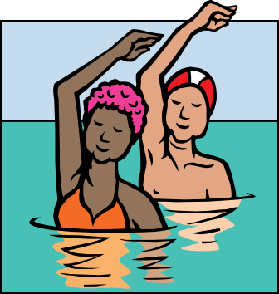
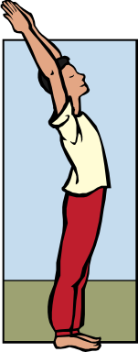
Tips for Students: Lifestyle
Evaluate your lifestyle to ensure that
you are taking good care of yourself.
Eat balanced meals
Try to exercise regularly
Limit caffeine and sugar intake
Learn positive self-talk
Learn to meditate
Find time for yourself

Slide 20
Tips for Students: Emotional Support
In times of stress it’s important to be able to
share your feelings and seek emotional support. Recognize the potential support in your life (friends, family, classmates).
Utilize personal counseling services at the Student Health Center
Meet with your academic counselor
Join community groups, student clubs or social groups
Talking things out will help you vent and lower your stress. It will also provide you with another perspective to handle the causes of your stress.

Slide 21
Tips for Students: Avoid the Quick Fix
Some quick ways to handle stress, like drinking or smoking, are not real solutions. They are just ways to avoid the problem and delay dealing with the issues. In fact, they make things worse, because they create a craving leading to an addiction. They are unhealthy patterns of behavior that only compound the problems.
If you cannot avoid these behaviors on your own, seek help. You can always talk with one of the counselors.

Slide 22
Tips for Students: Self-Awareness
Think about how you deal with stress and become aware of your copying mechanisms. What are some patterns you see in your coping strategies?
Do you tense up?
Reach for something to eat?
Do you get impatient or angry?
Are you reduced to tears?
Do you procrastinate or give up?
Do you let negative thoughts take over?
These are only temporary ways to reduce stress and will cause more damage in the long run. Try to replace these behaviors with more healthy responses to stress.

