Slide 1
Time Management
Improve your academic performance by managing your time effectively.

Slide 2
Introduction
Students entering college often see that they are getting lower grades than they used to get in high school. There are many reasons for this, but one of them is difficulty handling the increased time required to do well in college-level classes.

Slide 3
There’s no Single Solution
When dealing with time management, there is no “one size fits all” approach. Each person’s goals and needs are different, so the way they handle their time will have to be adapted to their situation.
In this learning activity, you will explore several ways to handle your time efficiently. It is up to you to decide which way will work best for your situation.

Slide 4
Knowledge Puts You in Control of Your Time
Know where you want to go: set goals
Know how to get there: have a plan
Know how long it’s going to take you: have a realistic idea of the time it takes to do things, and to do them well
Know the dangers along the way: be aware of distractions or activities that do not line up with your goals
Know yourself: be aware of your own tendencies toward procrastination or distractions and learn to say “no” to yourself when needed

Slide 5
Keys to Better Time Management
Set goals for each semester and use them to motivate yourself to work harder and better
Check that your use of time lines up with your goals
Be aware of how you use your time: distractions and procrastination only make things worse
Ensure that you allow enough time for studying
Use efficient time management tools, like a planner
Keep track of deadlines
Do things according to priority
Plan ahead: be proactive instead of reactive
Learn to say “no” to distractions
Actively reinforce good time management by rewarding yourself when you meet goals

Slide 6
Goals, Values and Time
Goals include anything you want to achieve, aim for, and put energy into attaining.
Values make up the belief system that underlies a decision you make.
When you have to choose an activity, consider your goals and values before you make the decision to spend time and energy on it.

Slide 7
Goals are Key to Success
Research shows that students who set goals for themselves do better at school. It makes sense: knowing where you are going helps you plan your trip. Not knowing where you want to go leads to wasted effort and time.
Plan your goals:
Long term: a degree, a job, or a personal objective
Short term: what you want to accomplish now, this week, this semester
Goals keep you from spending time on things that are not that important to you. They also motivate you to work harder and to avoid wasting time with distractions or procrastination.

Slide 8
Use of Time and Goals
Goals give you a sense of direction and motivate you to get there. They also help you sort out your “to do” list. Some things will support a goal, others won’t. Knowing that, you can decide what to do first, what to do later, and what not to do.

Slide 9
Distractions Get You Off Course
Nowadays there are many distractions around us that can get us off track: phones are a good example. They are always with us and can take our attention away from what we are doing. It takes time to concentrate on work, and distractions make us lose that time.
Think of all the things that can distract you from doing what you are supposed to do: phones, TV, friends, the internet… Worrying about things can also be distractions, for example, if you are having money troubles.
Plan the place, the time, and the way you study to avoid distractions.

Slide 10
Avoiding External Distractions
Distractions are everywhere, outside and inside us.
External distractions: The place, the time, and the method of studying can keep us from doing our work. Here are some ideas you may want to try:
Place: Find a place with few distractions, like a library.
Time: Work when there’s no one around to distract you. Also plan to work when you are not too tired or sleepy.
Method: Avoid studying in groups if you tend to chat too much instead of work. Work on only one thing at a time instead of doing two or more things simultaneously. Take notes as you study to stay focus and keep your mind from wandering.

Slide 11
Avoiding Internal Distractions
Some distractions come from within. When your mind wanders, you lose concentration. When you are worried about something, you also veer off course.
Distractions caused by your mind wandering: Here are some ideas you may want to try:
Find ways to focus, like taking notes while reading, or underlining.
Study in the same place at the same time to build a habit. Your mind will get used to this and will switch into study mode faster.
Develop your ability to concentrate. Be aware of what is distracting you. Write it down and decide to deal with it later. When you do this, you give the thought the attention it is asking for, but you are also managing it, so it does not bother you when you are trying to do something else.

Slide 12
More on Internal Distractions
If you are distracted because you are worrying about health, social, or financial issues, you can also find strategies to help you concentrate.
Distractions caused by worrying: Here are some ideas you may want to try:
Try to set aside time to deal with the issue. Knowing that you will address the issue later will let you concentrate on studying now.
Avoid obsessing about things over and over. For example, replaying an argument you had with someone over and over in your head only intensifies your distress. If this is happening to you, talk it out with someone you trust. It will help you vent while giving you another perspective from your friend’s feedback.
If you worry about not doing well in tests, try to overprepare. The more confident you are about the material, the less you will worry.
Seek help. Talk to one of the counselors.

Slide 13
Dealing With Procrastination
Procrastination is a natural tendency to avoid doing something we don’t particularly like. Waiting to do something we don’t like is like making it go away, at least for a while. The problem is that when we finally get to it is when we don’t have a choice: at the last possible moment. This not only causes stress –which can’t be good--, but also leads to poor quality work.
Benefits of Procrastination | Negatives of Procrastination
Makes the issue go away for now. It feels as if the problem has been resolved. There is an immediate decrease of anxiety. Procrastinating allows us to relax. Anxiety is reduced when we postpone something we don’t want to do, so we feel better. | When we finally deal with the issue, it’s at the last moment, so we are in a hurry to get it done. The compound effect of dealing with something we don’t want to do and doing it with little time increases our anxiety. As a result of this negative experience, you may avoid things more in the future, increasing your tendency to procrastinate the next time. The procrastination cycle feeds on itself.

Slide 14
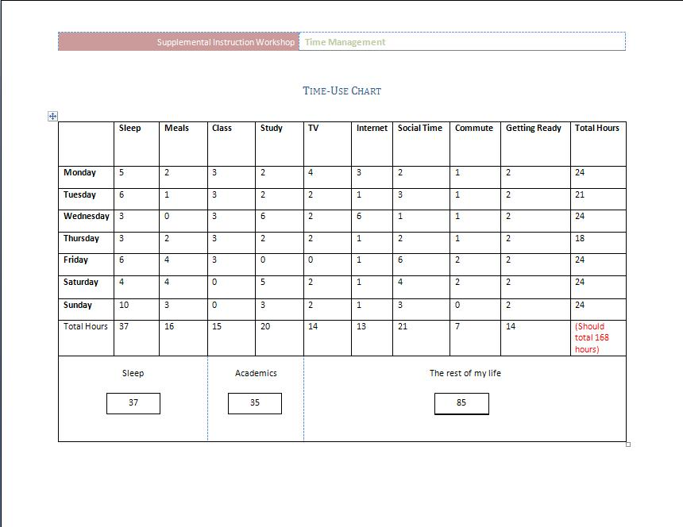
Time-Use Chart Where do you spend your time?

Slide 15
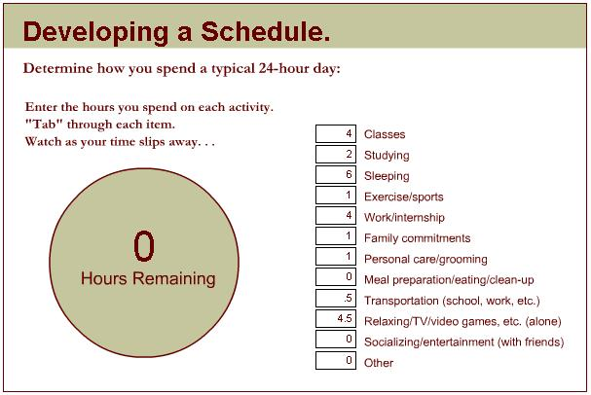
Time-Use Website http://www.studygs.net/schedule

Slide 16
Time, the great equalizer!
We each have 24 hours a day and 7 days a week.
What do you spend your time doing?
Work?
School?
Sleep?
Commuting?
Internet?
TV?
…..Other

Slide 17
School and Time
Are there enough hours in a day for you?
Each unit of a course is typically equal to one hour in class.
12 Units (full time) = 12 Hours
An average student can get by with average scores by studying 2 hours per hour of class.
12 units X 2 Hours = 24 Hours
Sleep is an important part of life.
7 hours = 49 Hours per week

Slide 18
How much time does that leave?
Hours Per Week | Class Hours | Sleep Hours | Study Hours | Remainder
168 | 12 | 49 | 24 | 83 Hours
What activities are not receiving your full attention?

Slide 19
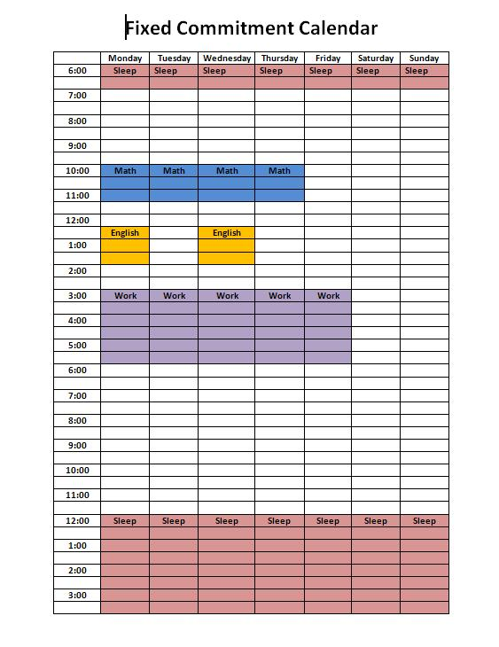
Time Management Strategies
Where do I put everything??
Look at commitments that you can’t change.
Assess where the gaps are.
Plan your flexible activities in those gaps.

Slide 20



Time Management Strategies
Monitor your time
How much time does it take you to complete certain tasks?
Reading
Math Homework
English Paper
Memorizing
Create a study log to plan out time for each activity.

Slide 21
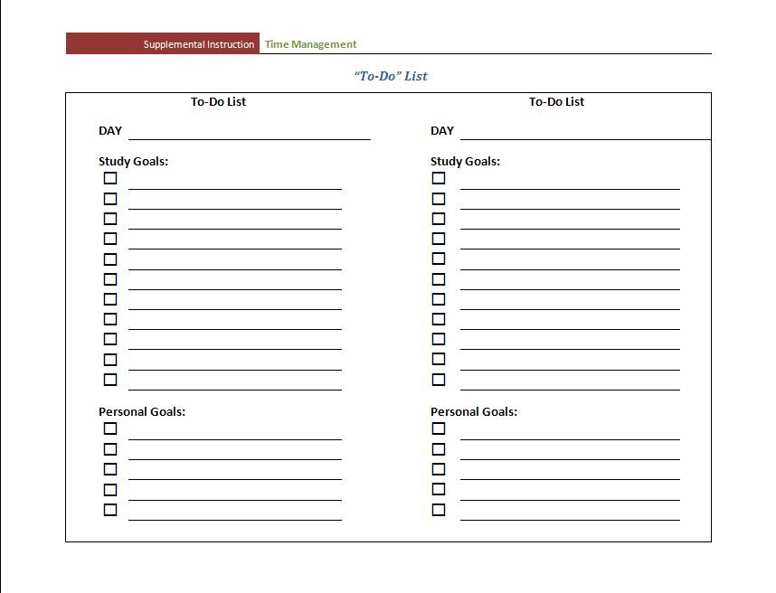

Time Management Strategies
To Do Lists
Ensure you don’t forget anything
Prioritize activities

Slide 22

Time Management Strategies
Calendars and Planners

Slide 23
Procrastination
Why do today what you can put off ‘till tomorrow?
Why combat procrastination?
Reduce stress.
More time to review and learn material at a deeper level.
Revise assignments to ensure accuracy.
Avoid mistakes that are created when rushed (like misspellings or incorrect mathematical computations).
Find out your printer is broken sooner than the day your paper is due.
Avoid embarrassment
Waiting to complete a task at the last minute.

