Slide 1

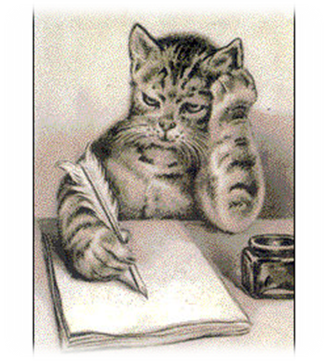
Nine tips that can help you
polish your papers

Slide 2

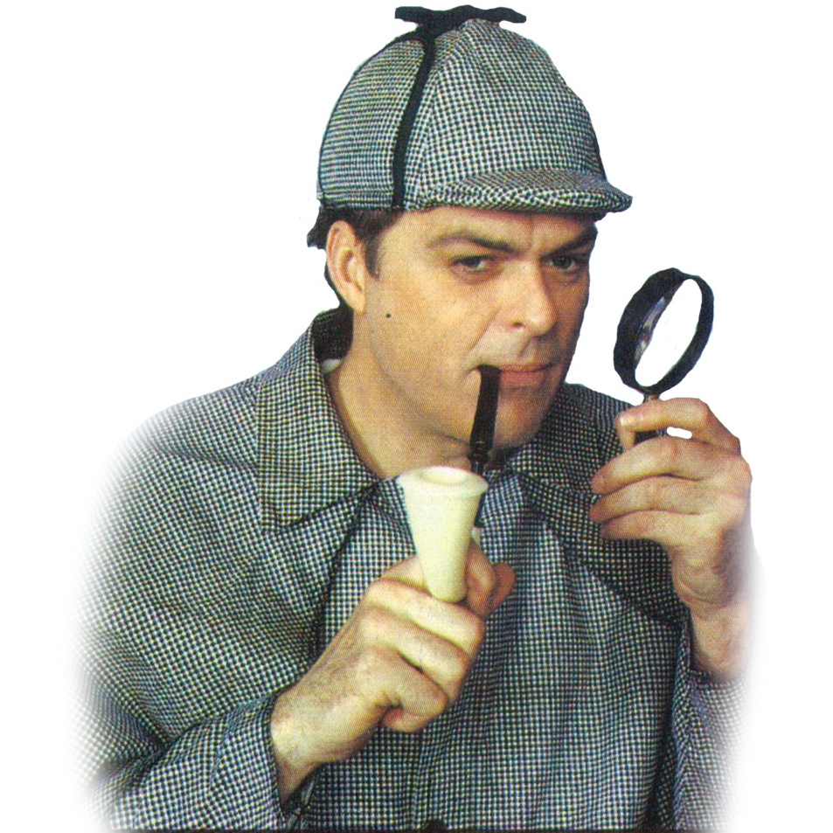
After you finish the essay, take a 5 or 10 minute break before starting to proofread.
This will help you
see your essay with
a fresh eye.

Slide 3

Allow enough time to thoughtfully address each sentence in the essay.
Most errors cannot be detected by quickly skimming the work or even reading at normal speed.

Slide 4




Don’t try to proofread when you are tired or overworked.
Find a quiet place without distractions.

Slide 5


This technique will slow down your reading so you can concentrate on finding errors.
Print a copy of your essay, if necessary.

Slide 6


Read only one sentence at a time and cover the rest of your essay with the blank paper so that you will not be distracted by the rest of the essay.

Slide 7


Read the last sentence of the
essay first and proceed up to
the first sentence.
Since the content of the essay
will not make sense (because
you are reading it backwards),
you can focus on each sentence
rather than on the ideas in your
essay.

Slide 8


Since your mind
fills in the words
for you when you read
silently , allow your
voice and your ears to
catch the errors that
silent reading misses.

Slide 9

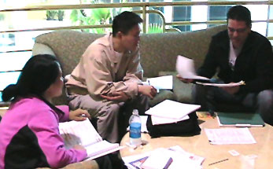
Pretend you are the instructor or one of your classmates and read the essay as an outsider who is not familiar with the content of the essay.

Slide 10

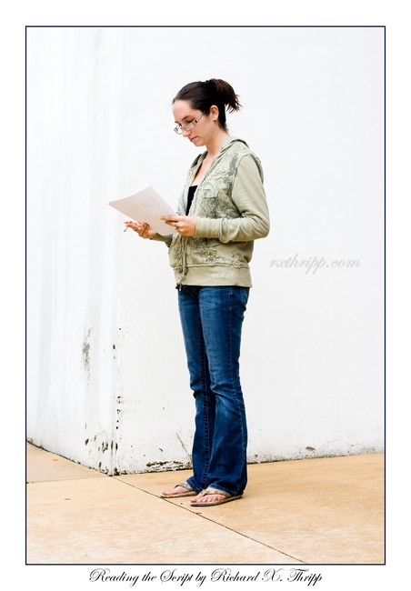
Ask someone you
trust to read your
essay out loud
and listen for
awkward sounding
sentences or
missing words.

Slide 11


Slide 12



Slide 13
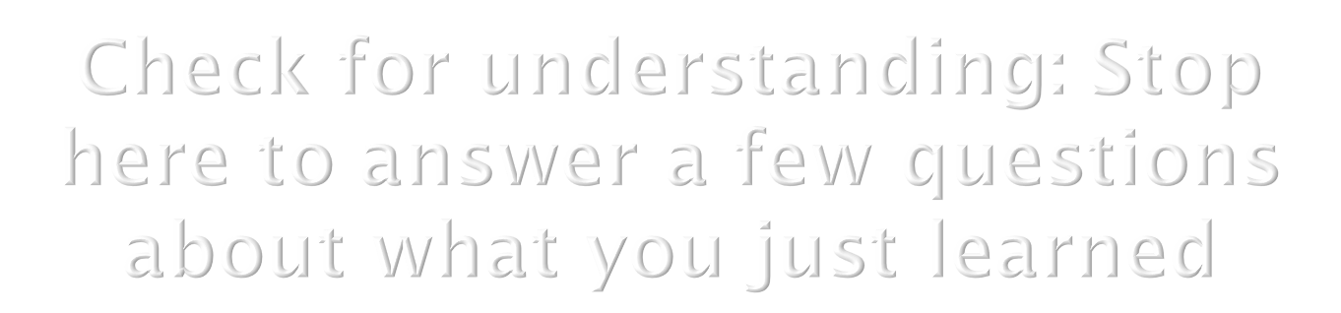

Click on the button to go to the interactive exercise.

