Slide 1
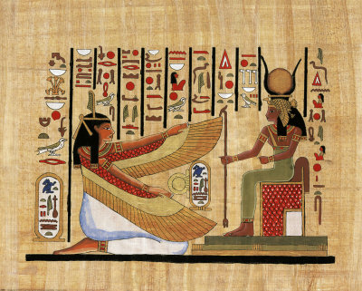
Unfamiliar Words

Slide 2
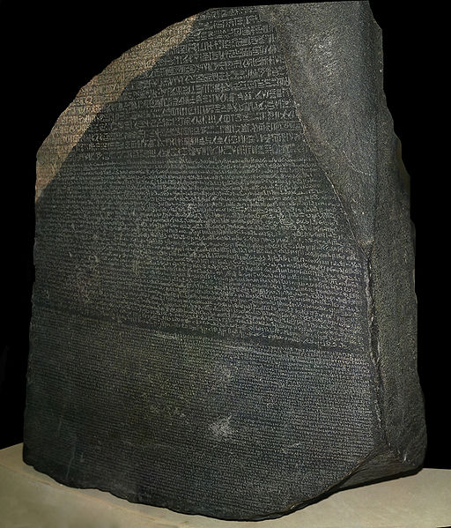
In 1822, a French scholar used the precious Rosetta Stone to decipher hieroglyphics, the mysterious script of the Egyptians.

Slide 3
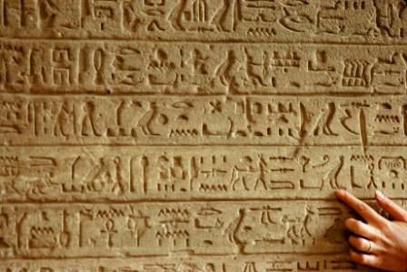
Until then, no one had any idea what the ancient symbols meant.

Slide 4


Sometimes when we read, we wish WE had a magic way to decipher the words we don’t understand. And sleeping under a stack of books won’t help!

Slide 5

While this workshop can’t provide a Rosetta Stone for decoding mysterious words, it will give you several strategies to help you decode unfamiliar words in your college reading.

Slide 6

In your college texts, you often encounter words that you’re not familiar with.
cursory? contralateral? feudal?
hoi polloi???

Slide 7
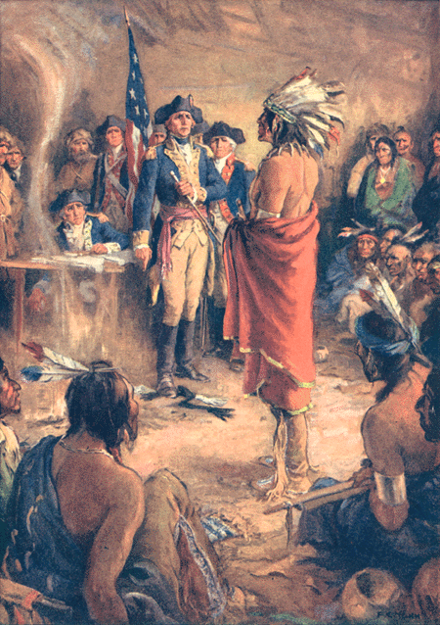
For example, if you’re taking an American History course, your textbook might contain a passage like this:

Slide 8
The interminable history of diplomatic relations between Indians and white men had before 1832 recorded no single instance of a treaty which had not been presently broken by the white parties to it . . . however solemnly embellished with such terms as “permanent,” “forever,” “for all time,” “so long as the sun shall rise.”. . . But no agreement between white men and Indians had ever been so soon abrogated as the 1832 Treaty of Washington. Within days the promises made in it on behalf of the United States had been broken. --Van Every

Slide 9
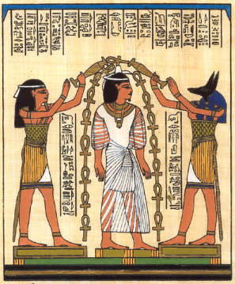
Being able to decipher unfamiliar words can enhance your academic success. Among other things, you will: 1. Comprehend what you read 2. Build your vocabulary 2. Learn new concepts 3. Express ideas more clearly

Slide 10

Now let’s take a look at four strategies that can help you achieve those goals: 1. Use context clues 2. Recognize word parts 3. Use the dictionary 4. Read more and often

Slide 11
Strategy #1 – USE CONTEXT CLUES Clues to a word’s meaning can occur inside the text itself—in the other words and sentences that surround the unfamiliar word. Like a detective, you can use those clues to guess a word’s meaning.

Slide 12
Here are six helpful context clues: Definitions Synonyms Antonyms Examples Contrast General context / sense Let’s look at these one at a time.

Slide 13
USING CONTEXT CLUES: DEFINITIONS Often an author will provide you with a definition of a challenging word. EXAMPLE: “crepuscular” Crepuscular creatures—those that are active during the twilight hours—are sometimes difficult to see on the road.

Slide 14
EXAMPLE: The words “dog”and “canine” are synonyms—words that have a similar meaning. EXAMPLE: “juxtaposed” In the ad, the images were juxtaposed—that is, placed side by side—to achieve a more powerful impact.

Slide 15
USING CONTEXT CLUES: SYNONYMS A writer will sometimes clarify a word by using a synonym—a word with a similar meaning—within the same sentence or in a nearby sentence. EXAMPLE: “forte” Madison’s forte was math. Her friends admired that strength. forte = strength

Slide 16
EXAMPLE: “loquaciousness” Amy’s loquaciousness surprised Jim. He didn’t know she could be so talkative. loquaciousness = talkativeness EXAMPLE: “panacea” The doctor wished he had a panacea, but there was no chance of that. The patient would receive lots of care and attention, but no cure-all. panacea = cure-all

Slide 17
USING CONTEXT CLUES: ANTONYMS Writers sometimes reinforce the meaning of a word with an antonym—a word with the opposite meaning. EXAMPLE: “gregarious” Hector and Elena have very different personalities. While Hector is a loner, Elena is quite gregarious. gregarious = social

Slide 18
EXAMPLE: “intrepid” Though usually an intrepid character, Cecilia was certainly afraid of spiders. intrepid = fearless EXAMPLE: “cursory” Brent read his class notes slowly and carefully; but he gave the chapter in the text a more cursory treatment. cursory = quick, superficial

Slide 19
USING CONTEXT CLUES: EXAMPLES Sometimes writers illustrate a word or concept with examples. Studying what the examples have in common can help you guess the word’s meaning. EXAMPLE: “nocturnal” Tyler studies nocturnal creatures, such as bats, owls, and mice. nocturnal = active at night

Slide 20
EXAMPLE: “cacophony” The trumpets were blaring, the soldiers were shouting, and the cannons were roaring. Who could think about strategy in that cacophony? cacophony = harsh or discordant sound

Slide 21
USING CONTEXT CLUES: CONTRAST Sometimes an author will contrast two ideas. The contrast can help you understand an unfamiliar term. EXAMPLE: “flout” Most countries respect international laws; only a few countries flout them. flout = disregard scornfully

Slide 22
USING CONTEXT CLUES: THE GENERAL SENSE OF THE PASSAGE Sometimes you can use the general sense of the passage to infer, or guess, the meaning of a word you don’t know. A single piece of information, or a combination of several ideas, may provide a clue.

Slide 23
EXAMPLE: “ambidextrous” We all admired Bernardo, who was ambidextrous, as he used first his right hand, and then his left, to quickly untie the knot. ambidextrous = using both hands easily

Slide 24
Strategy #2 – RECOGNIZE WORD PARTS Words can be built from smaller parts. By knowing how words are put together, and by recognizing the parts, you can sometimes guess at the meaning of unfamiliar words. Xenophobe diaphanous

Slide 25
Words can be built out of three kinds of segments: PREFIX …………...Placed before the root WORD ROOT……. The core of the word SUFFIX ……………….Placed after the root UN + COMFORT + ABLE prefix ROOT suffix “uncomfortable”

Slide 26
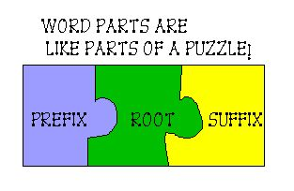

Slide 27

A word ROOT is the core of a word. It is fairly stable in meaning. Learning the meaning of common roots can help you guess the meaning of some words.

Slide 28
EXAMPLE: EXAMPLE: “chron” = time “dict” = say chronology predict chronograph contradict synchronize dictation diachronic dictator chronicle dictionary chronological dictum chronic valedictorian

Slide 29
Being familiar with common PREFIXES can also help you decipher words. un- = “not” pre- = “before” ex- = “out of” anti- = “opposing, against” ante- = “before, preceding” inter- = “between” intra- = “inside” post- = “after”

Slide 30
The prefix “pre-” (“before”) is found in many words! predict previous premonition predate prefabricated prejudice prelude preface

Slide 31
SUFFIXES can also give clues to word meaning. -able, -ible = able to, ability -ism = doctrine, belief -esque = in the style of -ment = (creates a noun) -ness = (creates a noun) -ize = (creates a verb) -oid = like, resembling

Slide 32
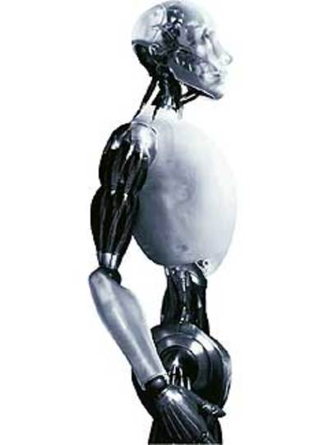
The suffix “-oid” is found in many words: andr + oid = android human-like robot sphere + oid = spheroid like a sphere in shape aster + oid = asteroid resembling a star ov + oid + ovoid egg-shaped

Slide 33
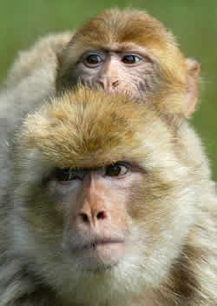
Put the clues together—roots, prefixes, and suffixes—and you may be able to guess at some word meanings. The root “anthrop,” which means humankind, is used in over 100 words! EXAMPLE: “anthropoid” (resembling humans) refers to one class of higher primates.

Slide 34
Here are two more “anthrop” words, combined with prefixes and suffixes: “anthropology” = the study of humankind “philanthropist” = someone who loves humanity and gives funds to improve human life

Slide 35

Strategy #3 – Use the Dictionary Of course, if you can’t guess a word from its context or its parts, then the dictionary is a worthy friend!

Slide 36
Strategy #4 – Read more, and often! Of course, the more you read, the more close encounters you will have with words in context. Minutes per Day Words per Year 14.2 1,146,000 21.1 1,823,000 65.0 4,358,000 (Anderson 1992 / Univ. of Oregon)

Slide 37
SOME SUGGESTIONS: 1. Read every day for at least 15 or 20 minutes. 2. Read a significant quantity of material—about 20 pages each day, or 100 pages each week. 3. Read a wide variety of material— articles, essays, stories, novels, poems (and of course, your textbooks).

Slide 38

4. To improve your vocabulary, read books that are challenging. 5. If you like, keep an informal journal of your reading. In the journal, include your response to the readings as well as new words.

Slide 39

LET’S REVIEW THE FOUR STRATEGIES: 1. Use context clues 2. Recognize word parts 3. Use the dictionary 4. Read more and often

Slide 40

Now let’s complete some exercises to practice the strategies.

Slide 41

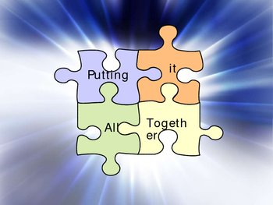
Happy reading!

