Slide 1
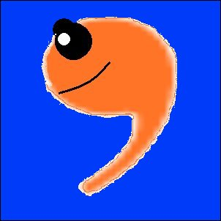
Apostrophe Abuse
Please learn to use
me, not abuse me!
Presentation created by
Laurel DiGangi

Slide 2
Students are not the only ones who misuse and abuse apostrophes.

Slide 3
Check out these “professional” signs.

Slide 4
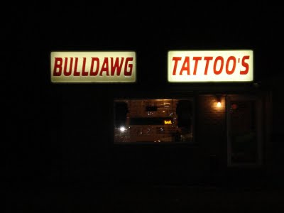
What’s wrong with this picture?

Slide 5
Tattoos, not tattoo’s!
Hope that tattoo needle
has a good spell check!

Slide 6
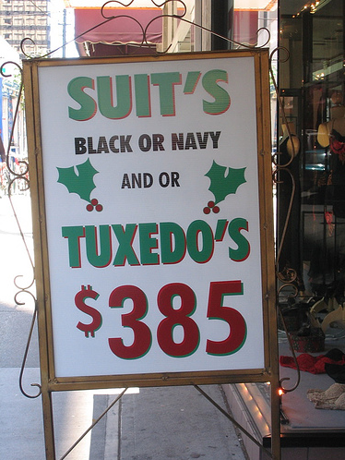
What’s wrong with this picture?

Slide 7
SUITS not SUIT’S
TUXEDOS not TUXEDO’S
It’s still
cheaper
to rent one!

Slide 8
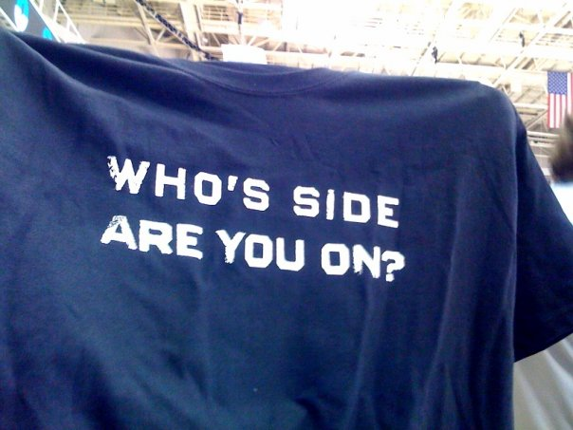
What’s wrong with this picture?

Slide 9
WHOSE, not who’s (who is)
We hope you’re
on the side of
good grammar!

Slide 10

What’s wrong with this picture?

Slide 11
PIES not PIE’S
Doesn’t look
too fresh to me!

Slide 12

What’s wrong with this picture?

Slide 13
OREOS not OREO’S
MMMM! MAKE MINE EXTRA GREASY!

Slide 14


What’s wrong with this picture?

Slide 15
NOTHING IS WRONG!
Wendy’s Old Fashioned Hamburgers
McDonald’s Restaurant

Slide 16
NOTHING IS WRONG!
Wendy’s Old Fashioned Hamburgers
McDonald’s Restaurant
I want a deep fried Oreo!

Slide 17
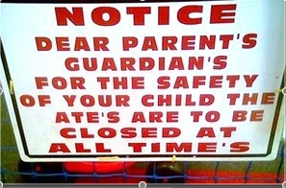
What’s wrong with this picture?

Slide 18
PARENTS not PARENT’S
GUARDIANS not GUARDIAN’S

Slide 19
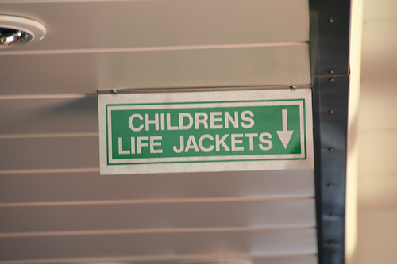
What’s wrong with this picture?

Slide 20
CHILDREN’S not CHILDRENS

Slide 21

What’s wrong with this picture?

Slide 22
ITS not IT’S
Bad grammar is NOT a bold move!

Slide 23
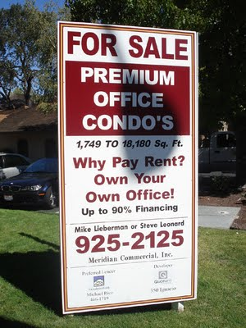
What’s wrong with this picture?

Slide 24
CONDOS not
CONDO’S

Slide 25
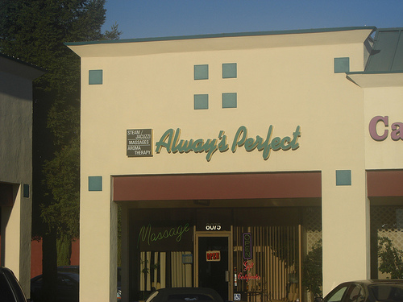
What’s wrong with this picture?

Slide 26

ALWAYS not ALWAY’S
NOT AS
PERFECT
AS THEY
THINK!

Slide 27
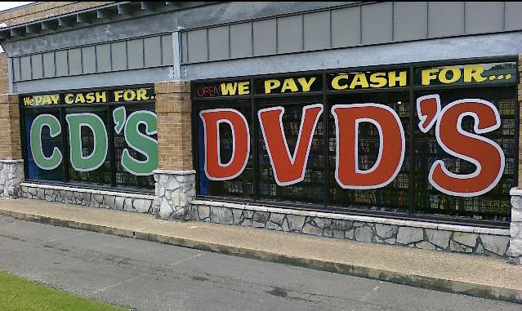
What’s wrong with this picture?

Slide 28

CDs not CD’s
DVDs not DVD’s
iPODs, not CDs!

Slide 29

What’s wrong with this picture?

Slide 30
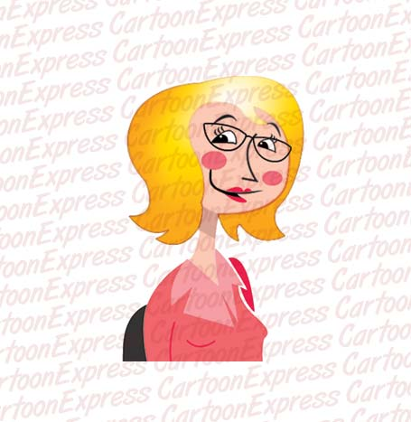
TEACHERS not TEACHER’S
I NEED TO
SHAPE
THAT
PRINTER’S
GRAMMAR!

Slide 31
The End
Thank you for learning
How to use me properly!

