Slide 1

Understanding Ideas Not Directly Stated:
Making Inferences

Slide 2
In your college classes, you read stories, essays, textbooks. You watch films. You look at images—photographs, advertisements, and political cartoons.
All of these texts—whether written or visual—express meanings and convey messages.

Slide 3
However . . .
Texts usually don’t “say” everything
they “mean.” Many ideas in a text
are not directly stated. You need to be a
detective to understand hidden ideas.
To read texts actively and critically,
and to improve your comprehension,
you often need to “read between the lines.”

Slide 4

This workshop will improve your ability to detect ideas that are not directly stated in a text.

Slide 5

Let’s begin with a visual text
What can you
guess or conclude
about the woman
in the picture?
Write your answer
in Box 1 on the
worksheet.

Slide 6
Okay!
The woman appears to be a student—perhaps a college student.

Slide 7
But how do you know this?
(This information isn’t directly stated in the picture.)
In Box 2 on your worksheet, briefly explain how you reached your conclusions.

Slide 8
Most likely, you used various
facts from
the picture as “clues.” You also applied
what you know about college students and college life.

Slide 9
The “FACTS” in the text:
1. The woman is casually dressed.
2. She seems to be in her late teens or early twenties.
3. She is using a computer.
4. There are large brick buildings in the background.

Slide 10
Your previous knowledge and experience helps!
1. You are familiar with college campuses.
2. You know that they often have large buildings and lawns.
3. You know that students often have breaks between classes.
4. You know that today’s students often bring their laptops to campus.
5. You know that some college students are in their late teens or early twenties.
6. You know that casual attire is usually appropriate on a college campus.

Slide 11
When you make a plausible (likely, reasonable) guess about ideas that are not directly stated in a text, you are making an INFERENCE.

Slide 12
To make an inference, you combine two “ingredients”: INFERENCE =
The facts you
observe in the
text
+ your previous
knowledge and
experience

Slide 13
In order to make inferences, we . . .
Ask questions (“I wonder who she is? Where is this taking place?”)
Make connections (“What do I know about this topic or situation?”)

Slide 14
Note, however, that inferences are not facts—they are interpretations.
They have degrees of plausibility, and their accuracy or validity is not entirely guaranteed.
The woman in the picture might not be a student. . . She might be visiting a friend who is a student.
The setting might be a factory or hospital, not a school.

Slide 15
Caution! Make sure your inferences are justified by the “facts” in the text
Avoid inferences that
contradict the facts:
“The woman is hiking.”
Avoid inferences that
stretch the facts too far:
“The woman is sending a message on Facebook.”
These are not reasonable inferences!

Slide 16
In order to make reasonable (likely, plausible) inferences, pay close attention to the facts in front of you—what you see, hear, read. Then connect what you see in the text to your own knowledge and experiences.

Slide 17
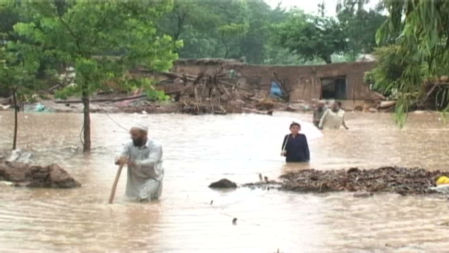
Study this picture
What reasonable inferences can you make about the people or situation?

Slide 18
Reasonable inferences—or not? Check “yes” or “no” in Box 3 on your worksheet.
1. The people in the picture are victims of a flood.
2. The setting is New York City.
3. The people in the picture are fishing.
4. The people in the picture are
desperate for help.

Slide 19
REASONABLE INFERENCE?
“The people in the picture are probably victims of a flood. “
YES: The “facts” in the picture support this conclusion. It is a plausible guess.

Slide 20
REASONABLE INFERENCE?
“The setting is New York City.”
This is not a reasonable inference.
It contradicts the “facts” in the picture and what we know about New York City.

Slide 21
REASONABLE INFERENCE?
“The people in the picture are probably fishing.”
Is this a reasonable inference?
Why or why not?

Slide 22
REASONABLE INFERENCE?
“The people in the picture are desperate for help.”
Is this a reasonable inference?
Why or why not?
Do we have enough information to draw that conclusion?

Slide 23
So far, we have discussed some visual texts. Now let’s discuss how we can make inferences when we read.
We often need to
“read between the lines”
to interpret written texts.
Again, we can use clues in the text
to make reasonable inferences.

Slide 24
Examples of Inferences
We make inferences about people, settings, and situations.
We make inferences about what will occur next.
We make inferences about the larger ideas or themes within a text, as well as the author’s purpose or message.
We make inferences about the meaning of individual words and phrases, using clues from the surrounding context.

Slide 25
Inferences about unfamiliar words and phrases
Using clues in the surrounding text, you can often make inferences about the meaning of unfamiliar words and phrases.
EXAMPLE: Ellen commiserated with Alex. She, too, had been laid off, so she knew how he must be feeling. “I’m so sorry you lost your job,” she told him.

Slide 26
“Commiserate”?
In Box 4 on your worksheet, make an educated guess about the meaning of the word “commiserate.”
What contextual clues did you use to make your inference? Write them down.

Slide 27
“Commiserate” means to express sorrow or compassion for someone
Did the contextual clues help you make a reasonable inference about the meaning of “commiserate”?

Slide 28
Inferences about unfamiliar phrases
Read the following passage in Box 5 on your worksheet: Before the class discussion, Maria was opposed to same-sex marriage. During class, however, she had a “road to Damascus moment.” Suddenly she realized that homosexual couples have the same hopes and dreams as heterosexual couples do, and she left class determined to defend gay rights.

Slide 29
What is a “road to Damascus moment”?
You do not need to be familiar with the Bible or geography to infer what this phrase might mean.
In Box 6, briefly state what you think a “road to Damascus moment” is, and then briefly discuss how the context helped you to guess the meaning.

Slide 30
“Road to Damascus”?
This phrase refers to an event in the New Testament
of the Bible. Saul was on his way to Damascus in Syria,
where he intended to arrest the followers of Jesus.
On the road, he had a vision in which he heard the voice
of Jesus. Soon after, he was converted to Christianity.
A “road to Damascus moment” therefore
refers to a sudden shift from one point of
view to another.
Did the contextual clues help you make a reasonable
inference about the meaning of this phrase?

Slide 31
Inferences about people, settings, and situations
When you read an essay or a story, you will find that the author doesn’t give you every bit of information.
You have to infer some of the information, supplying what the author left out. This is an “active reading” strategy that helps you stay engaged with the text and helps you get more meaning from what you read.

Slide 32
Read the passage in Box 7 on your worksheet.
Cassie looked at the hats hanging on the rack, next to the wheelchairs, canes, and support hose. She hesitated and then lifted a fuzzy blue cap from the hook. It was like a ski cap, and she suddenly remembered last winter, when she actually had the energy to ski down the slopes at Tahoe. Now she looked in the mirror at her bald head, which just a month ago was covered in thick black curls. Trying to smile, she put on the blue hat and pulled it down tight over her ears.

Slide 33
In Box 8, write down what you think you can infer about Cassie, about where she is, and about her situation.
1. Look for clues provided by the author—clues about people (what a character does, thinks, or says), emotions, places, situations, events.
2. Make connections to your own knowledge and experience--what you already know about the topic.
Then write down the contextual clues you used to draw your conclusions.

Slide 34
Predictions: Making inferences about what will occur next
When you make a prediction, you guess what
might happen, based on information in the
text and from your own experience.
You can make predictions about actions, events, and outcomes . (“What will happen next? What is the result of these actions?”)
After you make such predictions, you can confirm, revise, or discard them as you continue reading.

Slide 35
As you read the following passage in Box 9 on your worksheet, make some guesses about what might happen next.
“The accelerating extinction of languages on a global scale has no precedent
in human history. And while it is not exactly equivalent to biological
extinction of endangered species, it is happening much faster, making
species extinction rates look trivial by comparison. Scientists’ best
estimates show that since the year 1600 the planet lost a full 484 animal
species, while 654 plant species were recorded as having gone extinct.
Of course, these figures are estimates. But even so, they make up less than
7 percent of the total number of identified plant and animal species.
Compared to this, the estimated 40 percent of languages that are
endangered is a staggering figure.” --K. David Harrison, When Languages Die

Slide 36
Based on your reading, what can you infer about the future of endangered languages? Use Box 10 for your predictions.
Then write down the clues in the text
that helped you make your
predictions.

Slide 37
Making inferences about the larger ideas, themes, or purpose of a text
When you read essays, articles, stories, and other college texts, your instructor often asks you to identify the author’s main message (thesis or theme). You might also need to identify the author’s purpose.
Thesis, theme, and purpose are not always directly stated in the text, so you need to infer them yourself, and read between the lines!

Slide 38
With a partner, read the passage in Box 11 on your worksheet. Then, in Box 12, try to express (in one or two sentences) the author’s main idea. Next, write down what you think the author is trying to accomplish in the essay—her purpose.

Slide 39
Remember! Make sure your guesses are reasonable—that is, supported by the content of the passage.

Slide 40
When you and your partner are finished with Box 11, check your work:
1. Do your inferences contradict anything in the passage?
2. Do your inferences “stretch” the meaning of the passage? (Your statements may seem plausible, but are they really supported by the text?)

Slide 41
In the exercises you have completed today, you have studied various kinds of texts, both visual and written. To detect unstated ideas and meanings in those texts, you have looked for clues. Combining the clues with your own knowledge and experience, you have made some reasonable inferences.

Slide 42

With further practice, you can improve your skill in making inferences and move up the ladder of understanding.

Slide 43
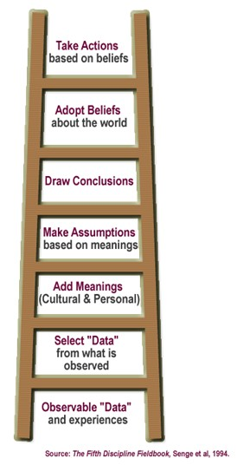


Slide 44
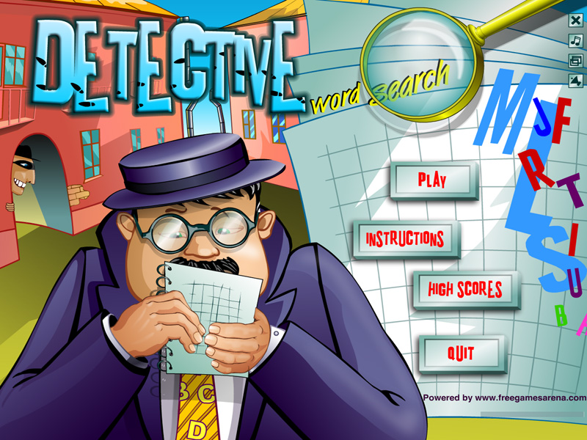
Now, please complete the quiz and self-reflection exercise.

