Slide 1
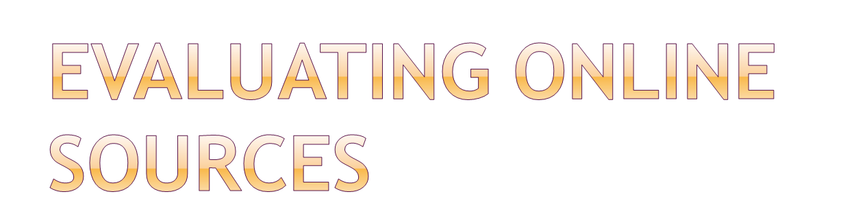


Slide 2


The source can be identified and is known to be a reliable authority.

Slide 3


What credentials does the author have?
Does the author have an affiliation with an institution such as a university, a research institute, or publication?

Slide 4
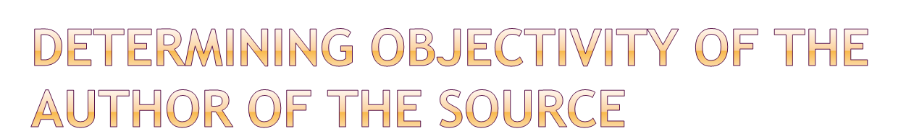

Is the author an advocacy organization?
Is the author a private individual expressing his or her own personal views?

Slide 5


Some websites are actually “masks” or “shells” that are being used to sell advertising. They have no author who can be identified, so they are not reliable.

Slide 6


Look for a publication date or an “updated on” date on the website. If there is no date, can you somehow confirm that the information is current?

Slide 7

The author of the evidence has authority, and you can prove this.
The author is objective, and you can prove this.
The evidence has currency: it is up-to-date, and you can also prove this.
AUTHORITY, OBJECTIVITY, AND CURRENCY.

Slide 8

Government agencies;
Universities;
Research institutes that are affiliated with governments or universities;
Newspapers;
Professional journals;
Professional associations;
Subscriber database services such as Proquest and Issues and Controversies.

Slide 9


Advertising masks or shells;
Advocacy organization websites;
Political organizations;
Personal websites;
Discussion boards.

Slide 10

Authority
Objectivity
Currency

