Slide 1
Supplemental Instruction
Time Management

Slide 2
Introduction
Time Management The way you regulate or schedule your time.

Slide 3
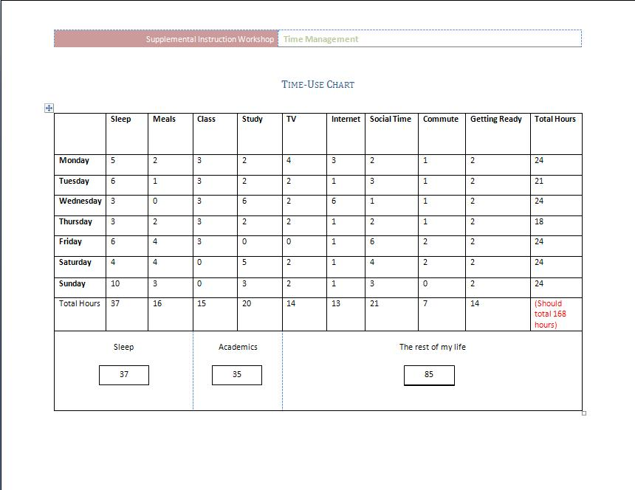
Time-Use Chart Where do you spend your time?

Slide 4
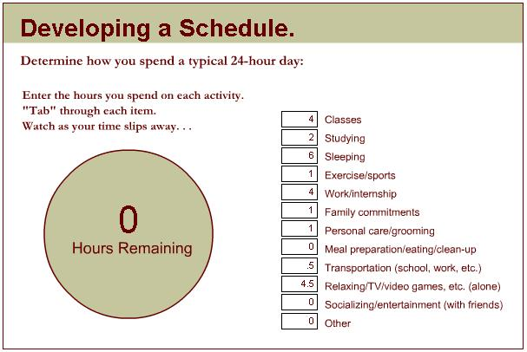
Time-Use Website http://www.studygs.net/schedule

Slide 5
Goals, Values and Time
Goals include anything you want to achieve, aim for, and put energy into attaining.
Values make up the belief system that underlies a decision you make.
When you have to choose an activity, you consider your goals and values before you make the decision to spend time and energy on it.

Slide 6
Time, the great equalizer!
We each have 24 hours a day and 7 days a week.
What do you spend your time doing?
Work?
School?
Sleep?
Commuting?
Internet?
TV?
…..Other

Slide 7
School and Time
Are there enough hours in a day for you?
Each unit of a course is typically equal to one hour in class.
12 Units (full time) = 12 Hours
An average student can get by with average scores by studying 2 hours per hour of class.
12 units X 2 Hours = 24 Hours
Sleep is an important part of life.
7 hours = 49 Hours per week

Slide 8
How much time does that leave?
Hours Per Week | Class Hours | Sleep Hours | Study Hours | Remainder
168 | 12 | 49 | 24 | 83 Hours
What activities are not receiving your full attention?

Slide 9
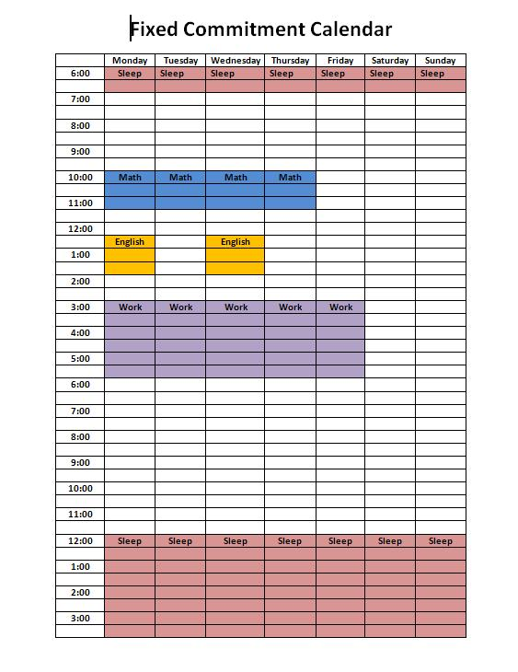
Time Management Strategies
Where do I put everything??
Look at commitments that you can’t change.
Assess where the gaps are.
Plan your flexible activities in those gaps.

Slide 10

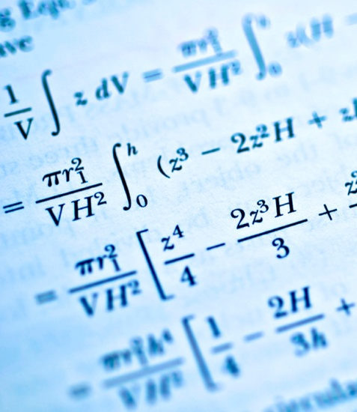

Time Management Strategies
Monitor your time
How much time does it take you to complete certain tasks?
Reading
Math Homework
English Paper
Memorizing
Create a study log to plan out time for each activity.

Slide 11
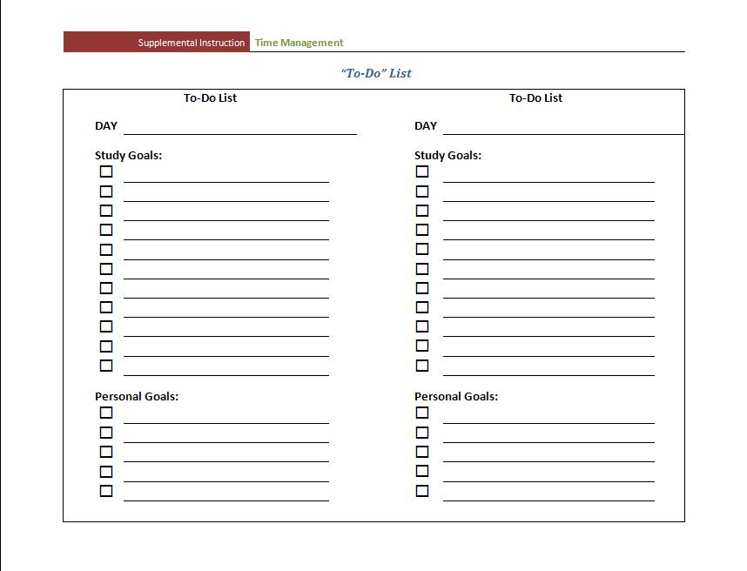

Time Management Strategies
To Do Lists
Ensure you don’t forget anything
Prioritize activities

Slide 12

Time Management Strategies
Calendars and Planners

Slide 13
Procrastination
Why do today what you can put off ‘till tomorrow?
Why combat procrastination?
Reduce stress.
More time to review and learn material at a deeper level.
Revise assignments to ensure accuracy.
Avoid mistakes that are created when rushed (like misspellings or incorrect mathematical computations).
Find out your printer is broken sooner than the day your paper is due.
Avoid embarrassment
Waiting to complete a task at the last minute.

