Slide 1
Comma Sense
(and Quotation Marks, too)

Slide 2
Commas

Slide 3
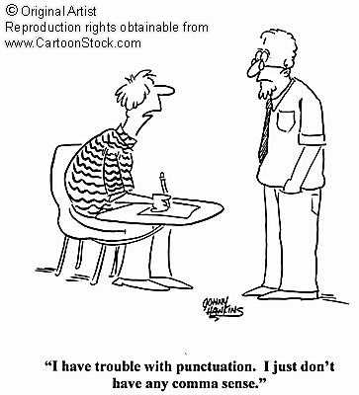

Slide 4
Comma Use #1: A Joiner
Use a comma and a fanboys conjunction
to join two sentences.
The movie was a little silly. We loved it.
The movie was a little silly, but we loved it.
But is a fanboys conjunction.

Slide 5
What are the other fanboys conjunctions?
For
And
Nor
But
Or
Yet
So
FANBOYS is a little trick to
help you remember
coordinating conjunctions.
These conjunctions help
connect two “equal” clauses.

Slide 6
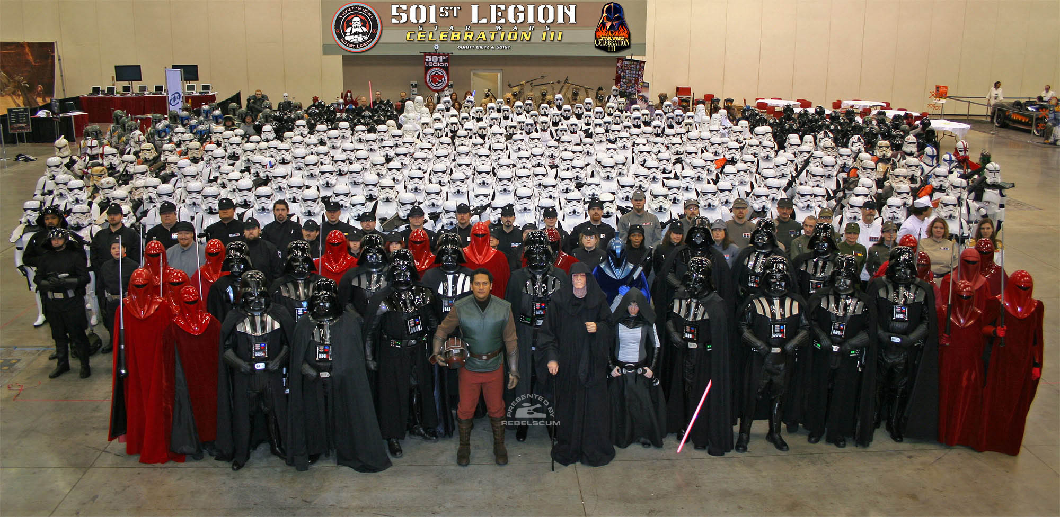
Fanboys is also a 2008 movie about
a group of nerdy Star Wars Fans. (Really!)

Slide 7
Mini-Quiz: Where do the commas belong?
Yoda said, “Do not judge me by my size for my ally is the force.”
My daughter was Princess Leia for Halloween and
my son was Hans Solo.
Margo never saw Star Wars in the theater nor had
she ever rented the DVD.
Studio executives wanted Chewbacca to wear
shorts but George Lucas vetoed the idea.
Notes:
Using “for” as a conjunction sounds a little old-fashioned, similar to how Yoda talks. Don’t confuse its use as a conjunction with its use as a preposition. (See sentence below: “for Halloween”)

Slide 8
Mini-Quiz: Where do the commas belong?
Yoda said, “Do not judge me by my size, for my ally is the force.”
My daughter was Princess Leia for Halloween and
my son was Hans Solo.
Margo never saw Star Wars in the theater nor had
she ever rented the DVD.
Studio executives wanted Chewbacca to wear
shorts but George Lucas vetoed the idea.

Slide 9
Mini-Quiz: Where do the commas belong?
Yoda said, “Do not judge me by my size, for my ally is the force.”
My daughter was Princess Leia for Halloween, and
my son was Han Solo.
Margo never saw Star Wars in the theater nor had
she ever rented the DVD.
Studio executives wanted Chewbacca to wear
shorts but George Lucas vetoed the idea.

Slide 10
Mini-Quiz: Where do the commas belong?
Yoda said, “Do not judge me by my size, for my ally is the force.”
My daughter was Princess Leia for Halloween, and
my son was Hans Solo.
Margo never saw Star Wars in the theater, nor had
she ever rented the DVD.
Studio executives wanted Chewbacca to wear
shorts but George Lucas vetoed the idea.

Slide 11
Mini-Quiz: Where do the commas belong?
Yoda said, “Do not judge me by my size, for my ally is the force.”
My daughter was Princess Leia for Halloween, and
my son was Han Solo.
Margo never saw Star Wars in the theater, nor had
she ever rented the DVD.
Studio executives wanted Chewbacca to wear
shorts, but George Lucas vetoed the idea.

Slide 12
Mini-Quiz: Where do the commas belong?
Either you will take me to see Star Wars or I
will go by myself!
Star Wars made over 300 million dollars yet it
only cost eight million to produce.
My cousin loved Star Wars so he saw it over
100 times.

Slide 13
Mini-Quiz: Where do the commas belong?
Either you will take me to see Star Wars, or I
will go by myself!
Star Wars made over 300 million dollars yet it
only cost eight million to produce.
My cousin loved Star Wars so he saw it over
100 times.

Slide 14
Mini-Quiz: Where do the commas belong?
Either you will take me to see Star Wars, or I
will go by myself!
Star Wars made over 300 million dollars, yet it
only cost eight million to produce.
My cousin loved Star Wars so he saw it over
100 times.

Slide 15
Mini-Quiz: Where do the commas belong?
Either you will take me to see Star Wars, or I
will go by myself!
Star Wars made over 300 million dollars, yet it
only cost eight million to produce.
My cousin loved Star Wars, so he saw it over
100 times.

Slide 16
Use a comma and a fanboys to connect two sentences.
S V S V
My cousin loved Star Wars, so he saw it over 100 times.
No comma is needed if only the verb (or noun) is compound.
S V V
My cousin loved Star Wars and saw it over 100 times.

Slide 17
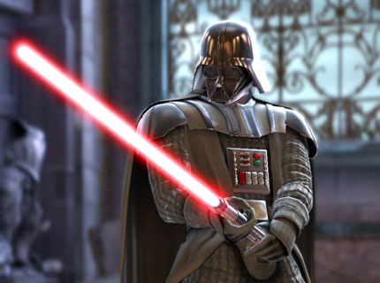
The Dreaded Comma Splice

Slide 18
The Dreaded Comma Splice
Never use a comma ALONE to connect two
sentences. Always use a fanboys conjunction.

Slide 19
The Dreaded Comma Splice
Never use a comma ALONE to connect two sentences. Always use a fanboys conjunction.
WRONG:
Studio executives wanted Chewbacca to wear shorts, George Lucas vetoed the idea.
CORRECT:
Studio executives wanted Chewbacca to wear shorts, but George Lucas vetoed the idea.

Slide 20
The Dreaded Comma Splice
Never use a comma ALONE to connect two sentences. Always use a fanboys conjunction.
WRONG:
Studio executives wanted Chewbacca to wear shorts, George Lucas vetoed the idea.
CORRECT:
Studio executives wanted Chewbacca to wear shorts, but George Lucas vetoed the idea.

Slide 21
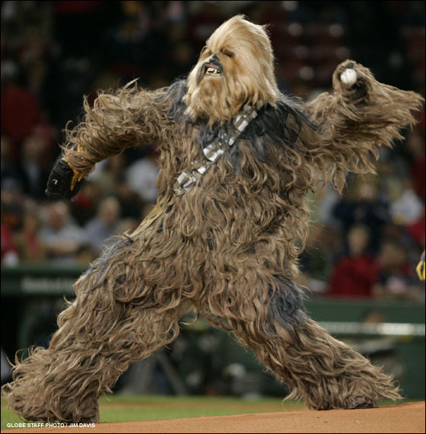
CORRECT:
Studio executives wanted Chewbacca to wear shorts, but George Lucas vetoed the idea.

Slide 22
Comma Use #2: An Introducer
Use a comma after introductory phrases and clauses.
From 2000 to 2002, the Lakers won three
titles consecutively.
The comma separates the introductory phrase from the subject and the verb, making the sentence easier to read.

Slide 23
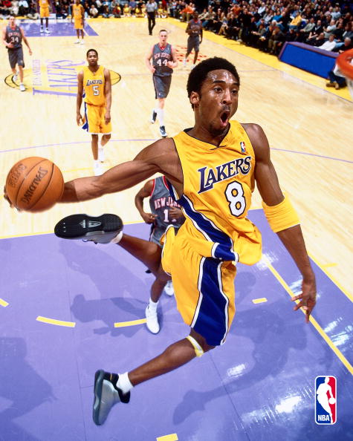
Frankly, Keith could live without
food before he could live without
basketball.
Susan loves the Lakers. However,
she rarely has time to watch their
games.
Because Bill was a huge
Lakers fan, he never missed a
game.

Slide 24
Note that when the dependent clause comes second, a comma is unnecessary.
Because Bill was a huge Lakers fan, he never missed a game.
Bill never missed a Lakers game because he was huge fan.
Some words that begin dependent clauses are if, before, although, when, whenever, because, before, and unless.

Slide 25
Mini-Quiz: Where do the commas belong?
When basketball season began Joan was so happy that she could not stop smiling.
If Ron could find time to practice he would be a
better player.
If you don’t add jalapenos the guacamole will be bland.

Slide 26
Mini-Quiz: Where do the commas belong?
When basketball season began, Joan was so happy that she could not stop smiling.
If Ron could find time to practice he would be a
better player.
If you don’t add jalapenos the guacamole will be bland.

Slide 27
Mini-Quiz: Where do the commas belong?
When basketball season began, Joan was so happy that she could not stop smiling.
If Ron could find time to practice, he would be a
better player.
If you don’t add jalapenos the guacamole will be bland.

Slide 28
Mini-Quiz: Where do the commas belong?
When basketball season began, Joan was so happy that she could not stop smiling.
If Ron could find time to practice, he would be a
better player.
If you don’t add jalapenos, the guacamole will be bland.

Slide 29

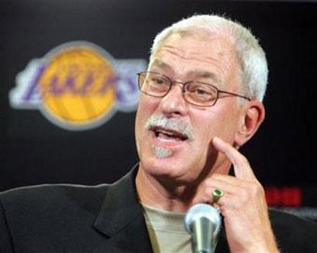
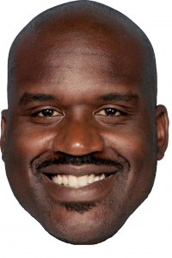
Comma Use #3: A Lister
Use a comma when listing 3 or more things in a series.
The Lakers won three titles consecutively
with the help of Shaquille O'Neal, Kobe Bryant,
and Hall of Fame coach Phil Jackson.

Slide 30



Use a comma when listing 3 or more things in a series.
Susan, Tiffany, and Amber got together to watch the
game on TV. They snacked on nachos, pizza, and
cut up carrots.

Slide 31
Do NOT use commas when you only list two things!
Susan and Amber snacked on nachos and salsa.
The Lakers won three titles consecutively
with the help of Shaquille O'Neal and Kobe Bryant.
What about me?!

Slide 32
Mini-Quiz: Where do the commas belong?
Both the Los Angeles Lakers and the Los Angeles Sparks wear purple and gold uniforms.
The Sparks the Lakers and the Clippers all play
At Staples Center.
Jane is either watching the game with her friends
enjoying it with her family at home or sitting in
Staples Center with her boyfriend.

Slide 33
Mini-Quiz: Where do the commas belong?
Both the Los Angeles Lakers and the Los Angeles Sparks wear purple and gold uniforms. NO COMMAS!
The Sparks the Lakers and the Clippers all play
At Staples Center.
Jane is either watching the game with her friends
enjoying it with her family at home or sitting in
Staples Center with her boyfriend.

Slide 34
Mini-Quiz: Where do the commas belong?
Both the Los Angeles Lakers and the Los Angeles Sparks wear purple and gold uniforms. NO COMMAS!
The Sparks, the Lakers, and the Clippers all play
At Staples Center.
Jane is either watching the game with her friends
enjoying it with her family at home or sitting in
Staples Center with her boyfriend.

Slide 35
Mini-Quiz: Where do the commas belong?
Both the Los Angeles Lakers and the Los Angeles Sparks wear purple and gold uniforms. NO COMMAS!
The Sparks, the Lakers, and the Clippers all play
at Staples Center.
Jane is either watching the game with her friends,
enjoying it with her family at home, or sitting in
Staples Center with her boyfriend.

Slide 36

Comma Use #4: An Interrupter
Use TWO commas with words or phrases
that interrupt the flow of the sentence or add
additional information.
Persimmons,
a delicious fruit,
are available in
the fall.

Slide 37

The Staples Center, which is located in downtown
Los Angeles, is current home to the Lakers.
My friend gave me a DVD of Toy Story, one of my
favorite movies, to cheer me up.

Slide 38
Note: Sometimes the “interrupter” comes at the
end of the sentence.
The Lakers’ current home is the Staples Center,
which is located in downtown Los Angeles.

Slide 39
Exception: Don’t use commas if the sentence
loses important meaning when you take out
the “interrupter.”
The man who grabbed my wallet lived in my
neighborhood.
The people who did the damage should pay for it.

Slide 40
DO NOT use one comma to separate the subject from its verb.
WRONG:
The man who looked just like Elvis, came into our
Store three times last week.
WRONG:
The problem I kept having with my noisy muffler,
suddenly went away by itself.
WRONG:
Sizzling Steakburgers which is near my apartment,
offers weekday specials on steak dinners.

Slide 41
DO NOT use one comma to separate the subject from its verb.
RIGHT:
The man who looked just like Elvis came into our
store three times last week.
WRONG:
The problem I kept having with my noisy muffler,
suddenly went away by itself.
WRONG:
Sizzling Steakburgers which is near my apartment,
offers weekday specials on steak dinners.

Slide 42
DO NOT use one comma to separate the subject from its verb.
RIGHT:
The man who looked just like Elvis came into our
Store three times last week.
RIGHT:
The problem I kept having with my noisy muffler
suddenly went away by itself.
WRONG:
Sizzling Steakburgers which is near my apartment,
offers weekday specials on steak dinners.

Slide 43
DO NOT use one comma to separate the subject from its verb.
RIGHT:
The man who looked just like Elvis came into our
Store three times last week.
RIGHT:
The problem I kept having with my noisy muffler
suddenly went away by itself.
RIGHT:
Sizzling Steakburgers, which is near my apartment,
offers weekday specials on steak dinners.

Slide 44
Mini-Quiz: Where do the commas belong?
My sister’s apology which came a year too late did
not change my mind about forgiving her.
The professor taking pity on the class postponed
the final paper for another week.
Mrs. Jones my eighth grade teacher won third place
in the Boston marathon.

Slide 45
Mini-Quiz: Where do the commas belong?
My sister’s apology, which came a year too late, did
not change my mind about forgiving her.
The professor taking pity on the class postponed
the final paper for another week.
Mrs. Jones my eighth grade teacher won third place
in the Boston marathon.

Slide 46
Mini-Quiz: Where do the commas belong?
My sister’s apology, which came a year too late, did
not change my mind about forgiving her.
The professor, taking pity on the class, postponed
the final paper for another week.
Mrs. Jones my eighth grade teacher won third place
in the Boston marathon.

Slide 47
Mini-Quiz: Where do the commas belong?
My sister’s apology, which came a year too late, did
not change my mind about forgiving her.
The professor, taking pity on the class, postponed
the final paper for another week.
Mrs. Jones, my eighth grade teacher, won third place
in the Boston marathon.

Slide 48

Comma Use #5: With Adjectives
If you can switch the order of two adjectives without changing the meaning, you need to use a comma.
The comma butterfly is a magical, fascinating insect.
The comma butterfly is a fascinating, magical insect.

Slide 49

But if you cannot switch the adjectives, you do NOT need a comma.
Ten red balloons fell from the ceiling.

Slide 50
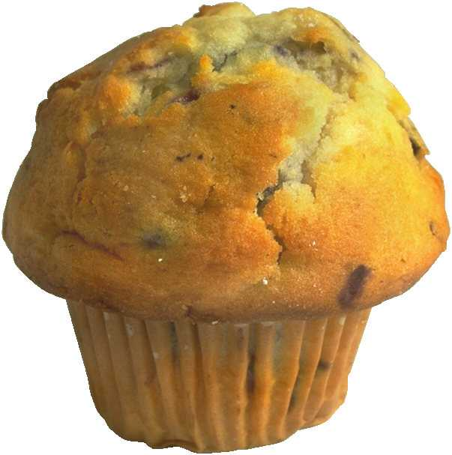
If you can switch the adjectives, use a comma.
If you CANNOT switch them, no comma.
Mini-Quiz: Where do the commas belong?
Fresh blueberry muffin
Stale crumbly muffin
Delicious nutritious muffin
Hot delicious pepperoni pizza

Slide 51
If you can switch the adjectives, use a comma.
If you CANNOT switch them, no comma.
Mini-Quiz: Where do the commas belong?
Fresh blueberry muffin
Stale, crumbly muffin
Delicious, nutritious muffin
Hot, delicious pepperoni pizza

Slide 52
Other ways to use the comma
In dates: October 16, 1955
In place names: Memphis, Tennessee
1234 Ivy Lane, Memphis, TN
In titles: Amy Jones, MD, is a good
doctor.
In numbers: I’d love to win $1,000,000.

Slide 53
Quotation Marks

Slide 54
Quotation Marks and Commas
If you quote someone and use a signal phrase
(such as he says, she claims, according to
Lincoln), put a comma after the signal phrase.
Yogi Berra, the famous New York Yankees
player, had a colorful way of expressing
himself. He once said, “Always go to other
people’s funerals, or else they won’t go to yours.”

Slide 55

Quotation Marks and Commas
If the signal phrase comes last, put the comma after the quote, BEFORE the quotation mark.
“I'm not going to buy
my kids an
encyclopedia,”
Berra said. “Let them
walk to school like I did.”

Slide 56
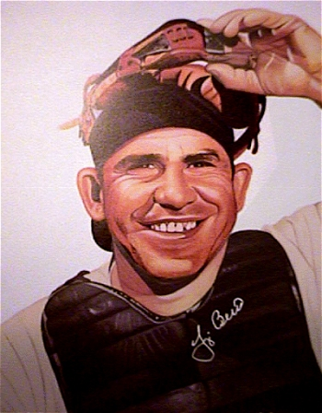
Quotation Marks and Commas
Don’t use a comma if the quote ends with a question mark or exclamation point.
“How can you think
and bat at the same
time?” asked Berra.

Slide 57
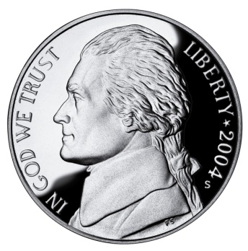
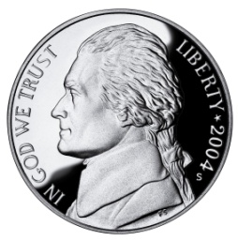
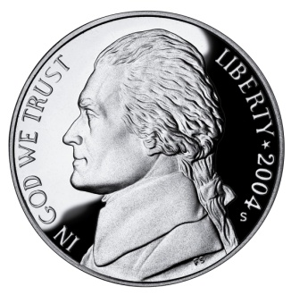

Quotation Marks and Commas
Don’t use a comma if the quotation is introduced with that.
Yogi Berra once claimed that “a nickel ain’t worth
a dime anymore.”

Slide 58
Where do the COMMAS
AND QUOTES go in these sentences?
Mark Twain said Cauliflower is nothing but cabbage with a college education.
Be careful about reading health books Mark Twain said. You may die of a misprint.
It’s a home run! the commentator screamed.

Slide 59
Where do the COMMAS
AND QUOTES go in these sentences?
Mark Twain said, “Cauliflower is nothing but cabbage with a college education.”
Be careful about reading health books Mark Twain said. You may die of a misprint.
It’s a home run! the commentator screamed.

Slide 60
Where do the COMMAS
AND QUOTES go in these sentences?
Mark Twain said, “Cauliflower is nothing but cabbage with a college education.”
“Be careful about reading health books,” Mark Twain said. “You may die of a misprint.”
It’s a home run! the commentator screamed.

Slide 61
Where do the COMMAS
AND QUOTES go in these sentences?
Mark Twain said, “Cauliflower is nothing but cabbage with a college education.”
“Be careful about reading health books,” Mark Twain said. “You may die of a misprint.”
“It’s a home run!” the commentator screamed.

Slide 62

You have completed the first step
It’s time to apply what you
have learned by completing
the handout exercises.

