Slide 1
“How Do I Get Started?”
Jump-start your paper with Prewriting Strategies

Slide 2

Don’t Know Where to Begin? Can’t Think of What to Write?

Slide 3

You can use a variety of methods to rev up your writing process.

Slide 4



In today’s workshop, you’ll have a chance to practice some effective strategies. You might find one that suits your style!

Slide 5
You probably know
what “prewriting” is.

Slide 6
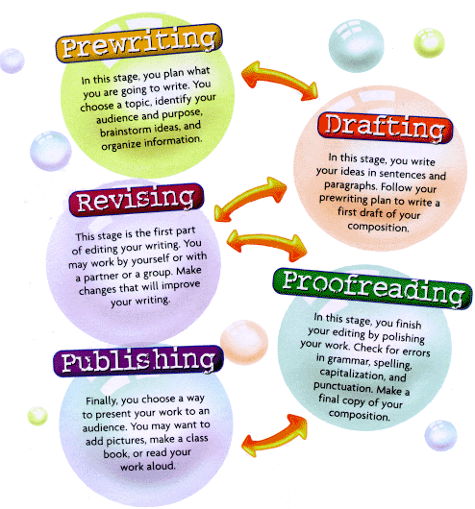
It’s just the first stage in the writing process.

Slide 7
Prewriting can involve . . .
Choosing and narrowing a topic
Coming up with ideas
Finding relationships between ideas (grouping or classifying, identifying cause-effect relationships, etc.)
Deciding on major ideas and details
Researching
Organizing information

Slide 8

Why is prewriting important? Writing is like building something. To build a house, for example . . .

Slide 9



you would first come up with ideas . . .

Slide 10

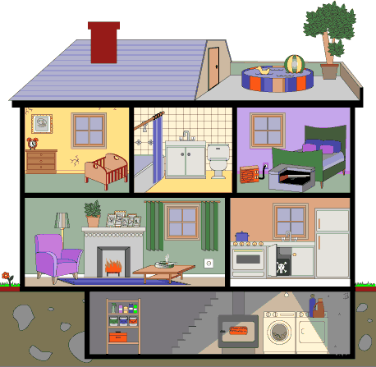
. . . and then develop a design or plan.

Slide 11

You may not know where you’re headed
when you begin, but by the end of the planning
stage you have some kind of design in mind.

Slide 12

Specifically, prewriting helps you . . .
Develop ideas you didn’t know you had
Connect with, and evaluate, your own
knowledge, past experiences, and interests
Clarify your belief and attitudes
Identify your purpose for writing
Develop a sense of your audience
Select and organize ideas to use in your paper

Slide 13
Let’s look at five prewriting strategies:
#1 - Asking questions
#2 - Brainstorming (listing)
#3 - Clustering
#4 - Freewriting
#5 - Talking it out

Slide 14
Strategy #1: Asking Questions
Imagine that your instructor has assigned this
broad topic for an essay:
“What can an individual do
to reduce environmental pollution?”
If you ask questions about the subject, you can
narrow the topic and discover ideas that you
hadn’t yet considered.

Slide 15
What questions can you can ask . . . ?
What are the various types of pollution? (air, water, etc.)
What causes pollution? (manufacturing, transportation, waste disposal, etc.)
How do we contribute to pollution? (buy harmful products, waste energy, don’t recycle, etc.)
What harmful products do we buy? (bottled water, batteries, etc.)

Slide 16
By asking questions about a topic, you can identify a possible narrowed focus for your paper—let’s say, “bottled water.” The controlling idea for your essay might be . . .
“Consumers can reduce environmental pollution by not purchasing bottled water, which is not necessarily superior to tap water.”

Slide 17
With further work, you can generate additional ideas and sketch an outline.
Environmental impact of bottled water
A. Pollution from manufacturing bottles
B. Pollution from transporting the product
C. Most bottles are not recycled
II. Not superior to other sources of water
A. Tap water has beneficial mineral content and is processed to remove contaminants
B. Filters—either on the faucet or in a pitcher—can remove chemicals, metals, and bacteria

Slide 18
Strategy #2: Brainstorming (listing)
Brainstorming can help you discover ideas for your paper, including main points and details.
To brainstorm, list as many ideas as you can on the assigned topic. If you like, you can number your list.

Slide 19
Try not to censor your thoughts!
Ideas that don’t seem important at first glance may prove to be useful later.
Just keep listing until you run out of ideas.

Slide 20
Here is a brainstorm on the topic, “Women who work may face special challenges. Discuss.”
1. women earn less money than men do
2. sexual harassment on the job
3. conflict with out-of-work husband
4. can’t keep up with household tasks
5. too little time for kids
6. too little time for self
7. not taken seriously by employer

Slide 21
After brainstorming, study your list.
Look for relationships between ideas, and group ideas that are related.

Slide 22
1. earn less money than men do
2. sexual harassment on the job Problems at work
3. conflict with out-of-work husband
4. can’t keep up with household tasks
5. too little time for kids
6. too little time for self Problems at home
7. not taken seriously by employer

Slide 23
For your paper, select the ideas that will build a logical structure. Scratch out ideas that you don’t want to include.
3. conflict with out-of-work husband

Slide 24
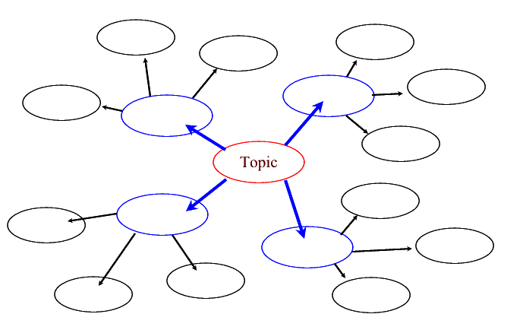
Strategy #3: Clustering (also called a bubble diagram, web, or mind-map)

Slide 25
In the middle of the page, draw a bubble for your general subject.
Let’s say your instructor has assigned this topic:
Challenges of first-year
college students

Slide 26
As you think of ideas on that topic, draw lines to additional bubbles.
Financial Classes are challenges more difficult than in high school Challenges of first-year
college students
No time for friends

Slide 27
From each new bubble, draw lines to specific details.
Tuition Financial Parking Classes are challenges more difficult than in high school Books Challenges of first-year
college students
Need to No time for work friends

Slide 28
From your diagram, you can begin to select and organize ideas for your paper:
Challenges faced by first-year college students
I. Financial challenges A. Tuition NOTE TO SELF: B. Books and supplies This affects
C. Parking academic &
D. Need to work social life !!!
II. Academic challenges (Write a cause-effect
III. Social challenges essay, instead? )

Slide 29
Strategy #4: Freewriting (also called fastwriting)
In this method, you write on a topic for ten or fifteen minutes without stopping. Write whatever comes to mind. Don’t worry if your thoughts are incomplete. Don’t worry about grammar or punctuation or “writing correctly.” Don’t worry about “making sense.”

Slide 30
Keep your pen moving on the page, even when you don’t know what to say. Write, “I don’t know what to write next” or even “This is dumb, this is dumb.”
Don’t stop until you fill up a page—or until the time is up!

Slide 31
Here is a sample freewrite on the topic of domestic violence:
Okay, what do I think about domestic violence? It’s a major problem these days, I know that, but maybe it ’s just because we talk about it more? I have a friend (we met in high school) . . . and when we got back in touch after several years, she told me her husband was physically and emotionally abusive. I’ve heard that abusers try to isolate their victims, so I’m glad she reached out to me. Why do they do it? Power? The need to control other people? How can domestic violence be prevented? What are the solutions? Where can victims get help? I think we need more education on this topic.

Slide 32
By the time you are finished, you may have discovered a new idea, or clarified a belief you have, or arrived at a possible focus for your paper.
The student who completed the freewrite on domestic violence might decide to focus on ways victims can get help. After further research, perhaps the student will decide to focus on domestic violence shelters and the services they offer.

Slide 33
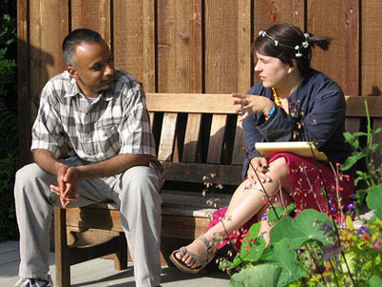
Strategy #5: Talk it out!
In this method, you will discuss the assigned topic
with a friend or classmate—let’s say your topic is
America’s war in
Afghanistan.
Talk for three minutes
on the topic while
your partner listens.

Slide 34
Your partner can ask you to provide more information, clarify an idea, or even introduce a different opinion:
I’m not sure what you mean by . . . Can you clarify that thought?
That sounds interesting. Tell me more!
Can you give me some examples?
But aren’t you assuming . . . ?
What if someone said the opposite. How would you respond?

Slide 35
When your time is up, you just may have some ideas to work with! You might also be more aware of opposing positions on the issue you’ve been discussing.
“Although many people support the war in Afghanistan, I believe humanitarian efforts will be more effective than military force in achieving our objectives.”

Slide 36
Why use prewriting techniques?
You can develop ideas you didn’t know you had
You can connect with, and evaluate, your own
knowledge, past experiences, and interests
You can clarify your belief and attitudes
You can identify your purpose for writing
You can develop a sense of your audience
You can select and organize ideas to use in your paper

Slide 37

Let’s try the five techniques that can jump start your writing process:
Asking questions
Brainstorming
Clustering
Freewriting
Talking it out

Slide 38

Check for understanding: Stop here to answer a few questions about what you just learned
Click on the button to go to the interactive exercise.

Slide 39

You have completed the first step
It’s time to apply what you have learned by completing the handout exercises.

