Slide 1
APA Essentials 6th Edition
Structure and Formatting
Guided Learning Activity & Workshop
Notes:
http://psychology.vanguard.edu/faculty/douglas-degelman/apa-style/
Both articles used in this tutorial are located on Degelman’s website (above)

Slide 2

What is APA Style used for?
Term Papers
Research Reports
Empirical Studies
Literature Reviews
Theoretical Articles
Methodological Articles
Case Studies
Notes:
This workshop will teach you how to apply some basic rules of APA style
APA style was developed by social and behavioral scientists to standardize scientific writing

Slide 3
General Format
An APA formatted paper usually includes four major sections:
Title Page
Abstract
Main Body
References
Verify with your instructor which sections are required for your paper.
References
Main Body
Abstract
Title page
Notes:
This slide introduces four required part of an APA paper: a title page, abstract, main body (essay itself), and a list of References.
An abstract page and list of references are titled as Abstract and Reference, respectively.
It is important to remind students that each page should have a page header with a short title and page number.

Slide 4
General Format
Figures
Tables
Depending on the subject of the paper written, an APA paper might also include
Appendix
Footnotes
Tables
Figures
Footnotes
Appendix
References
Main Body
Abstract
**Each of these sections must begin on a new page
Title page
Notes:
This slide introduces four required part of an APA paper: a title page, abstract, main body (essay itself), and a list of References. An abstract page and list of references are titled as Abstract and Reference, respectively.
It is important to remind students that each page should have a page header with a short title and page number.
This slide can be supplemented by the “General Format” section from OWL http://owl.english.purdue.edu/owl/resource/560/01/

Slide 5
Basic APA Format Guidelines
Margins: 1 inch on all sides
Font: 12 Point/Times New Roman
Spacing: Double spacing
Paragraph Indentation: 5 spaces
Alignment: Flush left
Page Header: Each page includes the page number and a Running Head (more details on a later slide)
Pagination: Page number located on upper right corner of each page (top line) beginning on the Title Page
Notes:
Formatting your paper in APA style means paying attention to mechanical details such as:
Typeface
Line spacing
margins
Page headers
Your essay should be typed, double-spaced on standard-sized paper (8.5" x 11") with 1" margins on all sides.
You should use a clear font that is highly readable. APA recommends using 12 pt. Times New Roman font.
Double space the entire paper
Also double space between the text and titles, headings and block quotations
Double space the reference list and figure captions
Indent the first line of every paragraph ½ inch
Align the text to the left hand margin, leaving a ragged right-hand margin
Page numbers consecutively starting with page 1

Slide 6
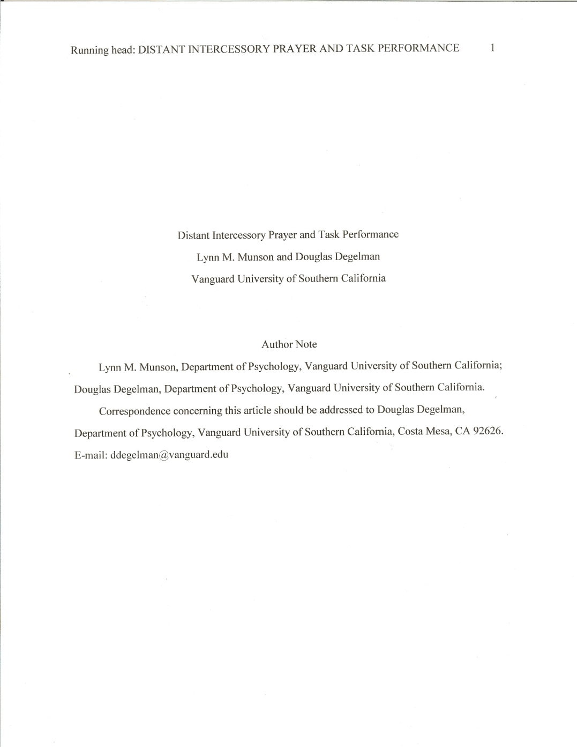
Title Page
Title page is page 1
Each line is centered on the title page
Use uppercase and lowercase letters
Title of paper
Author(s) Names
Include first, middle initial and last name,
Don’t use titles (PhD or M.D.)
Educational Institution
Author’s notes are not required; they add contact information
APA Format requires that the educational institution is listed on the title page. DO NOT put the date, the class name or class number unless required to do so by your instructor.
Notes:
The title should be typed in upper & lower case letters, centered between the left and right margins and positioned in the upper half of the page.
http://psychology.vanguard.edu/wp-content/uploads/2010/12/paper.pdf

Slide 7

Title Page: Page Header & Running Head
A Running head & page number of the document are located at the top of each page.
The Running Head is an abbreviated title printed at the top of each page.
The Running Head should be
a maximum of 50 characters
appear flush left in all capital letters at the top of the title page and all subsequent pages.
The words Running head (in upper and lower case letters) is included only on the Title Page to identify the Running head.
Notes:
The title should be typed in upper & lower case letters, centered between the left and right margins and positioned in the upper half of the page.
To create a page header, use “Insert Page Header” function of MSO Word. Choose “Insert Page Number” in the upper right-hand side and type two-three words of the title before page number. Separate the abbreviated title from the page number with five spaces.
http://psychology.vanguard.edu/wp-content/uploads/2010/12/paper.pdf

Slide 8
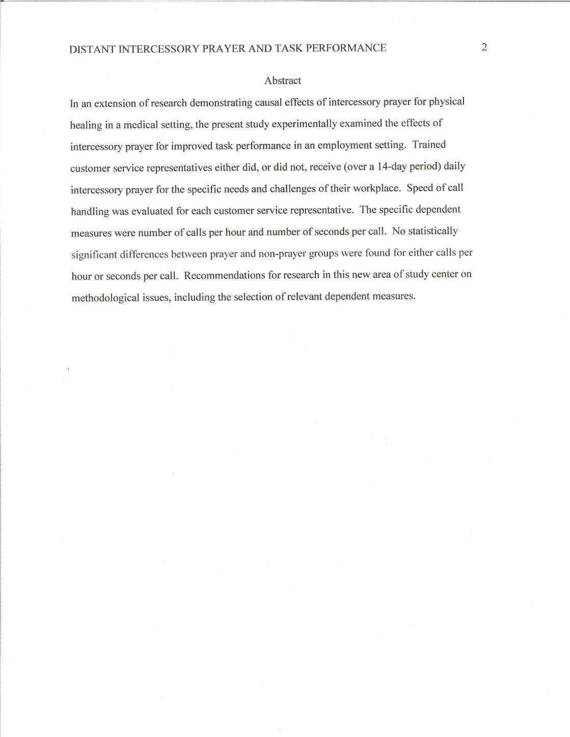
Title Page: Running head
On the title page, your page header/running head should look like this:
Running head: TITLE OF YOUR PAPER
On pages after the title page the running head should look like this:
TITLE OF YOUR PAPER
Notes:
Please note that on the title page, your page header/running head should look like this:
Running head: TITLE OF YOUR PAPER
Pages after the title page should have a running head that looks like this:
TITLE OF YOUR PAPER

Slide 9

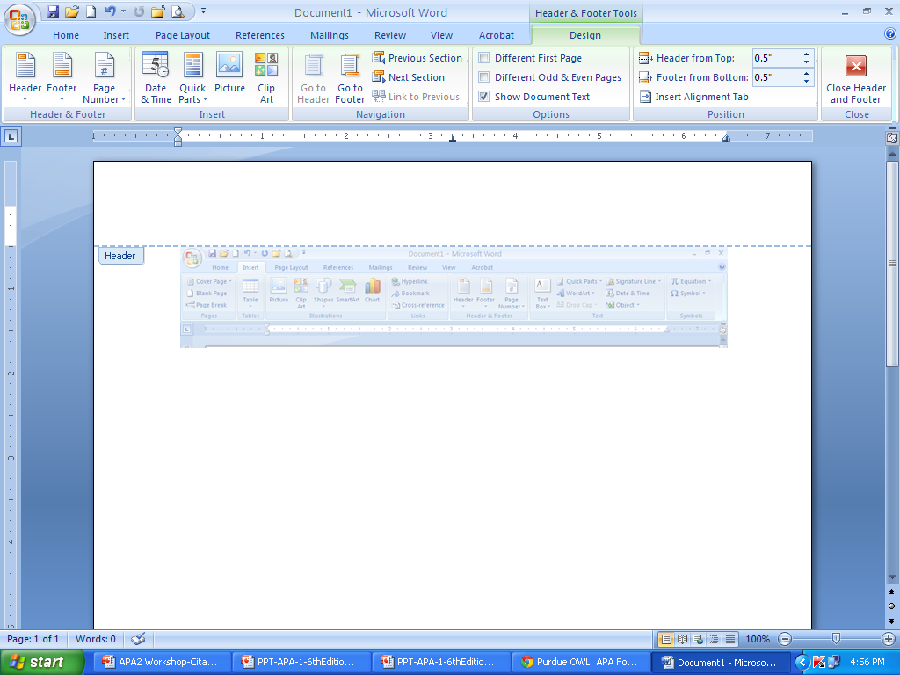
Title Page: Running head
Use the automatic functions of your word-processing program to generate headers and page numbers.
Use the Different first page check box to make the page 1 Running head different from the remaining pages of your paper.
Notes:
Please note that on the title page, your page header/running head should look like this:
Running head: TITLE OF YOUR PAPER
Pages after the title page should have a running head that looks like this:
TITLE OF YOUR PAPER

Slide 10
Abstract
Reminder: The Running Head (a short title) appears in all capital letters on each page.
The Abstract summarizes the main points of the paper in 150 to 250 words
The heading Abstract is centered at the top of the page and begins on page 2 of the paper
The abstract is not indented
Notes:
http://psychology.vanguard.edu/wp-content/uploads/2010/12/paper.pdf

Slide 11
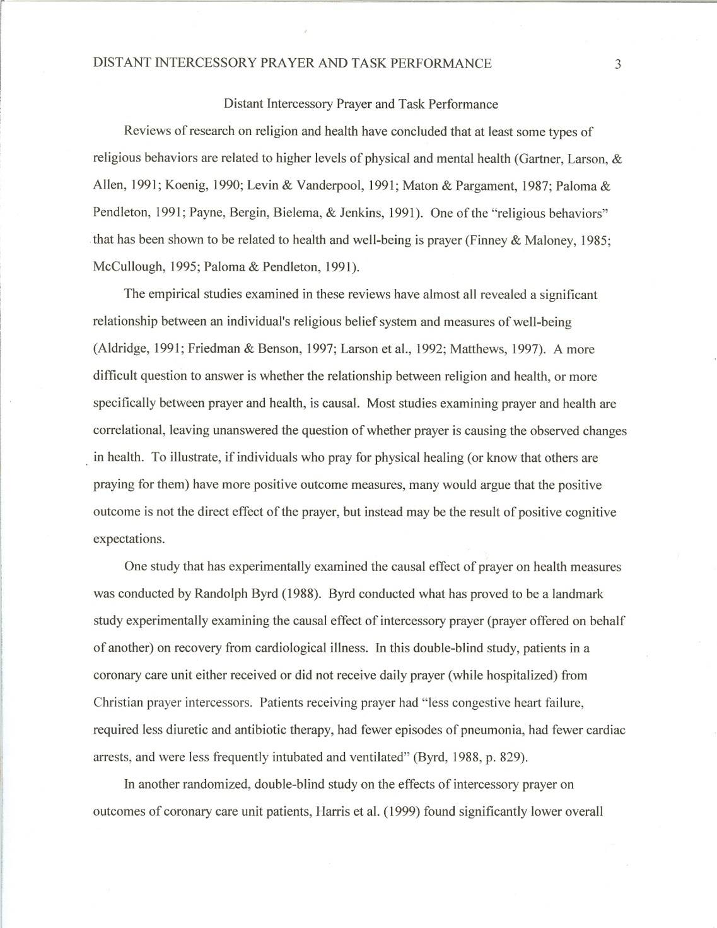
Body
The Running Head (a short title) appears in all capital letters on each page.
Body of paper starts on page 3
List the full title of the paper, centered on page 3
Remember: each page includes the Running Head in all capitals
Notes:
http://psychology.vanguard.edu/wp-content/uploads/2010/12/paper.pdf

Slide 12
Headings and Subheadings
Empirical Paper
Main Headings:
Methods
Results
Discussion
References
Sub Headings:
Participants, Apparatus, and Procedure (under)
Methods Main Heading
Open the link below to view an example of an empirical paper using Headings & Subheadings. Look on pages 4, 5,6. Then return to the PowerPoint presentation to continue the lesson.
http://psychology.vanguard.edu/wp-content/uploads/2010/12/paper.pdf
In an APA formatted paper, Headings and Subheadings are used to separate sections of the paper.
For example, in an empirical paper (when the author has conducted a research study), these sections may be used:
Notes:
http://psychology.vanguard.edu/wp-content/uploads/2010/12/paper.pdf

Slide 13
Headings and Subheadings
In a non-empirical paper, headings and subheadings may or may not be used, depending on the topic of your paper and the paper length.
Consult with your instructor to determine whether or not headings and subheadings are needed in your paper.
Non-Empirical Paper
Main Headings:
Specific headings based on material within sections of body of paper
Sub Headings:
May or may not be used (ask instructor)

Slide 14
Citations
Information from sources must be cited. This acknowledges the author’s work, and allows the reader to access the information in the References section of your paper
Follow the (author, date) method of in-text citation. If no date is available, write (n.d.) in place of the date
The author's last name and the year of publication for the source should appear in the text, for example
(Jones, 1998).
Author’s last name, year of publication
Notes:
In-text citations help establish credibility of the writer, show respect to someone else’s intellectual property (and consequently, avoid plagiarism).
More practically, in-text citations help readers locate the cited source in the references page. Thus, keep the in-text citation brief and make sure that the information provided in the body of the paper should be just enough so that a reader could easily cross-reference the citation with its matching entry on the reference page; i.e., the body of the paper and the in-text citation together contains the author’s name and the year of publication.
Anytime you use information from a source, provide in parenthesis the author’s name and the date of publication (Brown, 2010).
If you quote the author “word for word,” no matter how small, also provide the page number or paragraph number (Brown, 2010, p. 100).

Slide 15
Citations: Formula for the Citation
Use the following formula for the citation:
(author(s) last name (s), date of publication)
Examples:
Jones, 1998
Kanchier, 2000
Rogers & Frieberg, 1994
Kisangau, Lyarruu, Hosea, and Joseph (2007)
**always keep the author's names in the exact order in which they appear in the publication. Do NOT re order the names.
For example, do not reorder the names Kisangau, Lyarruu, Hosea, and Joseph.
Notes:
In-text citations help establish credibility of the writer, show respect to someone else’s intellectual property (and consequently, avoid plagiarism).
More practically, in-text citations help readers locate the cited source in the references page. Thus, keep the in-text citation brief and make sure that the information provided in the body of the paper should be just enough so that a reader could easily cross-reference the citation with its matching entry on the reference page; i.e., the body of the paper and the in-text citation together contains the author’s name and the year of publication.
Anytime you use information from a source, provide in parenthesis the author’s name and the date of publication (Brown, 2010).
If you quote the author “word for word,” no matter how small, also provide the page number or paragraph number (Brown, 2010, p. 100).

Slide 16
Citations: Groups as Authors
Groups such as corporations, associations, and government agencies can also author a publication.
Cite these sources using the group name as the author’s name in the citation and on the references page.
Examples:
Federal Communications Commission, 2001
Centers for Disease Control and Prevention, 2012
American Cancer Society, 2011
National Institute of Mental Health, 2006
You may use an abbreviation for the group author National Institute of Mental Health (NIMH), 2006 in subsequent citations providing you have identified the abbreviation in the first citation.
Notes:
In-text citations help establish credibility of the writer, show respect to someone else’s intellectual property (and consequently, avoid plagiarism).
More practically, in-text citations help readers locate the cited source in the references page. Thus, keep the in-text citation brief and make sure that the information provided in the body of the paper should be just enough so that a reader could easily cross-reference the citation with its matching entry on the reference page; i.e., the body of the paper and the in-text citation together contains the author’s name and the year of publication.
Anytime you use information from a source, provide in parenthesis the author’s name and the date of publication (Brown, 2010).
If you quote the author “word for word,” no matter how small, also provide the page number or paragraph number (Brown, 2010, p. 100).

Slide 17
Citations: et al. used for 3+ authors
# of Authors | First Citation | Subsequent Citations
One | Walker (2007) | Walker (2007)
Two | Walker and Allen (2004) | Walker and Allen (2004)
Three | Bradley, Ramirez, and Soo (1999) | Bradley et al. (1999)
Four | Bradley, Ramirez, and Soo, and Walsh (2006) | Bradley et al. (2006)
Five | Walker, Allen, Bradley, Ramirez, and Soo (2008) | Walker et al. (2008)
Six + | Wasserstein et al. (2005) | Wasserstein et al. (2005)
Group | University of Pittsburgh (2005) | University of Pittsburgh (2005)
Notes:
(APA Publication Manual, 2009, 6.11-6.15)
This information on this chart is taken from the APA Publication Manual. It reflects citation format based on number of authors.

Slide 18
Paraphrase
Paraphrase – a summary of information from a source – cite using author(s) last name(s), and year of publication
A paraphrase is used when you use the author’s ideas, and expressed them in YOUR OWN WORDS
Example:
Children choose the same foods they see their parents and friends eating (Berk, 2007).

Slide 19
Quotations: Short Quotes
A direct quote is when you use the author’s words, exactly.
Quotations with fewer than 40 words:
Use quotation marks, author(s) last name, year of publication, and page number (or paragraph number if no page number exists).
Example:
“Children tend to imitate the food choices of people they admire, both adults and peers” (Berk, 2007, p. 220).
Notes:
You may use an abbreviation for the group author National Institute of Mental Health (NIMH), 2006 in subsequent citations as long as you have identified the abbreviation in the first citation.

Slide 20
Quotations: Long Quotes
Quotations with 40 or more words – display in a block of text,
omit the quotation marks, indent each line 5 spaces, author(s) last name, year of publication and page (or paragraph number).
Example:
Though they eat less, preschoolers require a high- quality diet, including the same foods adults need, but in smaller amounts. Fats, oils, and salt should be kept to a minimum because their link to high blood pressure and heart disease in adulthood (Berk, 2007, p. 220).

Slide 21
Citation Examples
Kesler (2003) found that among research samples…
Early onset results in a more persistent and severe course (Kessler, 2003).
In 2003, Kessler’s study demonstrated
Notes:
If you need to cite two or more works together, arrange the in text citations alphabetically in the same order in which they appear in the reference list
Example: Several studies ( Miller, 1999; Shafranske & Mahoney, 1998)

Slide 22
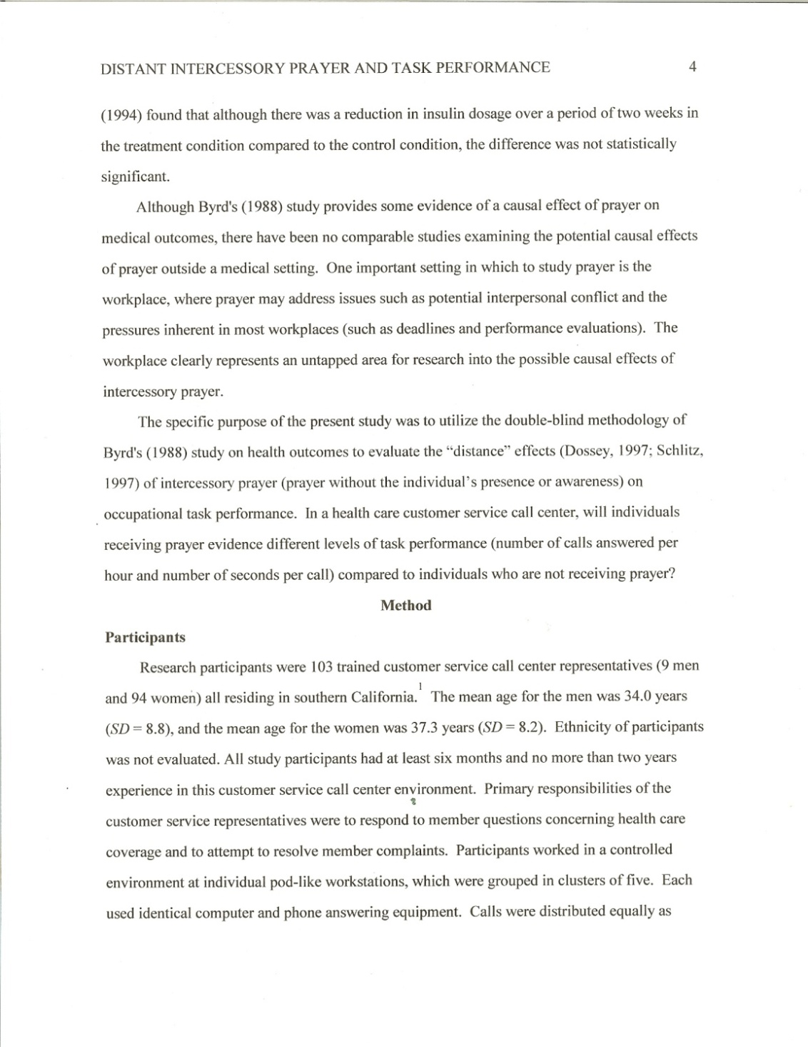
Citation Examples
The Running Head and Page number on all pages
Author’s name & date of publication in parenthesis.
In this example, two sources are cited. Notice that the writer cites both of the sources using APA format: Source’s last name and date of publication within the content of the paper
Notes:
If you need to cite two or more works together, arrange the in text citations alphabetically in the same order in which they appear in the reference list
Example: Several studies ( Miller, 1999; Shafranske & Mahoney, 1998)

Slide 23
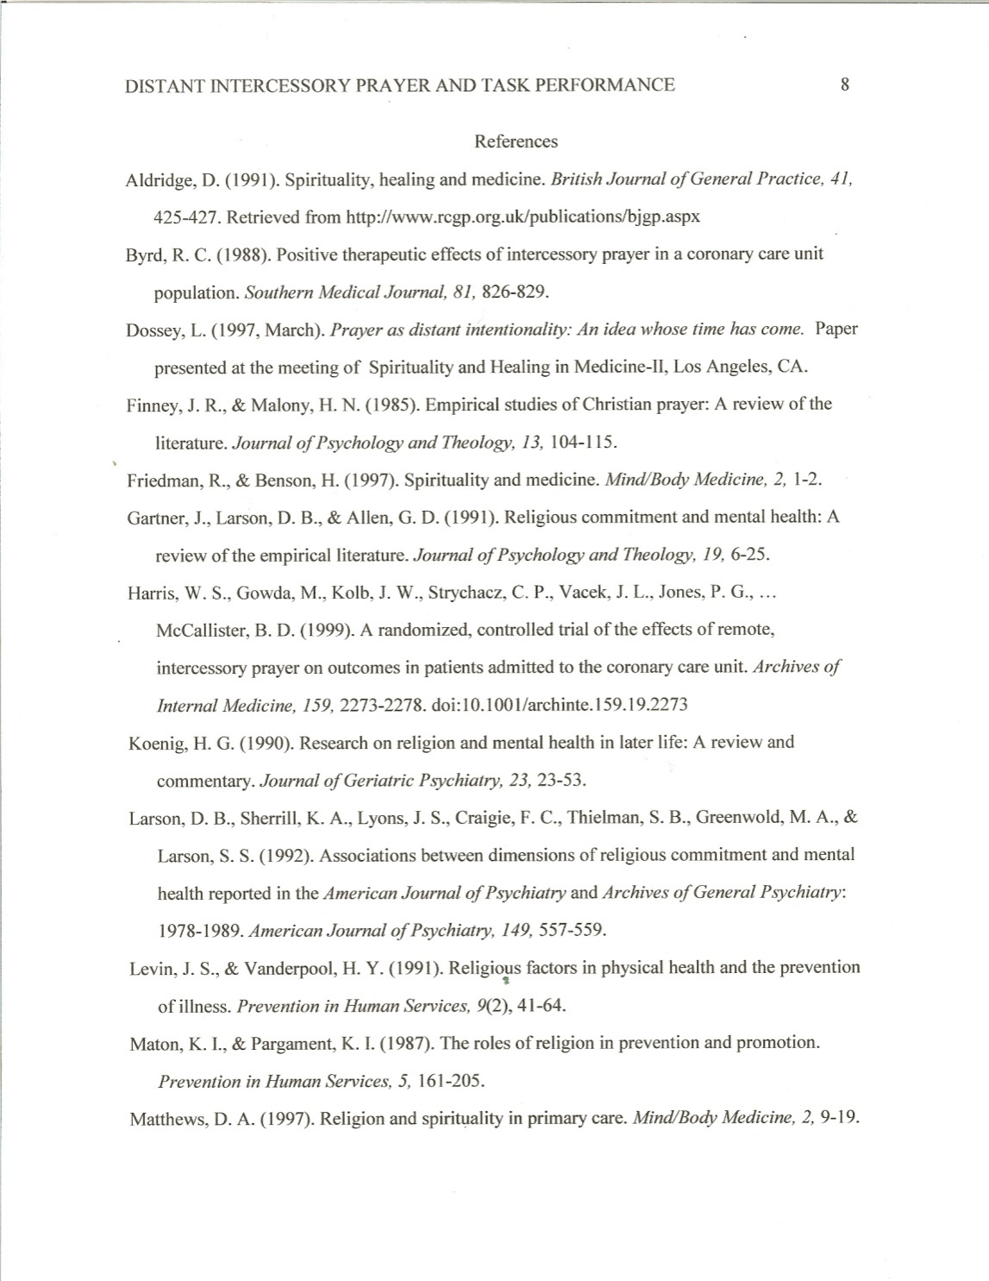
Reference Page
The Running Head and Page number on all pages
The References begin on a new page
The heading References is centered at the top of the page. It is not underlined, bolded or in quotations.
The References used in the paper are alphabetized by the first author’s last name.
Use a hanging indent for each new reference.
A hanging indent means that the author’s name is left aligned and subsequent lines in the Reference are indented 5 spaces.
Notes:
The purpose of a reference list is to help readers find the sources you used. Therefore, the reference list it should be as accurate and complete as possible.
All citations should be listed in the reference list.
References in order by the author’s last name, or first author’s last name if there’s more than one author.
Use the hanging indent paragraph style. Double space the entire reference list. That means the author’s last name is hanging out on the reference sheet. It’s a reverse indentation.
A references contain the following components:
Author’s last name, first initial only, publication date, title of work, and publication data.

Slide 24
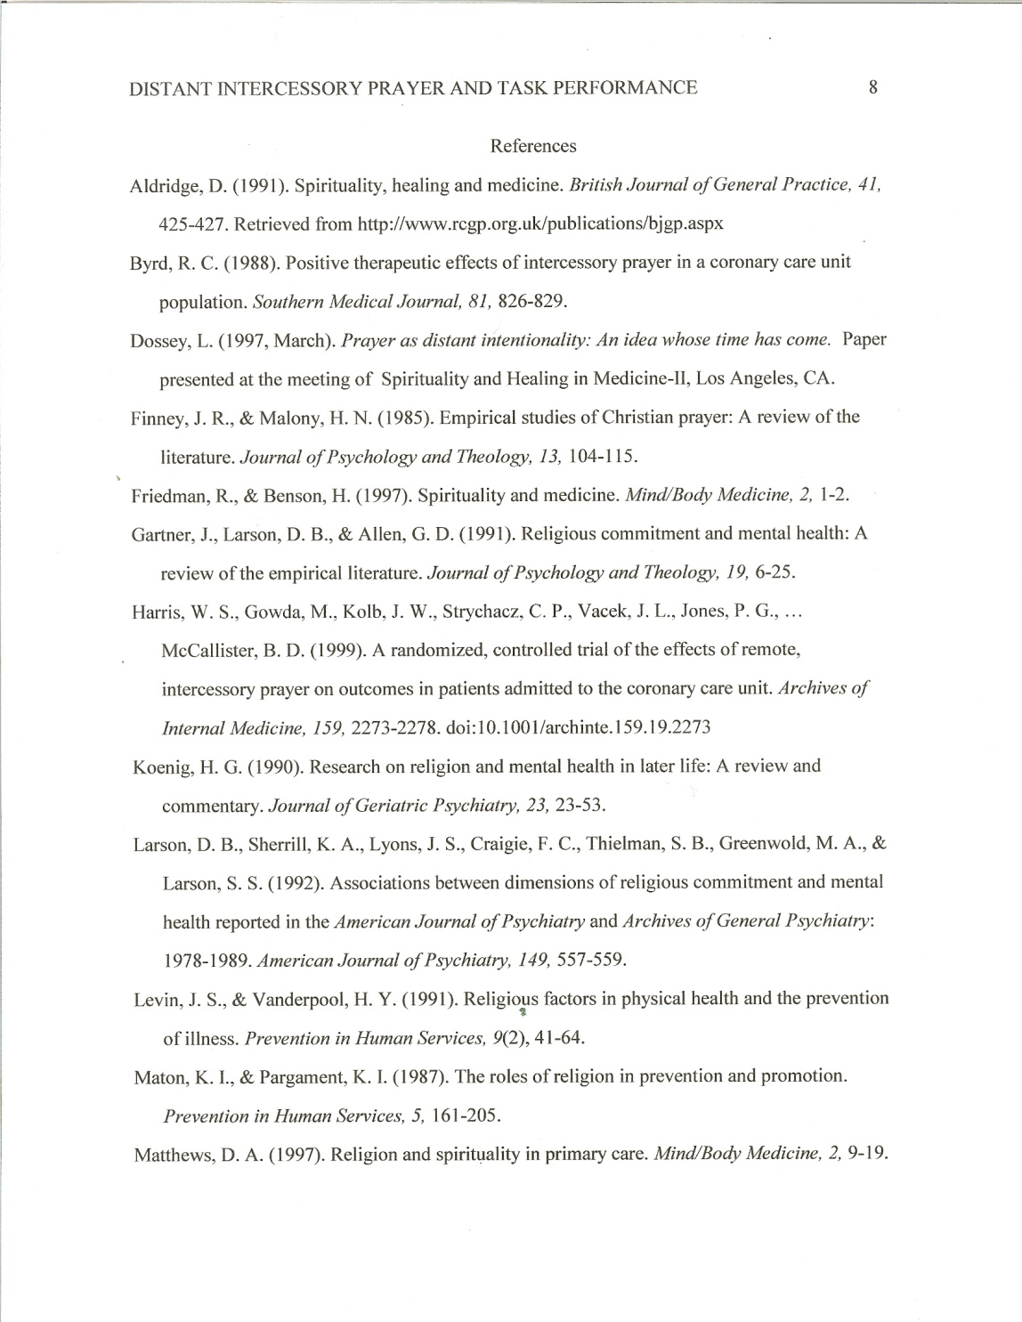
Reference Page
Each reference must contain
the author(s) name(s)
Use last names
Use first & middle initials only
Include author’s middle initials if they are provided in the publication
date of publication
title of work
publication information
Notes:
The purpose of a reference list is to help readers find the sources you used. Therefore, the reference list it should be as accurate and complete as possible.
All citations should be listed in the reference list.
References in order by the author’s last name, or first author’s last name if there’s more than one author.
Use the hanging indent paragraph style. Double space the entire reference list. That means the author’s last name is hanging out on the reference sheet. It’s a reverse indentation.
A references contain the following components:
Author’s last name, first initial only, publication date, title of work, and publication data.

Slide 25
Reference Page
All sources cited in the document, must be listed in the references.
All sources listed in the references must be cited in the document.
Remove website hyperlinks from the References page. Do not include retrieval dates for websites used.
Notes:
The purpose of a reference list is to help readers find the sources you used. Therefore, the reference list it should be as accurate and complete as possible.
All citations should be listed in the reference list.
References in order by the author’s last name, or first author’s last name if there’s more than one author.
Use the hanging indent paragraph style. Double space the entire reference list. That means the author’s last name is hanging out on the reference sheet. It’s a reverse indentation.
A references contain the following components:
Author’s last name, first initial only, publication date, title of work, and publication data.

Slide 26
Appendix
Used to include detailed information from the text, which is too distracting to include in the actual body of the text (ie. List of words, questionnaire used in research, details about apparatus used.)
If more than one appendix, each begins on a new page.

Slide 27
Tables
Pagination: Starts on new page
Heading: Tables (centered)
Tables used to organize data
Not always required – ask instructor

Slide 28
Figures
Pagination: Starts on new page
Heading: Graphs (Centered)
Used to support information in text (ie. Photograph, illustration, graph)
Not always required – ask instructor

Slide 29
APA 6th Edition Sample Paper Exercise
Read the following directions, then click on the link below to start the exercise.
Identify at least 2 different formatting and/or structure rules on each page of the paper in the link, which are consistent with APA 6th Edition.
Write them down on a piece of paper
Discuss findings with the facilitator.
Click on the link below to begin the exercise.
http://psychology.vanguard.edu/wp-content/uploads/2010/12/proposal.pdf
.

