Slide 1

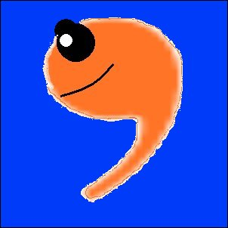
Please learn to use
me, not abuse me!

Slide 2
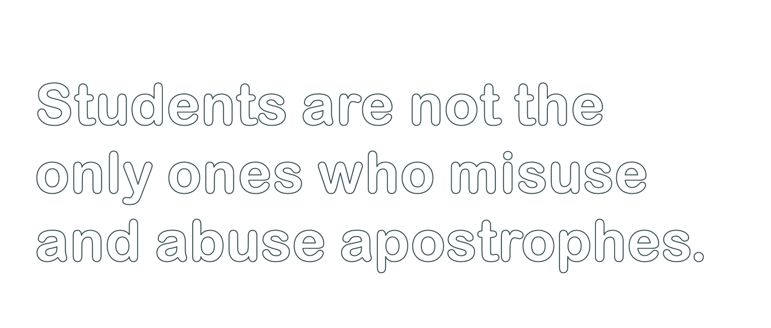

Slide 3


Slide 4

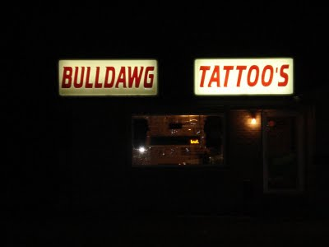

Slide 5

Hope that tattoo needle
has a good spell check!

Slide 6

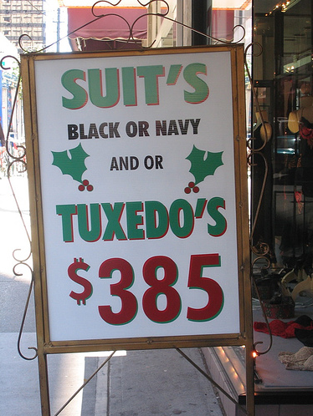

Slide 7

It’s still
cheaper
to rent one!

Slide 8

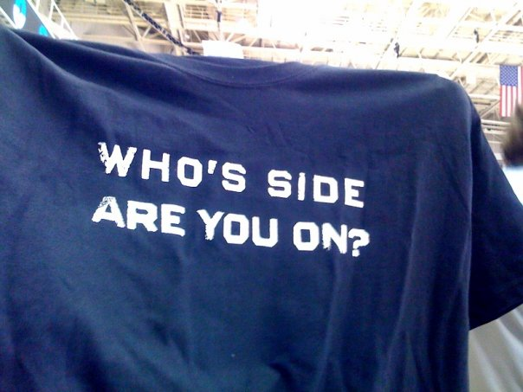

Slide 9

We hope you’re
on the side of
good grammar!

Slide 10



Slide 11


Doesn’t look
too fresh to me!

Slide 12



Slide 13

MMMM! MAKE MINE EXTRA GREASY!

Slide 14



What’s wrong with this picture?

Slide 15

NOTHING IS WRONG!
Wendy’s Old Fashioned Hamburgers
McDonald’s Restaurant

Slide 16

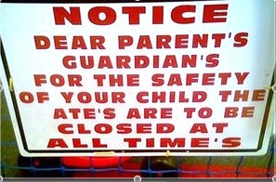

Slide 17


Slide 18
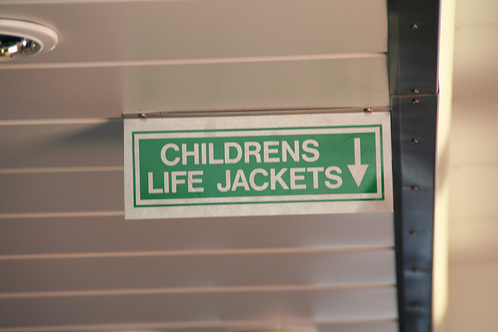

Slide 19


Slide 20
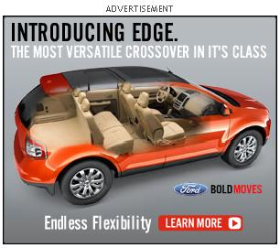

Slide 21

Bad grammar is NOT a bold move!

Slide 22
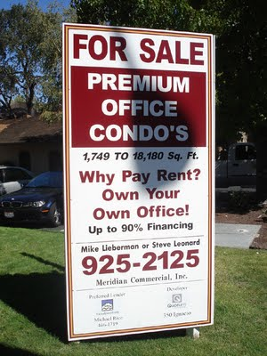
What’s wrong with this picture?

Slide 23
CONDOS not
CONDO’S

Slide 24
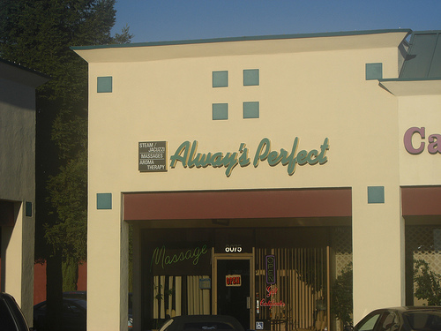

Slide 25


NOT AS
PERFECT
AS THEY
THINK!

Slide 26
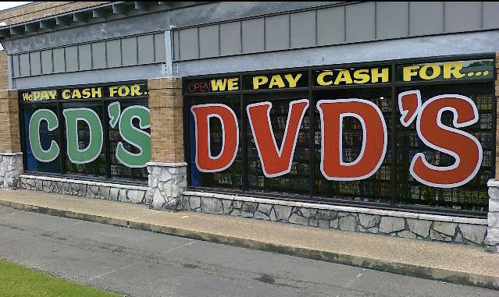

Slide 27


iPODs, not CDs!

Slide 28



Slide 29

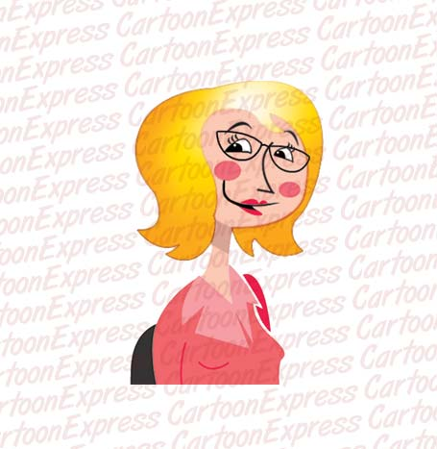
I NEED TO
SHAPE
THAT
PRINTER’S
GRAMMAR!

Slide 30
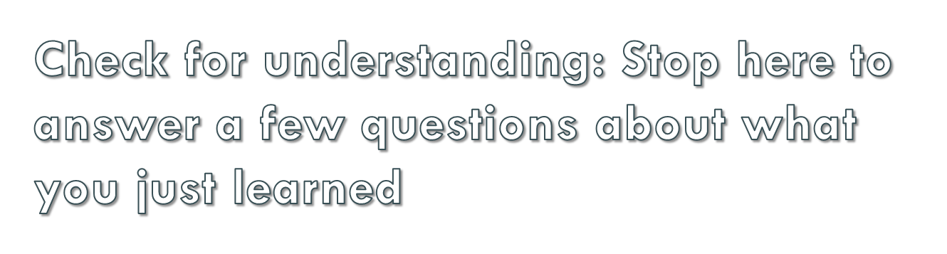

Click on the button to go
to the interactive exercise

Slide 31

It’s time to apply what you
have learned by completing
the handout exercises.

