Slide 1
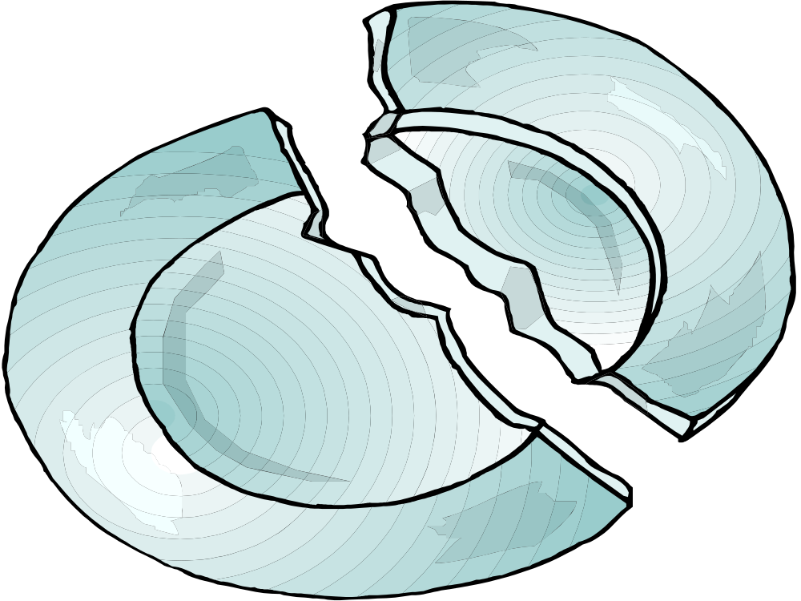
Avoiding Fragments
Notes:
INSTRUCTOR: Avoiding fragments. Does anybody know why we’ve illustrated this presentation with a cartoon drawing of a broken plate? (Prod students to talk about a plate broken into pieces, similar to the way a fragment is a “broken” sentence that is an incomplete part.

Slide 2
Sometimes students think a fragment is a sentence that is particularly short.
Notes:
INSTRUCTOR: Is this true? Are short sentences always fragments?

Slide 3


They really do?
Indeed, it’s true.
Why don’t they know?
I have no clue.
These are all complete sentences, NOT fragments.
Notes:
INSTRUCTOR: Yes, I know. This poem is silly. But each line is actually a complete sentence. In the first line, “They” is the subject, and “do” is the verb; in the second the contraction “it’s” or “it is” is the subject and the verb. What’s the subject in the third line? [Wait for student response}.

Slide 4
“Fragment” means piece, or something that is not complete. In grammar, a fragment is an incomplete sentence.
Notes:
INSTRUCTOR: A fragment is a piece, like those two pieces of the broken plate.

Slide 5

To understand fragments, we should first understand just what makes up a SIMPLE SENTENCE, also called an INDEPENDENT CLAUSE.
That sounds cool.
I’m digging it!
Notes:
INSTRUCTOR: This cool dude is also talking in compete sentences. “That sounds cool. I’m digging it!”

Slide 6
A CLAUSE has a SUBJECT and a VERB.
Notes:
INSTRUCTOR: A clause has a subject and a verb.

Slide 7
A subject can be a noun
(person, place, or thing) or a pronoun (that takes the place of a noun).
A verb reflects the subject’s action (action verb) or state of being (being verb).
Notes:
INSTRUCTOR: A subject can be a noun or pronoun; a verb must reflect some sort of action or being.

Slide 8
An INDEPENDENT CLAUSE has a SUBJECT, a VERB, and also expresses a complete thought!
Notes:
INSTRUCTOR: An independent clause is a particular kind of clause…one that expresses a complete thought.

Slide 9
Now, let’s look at some types of fragments.
Dependent Clause Fragments
Coordinating Conjunction Fragments
Participle Phrase Fragments
Relative Clause Fragments
Notes:
INSTRUCTOR: You probably thought we were finished! No, there are different kinds of fragments, too.

Slide 10
Dependent clause fragments
Notes:
INSTRUCTOR: However, a dependent cause is one that cannot stand on its own. It has a subject, a verb, but does NOT express a complete thought. Okay, so now you’re going to learn the difference between independent clauses that express complete thoughts, and dependent clauses that do not.

Slide 11


An INDEPENDENT CLAUSE can stand alone as a sentence.
I am very independent!
Notes:
INSTRUCTOR: “I am very independent.” That’s an independent clause. It can stand alone.

Slide 12
Note this independent clause: subject verb
Karen is a very independent young woman.
It has a subject, a verb, and expresses a complete thought.
Notes:
INSTRUCTOR: Notice how this clause can stand alone.

Slide 13
But watch what happens now: subject verb
Because Karen is a very independent young woman
By adding a subordinating conjunction, we still have a subject and a verb, but NO complete thought.
Notes:
INSTRUCTOR: Now, our clause cannot stand alone. It doesn’t express a complete thought anymore.

Slide 14
But watch what happens now: subject verb
Because Karen is a very independent young woman
By adding a subordinating conjunction, we still have a subject and a verb, but NO complete thought.
Notes:
INSTRUCTOR: “Because Karen is a very independent young woman.” Does that sound complete? No. Notice how “because” is a subordinating conjunction, and by adding it you’ve turned your independent clause into a dependent clause, or a fragment!

Slide 15
When we add a subordinate conjunction, our clause is not independent, but dependent. subject verb
Because Karen is a very independent young woman
Dependent
clause!
Notes:
INSTRUCTOR: [let slide speak for itself.]

Slide 16
When we add a subordinate conjunction, our clause is not independent, but dependent. subject verb
Because Karen is a very independent young woman
Dependent clauses are
a type of fragment.
Notes:
INSTRUCTOR: [let slide speak for itself.]

Slide 17
Dependent clauses need an independent clause to be complete.
Notes:
INSTRUCTOR: A dependent clause needs an independent clause to complete it.

Slide 18
DEPENDENT CLAUSES HAVE
A SUBJECT AND A VERB, BUT
DEPEND ON AN INDEPENDENT CLAUSE TO BE COMPLETE: subject verb
Because Karen is a very independent young woman, she enjoys living alone.
Notes:
INSTRUCTOR: “Because karen is a very independent young woman, she enjoys living alone.” Notice how “she enjoys living alone,” is an independent clause, it expresses a complete thought.

Slide 19
DEPENDENT CLAUSES HAVE
A SUBJECT AND A VERB, BUT
DEPEND ON AN INDEPENDENT CLAUSE TO BE COMPLETE: subject verb
Because Karen is a very independent young woman, she enjoys living alone.
Notes:
INSTRUCTOR: [let slide speak for itself.]

Slide 20
DEPENDENT CLAUSES HAVE
A SUBJECT AND A VERB, BUT
DEPEND ON AN INDEPENDENT CLAUSE TO BE COMPLETE: subject verb
Because Karen is a very independent young woman, she enjoys living alone.
Notes:
INSTRUCTOR: [let slide speak for itself.]

Slide 21
• Unless we hurry up and leave for the movie right now
Can you fix the following fragment?
Notes:
INSTRUCTOR: Okay, now let’s see what we’ve learned. Who would like to try fixing the following fragment? {Instructor listens to students responses. He/she praises or corrects as he/she runs through all three examples.]

Slide 22
Sample answer:
• Unless we hurry up and leave for the movie right now, we will be late.
Notes:
INSTRUCTOR: Okay, now let’s see what we’ve learned. Who would like to try fixing the following fragment? {Instructor listens to students responses. He/she praises or corrects as he/she runs through all three examples.]

Slide 23
Can you fix the following fragment?
When we vacationed in New York city last summer

Slide 24
Sample answer:
When we vacationed in New York city last summer, we climbed the Empire State Building and visited Time Square.

Slide 25
Can you fix the following fragment?
• After we took our seats at the restaurant and quickly looked at the menu

Slide 26
Sample answer:
• After we took our seats at the restaurant, we looked at the menu and quickly ordered.

Slide 27
Coordinating Conjunction Fragments
Notes:
INSTRUCTOR: Coordinationg conjunction fragments.

Slide 28
Incorrect use of
coordinating conjunctions also results in fragments.
Notes:
INSTRUCTOR: Does anybody remember what coordinating conjunctions are? [Waits for responses].

Slide 29
The coordinating conjunctions are sometimes referred to as “FANBOYS.”
F o r
A n d
N o r
B u t
O r
Y e t
S o
Notes:
INSTRUCTOR: Yes, the FANBOYS! For, and, nor, but, or, yet, so.

Slide 30
These conjunctions, with a comma, are used to join two independent clauses.
F o r
A n d
N o r
B u t
O r
Y e t
S o
The roses are very lovely, but
the bees lurking inside those beautiful blooms could sting you.
Notes:
INSTRUCTOR: [Let’s slide speak for itself].

Slide 31
These conjunctions, with a comma, are used to join two independent clauses.
F o r
A n d
N o r
B u t
O r
Y e t
S o
The roses are very lovely, but
the bees lurking inside those beautiful blooms could sting you.
Notes:
INSTRUCTOR: Notice how both of these clauses can stand on their own and each one expresses a complete thought. The roses are very lovely…one complete thought. The bees lurking inside those beautiful blooms could sting you…another complete thought.

Slide 32
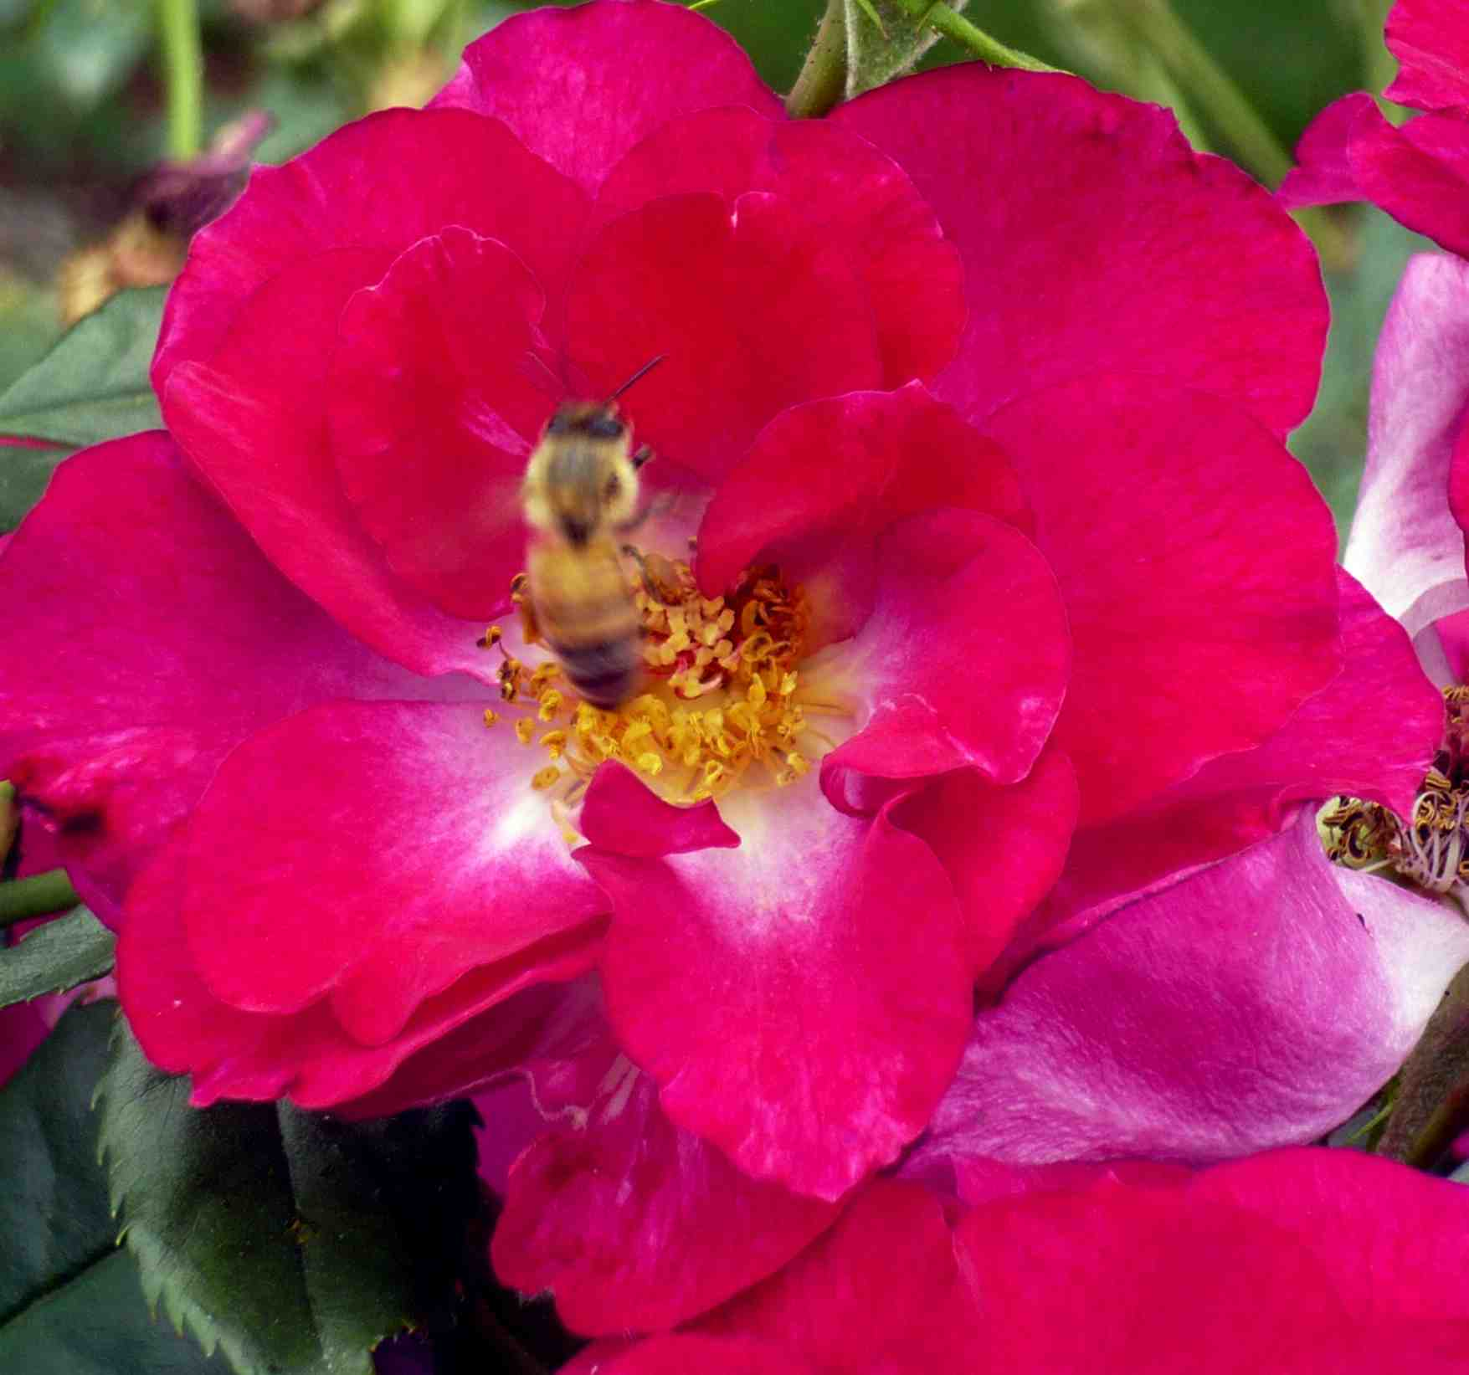
Do not begin a sentence with a “FANBOY” or you will create a fragment.
But the bees lurking inside those beautiful blooms could sting you.
Fragment!
Notes:
INSTRUCTOR: But if you begin your sentence with a FANBOY, you’ve created a fragment.

Slide 33

Use a “FANBOY” and a comma to connect two independent clauses.
Correct:
The roses are gorgeous, but the bees lurking inside those beautiful blooms could sting you.
Notes:
INSTRUCTOR: Remember, in formal academic writing, the FANBOYS cannot start sentences, although sometimes you see this frequently in more casual writing.

Slide 34
Can you fix the following fragment?
• And it must follow MLA formatting style.
Notes:
INSTRUCTOR: Okay, now let’s see what we’ve learned. Who would like to try fixing the following fragment? {Instructor listens to students responses. He/she praises or corrects as he/she runs through all three examples.]

Slide 35
Sample answer:
• The essay must be five to seven pages long, and it must follow MLA formatting style.
Notes:
INSTRUCTOR: Okay, now let’s see what we’ve learned. Who would like to try fixing the following fragment? {Instructor listens to students responses. He/she praises or corrects as he/she runs through all three examples.]

Slide 36
Can you fix the following fragment?
• Yet I stayed up all night celebrating Jim’s birthday
Notes:
INSTRUCTOR: Okay, now let’s see what we’ve learned. Who would like to try fixing the following fragment? {Instructor listens to students responses. He/she praises or corrects as he/she runs through all three examples.]

Slide 37
Sample answer:
• I should have been studying for the exam, yet I stayed up all night celebrating Jim’s birthday.
Notes:
INSTRUCTOR: Okay, now let’s see what we’ve learned. Who would like to try fixing the following fragment? {Instructor listens to students responses. He/she praises or corrects as he/she runs through all three examples.]

Slide 38
Can you fix the following fragment?
• So I passed all my classes with A’s.
Notes:
INSTRUCTOR: Okay, now let’s see what we’ve learned. Who would like to try fixing the following fragment? {Instructor listens to students responses. He/she praises or corrects as he/she runs through all three examples.]

Slide 39
Sample answer:
• I studied day and night, so I passed all my classes with A’s.
Notes:
INSTRUCTOR: Okay, now let’s see what we’ve learned. Who would like to try fixing the following fragment? {Instructor listens to students responses. He/she praises or corrects as he/she runs through all three examples.]

Slide 40
Participle phrase fragments.
Notes:
INSTRUCTOR: Okay, and another type of fragment is the participle phrase fragment.

Slide 41
Participle phrases alone are a type of fragment.
Notes:
INSTRUCTOR: Participle phrases are fine when connected to an independent clause, but standing alone, they are fragments.

Slide 42
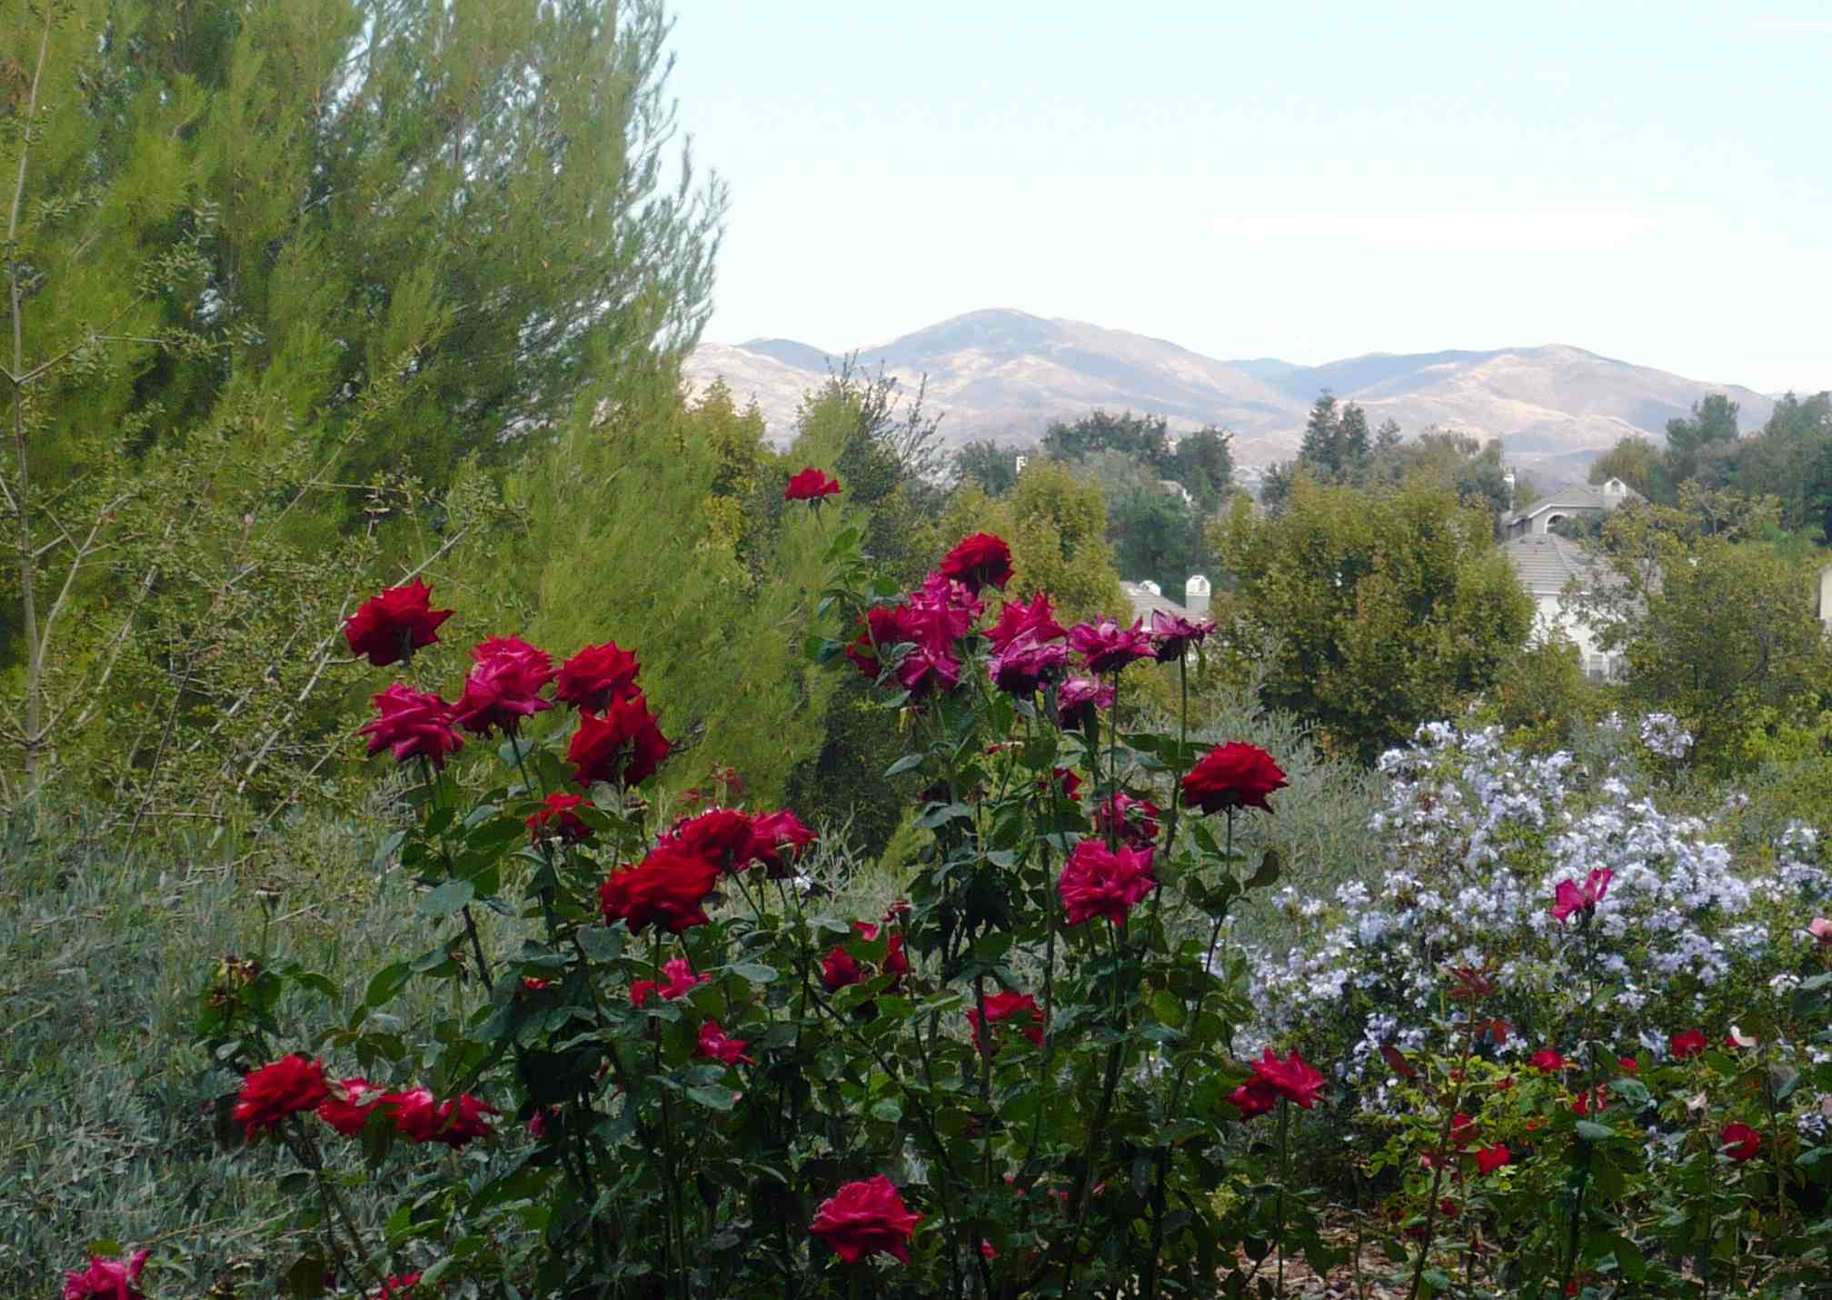
Studying outside the COC library on a bench near the rose garden.
Notes:
INSTRUCTOR: Does that sound like a complete thought to you? Why not? [Waits for student responses.]

Slide 43
Studying outside the COC library on a bench near the rose garden.
FRAGMENT
Notes:
INSTRUCTOR: It’s not a complete thought, it’s a fragment.

Slide 44
“Studying” is a participle.
Participles are the “ing” form of a verb. Participles can be used as adjectives. In this case, “studying” modifies “student.”
Correct:
The studying student
was lost in his thoughts.
Notes:
INSTRUCTOR: Studying is a participle. Participles are the “ing” form of verbs. They have different uses, for example, in this case “studying” modifies “student.”

Slide 45
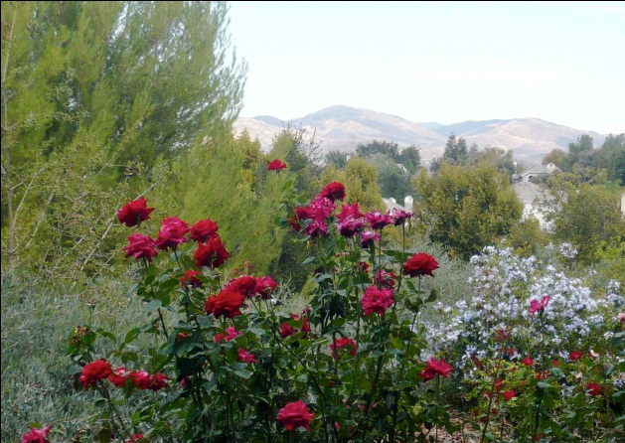
Participle phrases also need something to modify. Who is studying in this fragment?
Incorrect:
Studying outside the COC
library on a bench near
the rose garden.
Are the benches studying?
Is the rose garden studying?
I don’t think so
Notes:
INSTRUCTOR: A participle phrase also needs something to modify within the sentence. What exactly is studying in this fragment?

Slide 46


Correct:
Studying outside the COC library on a bench near the rose garden, Bart enjoyed the pleasant spring weather.
Bart is
studying!
Notes:
INSTRUCTOR: Okay, so Bart is studying, not the roses.

Slide 47
Correct:
Studying outside the COC library on a bench near the rose garden,
Bart enjoyed the pleasant spring weather.
Notice how the
participle modifies
“Bart.”
Notes:
INSTRUCTOR: So, when you have a participle phrase like “studying outside the COC library on a bench near the rose garden,” it’s a fragment unless it’s connected to a complete sentence, such as “Bart enjoyed the pleasant spring weather.”

Slide 48
Correct:
Bart, studying outside the COC library on a bench near the rose garden, enjoyed the pleasant spring weather.
Notice in this
variation, the
participle still
modifies “Bart.”
I’d enjoy it more
if I weren’t studying!
Notes:
INSTRUCTOR: You can move the participle too, but it must be close to the noun or pronoun it’s modifying, in this case, “Bart.”

Slide 49
Correct:
subject verb
Bart is studying outside the COC library on a bench near the rose garden.
Adding a helping verb, such as “is” or “was” to the participle, changes it to a main verb.
Notes:
INSTRUCTOR: Another thing about participles, they cannot be your main verb unless they’re combined with a helping verb, in this case, “is.”

Slide 50
Can you fix the following fragment?
• Swimming alone in the deep water
Notes:
INSTRUCTOR: Okay, now let’s see what we’ve learned. Who would like to try fixing the following fragment? {Instructor listens to students responses. He/she praises or corrects as he/she runs through all four examples.]

Slide 51
Sample answer:
• Swimming alone in the deep water, I got scared and called out for help.
Notes:
INSTRUCTOR: Okay, now let’s see what we’ve learned. Who would like to try fixing the following fragment? {Instructor listens to students responses. He/she praises or corrects as he/she runs through all four examples.]

Slide 52
Can you fix the following fragment?
• Hoping for an answer to the question on the exam
Notes:
INSTRUCTOR: Okay, now let’s see what we’ve learned. Who would like to try fixing the following fragment? {Instructor listens to students responses. He/she praises or corrects as he/she runs through all four examples.]

Slide 53
Sample answer:
• Hoping for an answer to the question on the exam, I called the professor at his home.
Notes:
INSTRUCTOR: Okay, now let’s see what we’ve learned. Who would like to try fixing the following fragment? {Instructor listens to students responses. He/she praises or corrects as he/she runs through all four examples.]

Slide 54
Can you fix these participle fragment?
• Rolling over on his back and playing dead
Notes:
INSTRUCTOR: Okay, now let’s see what we’ve learned. Who would like to try fixing the following fragment? {Instructor listens to students responses. He/she praises or corrects as he/she runs through all four examples.]

Slide 55
Sample answer:
• Rolling over on his back and playing dead, the dog tried to please his master.
Notes:
INSTRUCTOR: Okay, now let’s see what we’ve learned. Who would like to try fixing the following fragment? {Instructor listens to students responses. He/she praises or corrects as he/she runs through all four examples.]

Slide 56
Can you fix these participle fragment?
• Visiting six countries in two weeks
Notes:
INSTRUCTOR: Okay, now let’s see what we’ve learned. Who would like to try fixing the following fragment? {Instructor listens to students responses. He/she praises or corrects as he/she runs through all four examples.]

Slide 57
Sample answer:
• Visiting six countries in two weeks, the president attempted to persuade everyone to join the war effort.
Notes:
INSTRUCTOR: Okay, now let’s see what we’ve learned. Who would like to try fixing the following fragment? {Instructor listens to students responses. He/she praises or corrects as he/she runs through all four examples.]

Slide 58
Relative clause fragments
Notes:
INSTRUCTOR: Relative clause fragments

Slide 59
Clauses that begin with relative pronouns
(unless they are questions) are relative clauses. Relative pronouns are the following: who, whom, whose, which, and that.
Notes:
INSTRUCTOR: Relative clause fragments begin with relative pronouns.

Slide 60
Relative clauses are dependent clauses and must NOT stand alone.
Notes:
INSTRUCTOR: Like the dependent clauses we talked about earlier, relative clauses also cannot stand alone.

Slide 61
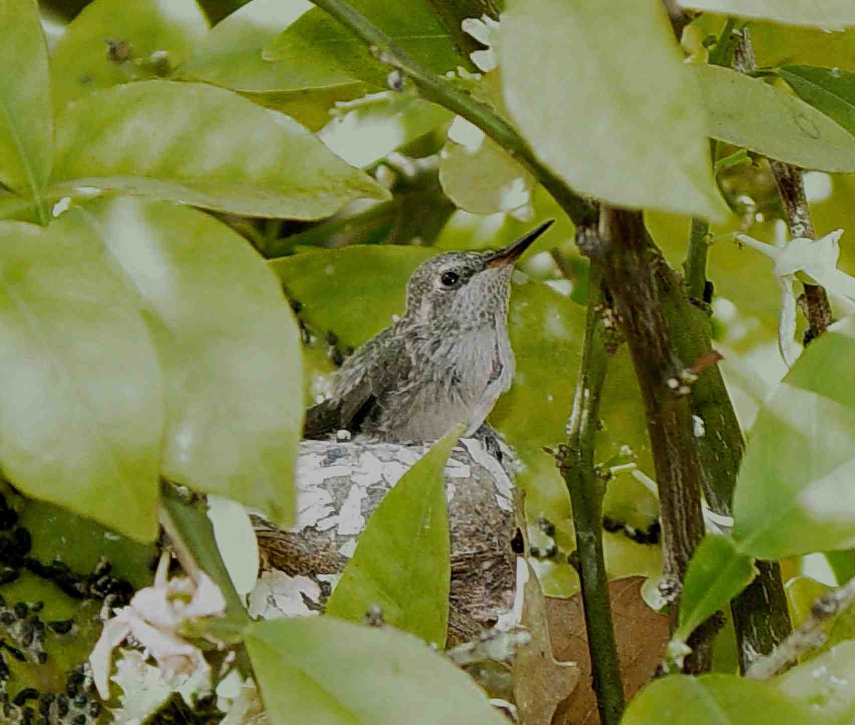
My neighbor took a stunning photograph of a hummingbird. That had built a nest in his orange tree.
Notes:
INSTRUCTOR: Does anything in this sentence sound like a fragment? [Instructor waits for responses].

Slide 62
My neighbor took a stunning photograph of a hummingbird. That had built a nest in his orange tree.
Fragment!
Notes:
INSTRUCTOR: Yep! That had built a nest in his orange tree. That’s not a complete thought, is it?

Slide 63

Correct:
My neighbor took a stunning photograph of a hummingbird that had built a nest in his orange tree.
A relative clause
needs to be
connected to an
independent clause.
Notes:
INSTRUCTOR: Now that sounds like a complete thought. And that’s one smart hummingbird, too.

Slide 64

Sometimes the subject of the independent clause is separated from its verb by the relative clause.
My neighbor, who is a professional artist, paints pictures of hummingbirds and other wildlife.
Notes:
INSTRUCTOR: Here’s another relative clause: “who is a professional artist.” Notice how the subject of the independent clause is separated from its verb by the relative clause.

Slide 65
Can you fix the following fragment?
• Whom I never trusted
Notes:
INSTRUCTOR: Okay, now let’s see what we’ve learned. Who would like to try fixing the following fragment? {Instructor listens to students responses. He/she praises or corrects as he/she runs through all three examples.]

Slide 66
Sample answer:
• My elephant, whom I never trusted, stepped on my new car out of spite.
Notes:
INSTRUCTOR: Okay, now let’s see what we’ve learned. Who would like to try fixing the following fragment? {Instructor listens to students responses. He/she praises or corrects as he/she runs through all three examples.]

Slide 67
Can you fix the following fragment?
• whose purse was stolen,
Notes:
INSTRUCTOR: Okay, now let’s see what we’ve learned. Who would like to try fixing the following fragment? {Instructor listens to students responses. He/she praises or corrects as he/she runs through all three examples.]

Slide 68
Sample answer:
• My grandma, whose purse was stolen, was sad because her grandson’s picture was in it.
Notes:
INSTRUCTOR: Okay, now let’s see what we’ve learned. Who would like to try fixing the following fragment? {Instructor listens to students responses. He/she praises or corrects as he/she runs through all three examples.]

Slide 69
Can you fix the following fragment?
• Which is why I rarely go to the beach
Notes:
INSTRUCTOR: Okay, now let’s see what we’ve learned. Who would like to try fixing the following fragment? {Instructor listens to students responses. He/she praises or corrects as he/she runs through all three examples.]

Slide 70
Sample answer:
• My skin burns easily which is why I rarely go to the beach.
Notes:
INSTRUCTOR: Okay, now let’s see what we’ve learned. Who would like to try fixing the following fragment? {Instructor listens to students responses. He/she praises or corrects as he/she runs through all three examples.]

Slide 71

Let’s review !
Notes:
INSTRUCTOR: Okay, now let’s review!

Slide 72
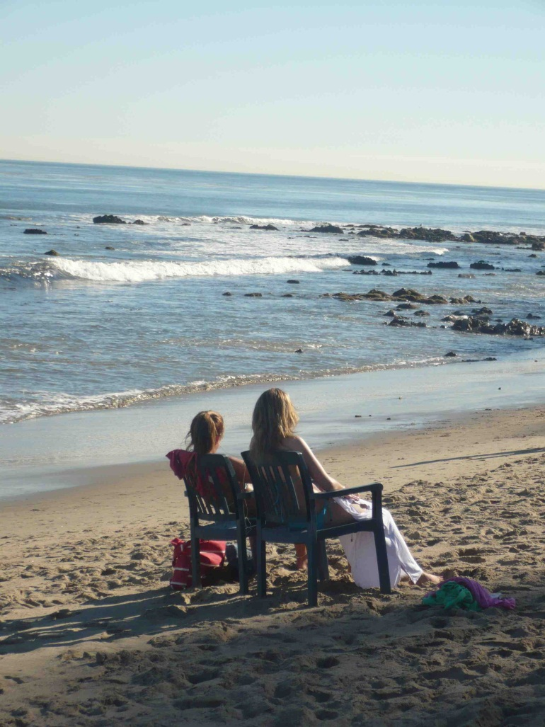
Dependent clauses should not stand alone.
Although my skin burns easily. I love going to the beach.
FRAGMENT
Notes:
INSTRUCTOR: Here’s our dependent clause fragment. How would we fix that? {Waits for response].

Slide 73
Dependent clauses need an independent clause to be complete.
Although my skin burns easily, I love going to the beach
CORRECT
Notes:
INSTRUCTOR: Great!

Slide 74
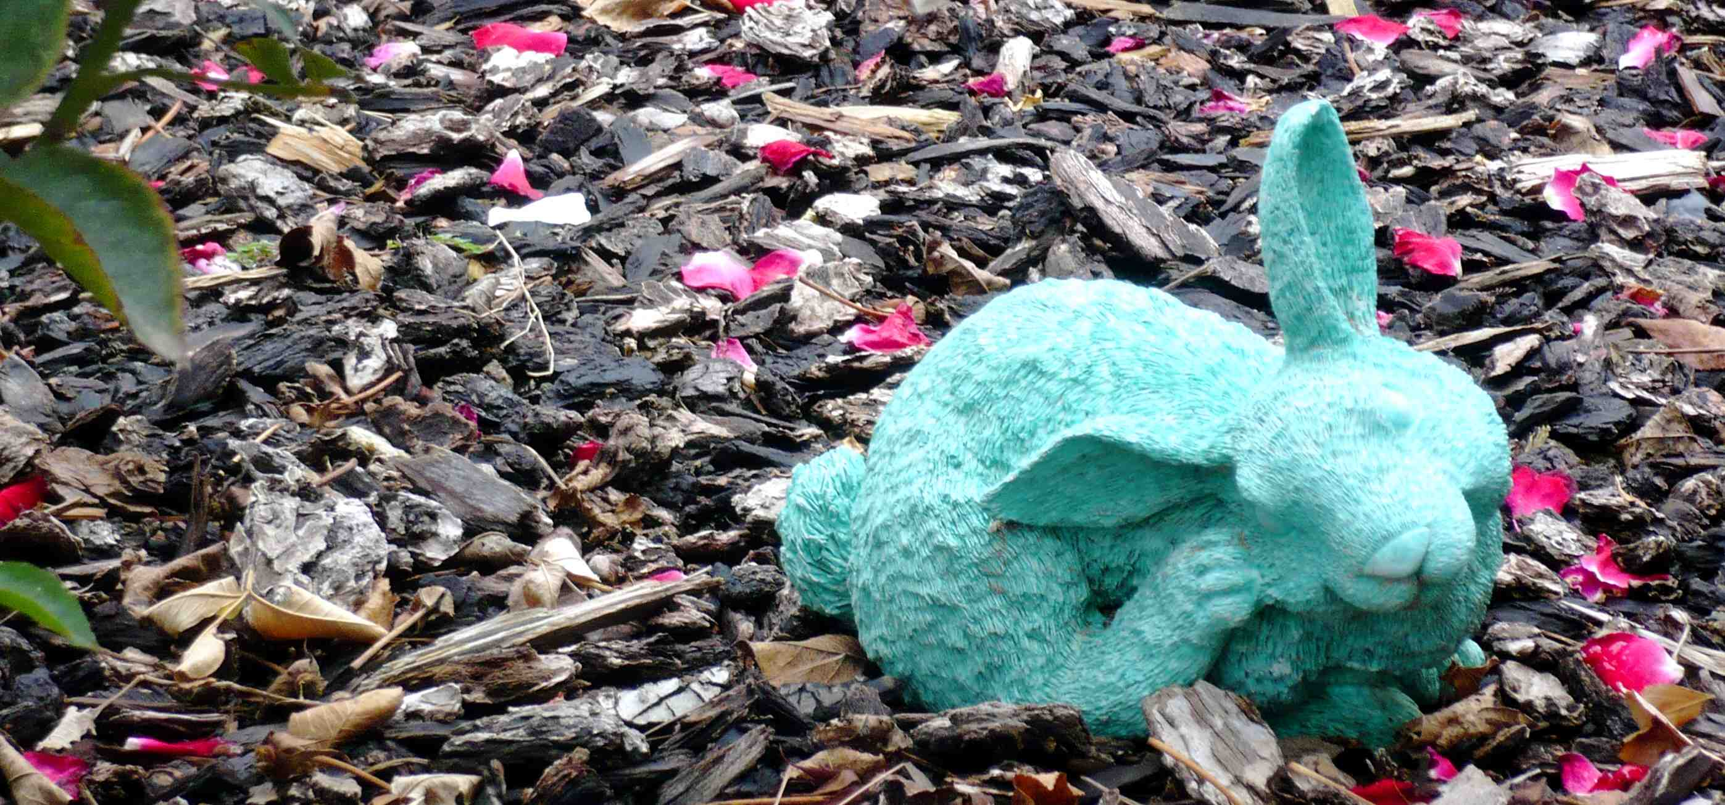
Do not begin a sentence with a coordinating conjunction (“FANBOYS”)
I like the garden’s ceramic bunnies. But real rabbits are even cuter.
FRAGMENT
Notes:
INSTRUCTOR: Here’s our coordinating conjunction fragment. How would we fix it? [Waits for student response.]

Slide 75
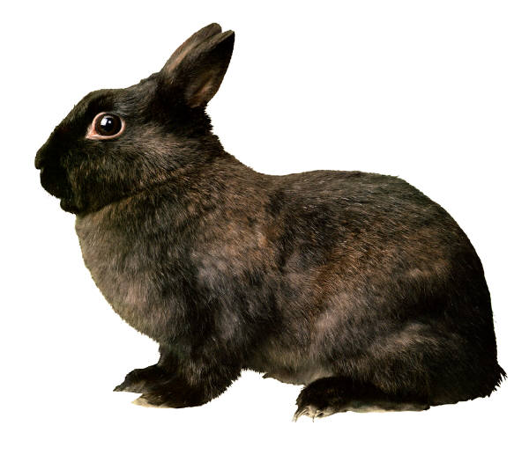
Use a coordinating conjunction (“FANBOYS”) to connect independent clauses.
I like the garden’s ceramic bunnies, but real rabbits are cuter.
CORRECT
Notes:
INSTRUCTOR: Great!

Slide 76
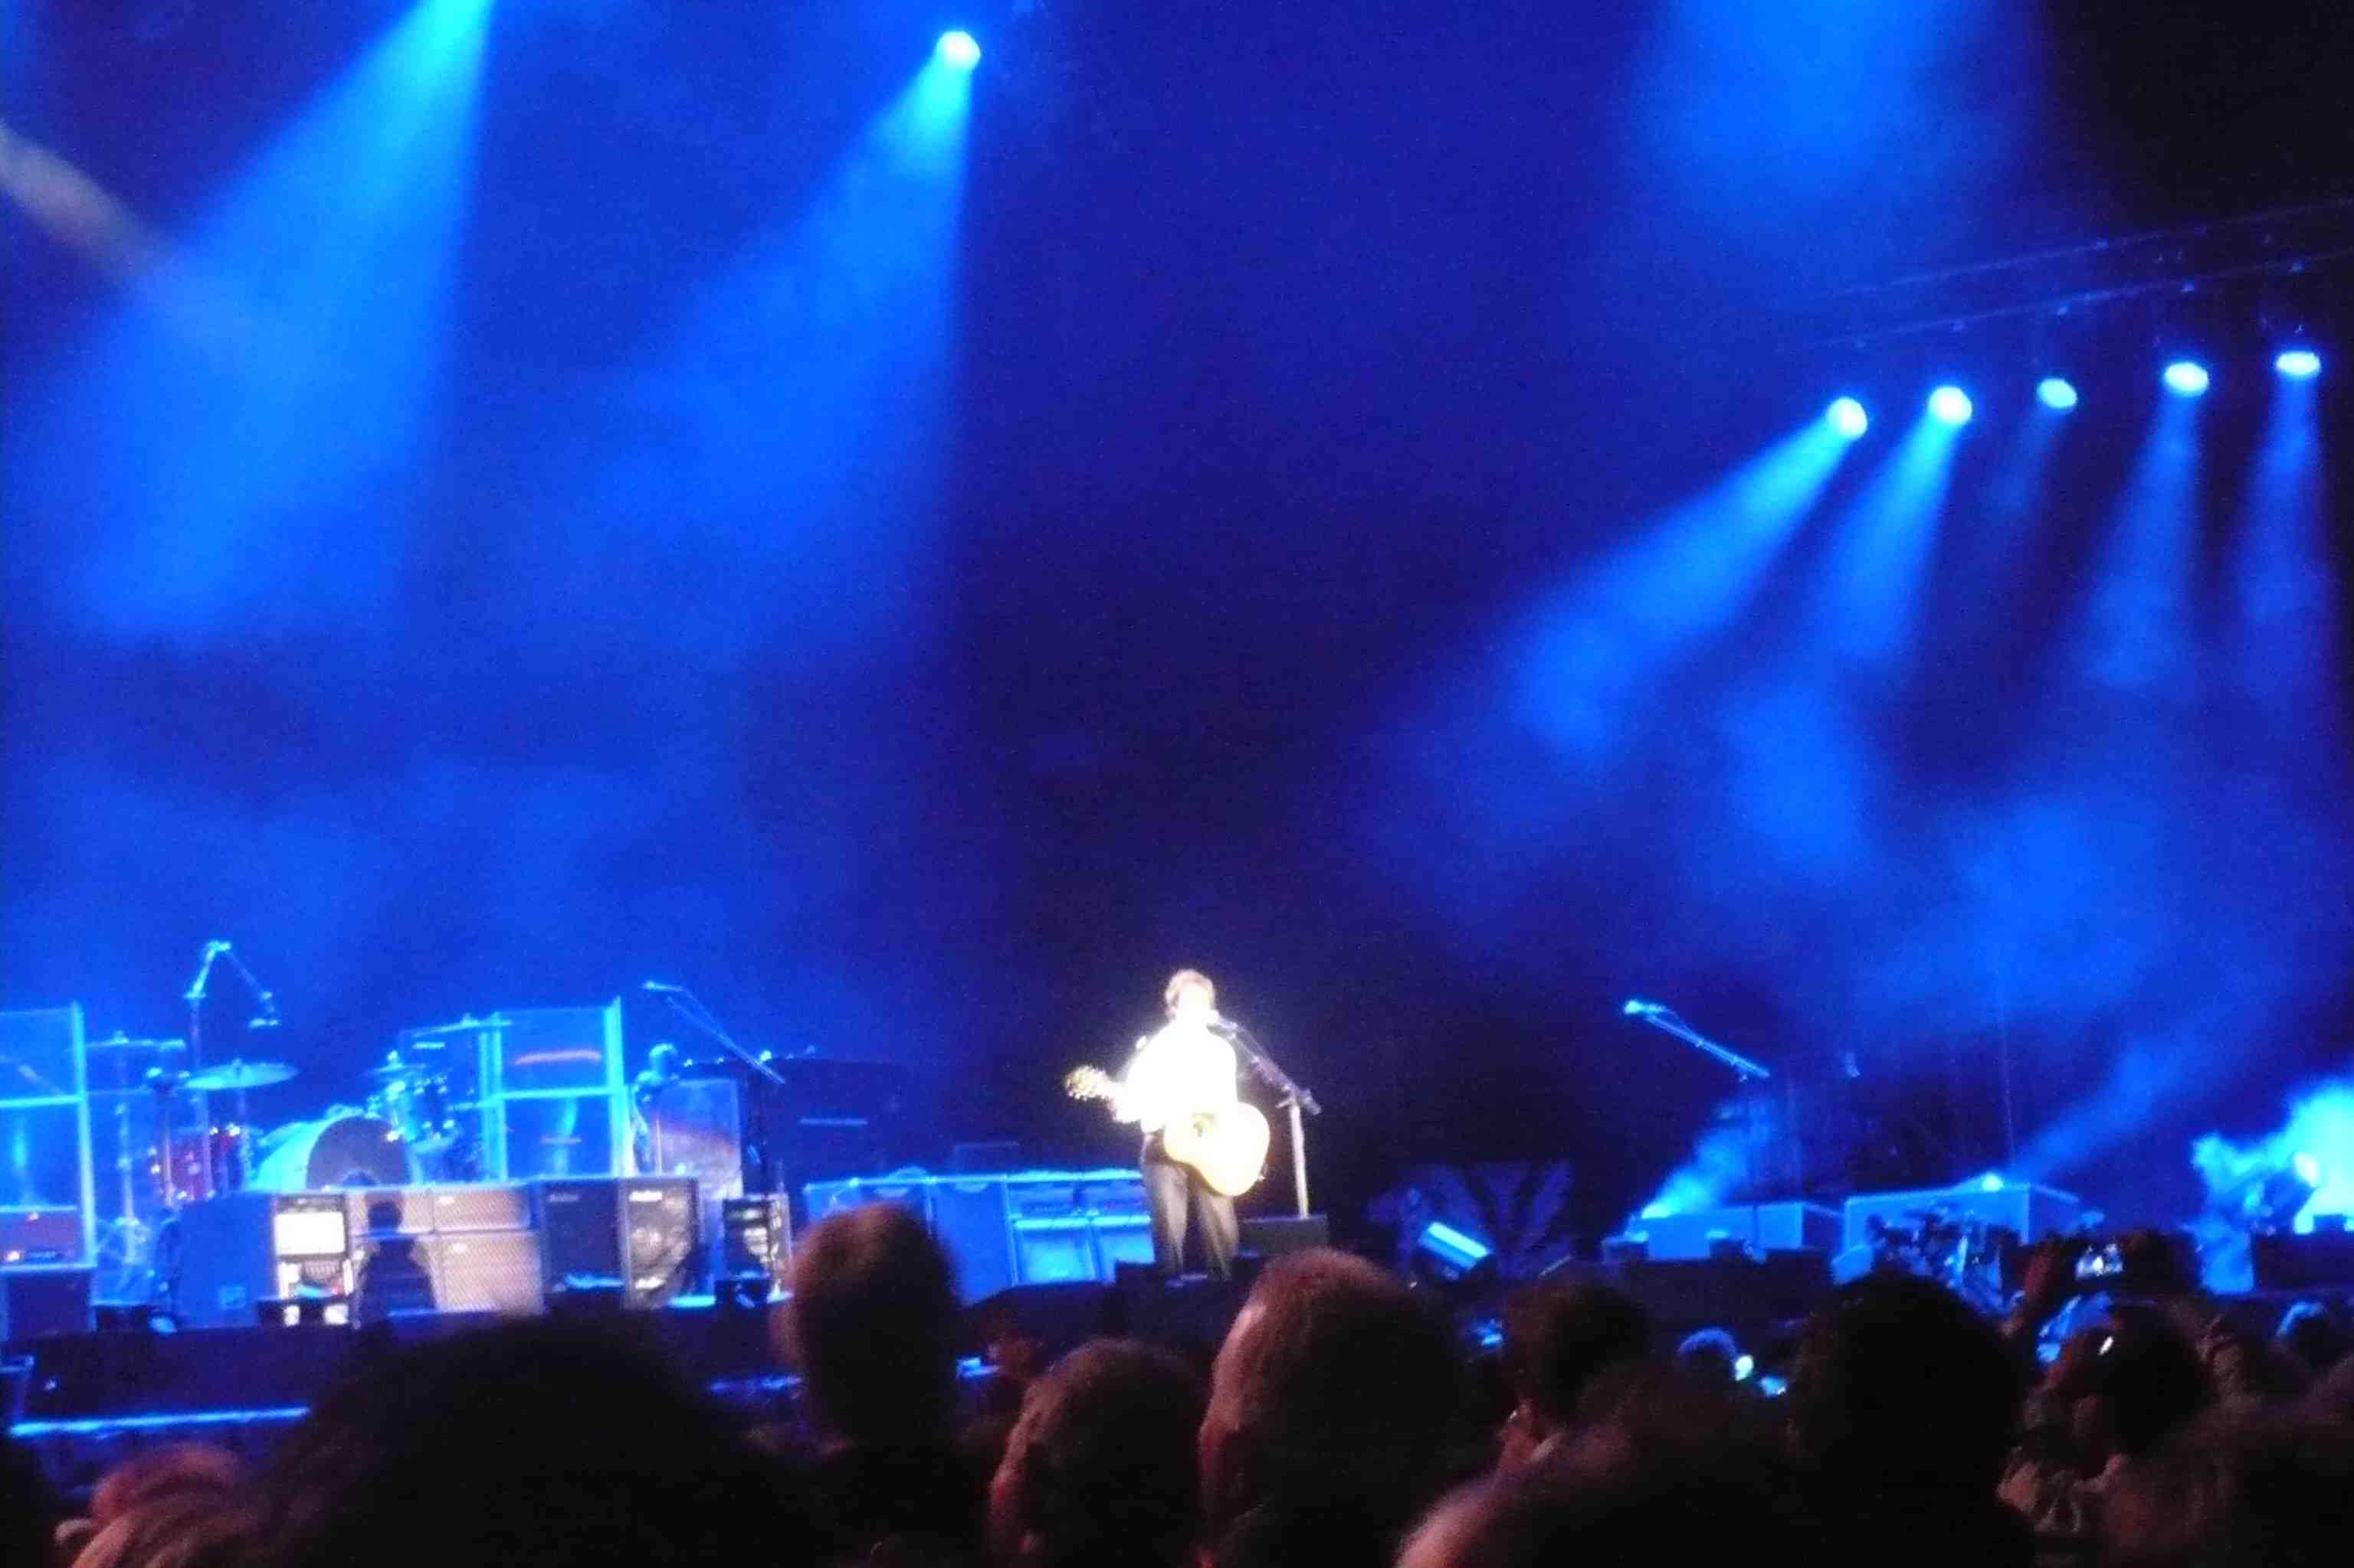
Do not use participle phrases alone.
Watching the concert from her tenth row seats. Fran didn’t care that the ticket cost her a week’s pay.
FRAGMENT
Notes:
INSTRUCTOR: Here’s our participle phrase fragment. How would we fix it?

Slide 77

Participle phrases must modify something within an independent clause.
Watching the concert from her tenth row seats, Fran didn’t care that the ticket cost her a week’s pay.
CORRECT
Notes:
INSTRUCTOR: Great!

Slide 78

Relative clauses are dependent clauses and must NOT stand alone.
The little dog who would do anything for treats. She let her owner dress her up like a clown.
FRAGMENT
Notes:
INSTRUCTOR: Here’s our relative clause fragment. How would we fix it?

Slide 79
Relative clauses are dependent clauses and must NOT stand alone.
The little dog who would do anything for treats let her owner dress her up like a clown.
CORRECT
Notes:
INSTRUCTOR: Great!

Slide 80
The
End
Notes:
INSTRUCTOR: The end--of students writing fragments…right?

Slide 81

Check for understanding: Stop here to answer a few questions about what you just learned
Click on the button to go to the interactive exercise.

Slide 82

You have completed the first step
It’s time to apply what you
have learned by completing
the handout exercises.

