Slide 1
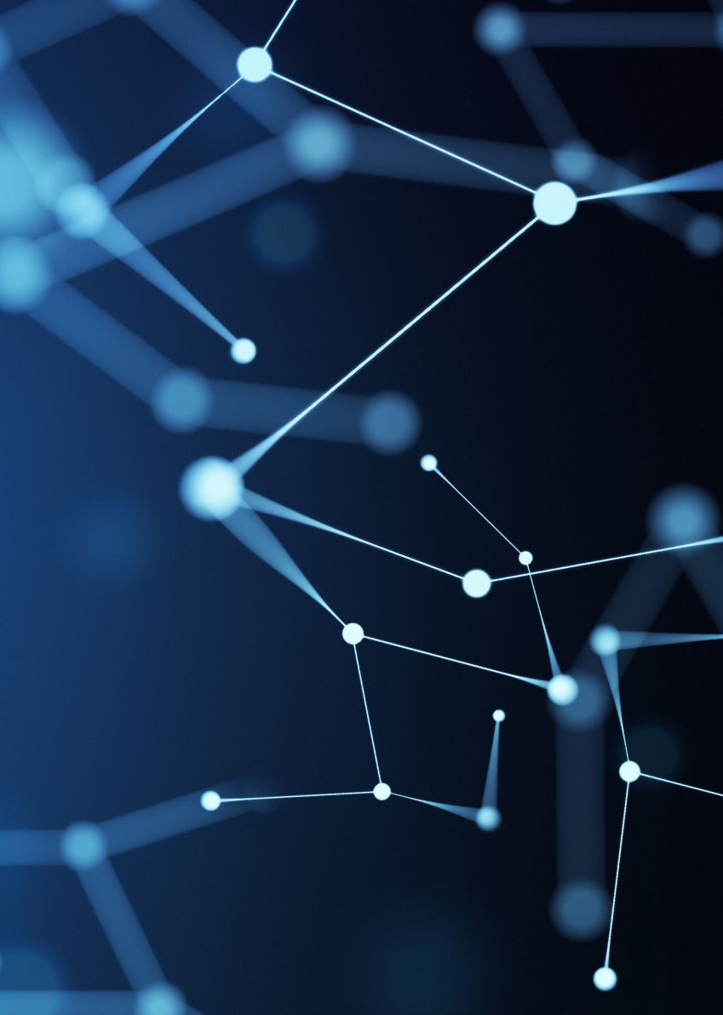
UTA-Project 4 from lyrics to sound
Bobby McGraw, Jackson Blanton, Jared Worrick, Jonathan Rangel, Tyler Levie, Will Granados

Slide 2
Overview
We created an AMNet neural network to turn lyrics into the estimated song/audio. When looking up the lyrics, the model should accurately guess the Song Title, Artist, etc. and play the sound.
Questions to answer
How accurately can we get our model run when given lyrics?
Can it run accurately with incomplete lyrics?
Can it run when given an Artist or Song Title?

Slide 3
DATA CLEANING
Data:
https://www.kaggle.com/datasets/neisse/scrapped-lyrics-from-6-genres?resource=download
Consisted of two .csv files
38k songs
50 different Languages
19k were English followed by Portuguese
Dropped duplicates,
Recreated Genres to simplify/separate 72 different genres
Cleaned up data frame to only include Song Name, Lyric, Artist, Popularity and Genre
From Sklearn, created file to start training 13.8k songs.

Slide 4
ML_Model
Import torch, pandas, numpy and sklearn
Read the train.csv file created from the clean_data.ipynb
Started to train different models
Results of this file was top input song lyrics and then retrieve from the ML Model the predict lyrics such as: artists and genre

Slide 5
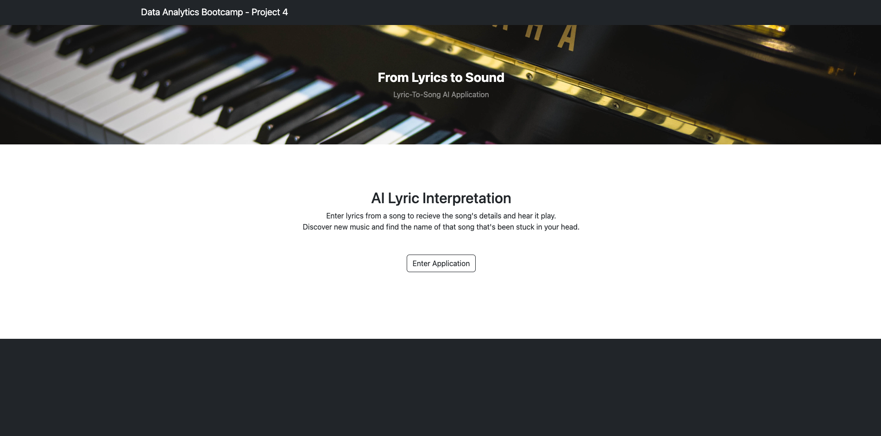
Creating the app
app.py consists of using flask to create a front-end appearance to run the Machine Learning Model

Slide 6
Issues we encountered!
Determining the right NN for the task
Started off the idea with YAMNet, quickly found out that won’t work as nicely.
Connecting all of us through AWS
Collabing on one set of cloud files. Giving access to all collaborators.
Deploying Flask on AWS
Combining two unique and complex systems
Infinite loop in Training Data.
Solved with Pytorch/Dataloaders

Slide 7
Results!
AWS Domain Our Website

