Slide 1




IOT-BASED ENVIRONMENTAL MONITORING
Group 3
Nguyễn Trí Thông

Slide 2



MEMBER 1: LƯƠNG VĂN THẮNG
MEMBER 2: NGUYỄN THỊ HẢI YẾN
MEMBER 3: MAI QUANG MINH
MEMBER 4: TRẦN TRỌNG VĂN

Slide 3



CONTEXT
Real-time environmental monitoring is essential for protecting health and preventing damage in homes, greenhouses, storage facilities, and small industrial sites. Traditional systems are often too expensive and complex for small-scale deployment. This project uses IoT technology with low-cost sensors, long-range LoRa communication, and cloud storage to create an affordable monitoring solution. An Arduino sensor node collects temperature, humidity, and dust data, transmits it wirelessly via LoRa to an ESP32 gateway, and displays readings on an LCD. The gateway uploads data to Firebase for visualization and sends alerts through Telegram when thresholds are exceeded. LoRa's ability to penetrate walls enables coverage of hundreds of meters without existing WiFi infrastructure.

Slide 4
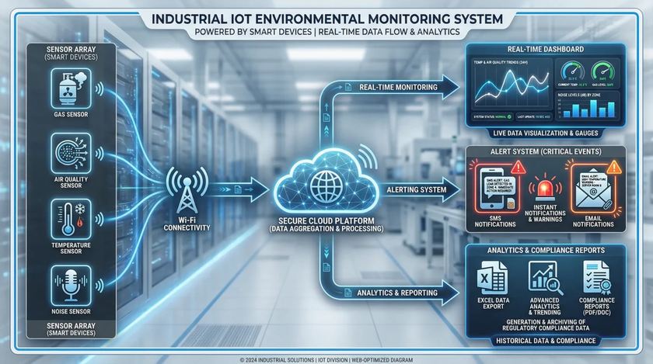


INTRODUCTION
  An environmental monitoring system is an integrated IoT platform for automated air quality tracking and remote data telemetry. The system deploys an Arduino sensor Node, connecting a DHT11 for temperature/humidity and a Sharp GP2Y10 for real-time dust detection.
  This data is transmitted wirelessly over long distances through obstacles via a pair of LoRa SX1278 modules. Finally, an ESP32 Gateway parses and syncs the data to the cloud, enabling real-time visual dashboards and automated smartphone alerts.

Slide 5

TABLE OF CONTENTS
O1 | INTRODUCTION ELECTRONIC COMPONENTS
05 | IMAGE & VIDEO PROJECT
02 | BLOCK DIAGAM
06 | CONCLUSION
03 | FUNCTION OF DEVICE
07 | FUTURE DEVELOPMENT
04 | FLOW CHART

Slide 6

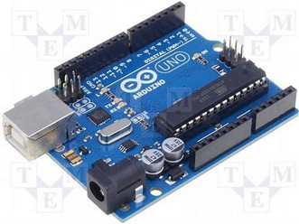
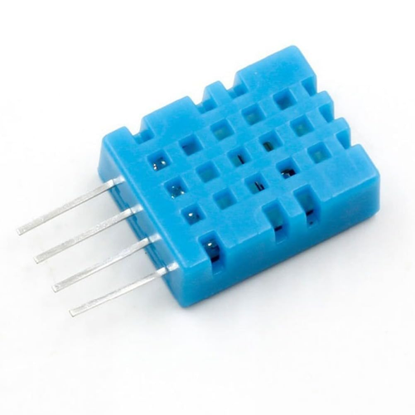
INTRODUCTION ELECTRONIC COMPOMENTS
  Arduino UNO R3 is the main controller at the transmitter Node. Every 2 seconds, it collects data from the DHT11 and Sharp GP2Y10 sensors, packs them into a single String, and commands the LoRa module via UART to broadcast the packet. Its stable 5V output ensures maximum sensor precision.
  The DHT11 is a low-cost digital sensor used at the transmitter Node to measure ambient temperature and humidity. Every 2 seconds, it outputs calibrated digital signals directly to the Arduino Uno, providing essential weather data for real-time environmental tracking.

Slide 7

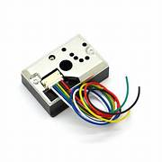
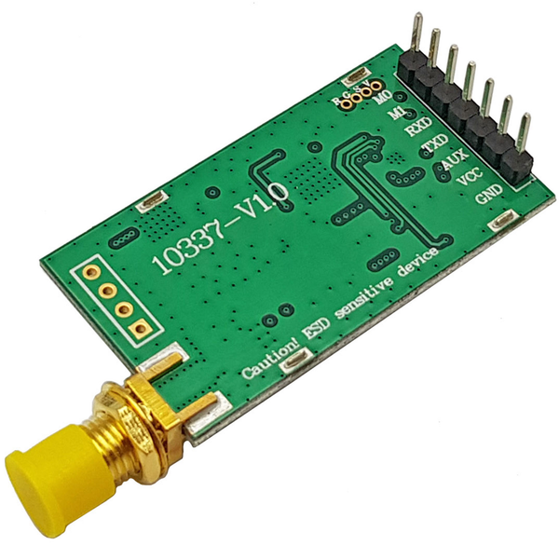
FUNCTION OF THE DEVICES
  The Sharp GP2Y1014AU0F is an optical sensor used at the transmitter Node to detect fine particulate matter (dust). By emitting an integrated infrared LED, it measures light reflection to determine air dust density and outputs a real-time analog voltage directly to the Arduino Uno.
  The LoRa E32 (433MHz) is a long-range wireless communication module used as the link between the transmitter Node and the Gateway. Powered by Chirp Spread Spectrum (CSS) technology, it enables the system to transmit the packaged sensor data across several kilometers and through physical obstacles with low power consumption.

Slide 8
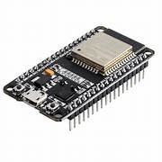

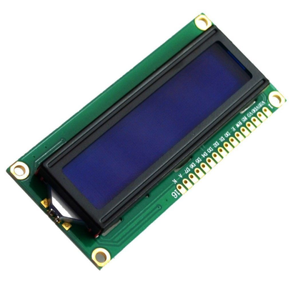
FUNCTION OF THE DEVICES
  The ESP32 DevKit V1 serves as the high-performance central Gateway of the system. Powered by a dual-core processor and integrated Wi-Fi, it processes the long-range data received from the LoRa module, performs string parsing to separate the sensor variables, and syncs them seamlessly to the Firebase for real-time tracking.
  The LCD 16x2 acts as the local display station at the Gateway Node. With a compact 2-line, 16-character interface, it provides immediate on-site monitoring by displaying real-time temperature and humidity on the first row, and the fine dust concentration along with the environmental status on the second row.

Slide 9
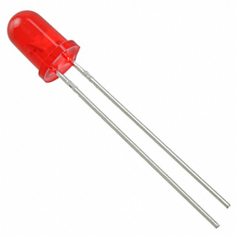
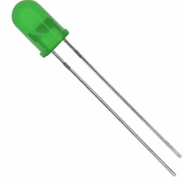
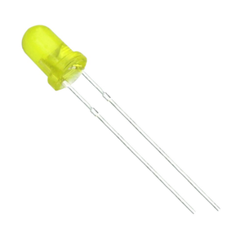
FUNCTION OF THE DEVICES
  The Red LED serves as the critical danger indicator of the system. It automatically lights up to provide an instant physical alert whenever any environmental index or dust concentration level exceeds the safe maximum threshold.
  The Green LED functions as the safe status indicator for the system. It remains illuminated as long as all measured air quality metrics and environmental conditions are completely within safe and healthy thresholds
  The Yellow LED acts as the system's cautionary warning indicator. It triggers to provide an immediate local notification when the sensor readings begin to drift or exceed standard comfortable levels, signaling minor attention is required.

Slide 10
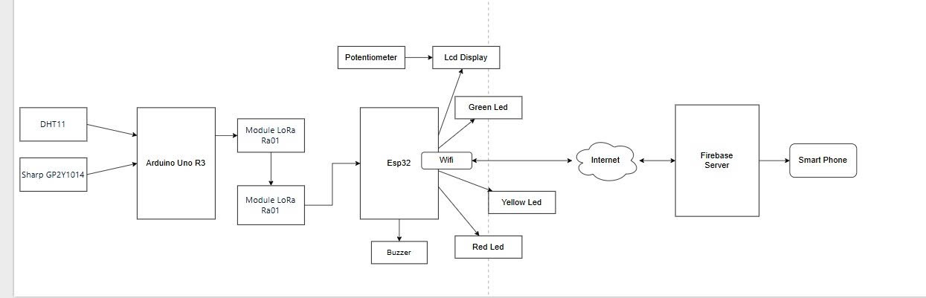
BLOCK DIAGRAM

Slide 11
FLOWCHART

Slide 12
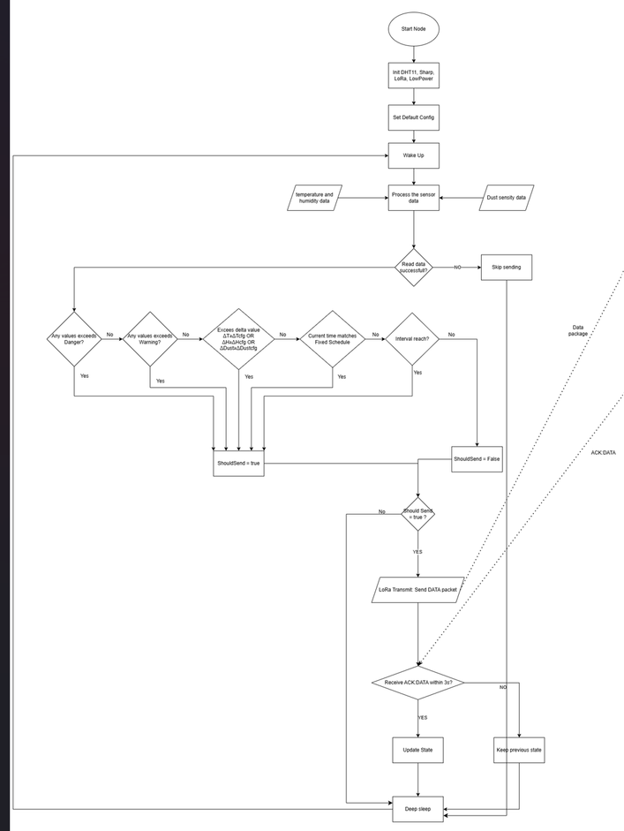
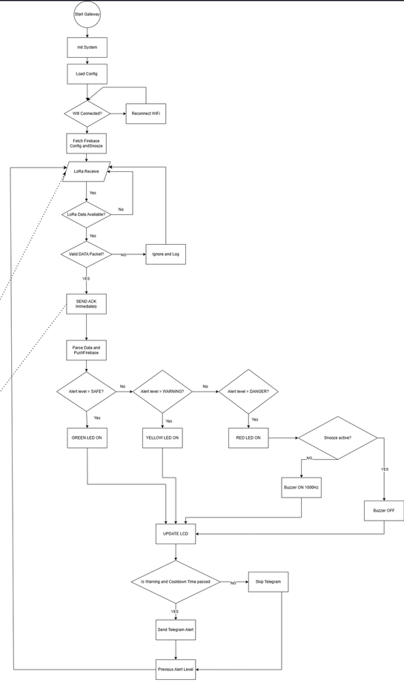

Slide 13
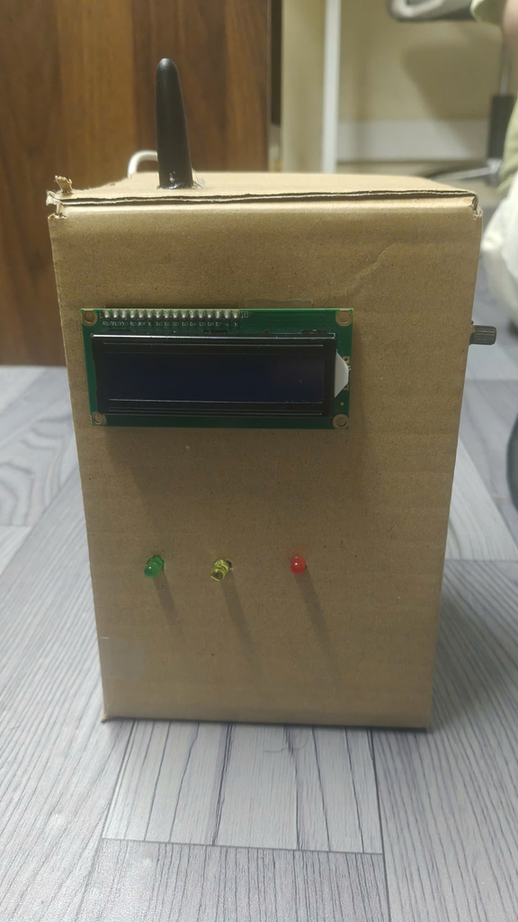
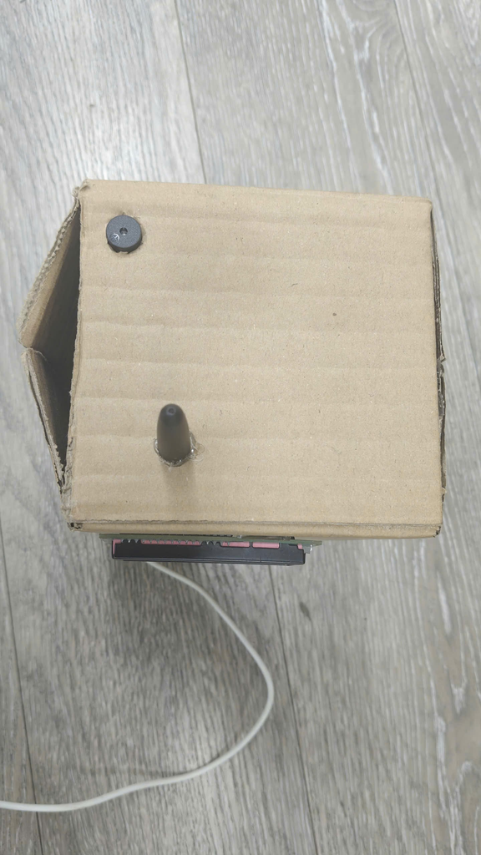
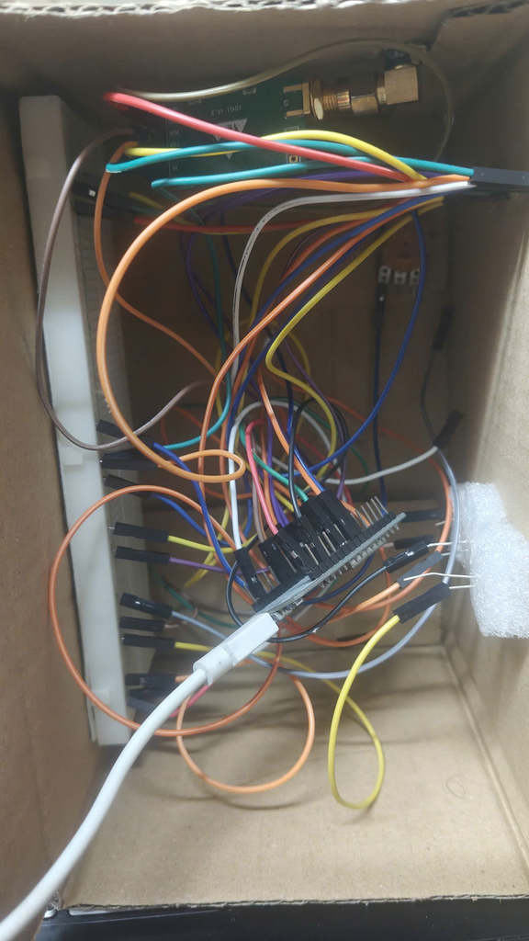
PROJECT IMAGE

Slide 14
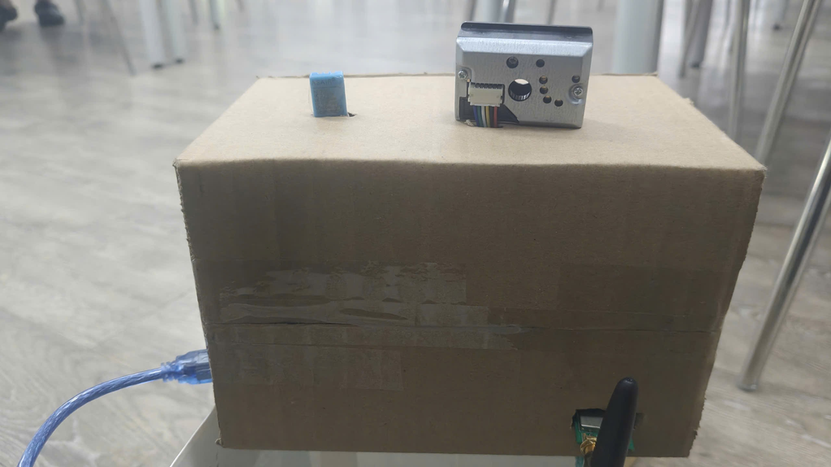
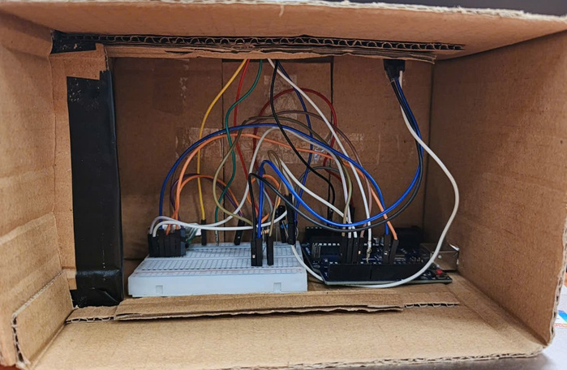
PROJECT IMAGE

Slide 15


DEMO PROJECT
LINK YOUTUBE :
THIS LINK

Slide 16
CONCLUSION
The project has successfully developed an enhanced environmental monitoring and multi-
channel alert system based on the Internet of Things (IoT) and Wireless Sensor Networks
(WSN). The system has fully met the initial criteria set out:
• Successfully collected, filtered, and synchronized dynamic environmental metrics
(temperature, humidity, fine dust, and precipitation) using the long-range LoRa
protocol, ensuring robust communication stability across a wide operating radius
without redundant data transmissions.
• The gateway station effectively handles event-driven sequential processing, simul-
taneously synchronizing filtered analytical data packets with the cloud realtime
database while evaluating local threshold logic to trigger the multi-tier on-site warn-
ing light and physical buzzer system.
• Fully automated the remote emergency alert workflow via the Telegram Bot API,
integrating a strict anti-spam rate-limiting mechanism and a 30-minute status filter
to keep users continuously informed without message flooding.

Slide 17
FUTURE DEVELOPMENT
Although the system operates stably, we propose several scaling directions for practical
deployment:
• Energy Optimization: Integrate solar harvesting panels and leverage hardware-
level deep-sleep algorithms for the sensor transmitter node to operate completely
independently as a long-term outdoor telemetry station.
• Network Scaling and Remote Configuration: Expand the network topol-
ogy to support multiple sensor nodes connecting simultaneously to a single central
Gateway, while developing a secure downstream data transmission protocol to dy-
namically update threshold configurations directly from the Web interface without
firmware flashing.
• Industrial Design Refinement: Utilize 3D printing technology to design and
manufacture industrial-grade, waterproof (IP-rated) enclosures tailored for complex
agricultural environments or outdoor exposures.

Slide 18

THANKS FOR YOUR ATTENTION!

