Slide 1
Join PyCon JP as a staff with Python!
In PyCon JP staff activities, I automated operation about Slack and Google Drive using AWS
PyCon Taiwan 2020 (Fri 07/08) nikkie
Notes:
So let's get the ball rolling.
The title is “Join PyCon JP as a staff with Python!”
In PyCon JP staff activities, I automated operation about Slack and Google Drive using AWS.
Let’s go!

Slide 2
Hello PyCon Taiwan!
Nice to meet you!😃 Please call me nikkie.
Joining from Japan🇯🇵
Thank you for the opportunity to speak remotely!
Materials
Slide: https://bit.ly/join-staff-pycontaiwan
Source code: ftnext/python-as-pyconjp-staff
Notes:
Nice to meet you!😃 Please call me, “nikkie.”
I’m joining from Japan.🇯🇵
Thank you for the opportunity to speak remotely!

Slide 3
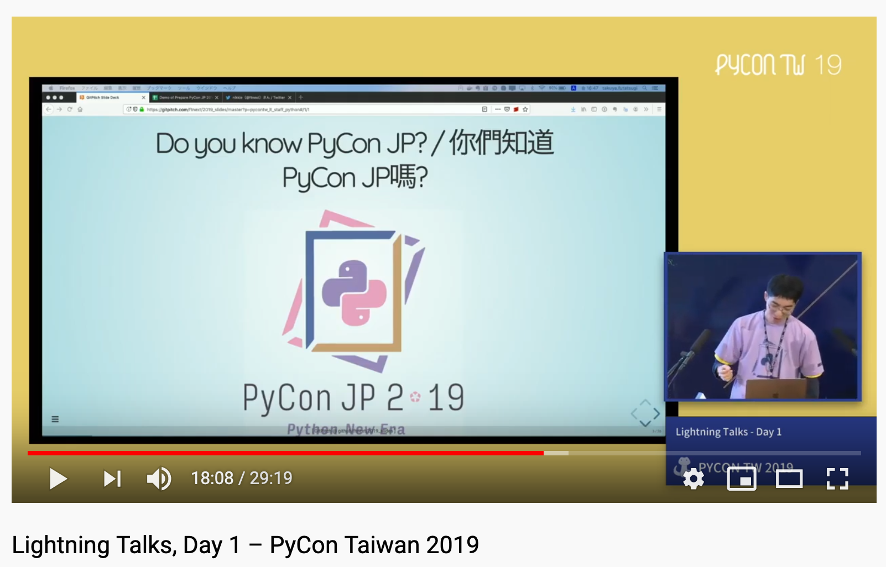
Notes:
Last year, I gave a lightning talk about PyCon JP staff.
I’m now really glad to talk to you.

Slide 4
Introduce myself (nikkie)
Twitter @ftnext / GitHub @ftnext / Linkedin
Data Scientist (NLP) at Uzabase, inc. Tokyo, Japan
My favorites💖: To automate boring stuff with Python & Anime (Japanese cartoons)
PyCon JP staff (2019/2020)
Slide: https://bit.ly/join-staff-pycontaiwan
Notes:
I use the ID “ftnext” on Twitter and GitHub.
I’m working on natural language processing at Uzabase in Tokyo.
I’m so lazy that I’m enthusiastic about automating boring stuff with Python.
I've been staff of PyCon JP since last year.

Slide 5
nikkie's output (2020 summer)
How to automate PyCon staff activities with Python!
PyCon Africa (August)
Bring your Python script to more users!
EuroPython (July)
Slide: https://bit.ly/bring-script-europython
Workshop at PyCon APAC (Next week!)
Slide: https://bit.ly/join-staff-pycontaiwan
Notes:
In this summer, I've been speaking online at PyCons around the world.
I talked about this topic at PyCon Africa in August.
And I Speaked on another topic, Bring your Python script to more users at EuroPython
and hold a workshop at PyCon APAC next week!
Let’s cut to the chase.

Slide 6
Join PyCon JP as a staff with Python!
Case study about automation with Python
Examples of automation in PyCon JP staff activities
Slide: https://bit.ly/join-staff-pycontaiwan
Notes:
This talk is a case study about automation with Python.
I will share some examples of automation in PyCon JP staff activities.

Slide 7

Do you know PyCon JP?
PyCon JP 2020 held ONLINE last week! (YouTube)
2 days conference, 50+ talks, 550+ participants
want to know PyCon JP history 👉 takanory-san's talk "Decade of PyCon JP"
Slide: https://bit.ly/join-staff-pycontaiwan
Notes:
PyCon JP 2020(twenty-twenty) was held as an Online Conference last week!
Conference is 2 days and we have fifty over talks and 550 over participants.
If you want to know PyCon JP history, check takanory-san's talk.

Slide 8
Many tasks, many tools!
50 over services (reference), e.g.
Slack (for communication)
G Suite (for collaboration)
Google Drive, Google Documents, Google Spreadsheets, ...
Slide: https://bit.ly/join-staff-pycontaiwan
Notes:
PyCon JP is big, and there's a lot to do.
In the staff activities, we use a lot of services.
For example, we communicate in Slack, and collaborate in G Suite.

Slide 9
When I use tools
Some of the things that I felt were not cool🆒 with the tool.
Boring operations over and over again. 😫
Slide: https://bit.ly/join-staff-pycontaiwan
Notes:
When I use Slack and G Suite in staff activities, I found that some points were not cool with the tool.
I was going through a series of boring operations over and over again.

Slide 10
When I use tools
Some of the things that I felt were not cool🆒 with the tool.
Boring operations over and over again. 😫
👉 automate the recurring boring stuff with Python
Slide: https://bit.ly/join-staff-pycontaiwan
Notes:
I wanted to handle the stuff better,
so automated the recurring boring stuff with Python!
I'll tell you the details later.

Slide 11
Why automate with Python?
Many tasks as a leader of Program Team.
Focus resources on tasks that humans need to do.
Slide: https://bit.ly/join-staff-pycontaiwan
Notes:
In 2020, I have many tasks as a leader of the Program Team.
I want to focus my resources on tasks that humans need to do.

Slide 12
Why automate with Python?
Many tasks as a leader of Program Team.
Focus resources on tasks that humans need to do.
tasks machines cannot do
e.g. proposal design, speaker communications
🤖 Recurring boring stuff
Slide: https://bit.ly/join-staff-pycontaiwan
Notes:
In other words, the tasks machines cannot do.
For example, I want to focus on proposal design and speaker communications.
By automation, I let the machine do the recurring boring stuff for me.

Slide 13
Benefit of automation 🙌
Labor-saving and stable quality.
With Python, do more things as staff. (Become 2x staff😃)
Slide: https://bit.ly/join-staff-pycontaiwan
Notes:
Automation brings the saving of labor and stable quality of output.
With Python, I can do more things as staff.
I might be 10 times PyCon staff in the future :)

Slide 14
Table of contents
2 examples of automation with Python
Customized Slack reminder (10min)
Slack command to copy template Google Docs (9min)
Slide: https://bit.ly/join-staff-pycontaiwan
Notes:
The table of contents are here.
I introduce two examples.

Slide 15
Your take-away 🧺 (proposal)
How to post a message to Slack with Python
How to do the above regularly using AWS Lambda
How to manipulate Google Drive documents with Python
A series of ways to manipulate Google Drive documents from Slack (via Python scripts deployed on AWS)
Knowledge of what the PyCon JP staff is doing
Slide: https://bit.ly/join-staff-pycontaiwan
Notes:
Referring to the proposal, You can take away 5 things.
I handle automating the staff about Slack or Google Drive with Python,
and I talk about Amazon Web Services, a.k.a AWS

Slide 16
Example 1. Customized Slack reminder
Table of contents
2. Slack command to copy template
Slide: https://bit.ly/join-staff-pycontaiwan
Notes:
The first example is a customized Slack reminder.

Slide 17
Your take-away 🧺
🧺 How to post a message to Slack with Python
🧺 How to do the above regularly using AWS Lambda
How to manipulate Google Drive documents with Python
A series of ways to manipulate Google Drive documents from Slack (via Python scripts deployed on AWS)
Knowledge of what the PyCon JP staff is doing
Notes:
From this example you can take away 2 things:
How to post a message to Slack with Python and
how to do this regularly using AWS Lambda

Slide 18
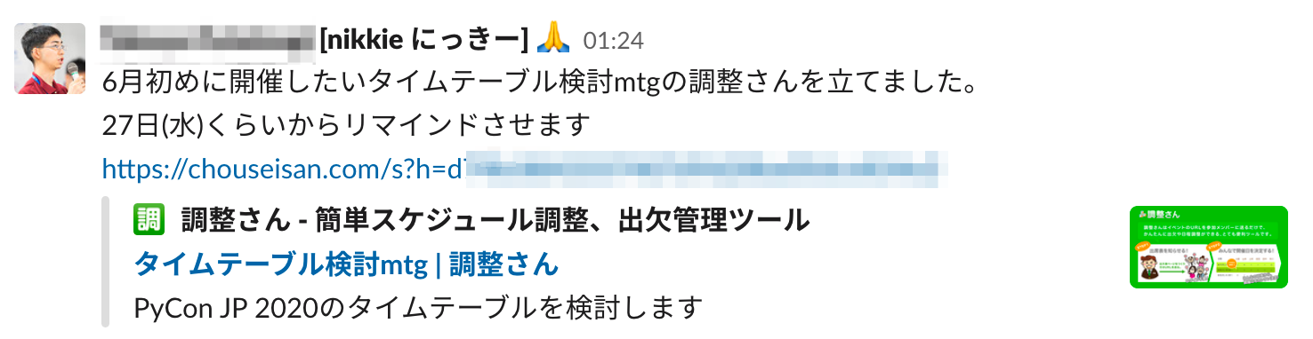
Communications in Slack
e.g. To set up a meeting, ask staff what days they are available.
Notes:
PyCon JP Staff communicate with each other in Slack.
For example, to set up a meeting, I asked the staff what days they are available.

Slide 19
Communications in Slack
So many posts on Slack that the post flow away 🌊 after a few days.
Need to post repeatedly to make sure other staff see the post.
Notes:
There are so many posts on Slack that posts flow away after a few days.
You need to post the message repeatedly to make sure others see the post and do the action.

Slide 20
Post repeatedly in Slack
Tedious to post repeatedly by hand. 😫
👉Slack reminder feature: Set a reminder
Notes:
It is tedious to post repeatedly by hand.
Slack supports the reminder feature, so let’s use it.

Slide 21
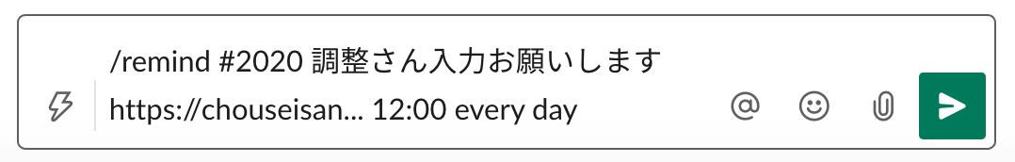
Post repeatedly in channel
/remind [#channel] [what] [when]
Notes:
Type /remind, then specify a channel, what and when.

Slide 22
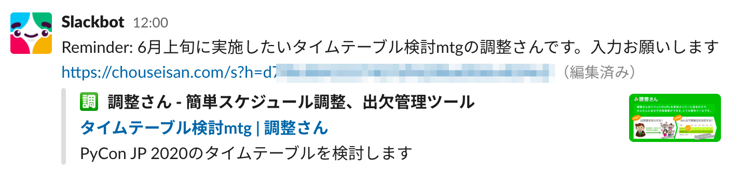
Post repeatedly in channel 😃
/remind [#channel] [what] [when]
e.g. /remind #2020 調整さん入力お願いします https://chouseisan... 12:00 every day
Notes:
In this example, Slackbot reminds us of the message every noon.
Automate the repeat post with Slackbot using /remind.

Slide 23
What I felt wasn't cool
Slackbot posts EVERY day!
Have to stop the reminder manually & remember when to stop 😫
Notes:
But there is a thing that I felt was not cool.
Slackbot posts EVERY day even after the meeting,
so we have to stop the reminder manually and remember when to stop

Slide 24
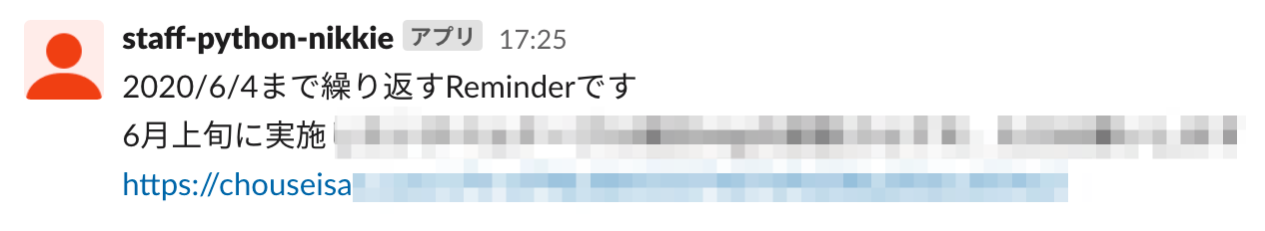
Customized Slack reminder ✨
Create a reminder which can end automatically.
Notes:
It’s turn of the customized Slack reminder!
I created a reminder which can end automatically.
There is no need to stop manually or remember when to stop.

Slide 25
Components of customized Slack reminder
Implementation: Python script
Data: Google Spreadsheets
Deploy on: AWS Lambda
Notes:
The customized reminder consists of three components, Python script, Google spreadsheets, AWS Lambda.

Slide 26
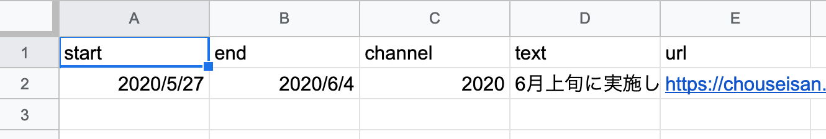
Data in Google Spreadsheets (example)
Represents to post a message including text and url in channel from start to end periodically
Notes:
This is an image of a spreadsheet.
Each row represents to post a message, including text(D) and url(E),
in channel(C) from start(A) to end(B) periodically.
This example shows from 27th May to 4th June post in the 2020 channel.

Slide 27
Python script
Fetch data in the spreadsheet.
Determine if the message needs to be posted.
Post messages to Slack.
Notes:
The Python script does three things:
1. Fetch data in the spreadsheet.
2. Determine if the message needs to be posted.
3. Post messages to Slack.

Slide 28
Python script
Fetch data in the spreadsheet.
Determine if the message needs to be posted.
Post messages to Slack.
Notes:
First, we take a look at how to post messages to Slack with Python.

Slide 29
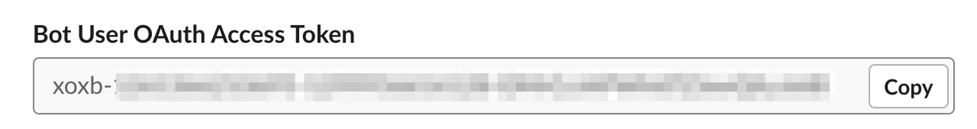
How to post with Python:
Preparation (in browser)
Create a bot for your workspace (👉 Appendix)
Create a Slack app
Configure Bot Token Scopes (chat:write.public)
Install app and get Bot User OAuth Access Token
Notes:
To post to Slack with Python, Create a Slack app, configure, and install.
Jot down Bot User OAuth Access Token.

Slide 30
How to post with Python
chat.postMessage method | Slack
POST to https://slack.com/api/chat.postMessage
Notes:
To post a message to Slack, call the chat.postMessage endpoint with the POST method.

Slide 31
How to post with Python
Using the Slack Web API - Basics
Header:
Authorization (using Bot User OAuth Access Token)
Content-type
Notes:
When in Rome, do as the Romans do.
When calling the slack APIs, do as the documents read.
Request header contains two items, authorization and content-type.
In the authorization field, use the Bot User token.

Slide 32
How to post with Python
Using the Slack Web API - Basics
Header: Authorization, Content-type
Body: JSON-encoded
channel, text for chat.postMessage
Notes:
The request body is JSON-encoded.
Specify the channel and the text for chat.postMessage endpoint.
(in this time content-type must be application/json)

Slide 33
How to post with Python
Using the Slack Web API - Basics
Header: Authorization, Content-type
Body: JSON-encoded
👉 using urllib from stdlib
Notes:
In implementation, we use urllib from the Python Standard Library.

Slide 34
Impl. of how to post with Python 1/2
header = {
"Authorization": "Bearer xoxb-...", # Use the token
"Content-type": "application/json",
}
Notes:
In implementation, Create a header as seen in the documentation:
Authorization using bot user token and Content-type.

Slide 35
Impl. of how to post with Python 1/2
import json
header = {
"Authorization": "Bearer xoxb-...",
"Content-type": "application/json",
}
data_dict = {"channel": "2020", "text": "Reminder: ..."}
body = json.dumps(data_dict).encode() # JSON-encoded body
Notes:
Prepare JSON encoded body using json.dumps method.

Slide 36
Impl. of how to post with Python 2/2
from urllib.request import Request, urlopen
uri = "https://slack.com/api/chat.postMessage"
request = Request(uri, data=body, headers=header, method="POST")
urlopen(request)
# ref: HOWTO Fetch Internet Resources Using The urllib Package
Notes:
Using the header and the body, send a POST request to the Slack API using urllib.

Slide 37
Python script
Fetch data in the spreadsheet.
Determine if the message needs to be posted.
Post messages to Slack.
Notes:
Next, let's see how to fetch data in Google spreadsheets with Python.

Slide 38
How to fetch data: Overview
Python operates spreadsheets via Sheets API.
Use gspread package, a wrapper of Sheets API v4.
Notes:
Python operates spreadsheets via Sheets API.
We use the gspread package, a wrapper of Sheets API version four.

Slide 39
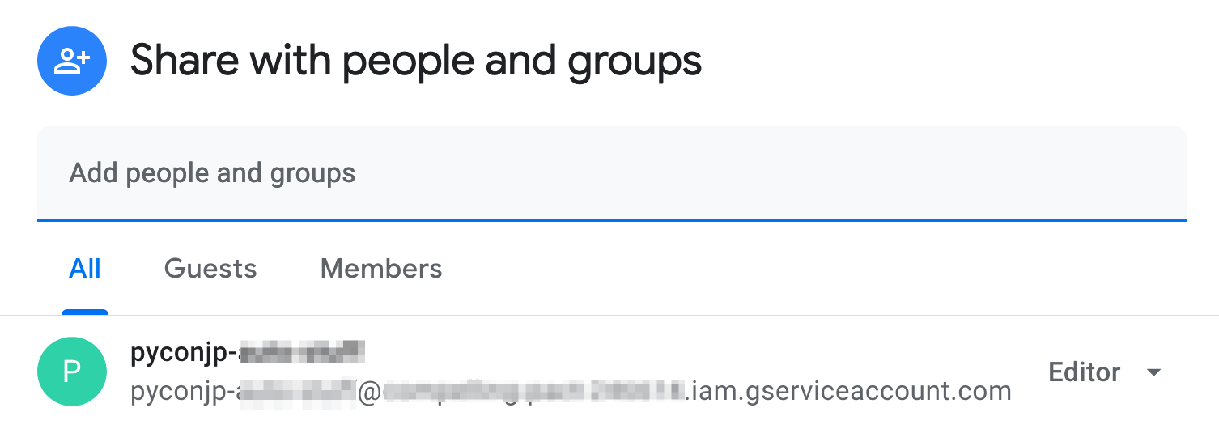
How to fetch data: Preparation (in browser)
Enable Sheets API. (Docs)
Create a service account. (Docs)
Share the spreadsheet with the service account. (Docs)
Notes:
To operate the spreadsheet with Python,
in Google Cloud Platform console, enable Sheets API, then create a service account.
Share the target spreadsheet with the service account; we are ready to go!

Slide 40
Impl. of how to fetch data with Python 1/2
from gspread import service_account
scopes = [
"https://www.googleapis.com/auth/spreadsheets",
"https://www.googleapis.com/auth/drive",
]
gc = service_account("sa_demo_automate_talk.json", scopes)
Notes:
Create a client from the service account.

Slide 41
Impl. of how to fetch data with Python 2/2
# https://docs.google.com/spreadsheets/d/<file_id>/edit#gid=0
spreadsheet = gc.open_by_key("<file_id>")
worksheet = spreadsheet.sheet1 # default first worksheet
all_rows_list = worksheet.get_all_values() # Docs
# >>> print(all_rows_list)
# [['start', 'end', 'channel', 'text', 'url'], [...], ...]
Notes:
Using the client, access the target spreadsheet and the first worksheet,
then get all values in the worksheet as a list of lists.

Slide 42
Python script
Fetch data in the spreadsheet.
Determine if the message needs to be posted.
Post messages to Slack.
Notes:
Lastly, I tell the logic to determine if the message needs to be posted.

Slide 43
Logic
For each row
time
start
end
Notes:
Do you remember?
Each row in the spreadsheet has a start date and end date.

Slide 44
Logic: need to be posted 🙆‍♀️
For each row
time
start 2020/08/04
execution date
2020/08/07
end
2020/08/08
Notes:
If the execution date is between the start date and the end date,
the message of the row needs to be posted to Slack.

Slide 45
Logic: NOT need to be posted 🙅‍♂️
For each row
time
execution date
2020/07/31
start 2020/08/04
end
2020/08/08
execution date
2020/08/11
Notes:
elIf the execution date is before the start date or after the end date,
the message does not need to be posted.
That’s all for Python script.

Slide 46
Components of customized Slack reminder
✅ Implementation: Python script
✅ Data: Google Spreadsheets
Deploy on: AWS Lambda
Notes:
I've told you about the implementation and data.
Now we want to run the script periodically, right?
In this time I chose AWS for periodically execution.
I will tell you about AWS Lambda.
なぜAWSを選んだのか (Why AWS?)→Appendix

Slide 47
AWS Lambda
What is AWS Lambda? - AWS Lambda
a compute service that lets you run code without provisioning or managing servers.
Notes:
According to the AWS developer guide, AWS lambda is a compute service
that lets you run code without provisioning or managing servers.
All we have to prepare is only code, so it is called serverless, which means no need for us to manage servers.

Slide 48
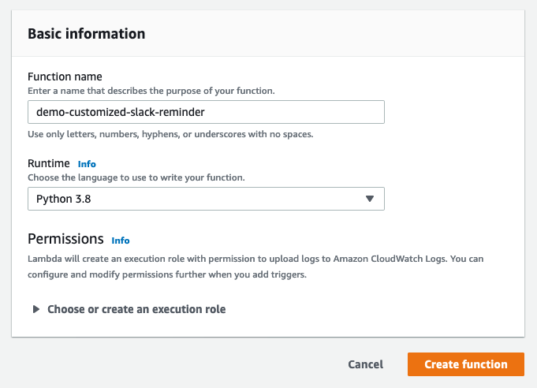
AWS Lambda
Deploy module in Python script as Lambda function.
Choose Python runtime.
ref: Building Lambda functions with Python - AWS Lambda
Notes:
We can deploy a module in Python script as a Lambda function.
AWS Lambda supports a wide range of programming languages; we need to specify runtime.

Slide 49
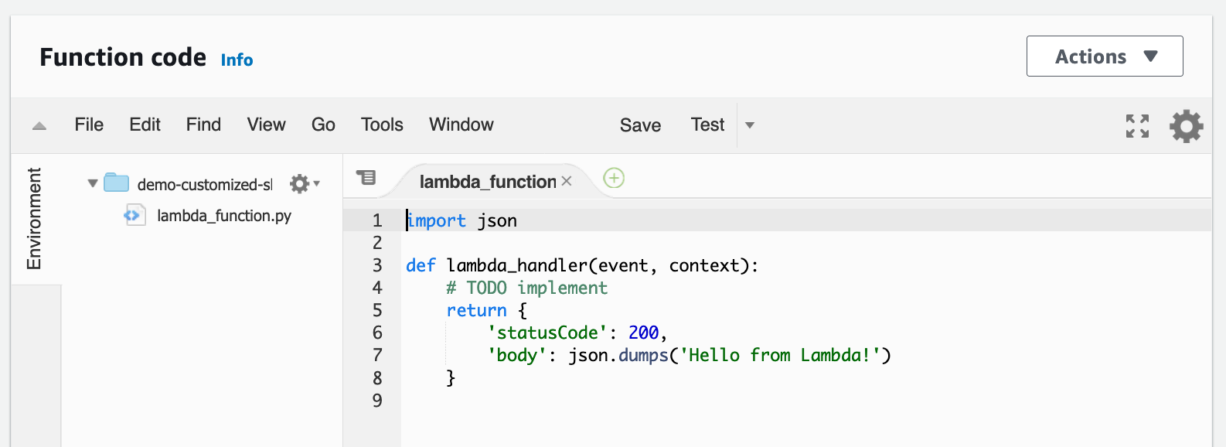
Lambda function code editor (browser!)
Notes:
After creating a lambda function, you can edit Python code on your browser!
This editor is handy because it enables us to try and error.
In the default setting, the lambda_handler function is executed, so put your code in the function.

Slide 50
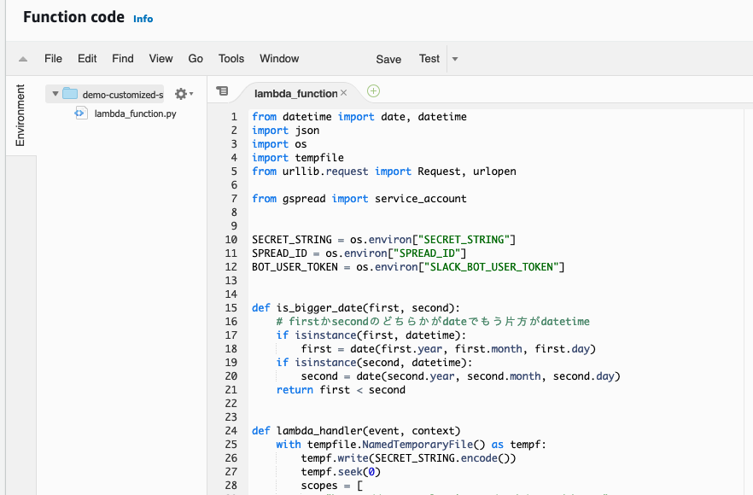
Notes:
Put the code I've prepared so far in the lambda_handler function.

Slide 51
How to install gspread? (later)
Notes:
The gspread package is not installed in the Lambda function runtime.
I will tell you how to install a third-party package later.

Slide 52
My idea: Service account contents as an environment variable
(👉 Appendix)
Notes:
I set the contents of service account to an environment variable.
I will explain it in the appendix.

Slide 53
Run Lambda function periodically
Event-driven (lambda_handler(event, context))
Occur events periodically
Notes:
Lambda functions are event-driven.
When an event occurs, it executes a configured lambda function.
We want to run the lambda function periodically, for example, once a day,
so we occur the event once a day.

Slide 54
Run Lambda function periodically
Event-driven (lambda_handler(event, context))
Occur events periodically
👉 Amazon CloudWatch Events
What Is Amazon CloudWatch Events? - Amazon CloudWatch Events
Notes:
To occur events periodically, we use CloudWatch Events.

Slide 55
CloudWatch Events
Schedule the occurrence of an event.
e.g. every day noon (UTC): cron(0 12 * * ? *)
ref: Schedule expressions using rate or cron - AWS Lambda
Notes:
CloudWatch Events schedules the occurrence of an event.
Specify In a format similar to the cron expression.

Slide 56
CloudWatch Events
Schedule the occurrence of an event.
e.g. every day noon (UTC): cron(0 12 * * ? *)
ref: Schedule expressions using rate or cron - AWS Lambda
Route events to Lambda function: Rule.
Notes:
CloudWatch Events route events to the Lambda function with the specified rule.

Slide 57
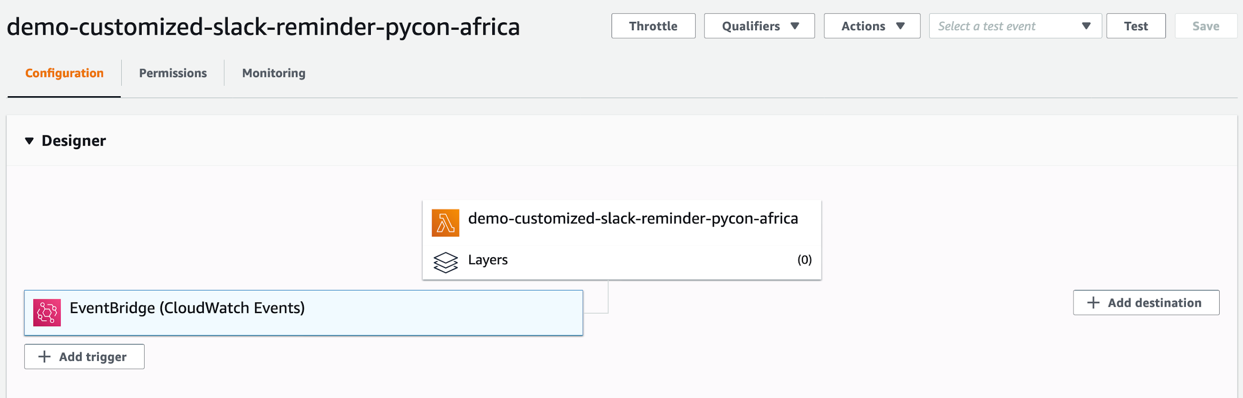
CloudWatch Events (browser)
Scheduled events
Rule
Notes:
In your browser, add CloudWatch Events as a trigger.
This lambda function runs once a day!
（once a dayがスケジュール。Lambda関数への紐づきはruleによる）

Slide 58
How to install third party packages?
Need to install gspread in Lambda function runtime.
Notes:
Now we need to install the gspread package in the Lambda function runtime.

Slide 59
How to install third party packages?
Need to install gspread in Lambda function runtime.
Recommendation: Lambda layers
AWS Lambda layers - AWS Lambda
Notes:
I recommend using Lambda Layers.

Slide 60
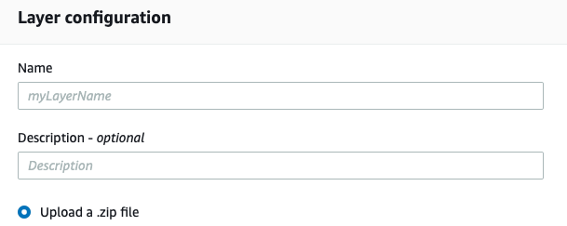
Create Lambda layer
Zip the package on command line and upload it from browser
Notes:
To create a Lambda Layer, zip the package on your command line and upload it from your browser.

Slide 61
Create Lambda layer
Zip the package on command line and upload it from browser
pip install -t python/ gspread
zip -r python_gspread_layer.zip python/
Upload the zip file.
Notes:
Install the packages in the target directory with t option, then zip the directory, upload the zip file.

Slide 62
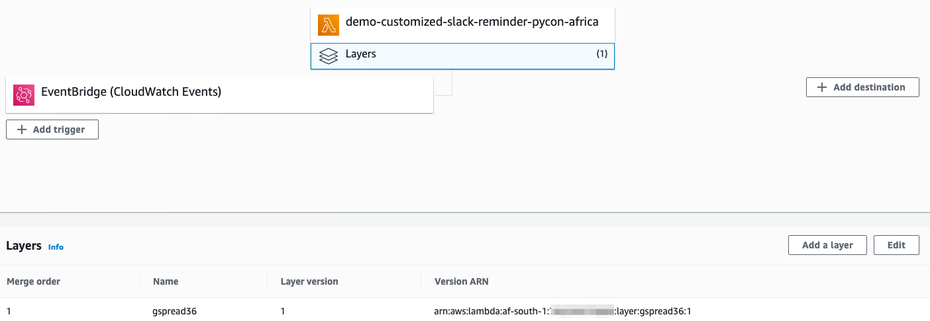
Lambda Layer
Notes:
Add the gspread layer to the function, so it can import now!
（Layerの利点は引き続きブラウザでスクリプトを編集できること）

Slide 63
🚧Pitfall: Zip third party packages in your PC
Python packages vary by platform.
Local PC: macOS
Lambda Runtime OS: amazonlinux (ref)
Notes:
There is a pitfall in creating the zip file.
Python packages vary by platform,
so installed packages in macOS may not work well in the Lambda runtime, amazonlinux environment.

Slide 64
🚧Pitfall: Zip third party packages in your PC
Python packages vary by platform.
Local PC: macOS
Lambda Runtime OS: amazonlinux (ref)
👉 Run amazonlinux Docker image in local PC (Appendix)
Notes:
One solution is to run amazonlinux on the development PC.
I ran the amazonlinux Docker image and installed the packages in the container.
(If you want to use the requests package instead of urllib, I recommend creating a layer for requests package.)

Slide 65
📚Recap: Customized Slack reminder
How to post a message to Slack with Python
👉 urllib
as the Slack documents read
How to do the above regularly using AWS Lambda
👉 Lambda function and CloudWatch Events
FYI: shell script to deploy template function which can read/write Google spreadsheet and post to Slack (README)
Notes:
It is Recap time.
To post a message to Slack, use urllib as the Slack documents read.
To post a message regularly on AWS, create Lambda function and occur events with CloudWatch Events.

Slide 66
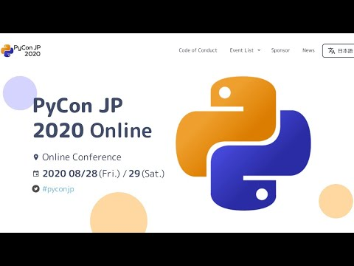
🍵 Short interval ... 🍵
PyCon JP 2020 memory: Day 2 Keynote
Notes:
Let’s take a short break.
In PyCon JP 2020, day 2 keynote is memorable.
Rich Jones, the author of Zappa talked
planning: 16 min

Slide 67
Example 2. Slack command to copy template Google Docs
Table of contents
Customized Slack reminder
Slide: https://bit.ly/join-staff-pycontaiwan
Notes:
The second example is the Slack command to copy template Google Documents.

Slide 68
Your take-away 🧺
How to post a message to Slack with Python
How to do the above regularly using AWS Lambda
🧺 How to manipulate Google Drive documents with Python
🧺 A series of ways to manipulate Google Drive documents from Slack (via Python scripts deployed on AWS)
Knowledge of what the PyCon JP staff is doing
Notes:
From this example you can take away 2 things:
How to manipulate Google Drive documents with Python and
a series of ways to manipulate Google Drive documents from Slack.

Slide 69
Staff meetings
Hold mtg every other week.
Take minutes of mtg in Google Documents. 📝
Notes:
PyCon JP staff hold mtg every other week.
We take minutes of mtg in Google Documents.

Slide 70
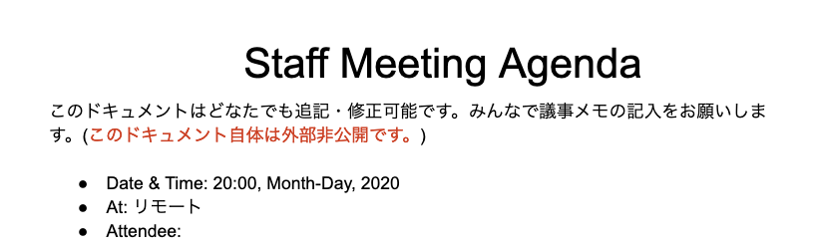
Preparation of staff meetings
Copy a template Docs in Google Drive manually.
Notes:
Before the meeting, we copy a template Documents manually.

Slide 71
What I felt wasn't cool
Copy a template manually every other week. 😫
👉 Start to write Python script ...
Notes:
There is a thing that I felt was not cool.
I don’t want to copy a template manually every other week.
I started to write a Python script for automation.

Slide 72
Python script
Copy file specified by id in Google Drive.
Notes:
The Python script does one thing:
Copy the file in Google Drive.

Slide 73
Python script
Copy file specified by id in Google Drive.
https://docs.google.com/document/d/<file_id>/edit
same for Spreadsheets and Slides.
Notes:
To copy, We specify the target file by the id.
The Google Docs ID is this part of the URL.
It's the same for spreadsheets and slides.

Slide 74
How to copy Docs with Python: Overview
Python operates files in Google Drive via Drive API.
PyDrive: known as a wrapper of Drive API v2.
Notes:
Python operates files in Google Drive (like Google Documents) via Drive API.
PyDrive package is known as a wrapper of Drive API version two. You may have heard of it.

Slide 75
How to copy Docs with Python: Overview
Python operates files in Google Drive via Drive API.
PyDrive is known as a wrapper of Drive API v2.
Use PyDrive2, actively maintained fork of PyDrive.
Notes:
In this time, we use PyDrive2, the actively maintained fork of PyDrive.

Slide 76
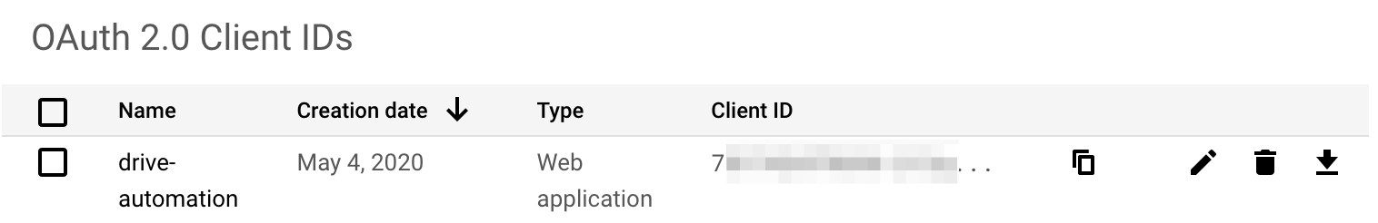
How to copy Docs with Python: Preparation (in browser)
Quickstart — PyDrive 1.3.0 documentation
Enable Drive API.
Create an OAuth client ID. (Docs)
Download JSON file.
Notes:
Before calling Drive API with Python,
visit the Google Cloud Platform console,
enable Drive API, then create an OAuth client id and download it.

Slide 77
Impl. of how to copy Docs with Python: Authentication
from pydrive2.auth import GoogleAuth
gauth = GoogleAuth() # See settings.yaml (next slide)
gauth.LocalWebserverAuth()
# ├── settings.yaml
# └── this_script.py
Notes:
This is the implementation of the authentication part.
You can write the configuration for authentication in the settings.yaml.
This code refers to settings.yaml.

Slide 78
Settings of how to copy Docs with Python
# settings.yaml (Docs)
client_config_file: my_client_secrets.json # OAuth client ID
save_credentials: True
save_credentials_backend: file
save_credentials_file: saved_credentials.json
get_refresh_token: True # not to launch browser
Notes:
Settings.yaml is here.
This means using the OAuth client ID file in the same directory
and if saved credential file exists, refresh automatically then authenticate.
TODO：認証の仕組みをAppendixで補足したほうがいいか？（積み残し）

Slide 79
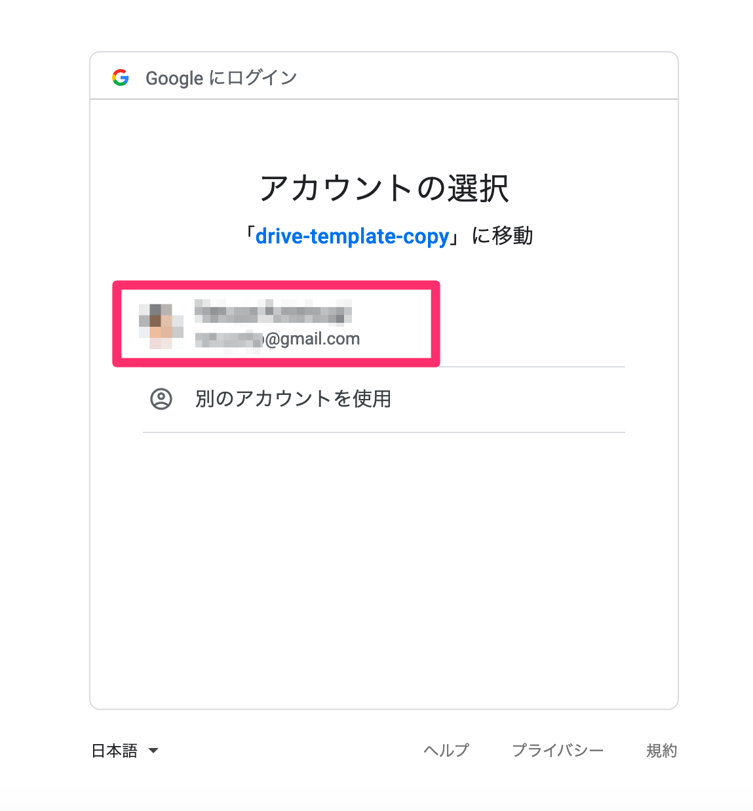
Authentication
Required for the first time only.
The script launches your browser ➡️
Select Google account.
Notes:
The first time you run the script, your browser will launch.
You need to select your account.
If authentication passed, credentials are saved in your PC.
After the second time, your browser won't launch because the script uses the saved credentials.

Slide 80
Impl. of how to copy Docs with Python
GoogleDrive(gauth).auth.service.files()
.copy(
fileId="...", body={"title": "copied file"},
supportsAllDrives=True
)
.execute()
# ref
Notes:
After authentication, you can copy the file by specifying its ID as a fileId parameter.

Slide 81
Packaging for my use case 📦
ftnext/diy-googledrive-operate
# in main.py
def cp_in_drive(source_id):
drive = create_diy_gdrive() # Auth code
dest_title = build_dest_title(drive, source_id)
return drive.copy_file(source_id, dest_title) # copy code
Notes:
I've packaged the scripts for my use case.
This code calls auth code and copy code we just saw.

Slide 82
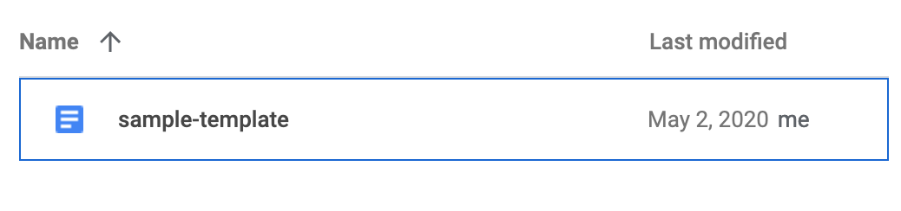
Packaging for my use case 📦
ftnext/diy-googledrive-operate
$ python main.py <file_id>
Notes:
Run the entrypoint script with this file id, …(next)

Slide 83
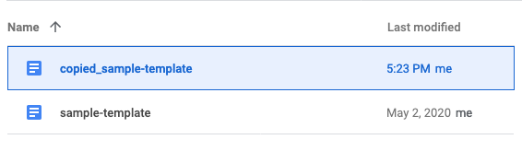
Packaging for my use case 📦
ftnext/diy-googledrive-operate
$ python main.py <file_id>
コピーされました: https://docs.google.com/document/d/<copied_file's_id>/edit?usp=drivesdk
Notes:
It copies the specified file in the same folder.

Slide 84
Impressions
🙌 Got a script to automate the boring stuff.
Notes:
I did it!
Got a script to automate the boring stuff.

Slide 85
Impressions
🙌 Got a script to automate the boring stuff.
In staff activities, often use Web browser. Can I run the script from the browser? 🤔
Notes:
But In staff activities, I often use a Web browser.
Can I run the script from the browser?

Slide 86
How to run the scripts from browser
In this time,
Create Lambda function from the script.
Call the function from Slack. (Slash Command)
Notes:
To run the scripts from browser,
I converted the script to a Lambda function,
then set up to call the Lambda function from Slack.

Slide 87
How to run the scripts from browser
In this time,
Create Lambda function from the script.
Call the function from Slack. (Slash Command)
Notes:
You know how to make a Lambda function from the first example.

Slide 88
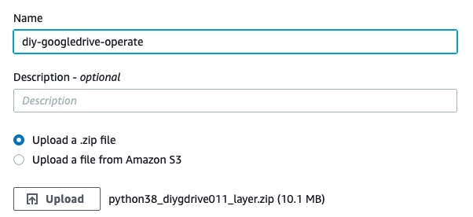
Create Lambda function
Create layer from my writing diy-googledrive-operate.
Notes:
In this time, I created Lambda Layer from my writing package.

Slide 89
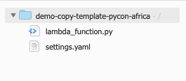
Create Lambda function
Create layer from my writing diy-googledrive-operate.
Arrange script as in the local PC (credentials 👉 Appendix).
Use diy-googledrive-operate
Notes:
Then arrange the script and credentials as in the local PC.

Slide 90
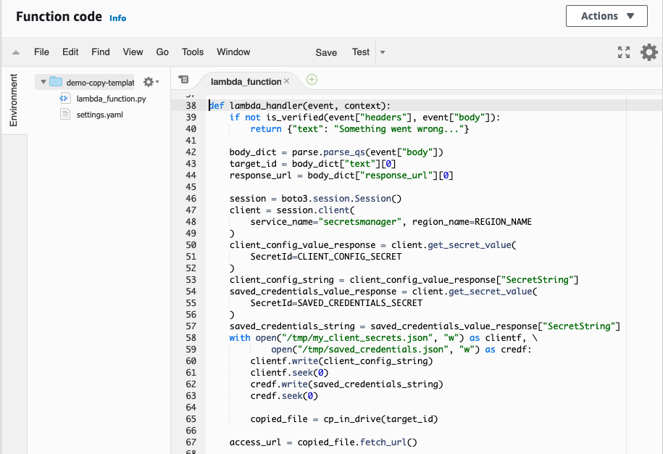
Notes:
Lambda function code is here!

Slide 91
How to run the scripts from browser
In this time,
Create Lambda function from the script.
Call the function from Slack. (Slash Command)
Notes:
Let's see how to call this Lambda function from Slack.
We use something called Slash Command.

Slide 92
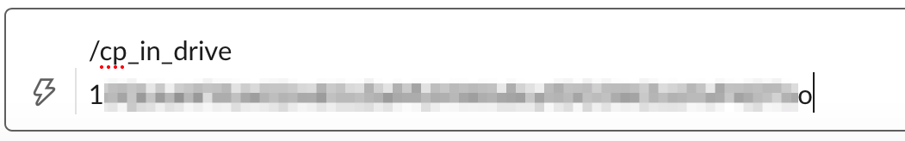
Slack Slash Command
/cp_in_drive [file_id]
Notes:
Here's the Slash Command I made.
Call the command /cp_in_drive and the target file id.

Slide 93
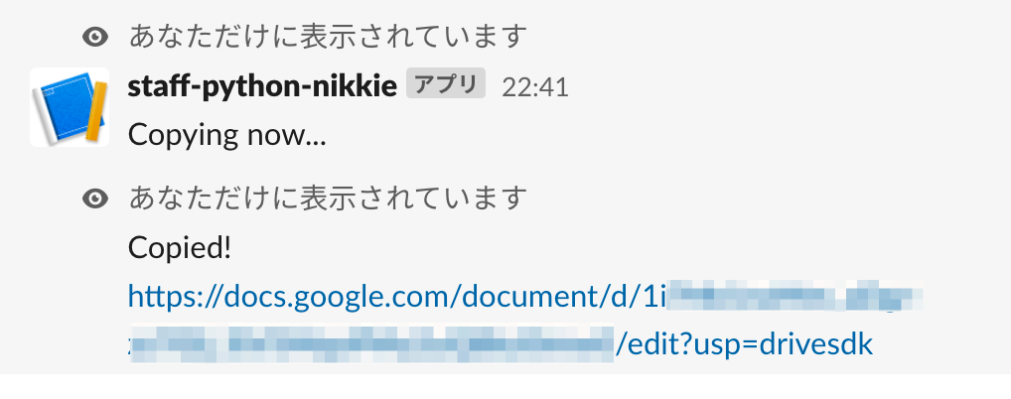
Slack Slash Command
Notes:
When the command is executed, the link of the copied file will be displayed.
Actually /remind is a builtin Slash Command.

Slide 94
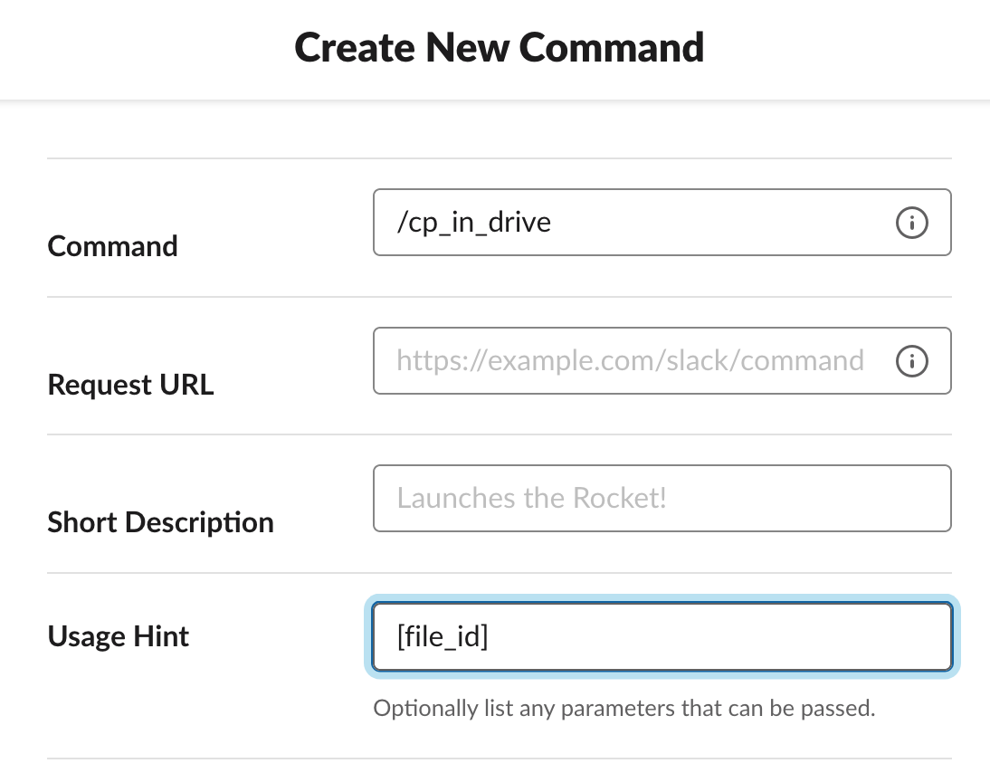
Components of Slash Command
Enabling interactivity with Slash Commands | Slack
Slack app
Request URL
Notes:
Slash command consists of two things: The slack app and the Request URL.

Slide 95
Components of Slash Command
Enabling interactivity with Slash Commands | Slack
Slack app (👉 Appendix)
Request URL
Notes:
We've already made the Slack app in the custom reminder section.
Slash Command needs additional settings a little. please visit the Appendix.

Slide 96
Components of Slash Command
Enabling interactivity with Slash Commands | Slack
Slack app
Request URL
Slack sends data to this URL.
= URL of Lambda function.
Notes:
After a user invokes, Slash Command sends the data to the Request URL.
Now we want Slack to send the data to the Lambda function.

Slide 97
How to attach URL to Lambda function
👉 Amazon API Gateway
What is Amazon API Gateway? - Amazon API Gateway
an AWS service for creating, publishing, maintaining, monitoring, and securing REST, HTTP, and WebSocket APIs at any scale.
Notes:
To attach URL to the Lambda function, we use Amazon API Gateway.
It allows us to create an API endpoint, so we have Slack to send to the endpoint.

Slide 98
Slash Command: Slack's behavior
POST request to the Request URL
Content-type: application/x-www-form-urlencoded
Contains data: text=file_id&response_url=https://hooks.slack.com/commands/1234/5678 (Detail)
Notes:
According to the Slack document, when a user invokes a Slash Command,
Slack sends the POST request as form-urlencoded type.

Slide 99
How to configure API Gateway
Create a REST API with Lambda integrations in Amazon API Gateway - Amazon API Gateway
Create REST API for POST method.
Specify Mapping Templates (👉 Appendix) for application/x-www-form-urlencoded.
Attach the endpoint to Lambda function.
Notes:
Configure the API Gateway to match Slack’s behavior.
Create an API for the POST method.
Using Mapping Templates, enable the endpoint to process form-urlencoded type’s data.
Then attach the URL to the file copy function.

Slide 100
Slash Command: Add implementations to Lambda function
Verify request from Slack.
Parse sent data.
Notes:
You need to add some code in the Lambda function.

Slide 101
Slash Command: Impl. of verification
Verifying requests from Slack | Slack
Implement "How to make a request signature in 4 easy steps: an overview" (above link)
In short, less than 5 minutes and the same hash (hmac.compare_digest).
Notes:
To verify the request from Slack, write Python code as the document read.
Maybe this explanation is too short,
but if the request is within 5 minutes and the hash of the data matches,
it passes verification and run the code for copy.

Slide 102
Slash Command: Impl. of parse
from urllib import parse
# event["body"]: text=file_id
&response_url=https://hooks.slack.com/commands/1234/5678
body_dict = parse.parse_qs(event["body"])
target_id = body_dict["text"][0] # target file id
response_url = body_dict["response_url"][0]
Notes:
Using parse_qs from urllib, parse the sent data from Slack.
The field text includes the target file id.

Slide 103
Slash Command: Impl. of parse
from urllib import parse
# event["body"]: text=file_id
&response_url=https://hooks.slack.com/commands/1234/5678
body_dict = parse.parse_qs(event["body"])
target_id = body_dict["text"][0] # target file id
response_url = body_dict["response_url"][0]
# But! it takes more ingenuity😇. See Appendix
Notes:
Actually, it still takes more ingenuity, but I can't tell you in the time left, so check out Appendix!

Slide 104
📚Recap: Slack command to copy template Google Docs
How to manipulate Google Drive documents with Python
👉 PyDrive2
Need OAuth Client ID.
A series of ways to manipulate Google Drive documents from Slack (via Python scripts deployed on AWS)
👉 Lambda function & API Gateway
as the Slack Slash Command documents read
Notes:
It is Recap time.
To manipulate Google Drive documents, prepare OAuth client ID and use PyDrive2.
To run the command to manipulate Google Drive files from Slack, set up Slash Command.
Create an endpoint with API Gateway, attach it to the Lambda function, and specify it as the Request URL.

Slide 105
🌯 Wrap up: Join PyCon JP as a staff with Python!
Notes:
Here's a recap of our case study.

Slide 106
Recap: Join PyCon JP as a staff with Python!
Share 2 examples:
Customized Slack reminder: Run Python script periodically in AWS
Slack command to copy template Google Docs: Run Python script on AWS from Slack via URL
Notes:
I shared 2 examples.
One is a Customized Slack reminder, which shows how to Run Python script periodically in AWS.
Other is Slack command to copy template Google Docs,
which shows how to Run Python script on AWS from Slack via URL.

Slide 107
Thank you very much for your attention.
 | Python | AWS
Customized Slack reminder | urllib gspread | AWS Lambda (run Python module as Lambda function by event) Amazon CloudWatch Events (occur events and route to Lambda function)
Slash Command to copy file | PyDrive2 | AWS Lambda Amazon API Gateway (create endpoints; attach to Lambda function)
Notes:
Thank you very much for your attention.
Any question?

Slide 108
Special thanks ❤️
Thanks to two of my colleagues who answered my question about AWS

Slide 109
Appendix
Table of contents
Customized Slack reminder
Slack command to copy template

Slide 110
Why AWS?
Appendix
interested by PyCon Singapore 2019 talk (YouTube).
With AWS Lambda, not have to manage servers.
Free for a few uses.
The AWS Lambda free usage tier includes 1M free requests per month and 400,000 GB-seconds of compute time per month. (Pricing)

Slide 111
How to start AWS
Appendix
How do I create and activate a new AWS account?
Creating Your First IAM Admin User and Group - AWS Identity and Access Management
As a best practice, do not use the AWS account root user for any task where it's not required. Instead, create a new IAM user for each person that requires administrator access. (the latter)

Slide 112
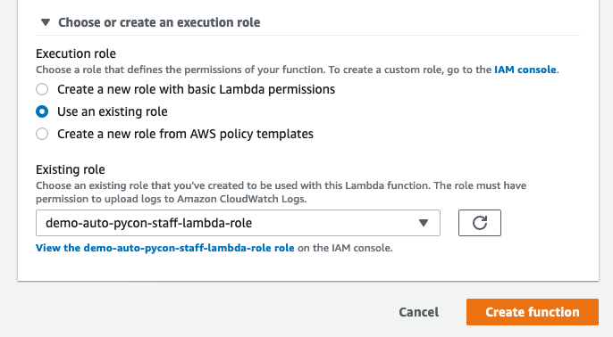
Supplement to Lambda functions 1/4
Appendix
Recommend: Create role beforehand and choose it. (Docs)

Slide 113
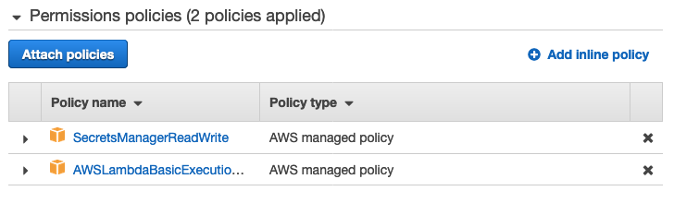
Supplement to Lambda functions 2/4
Appendix
Roles determine which AWS services Lambda functions can access (can read from AWS Secrets Manager (later))

Slide 114


Supplement to Lambda functions 3/4
Appendix
Default settings (See Basic settings)
Execute: lambda_handler function in lambda_function.py
Timeout: 3 seconds (Extend as needed)

Slide 115
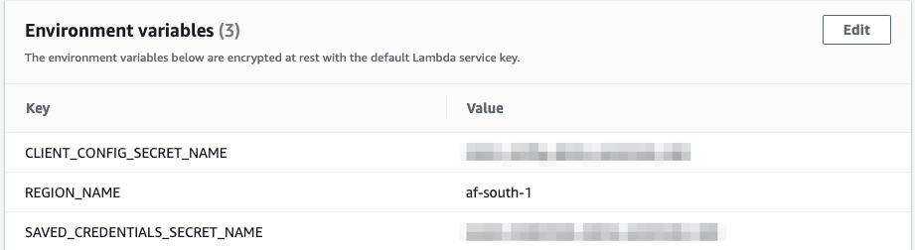
Supplement to Lambda functions 4/4
Appendix
Best Practices: Best practices for working with AWS Lambda functions - AWS Lambda
Use environment variables. (not hard-coding)

Slide 116
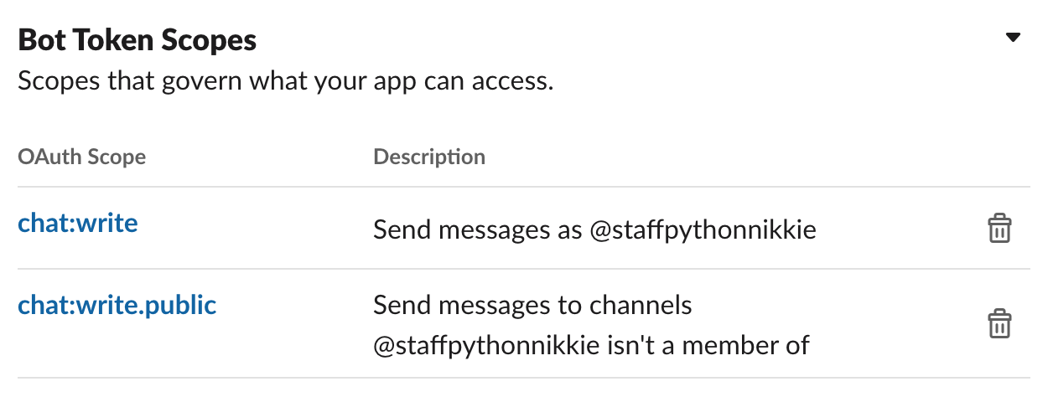
How to post to Slack with Python: Preparation
Appendix
Easy-to-follow tutorial: 01 - Creating the Slack app
Diff from the tutorial: Need to add a scope chat:write.public to post to any channel

Slide 117
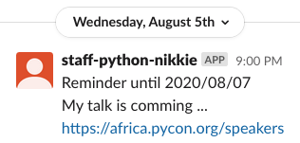
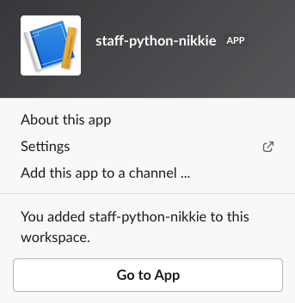
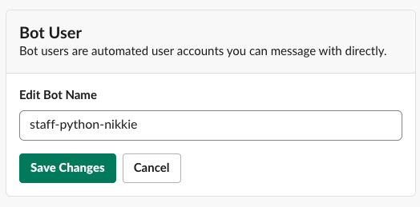
Tips: Edit bot name
Appendix

Slide 118
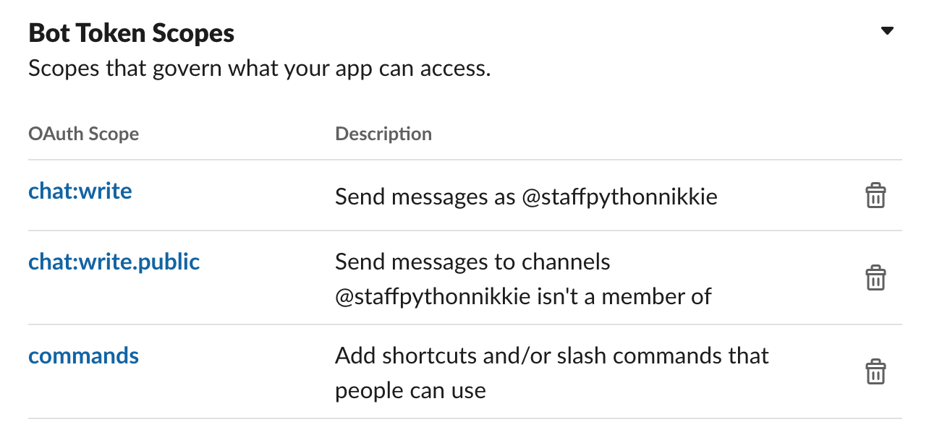
Slack app settings for Slash Command
Appendix
follow Enabling interactivity with Slash Commands | Slack
add commands scope

Slide 119
How to handle your secrets securely in AWS Lambda (2 options)
Appendix
Environment variables (Appendix)
e.g. Customized Slack reminder
idea💡: set file contents as a oneliner string
when exceed total size limit (4KB), use Secrets Manager
AWS Secrets Manager (Appendix)
e.g. Copy Slash Command

Slide 120
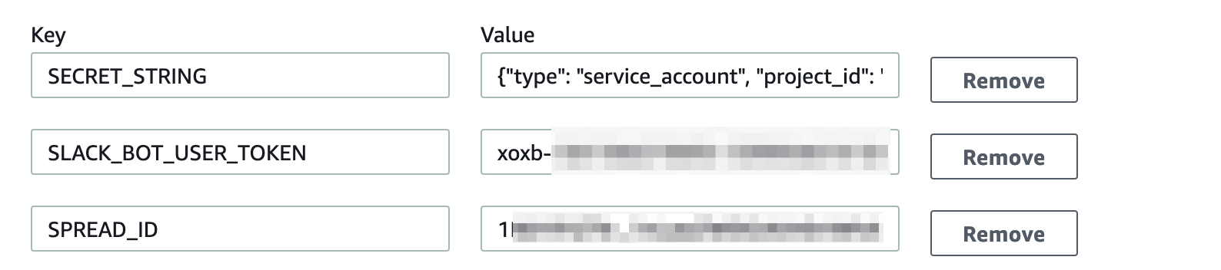
🗝 To handle secrets securely:
Environment variables 1/2
Appendix
Using AWS Lambda environment variables - AWS Lambda

Slide 121
🗝 To handle secrets securely:
Environment variables 2/2
Appendix
Idea💡: Dump secret file contents as a oneliner string, paste it on Lambda Environment (like previous slide, SECRET_STRING)
oneliner_credential.py
Use the oneliner string to write to a temporary file
with tempfile.NamedTemporaryFile() as tempf:
tempf.write(os.environ["SECRET_STRING"].encode())
tempf.seek(0)
gc = service_account(tempf.name, scopes)

Slide 122
🗝 To handle secrets securely:
AWS Secrets Manager 1/3
Appendix
What Is AWS Secrets Manager? - AWS Secrets Manager
Secrets Manager enables you to replace hardcoded credentials in your code, including passwords, with an API call to Secrets Manager to retrieve the secret programmatically.

Slide 123
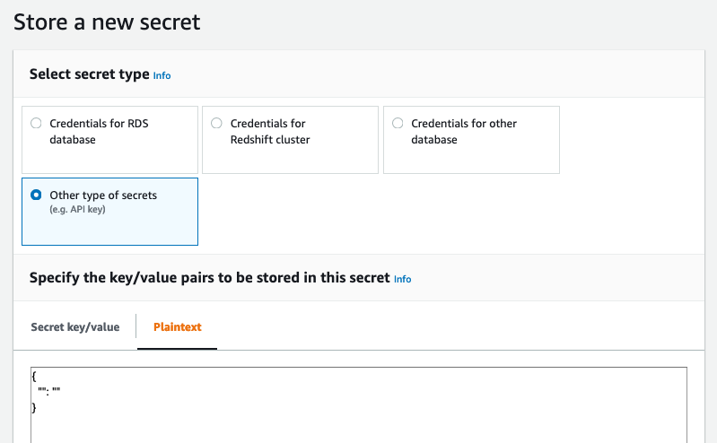
🗝 To handle secrets securely:
AWS Secrets Manager 2/3
Appendix
paste the contents of service account or OAuth client ID

Slide 124
🗝 To handle secrets securely:
AWS Secrets Manager 3/3
Appendix
import boto3
def lambda_handler(event, context): # Note: Add policy to role
session = boto3.session.Session()
client = session.client(
service_name="secretsmanager", region_name=REGION_NAME
)
# get SecretString in secret and write it in a tempfile
# then access to spreadsheets using the tempfile (whole code)

Slide 125
Small tool to zip for Lambda layers
Appendix
Dockerfile
Shell script: create_layer_zip.sh
$ ./create_layer_zip.sh -l python38_gspread36_layer.zip -p gspread==3.6.0
$ ./create_layer_zip.sh -l python38_diygdrive011_layer.zip -p git+https://github.com/ftnext/diy-googledrive-operate@master#egg=operate_drive

Slide 126
Mapping Templates in API Gateway 1/2
Appendix
Create a REST API with Lambda integrations in Amazon API Gateway - Amazon API Gateway (Step2)
-> image (next slide)

Slide 127
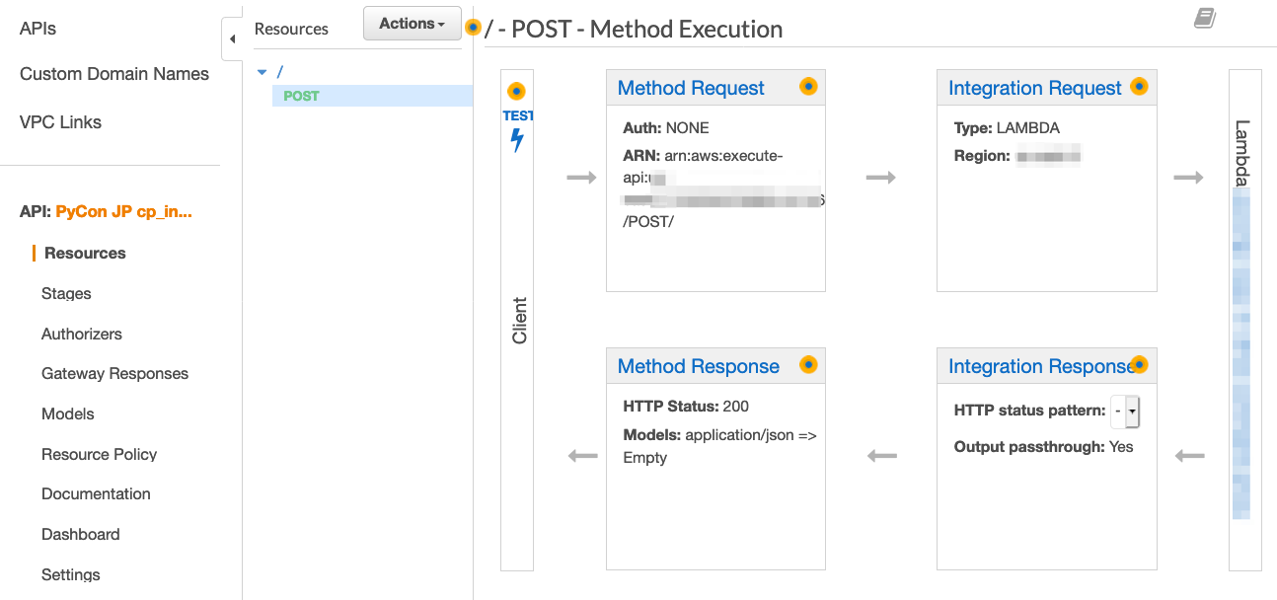
Appendix

Slide 128
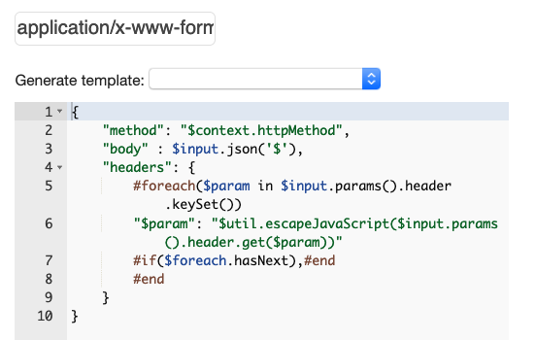
Mapping Templates in API Gateway 2/2
Appendix
Pass Custom Headers Through API Gateway to a Lambda Function
Specify in Integration Request

Slide 129
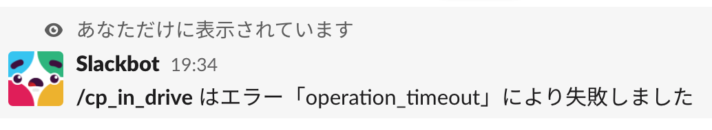
Slash Command Timeout
Appendix
Last 1 mile of copy command 1/6
This confirmation must be received by Slack within 3000 milliseconds of the original request being sent, otherwise a Timeout was reached will be displayed to the user. (Enabling interactivity with Slash Commands | Slack)

Slide 130
Prevent timeout
Appendix
Last 1 mile of copy command 2/6
Split Lambda function
Proxy (code)
return to Slack within 3000 milliseconds.
kick main Lambda function.
Main Command (code)
copy specified file in Google Drive.

Slide 131
One way to kick another Lambda Function: AWS Step Functions
Appendix
Last 1 mile of copy command 3/6
What Is AWS Step Functions? - AWS Step Functions
Combine steps to define an application
In this time, the app consists of one Lambda Function (main command Lambda function)

Slide 132
Proxy Lambda function (code)
Appendix
Last 1 mile of copy command 4/6
Specify as Request URL: Attach URL with API Gateway
Impl.: Verify request and parse data (slide)
Call Step Functions of main command
Add policy to start Step Functions to role

Slide 133
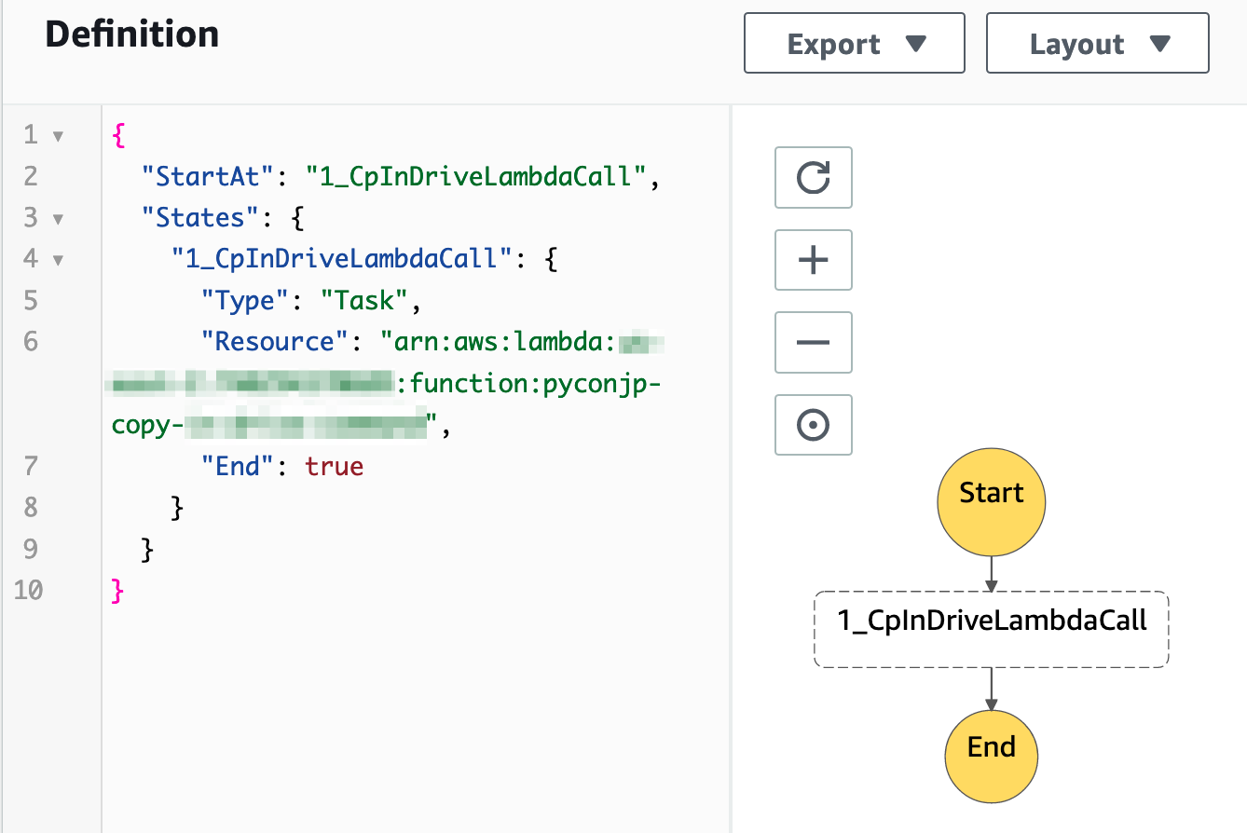
Main command Step Function
Appendix
Last 1 mile of copy command 5/6
Create State Machine which call main command Lambda Function (code)
Call main command Lambda Function

Slide 134
How 2 Lambda function work?
Appendix
Last 1 mile of copy command 6/6
User | Slack | Proxy | Main command
1. invoke /cp_in_drive | 2. send data to Request URL | 3. receive data and verify
 |  | 4. start main command | 4'. start
6. see message “Copying now ...” |  | 5. return Slack (within 3 sec.) | (copying ...)
8. see copied file URL |  |  | 7. copied! send message to Slack
time

